Slide 1
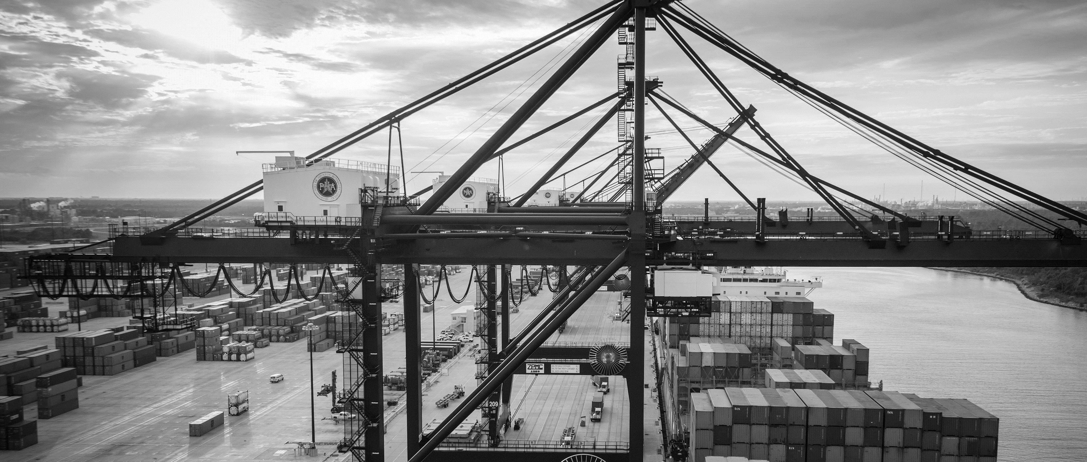
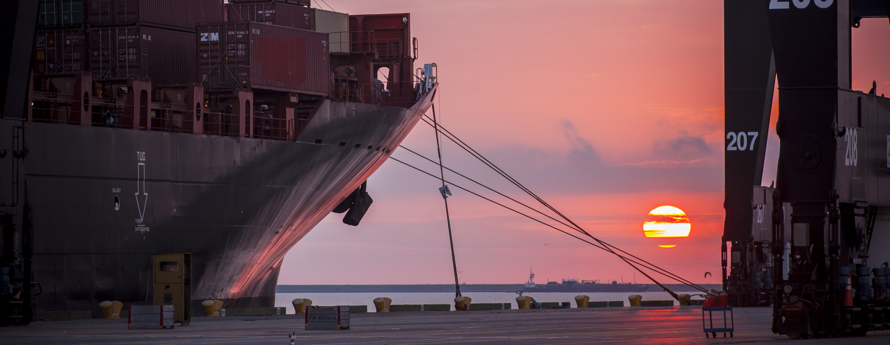
RFQ- 883 ELECTRICAL AND COMMUNICATIONS FACILITY INSPECTION CONDITION ASSESMENT PROGRAM
Bill Aguirre, P.E. | Project Manager | Project & Construction Management - 10/3/2018

Slide 2
Port Commission
John D. Kennedy
Dean E. Corgey
Clyde Fitzgerald
Janiece M. Longoria
Chairman
Theldon R. Branch, III
Stephen H. DonCarlos
Roy D. Mease

Slide 3
ELECTRICAL AND COMMUNICATIONS FACILITY INSPECTION CONDITION ASSESMENT PROGRAM
AGENDA
Introductions
Procurement Services
Selection Criteria
Project Description
Scope of Services
Questions
Please sign attendance sheet. No site visit is scheduled.

Slide 4
EELECTRICAL AND COMMUNICATIONS FACILITY INSPECTION CONDITION ASSESMENT PROGRAMLECTRICAL AND COMMUNICATIONS FACILITY INSPECTION CONDITION ASSESMENT PROGRAM
PHA Personnel:
Roger H. Hoh, P.E. – Director, PCM
Charlie Jenkins, Asset Management Director
Don Smith – Engineering Design and Planning Manager
Bill Aguirre, P.E. – Project Manager
Yvette Camel-Smith – Director of Procurement
Dean Ainuddin- Contracts Manager

Slide 5
EELECTRICAL AND COMMUNICATIONS FACILITY INSPECTION CONDITION ASSESMENT PROGRAMLECTRICAL
2. Procurement:
RFQs are due on October 17, no later than 11:00 A.M.
One original and seven copies, packaged in one sealed envelope.
Late submittals will not be evaluated
Any questions regarding submittal procedures should be directed to Ms. Yvette Camel- Smith, Director of Procurement , at (713) 670-2460
Technical questions should be posted at the PHA’s BuySpeed webpage accessible through the Port Authority website www. porthouston.com

Slide 6
EELECTRICAL AND COMMUNICATIONS FACILITY INSPECTION CONDITION ASSESMENT PROGRAMLECTRICAL
3. Selection Criteria and Relative Weights:
A. Respondent’s (and Sub consultants if applicable) Reputation and Quality of Services. (20%)
B. Personnel (Including Sub consultant personnel if applicable) Qualifications and Experience. (35%)
C. Performance Plan and Other Benefits. (40%)
D. Overall Compliance with PHA Policies (5%)

Slide 7
EELECTRICAL AND COMMUNICATIONS FACILITY INSPECTION CONDITION ASSESMENT PROGRAMLECTRICAL
4. PROJECT DESCRIPTION
As part of the broad asset management program currently developed by the Port Authority, a specific electrical distribution and communications program has been conceptualized to document and evaluate the condition of all electrical and communications assets. The program will include the development of a facility inspection and condition assessment program (FICAP) manuals for electrical and communication assets in the field, document baseline values of electrical parameters, newly developed electrical and communication drawings and integration of the new information into the PHA’s asset registry database and GIS system.

Slide 8
EELECTRICAL AND COMMUNICATIONS FACILITY INSPECTION CONDITION ASSESMENT PROGRAMLECTRICAL
5. SCOPE OF SERVICES
1. Develop a Facilities Inspection and Condition Assessment Program Manual (FICAP Manual) which will provide consistency in the inspection and condition assessment approach, the following aspects should be addressed: (Uploaded as supplemental Info)
Inspections types (baseline, routine or special) in accordance with objectives and scope. Recommend NETA Standards
Identify and list electrical component types
Condition rating criteria used for component condition assessment
Guidance on the recommended actions following inspections
Documentation and reporting requirements for inspections (as per inspection database requirements)
2. Development of standard documentation on support of FICAP manual:
Asset numbering and labeling schemes.

Slide 9
EELECTRICAL AND COMMUNICATIONS FACILITY INSPECTION CONDITION ASSESMENT PROGRAMLECTRICAL
SCOPE OF SERVICES (continued):
Assessment and rating system for components and assets
Electrical asset naming convention
Parts inventory, inspection and other reporting forms, populating forms from available records data
Facilities and electrical asset list
Baseline drawings showing locations of existing electrical assets throughout the terminals
Baseline drawings showing locations of fiber optic communications cabling throughout the terminals
Integration of all new information into PHA’s asset registry database and GIS system
3. Field identification of electrical assets installed throughout the terminals and develop updated single line diagrams of the distribution systems.
4. ETAP modeling capabilities required.

Slide 10
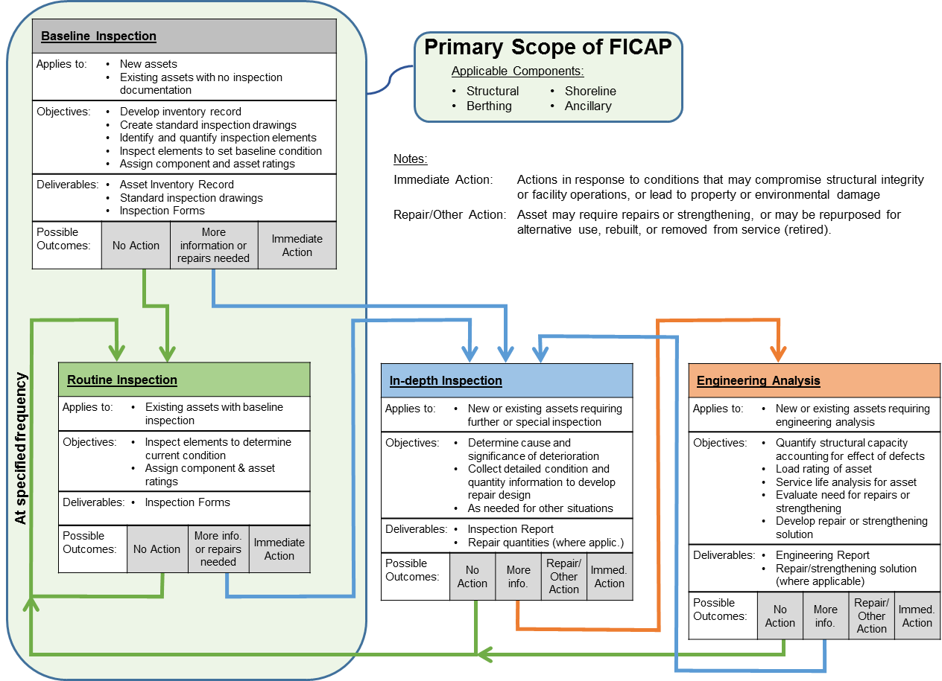
FICAP Primary Scope – for reference

Slide 11
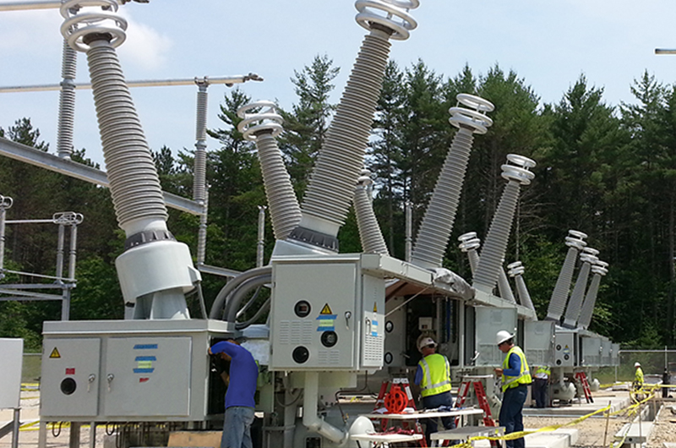
EELECTRICAL AND COMMUNICATIONS FACILITY INSPECTION CONDITION ASSESMENT PROGRAMLECTRICAL
SUBSTATION TESTING

Slide 12
THANK YOU
Bill Aguirre, P.E.
Project Manager
Port Houston
Questions?
713.670.2400
email@poha.com
www.PortHouston.com
111 East Loop North
Houston, TX 77029
WELCOME MESSAGE | 4

