Slide 1
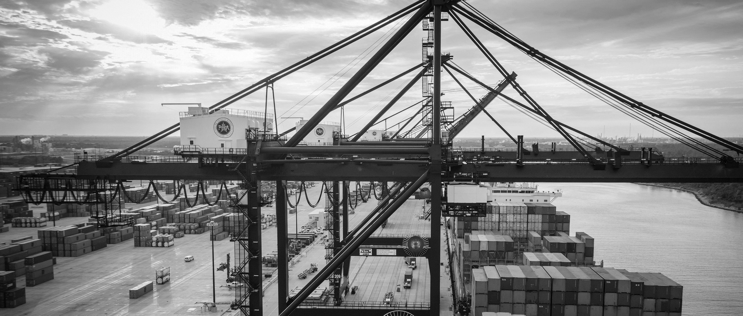
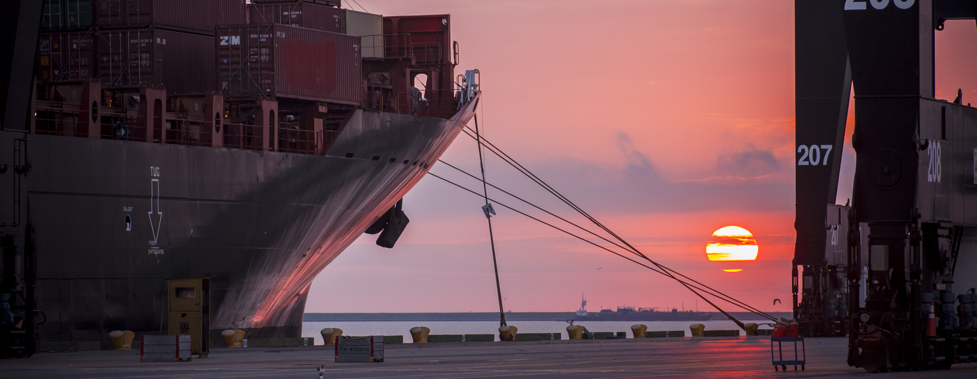
RFQ-875 Professional Design Services for Port Road Expansion and Drainage at Bayport Container Terminal
Ural Thompson / Barbara Smith | Project Manager | Project & Construction Management (PCM)

Slide 2
RFQ-875
Introductions
Procurement
Selection Criteria
Scope of Services
Site Layout/Drawings
Questions
Note: Please sign attendance sheet. No site visit is scheduled.

Slide 3
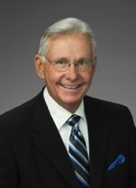
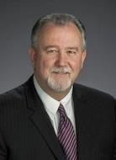
Port Commission
John D. Kennedy
Dean E. Corgey
Clyde Fitzgerald
Janiece M. Longoria
Chairman
Theldon R. Branch, III
Stephen H. DonCarlos
Roy D. Mease

Slide 4
RFQ-875
PHA Personnel:
Steve Cassidy – Director of BPT Operations
Bryan Seitz – Manager of Analysis & Planning at BPT
Roger Hoh – Director of Project & Construction Management
Don Smith – Manager of Engineering Design & Planning
Ural Thompson / Barbara Smith – Project Manager
Ross Talbot – Construction Projects Delivery Manager
Yvette Camel-Smith – Director of Procurement
Pedro Gonzales – Small Business Development

Slide 5
RFQ-875
Procurement:
Request for Qualifications (RFQ) due Wednesday, October 10, 2018 no later than 11:00 A.M.
Eight (8) hard copies packaged in one sealed envelope
Facsimile copies are not acceptable
All responses to the RFQ will be dated and the time received recorded upon receipt. PHA will not be responsible for late or incomplete responses due to mistakes or delays of the Respondent or carrier used by the Respondent or weather delays. A postmark is not sufficient. LATE SUBMITTALS WILL NOT BE EVALUATED.

Slide 6
RFQ-875 Selection Criteria
Most Highly Qualified Provider
Using Criteria and Relative Weight
CRITERIA | RELATIVE WEIGHT
RESPONDENT’S REPUTATION AND QUALITY OF SERVICES | 15%
PERSONNEL QUALIFICATIONS AND EXPERIENCE | 40%
PERFORMANCE PLAN AND OTHER BENEFITS | 40%
OVERALL COMPLIANCE WITH PHA POLICIES | 5%
 | 100%

Slide 7
RFQ-875 Scope of Services
Design Bayport Port Road expansion to six lanes.
Design Bayport 95.5 Acre drainage basin.
Provide 30%, 60%, and final Design documents to PHA
Provide Bid and CPS services for duration of project.

Slide 8
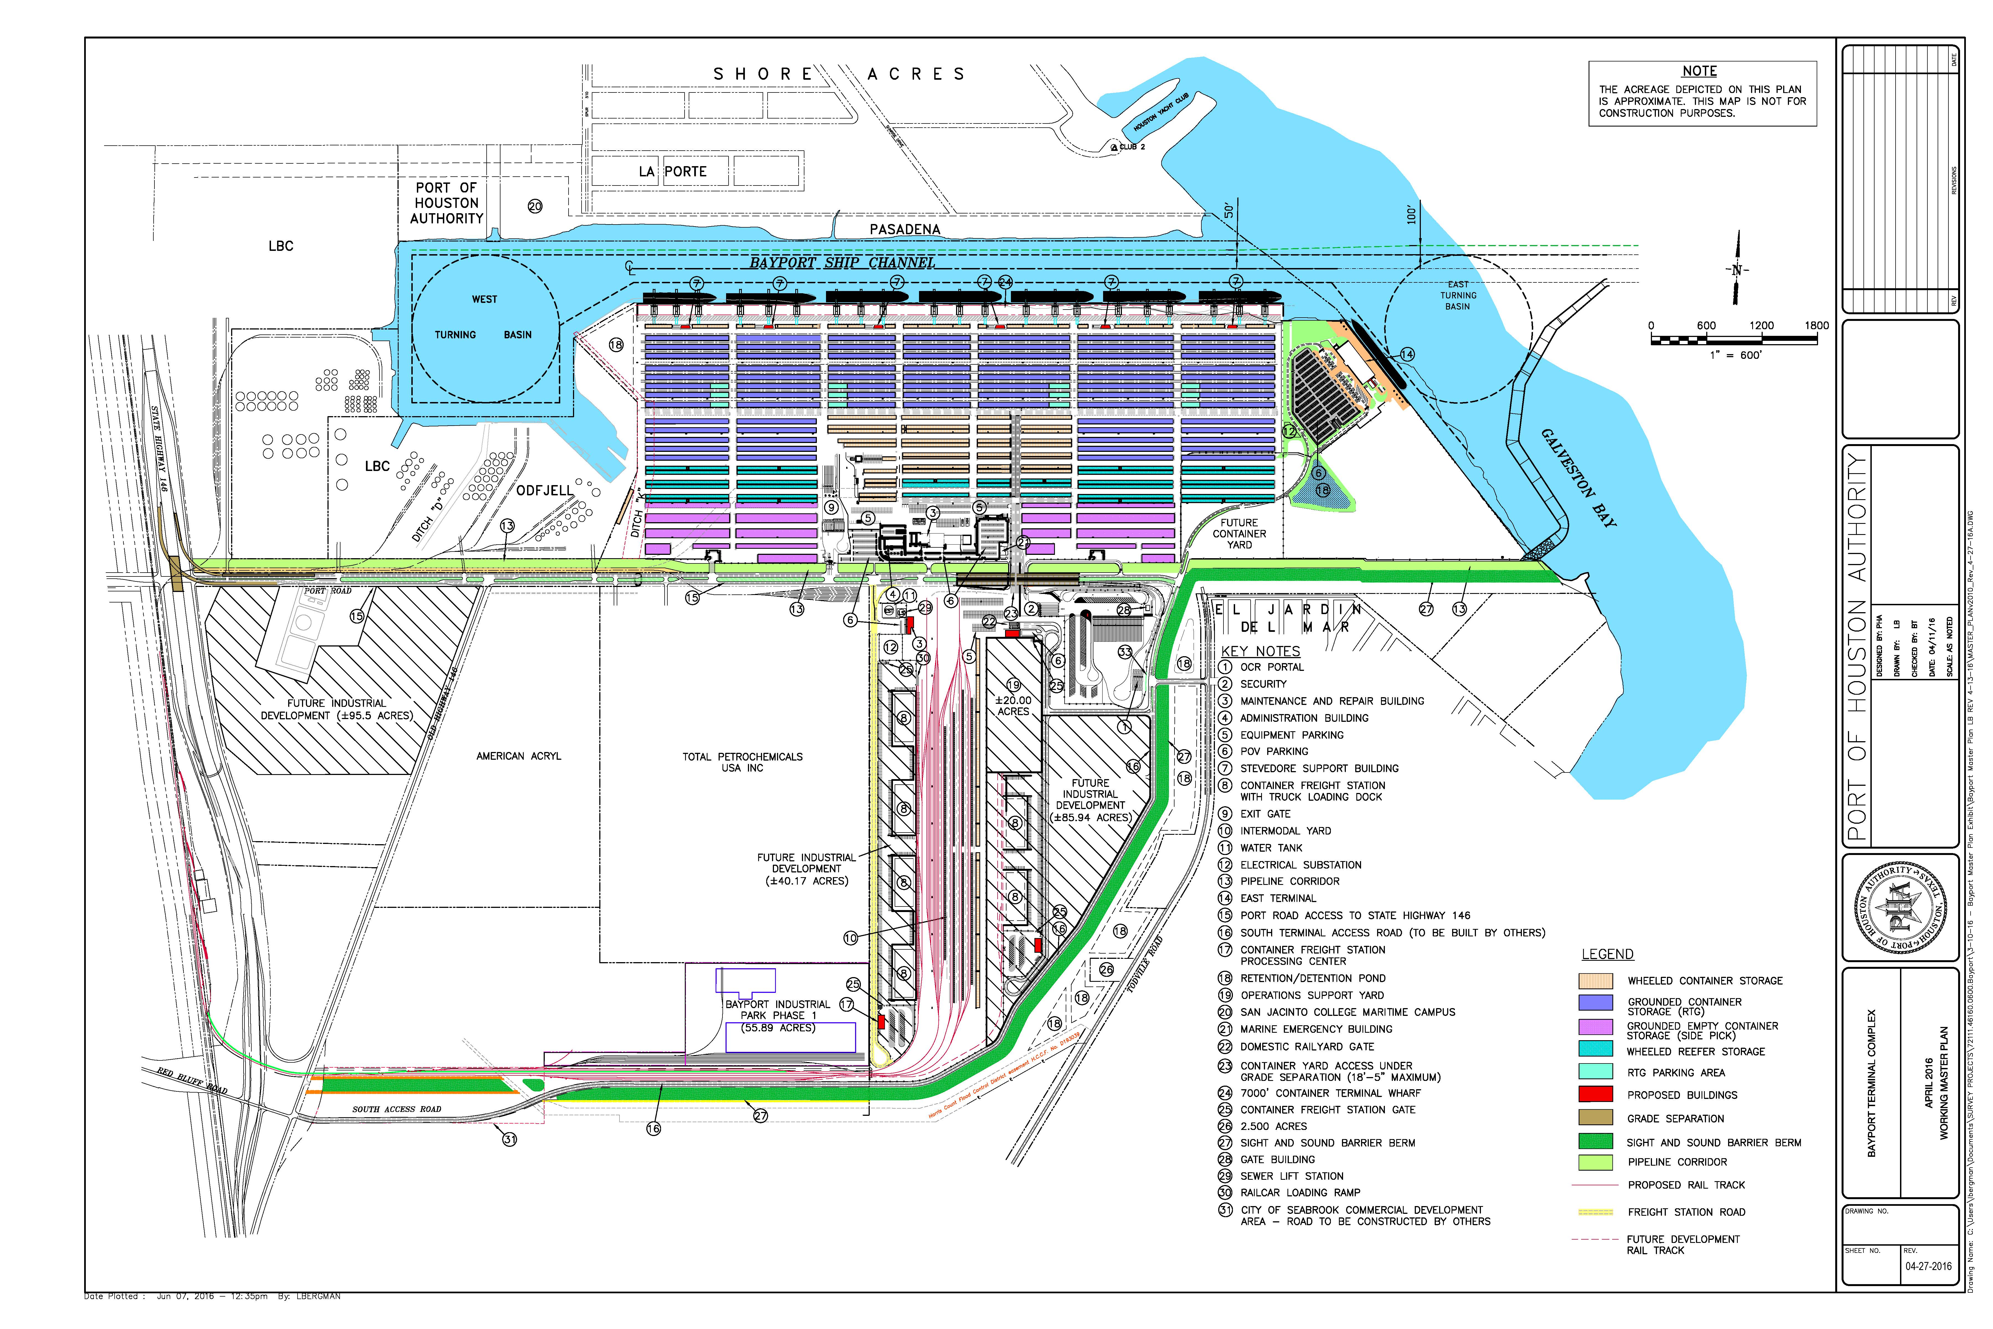
RFQ-875 Bayport Master Plan
2016 Master Plan Update

Slide 9
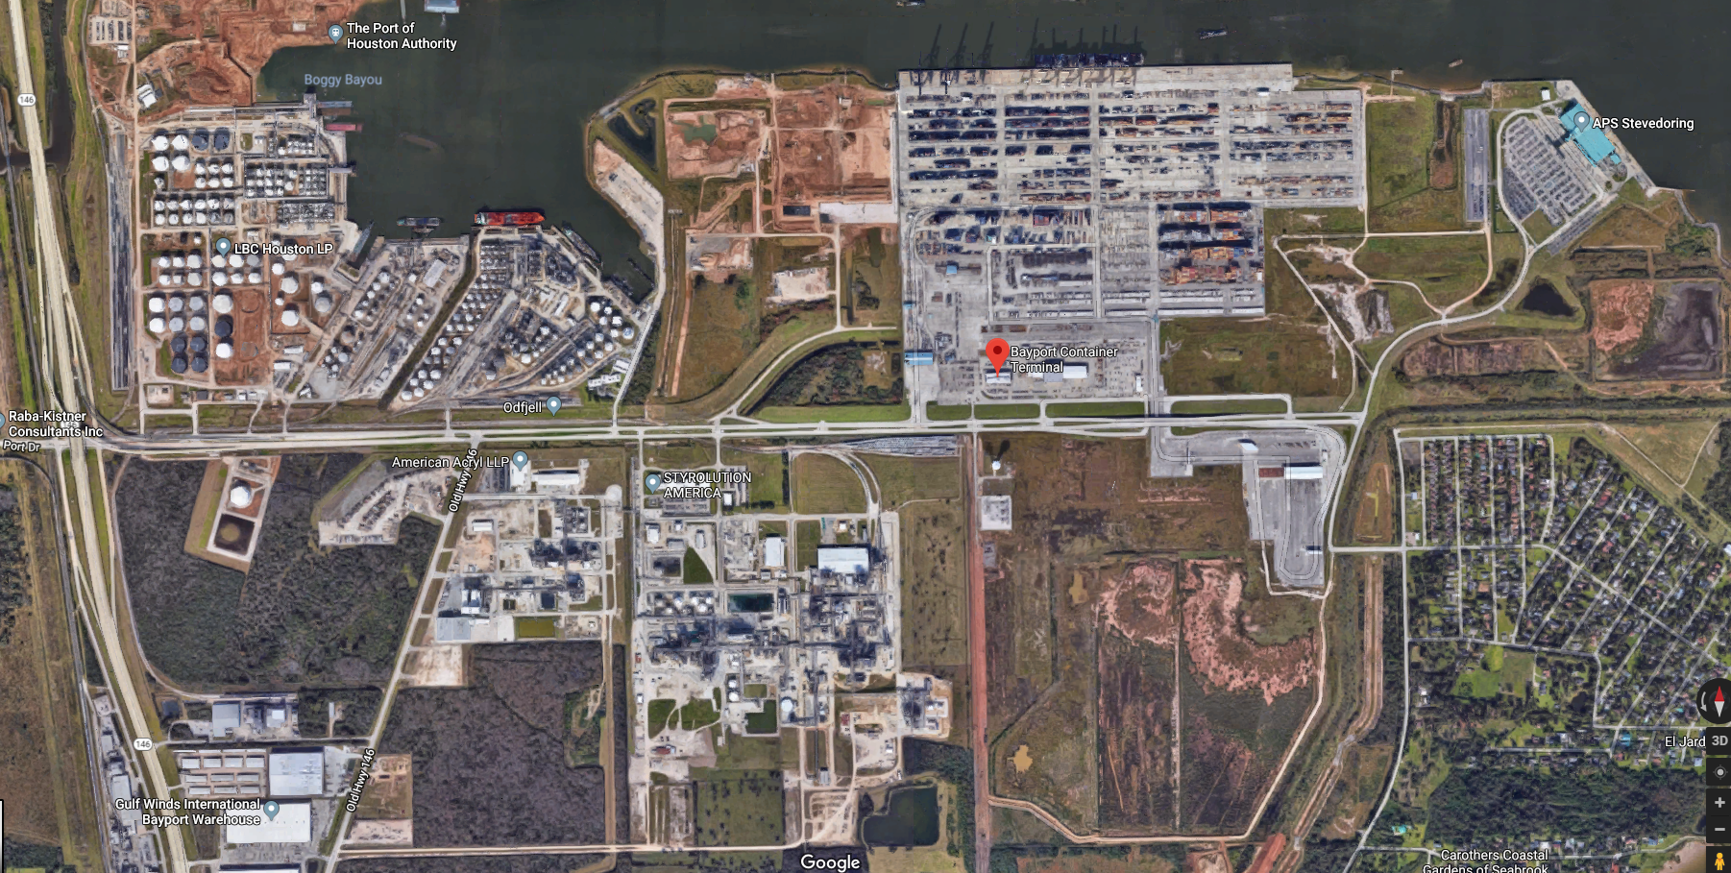
RFQ-875 Bayport Master Plan
2016 Master Plan Update

Slide 10
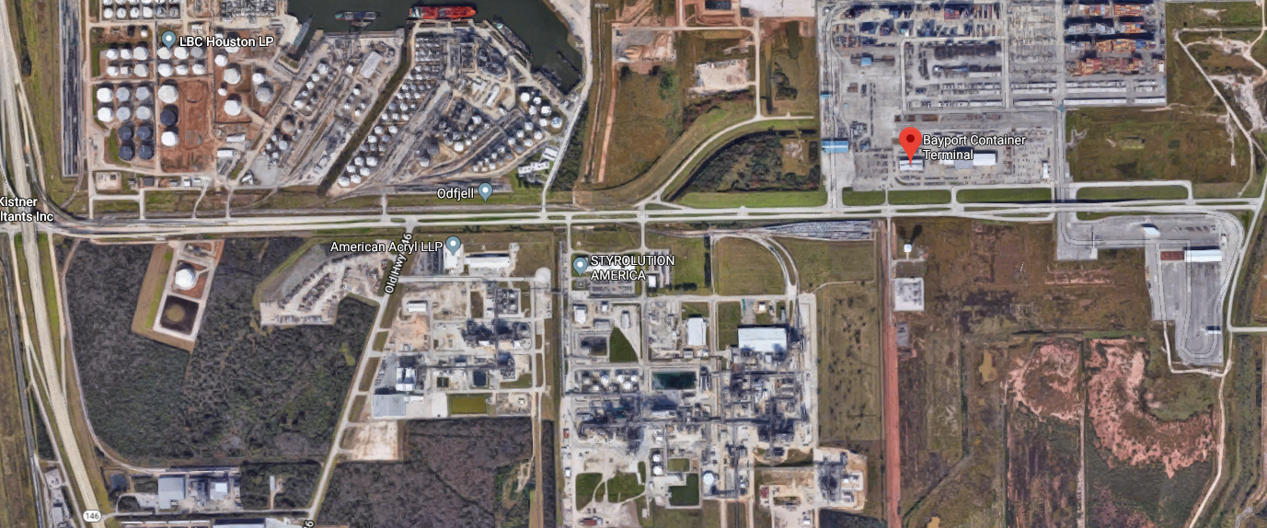
RFQ-875 Existing Site Layout

Slide 11
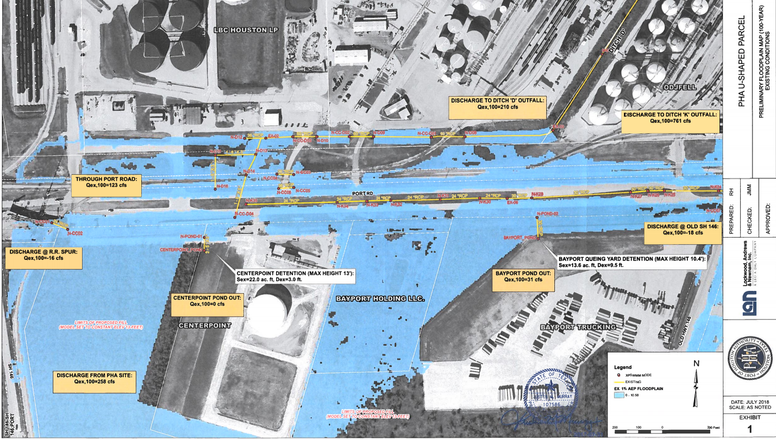
RFQ-875 Existing Flood Plain

Slide 12
THANK YOU
Ural Thompson
Barbara Smith
Project Manager
Port Houston
Questions?
713.670.2813
uthompson@poha.com
www.PortHouston.com
111 East Loop North
Houston, TX 77029
WELCOME MESSAGE | 4

