Slide 1
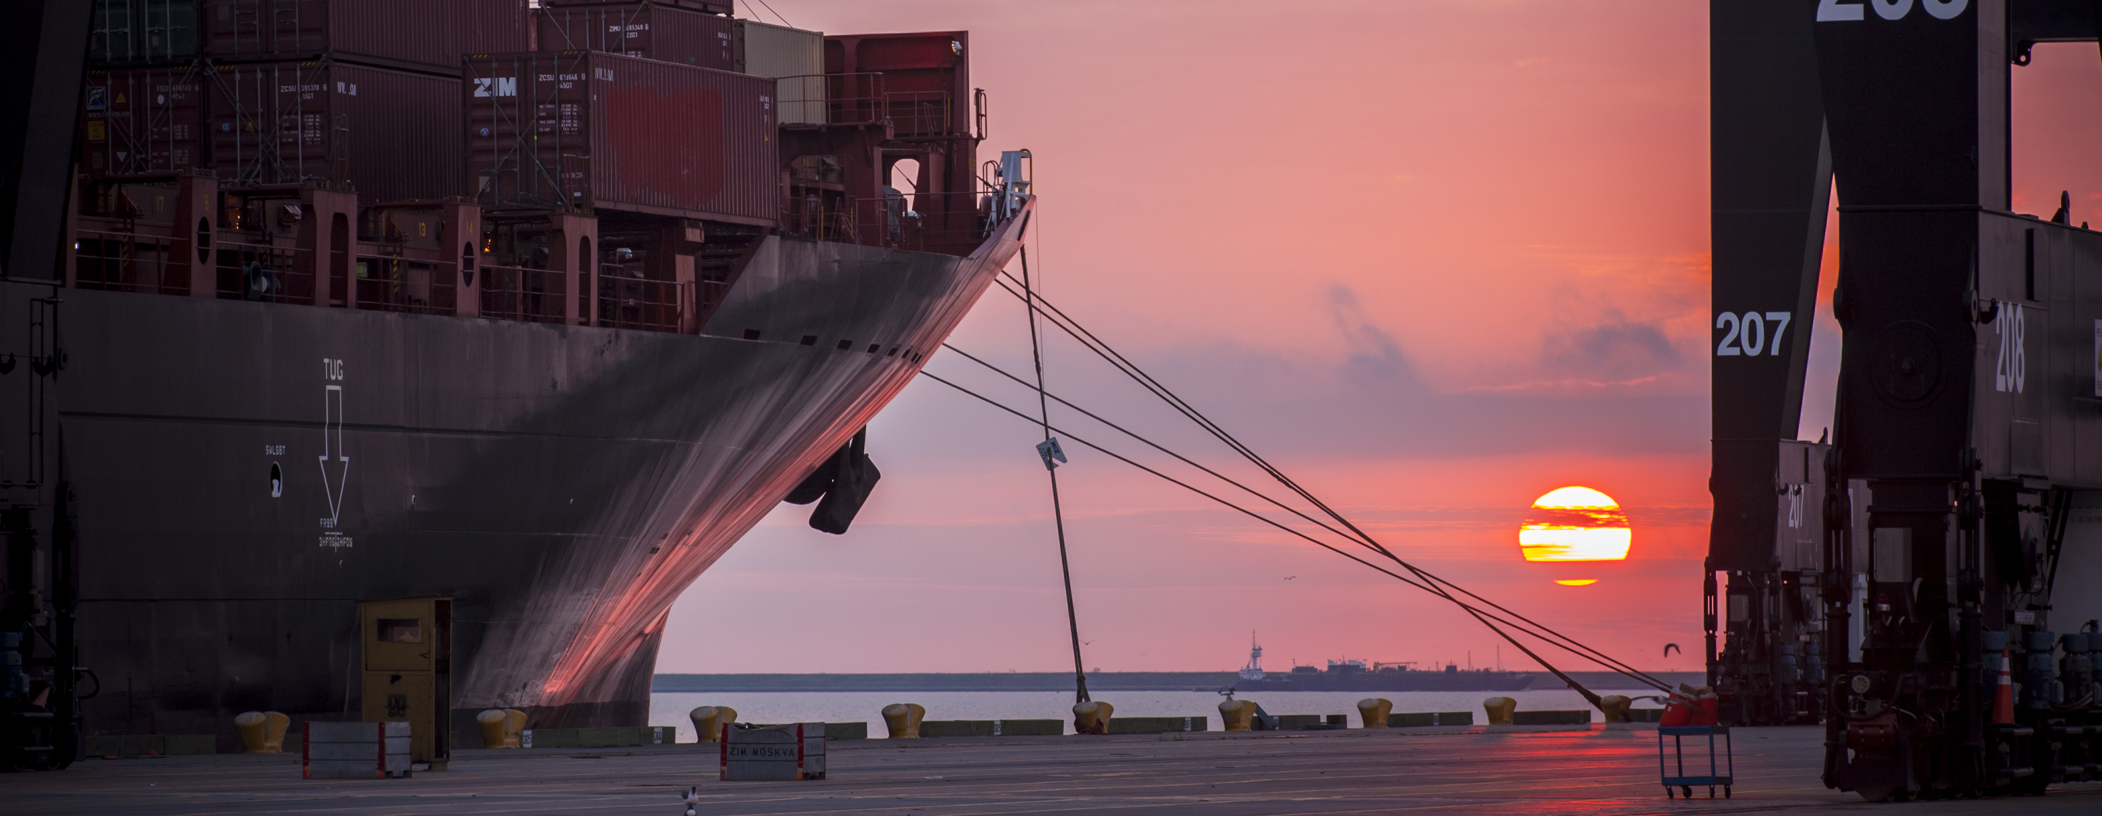
RFQ-874 Professional Architectural Services for Building Program Development & Design of the Maintenance and Admin Complex at Barbours Cut Terminal
Jessica Shambra, PE | Project Manager | Project & Construction Management (PCM)

Slide 2
RFQ-874
Introductions
Procurement
Selection Criteria
Scope of Services
Site Layout/Drawings
Questions
Note: Please sign attendance sheet. No site visit is scheduled.

Slide 3
Port Commission
John D. Kennedy
Dean E. Corgey
Clyde Fitzgerald
Janiece M. Longoria
Chairman
Theldon R. Branch, III
Stephen H. DonCarlos
Roy D. Mease

Slide 4
RFQ-874
PHA Personnel:
Roger Hoh – Director of Project & Construction Management
Don Smith – Manager of Engineering Design & Planning
Jessica Shambra – Project Manager
Bryan Seitz – Operations, Manager of Analysis and Planning
Paulo Soares – Maintenance Director
Yvette Camel-Smith – Director of Procurement

Slide 5
RFQ-874
Procurement:
Request for Qualifications (RFQ) due Wednesday, October 17, 2018 no later than 11:00 A.M.
Eight (8) hard copies packaged in one sealed envelope
Facsimile copies are not acceptable
All responses to the RFQ will be dated and the time received recorded upon receipt. PHA will not be responsible for late or incomplete responses due to mistakes or delays of the Respondent or carrier used by the Respondent or weather delays. A postmark is not sufficient. LATE SUBMITTALS WILL NOT BE EVALUATED.

Slide 6
RFQ-874 Selection Criteria
Most Highly Qualified Provider
Using Criteria and Relative Weight
CRITERIA | RELATIVE WEIGHT
RESPONDENT’S REPUTATION AND QUALITY OF SERVICES | 20%
PERSONNEL QUALIFICATIONS AND EXPERIENCE | 40%
PERFORMANCE PLAN AND OTHER BENEFITS | 35%
OVERALL COMPLIANCE WITH PHA POLICIES | 5%
 | 100%

Slide 7
RFQ-874 Scope of Services
Develop conceptual building program for the relocation of the maintenance and administrative buildings at Barbours Cut Terminal
Define and incorporate operational requirements to provide preliminary planning for the buildings including size, layout, location and functionality
Additional considerations should include required parking, laydown and staging areas
Develop alternatives and examine best options
Selected team shall have the capabilities to continue with detailed design, preparation of plans and specifications, and construction phase services

Slide 8
RFQ-874 Existing Site Layout
EXISTING M&R BUILDING
EXISTING ADMIN BUILDING

Slide 9
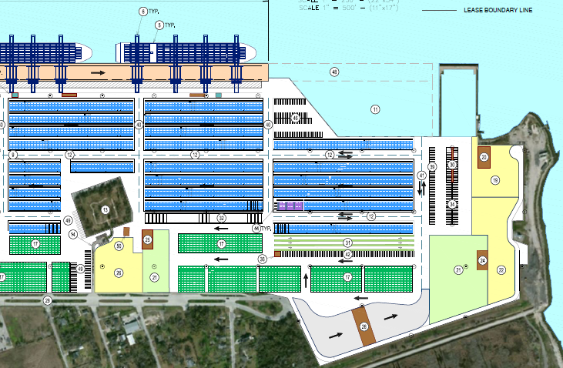
RFQ-874 BCT 2012 Plan
RELOCATED ADMIN BUILDING (PROPOSED)
RELOCATED M&R BUILDING
(PROPOSED)

Slide 10
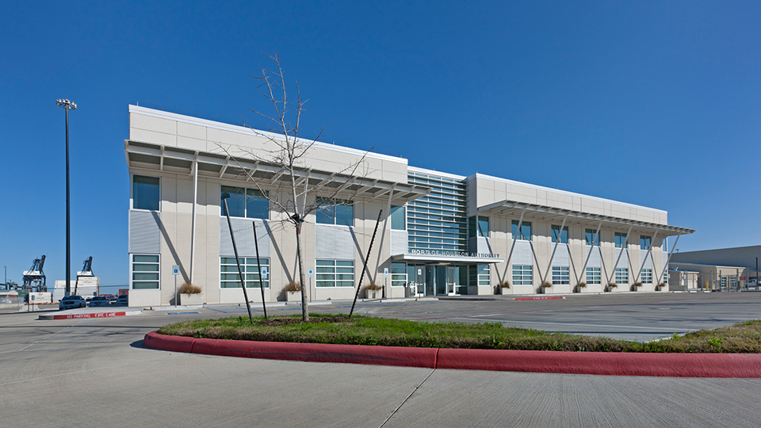
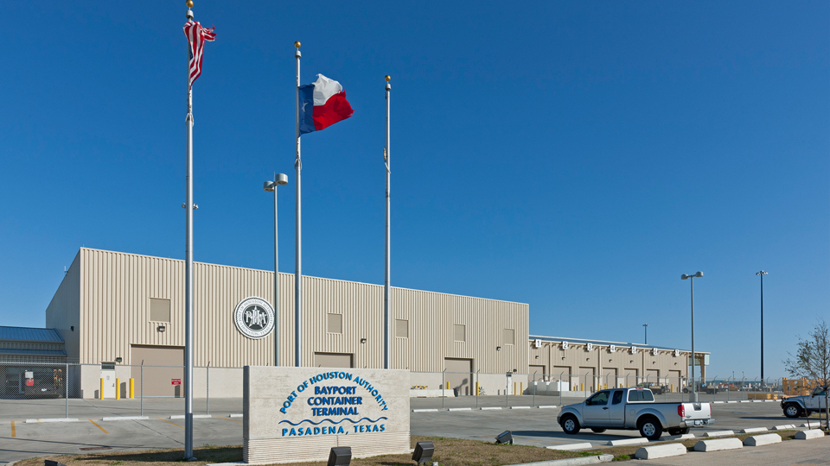
RFQ-874 Bayport Buildings

Slide 11
THANK YOU
Jessica Shambra, PE
Project Manager
Port Houston
Questions?
713.670.2527
jshambra@poha.com
www.PortHouston.com
111 East Loop North
Houston, TX 77029
WELCOME MESSAGE | 4

