Slide 1

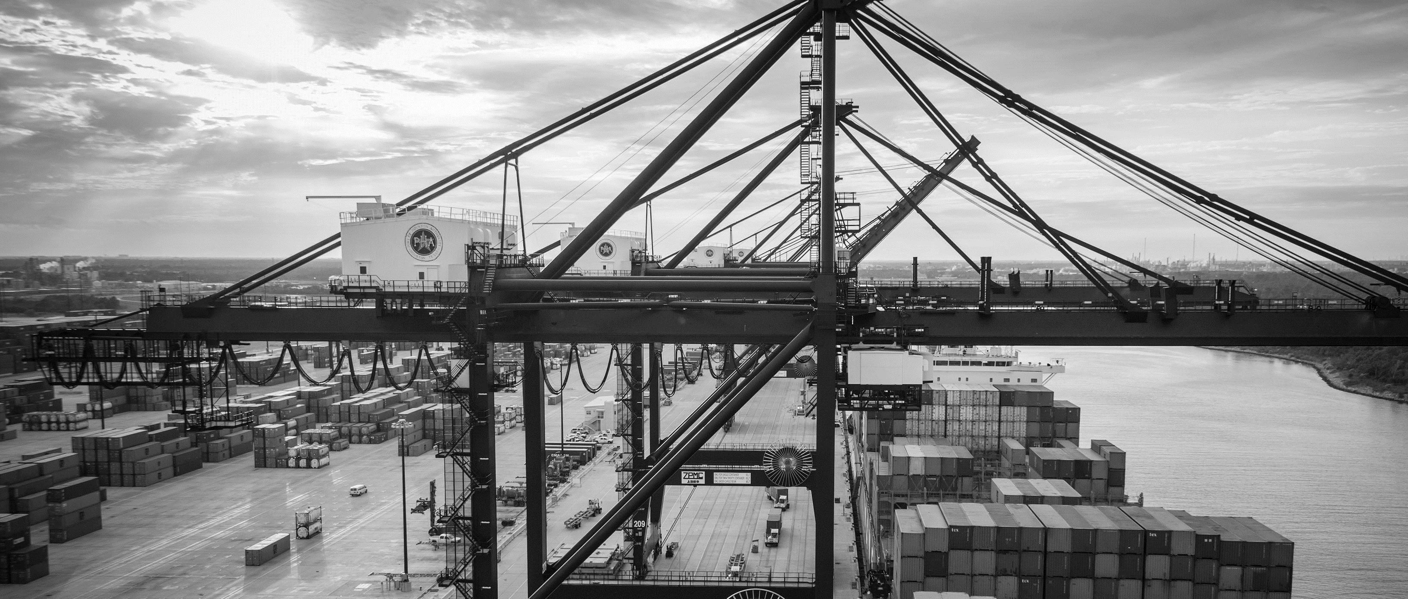
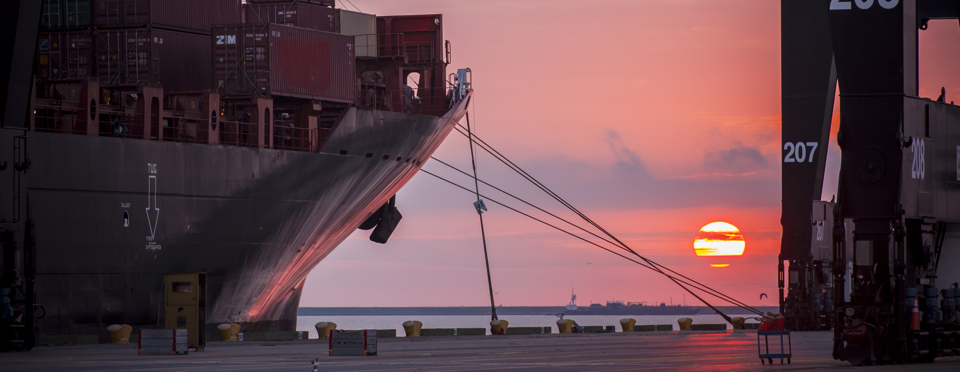
RFQ 724 - Rehabilitation and Repair of Wharf 2 at Manchester Terminal
Eddy Kharrazi, P.E. | Project Manager | Project & Construction Management (PCM)

Slide 2
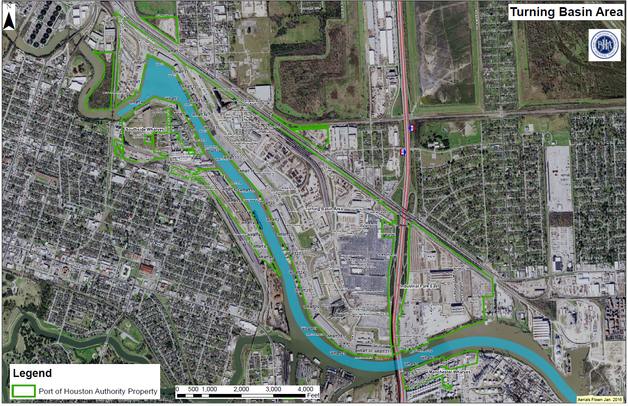
RFQ – M2 Repair
You Are Here
M2

Slide 3
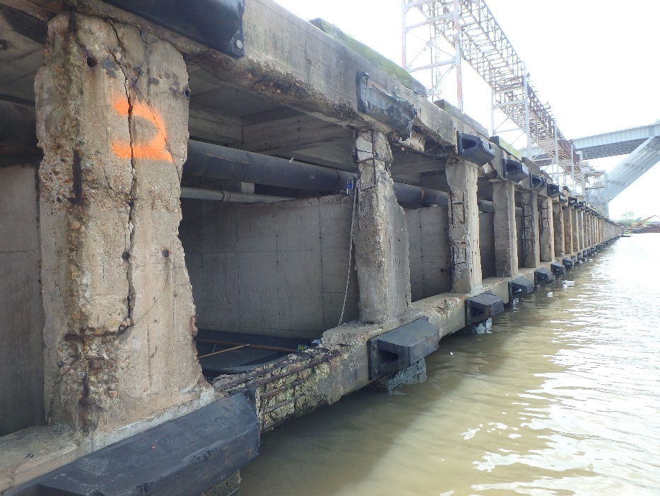
Overall view of front of wharf

Slide 4
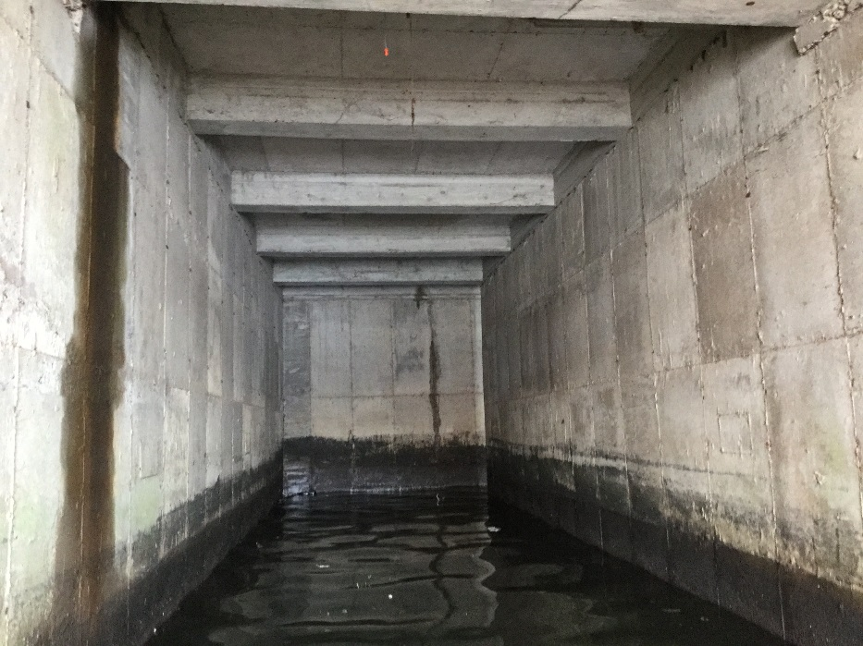
Typical view under deck

Slide 5
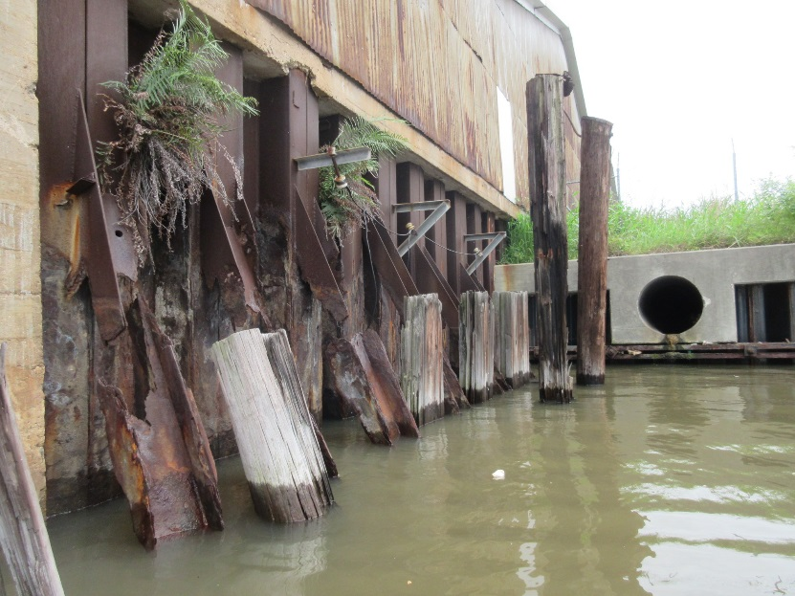
West Retaining Wall (1948)

Slide 6
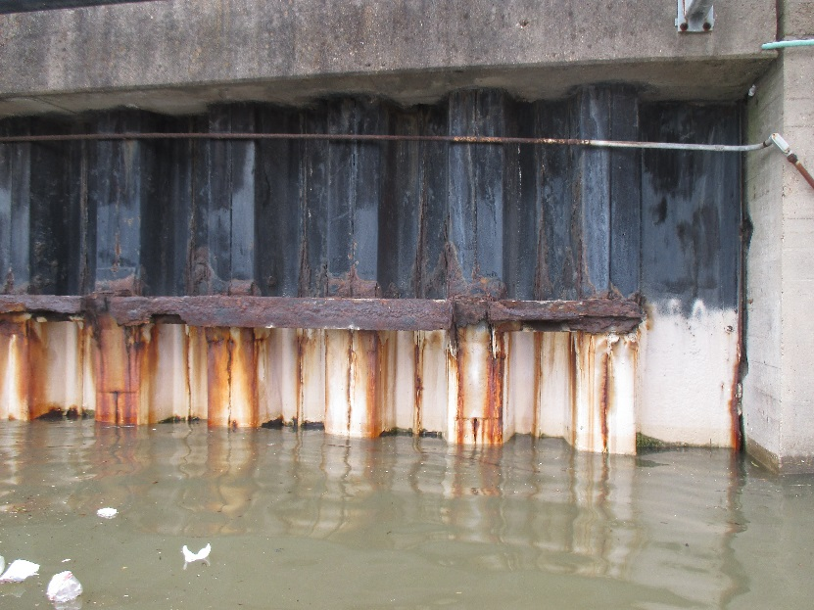
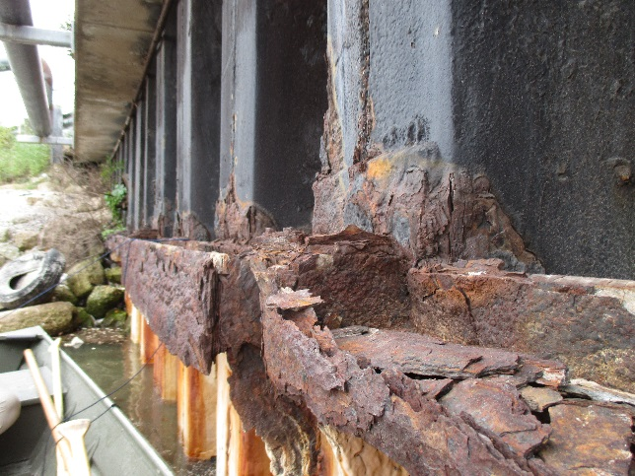
East Retaining Wall (1963)

Slide 7
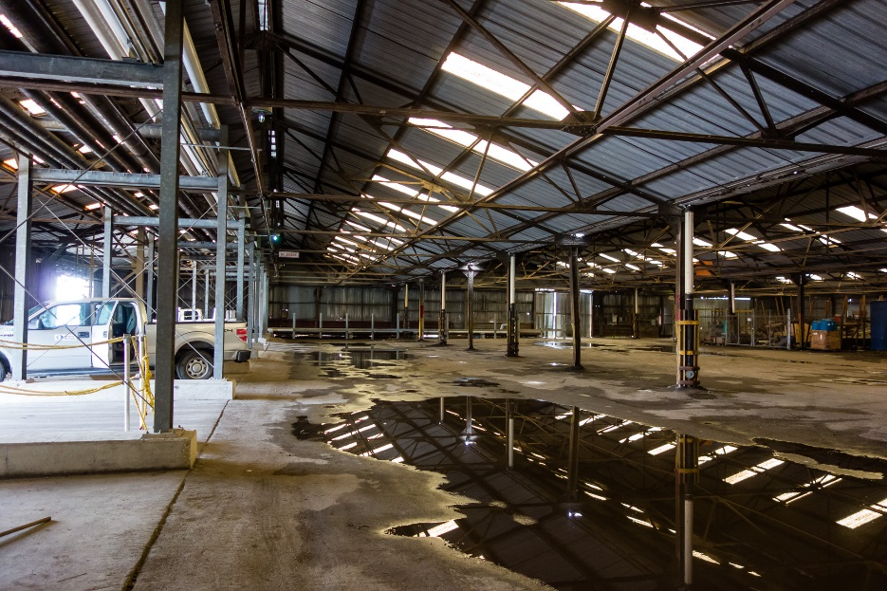
Inside Shed at Timber Retaining Wall

Slide 8
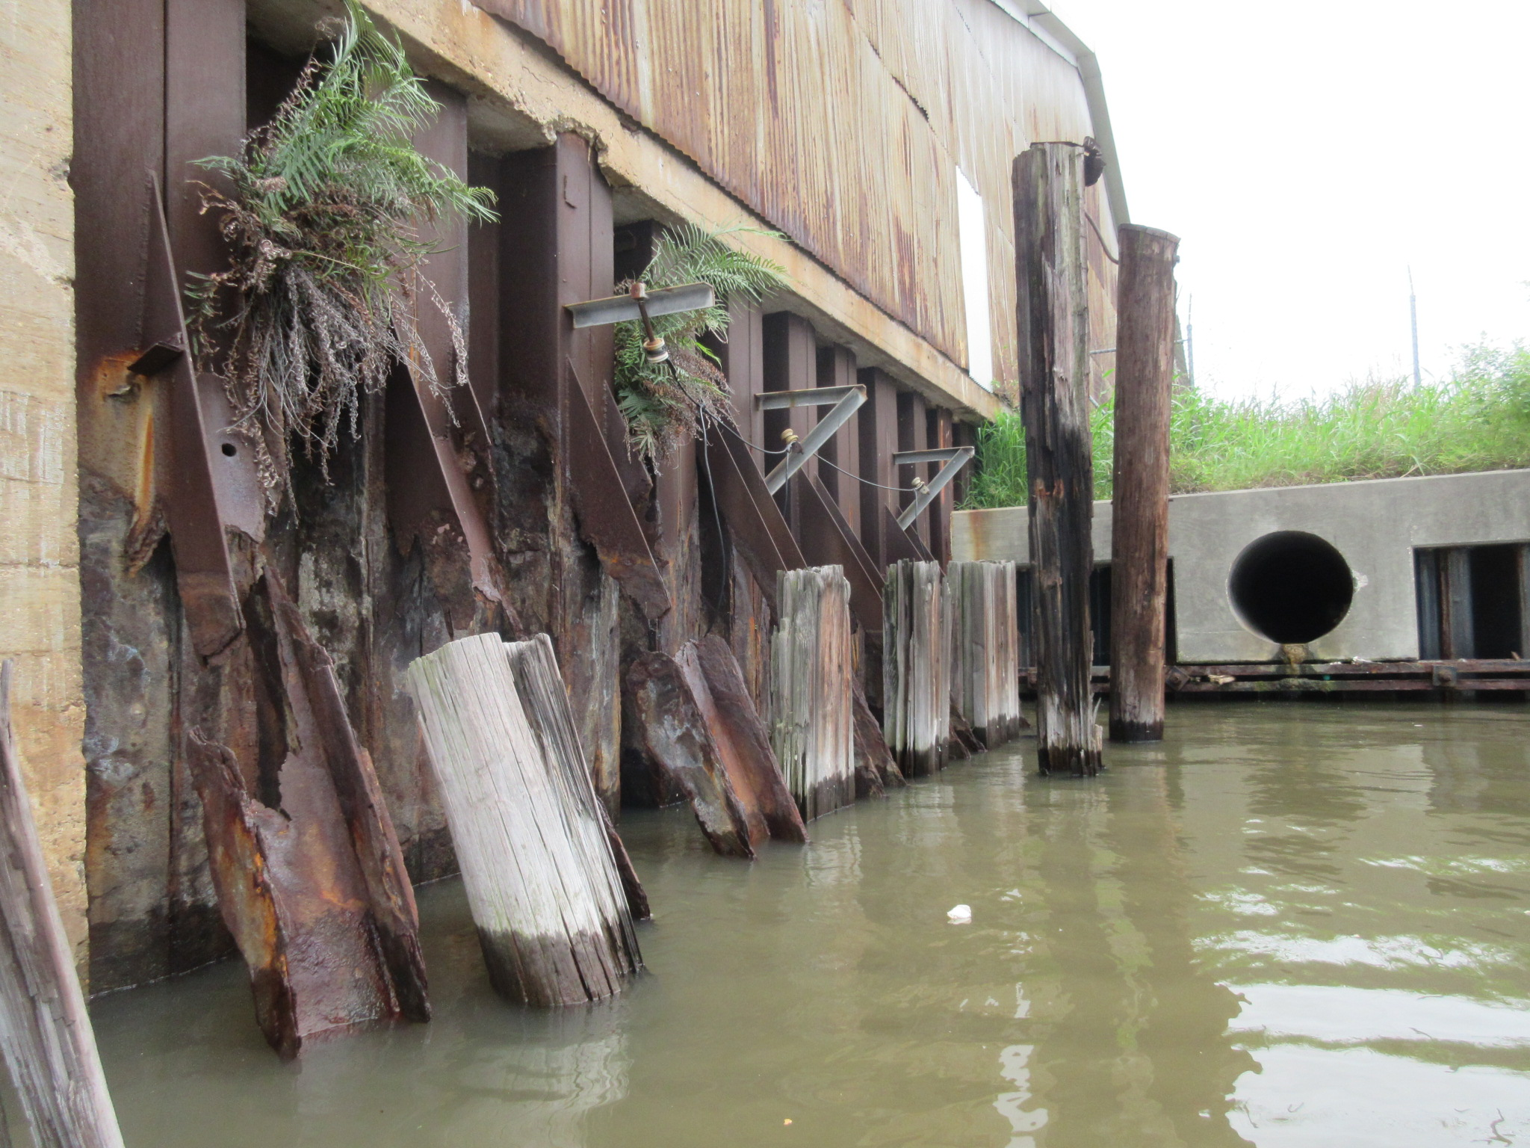
M-2 Existing Condition
Corrosion/section loss from ship impact and exposure
Deteriorating timber piles
Safety factor ~1.0 for long-term slope stability
Retaining wall deterioration

Slide 9
Highly Utilized Wharf
Liquid cargo facility
  20 ft. accessibility area
  Limited live loads
  Light-duty forklifts
Minimize downtime / phased approach

Slide 10
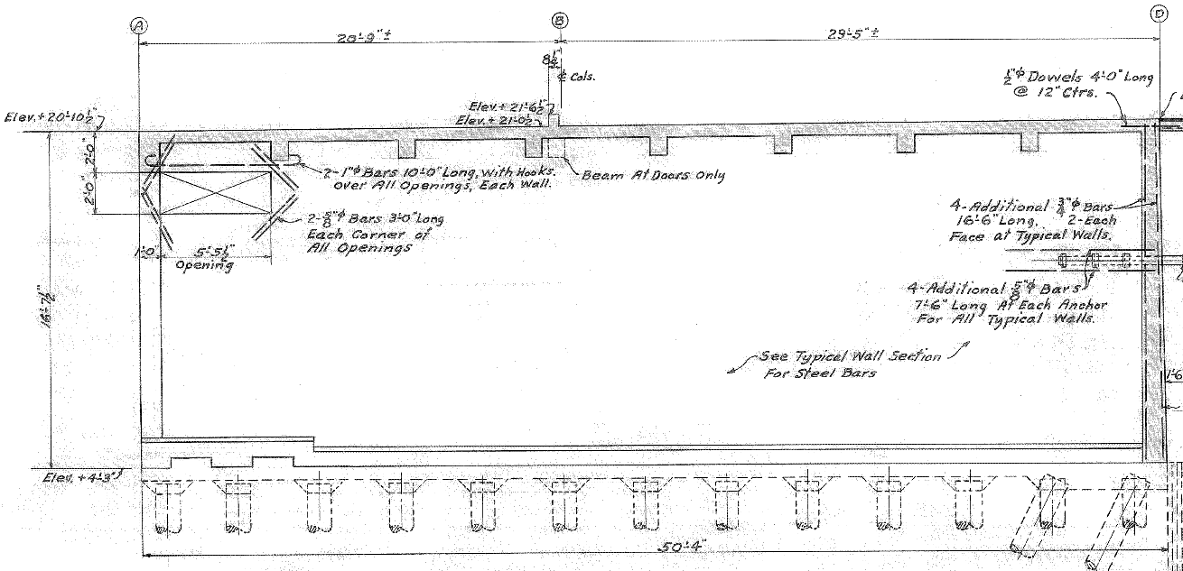
Spandrel Beam
(1948/1980)
Deck (1948)
Trench Drain Beam (1948)
Deck Beam (1948)
Wale Beam (1980)
Shear Wall (1948)
Timber Piles (1921)
Platform Slab (1948)
Platform Slab (1921)
Wharf M2
Original Construction: 1921 | Reconstruction: 1948 Gantry Crane: 1970 | Repairs: 1981

Slide 11
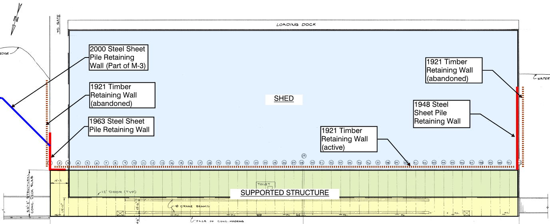
M2 - Plan view of dock and shed

Slide 12
SELECTION PROCESS
A. Respondent’s (and Subconsultant’s, if Applicable) Reputation and Quality of Services (15%):
Background of Respondent (the type of projects that the company has completed that is relevant to M2)
Reputation of Respondent and of Respondent’s services (any litigation in the last 5 years should be disclosed – include insurance reports).
References, including government project examples (with reference to Section V.C. include sample of projects and their relevance to M2, as well as, the personnel’s involvement in that project - include preferably government project examples.)
Quality of Respondent’s services (with reference to Section V.C. include a list of 5 to 10 projects that could provide information of the quality of work that is similar to that of M2. Also, include references from the client that could provide details on the project)
Availability and dedication of resources to PHA projects, including the ability to perform multiple projects at the same time (explain proposed process to for resource change)
Respondent’s past relation with the Port Authority (submit up to the last 3 projects conducted with the Port Authority and explain lesson learned and how would you address the issue better this time. If Respondent has never done a project with the PHA, use other projects similar to M2).

Slide 13
SELECTION PROCESS
B. Personnel (Including Subconsultant Personnel, if Applicable) Qualifications and Experience (40%):
Background, reputation, qualifications, and relevant experience of assigned personnel (with reference to Section V.B. include resumes of the personnel and the relevant projects in the resumes have to be highlighted – the resume should indicate type of repair experience: marine structures, complexity, involvement, etc.)
Availability and dedication of qualified personnel to PHA projects, including the ability to perform multiple projects at the same time (indicate number of projects the personnel expected to be involved in 2018/2019 excluding M2)
Certifications, registrations, and licenses of available and dedicated personnel (all professional personnel should be in good standing with the Texas Board of Professional Engineers – if not, it should be disclosed).
Personnel’s past relation with PHA (add any significant problem solving by personnel on PHA projects)
Personnel capabilities and resilience (add an example of a project they were involved in that took a wrong turn and how they did manage the issues, elevate the risk and mitigate the problem).
Personnel’s past professional reputation (disclose if professional personnel, particularly professional engineers, have been involved in any professional litigation).

Slide 14
SELECTION PROCESS
C. Performance Plan and Other Benefits (40%):
The methodology proposed to perform PHA projects and services (include a high level schedule, execution plan, and organization chart)
Plan for communicating with PHA (add the project focal point, potential interfaces, and the design and construction phase communication process)
Any unique or specialized processes, organization, capabilities, safety or environmental considerations, best practices, or quality control methods (propose process to minimize mistakes and change orders).
Outline what are the important issues to consider in the rehabilitation of M2 and whether the respondent have done such task in the past (provide high level insight / assessment in regards to the proposed plan in Exhibit 3 – e.g. how the respondent would use the existing information provided in that report and what the respondent would propose as rehabilitation concept for M2.)
Example of performance issue (include a number of lesson learned of projects and processes that were not successful and why)

Slide 15
SELECTION PROCESS
D. Overall Compliance with PHA Policies (5%):
Demonstrated understanding of the RFQ and its objectives (Any submitted information (such as example projects, Respondent’s experience, etc.) that are not related to this RFQ will be considered lack of understanding).
Clarity and brevity of the Response (Any response that is not clear will be disregarded and in addition to that will not receive points).
Thoroughness of Response, including submission of all items required by RFQ (All documentation and information are submitted as outlined by this RFQ and procurement).

Slide 16
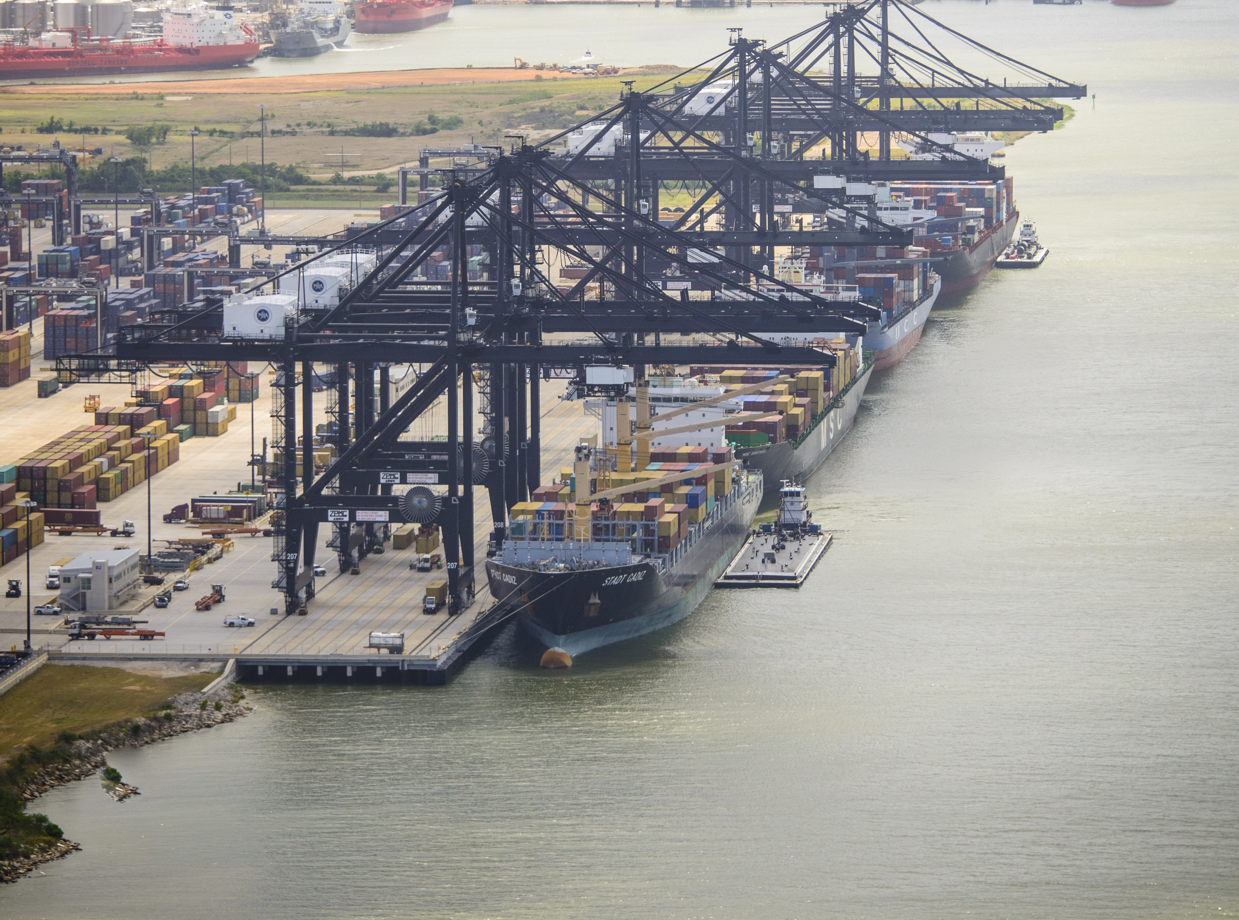
THANK YOU
Eddy Kharrazi, P.E.
Project Manager
Port Houston
Questions?
www.PortHouston.com
111 East Loop North
Houston, TX 77029

