Slide 1
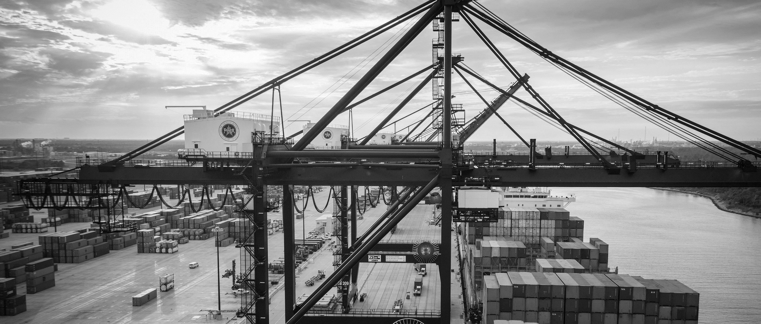
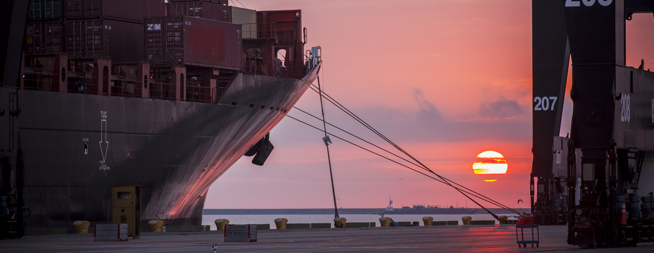
RFQ-693 Professional Services to Support Master Planning Studies and Investigations: Market and Industry Trends for General Cargo Facilities
Facility Planning

Slide 2
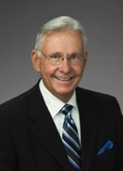
Port Commission
John D. Kennedy
Dean E. Corgey
Clyde Fitzgerald
Janiece M. Longoria
Chairman
Theldon R. Branch, III
Stephen H. DonCarlos
Roy D. Mease
PORT HOUSTON: THE INTERNATIONAL PORT OF TEXAS

Slide 3
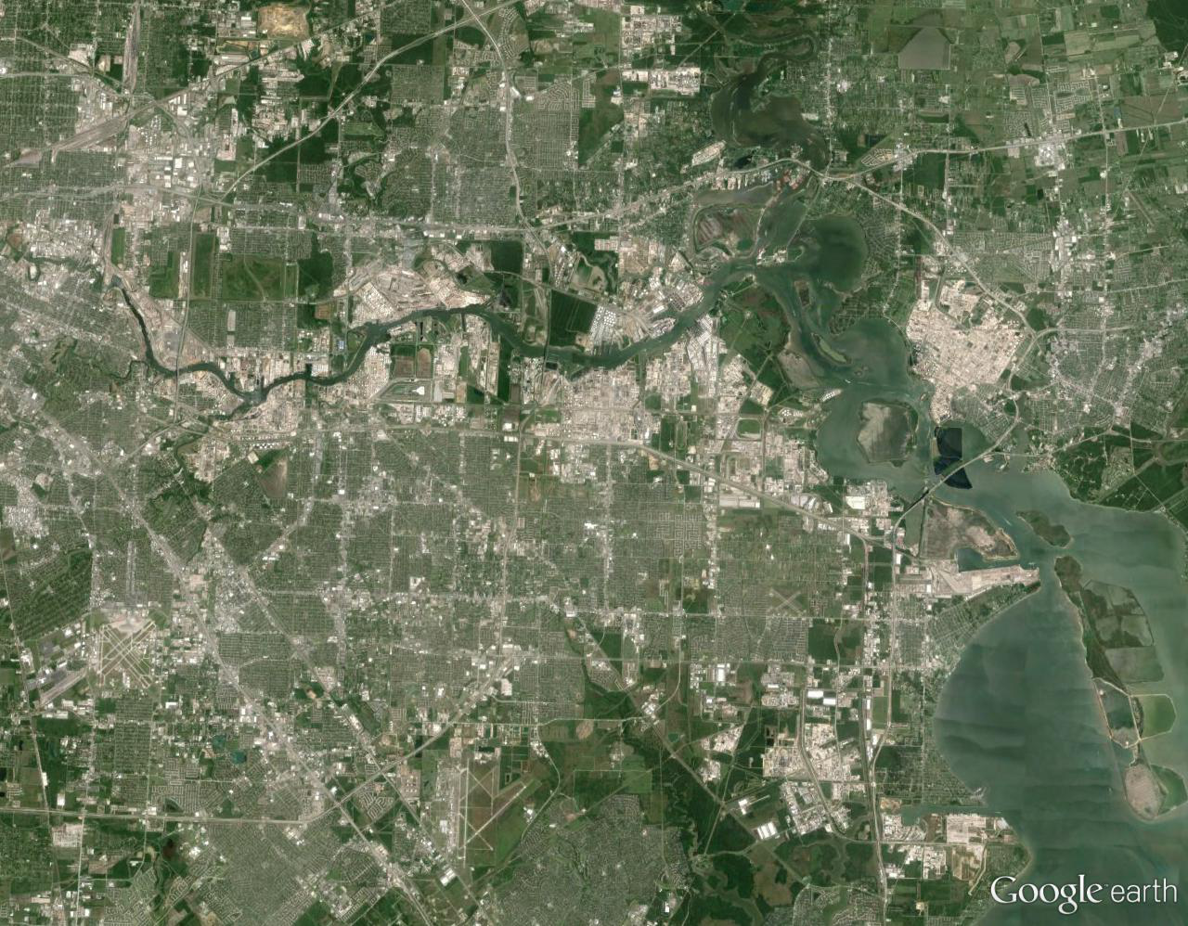
Port Houston Terminals
Turning Basin
Bulk Handling
Jacintoport
Woodhouse
Grain Elevator
CARE
Barbours Cut
Bayport
Notes:
The Port of Houston Authority operates two Container Terminals and leases 6 general cargo facilities.

Slide 4
RFQ-693
Introductions
Procurement
Selection Criteria
Scope of Services
Photos
Questions
All attendees must sign in and indicate attendance for site visit and TWIC cardholders.
Turning Basin
Notes:
The Port of Houston Authority operates two Container Terminals and leases 6 general cargo facilities.

Slide 5
RFQ-693
PHA Personnel
Rich Byrnes – Chief of Infrastructure
Yvette Camel-Smith – Director of Procurement
Mark Griffin – Director of Facility Planning
Allie Isbell – Manager, Long Range Planning
Pedro Gonzales – Small Business Development
Harvey Ross – Construction Manager
Notes:
The Port of Houston Authority operates two Container Terminals and leases 6 general cargo facilities.

Slide 6
RFQ-693
Procurement
Request for Qualifications (RFQ) due May 9, 2018 no later than 11:00 A.M.
Five (5) hard copies packaged in one sealed envelope.
Facsimile copies are not acceptable.
All responses to the RFQ will be dates and the time received recorded upon receipt. PHA will not be responsible for late or incomplete responses due to mistakes or delays of the Respondent or carrier used by the Respondent or weather delays. A postmark is not sufficient.
LATE SUBMITTALS WILL NOT BE EVALUATED.
Turning Basin
Notes:
The Port of Houston Authority operates two Container Terminals and leases 6 general cargo facilities.

Slide 7
RFQ-693 Selection Criteria
Most highly qualified provider using criteria and relative weight.
Criteria Relative Weight
Respondent’s Reputation and Quality of Services 20%
Personnel Qualifications and Experience 25%
Performance Plan and Other Benefits 50%
Overall Compliance with PHA Policies 5%
Turning Basin
Notes:
The Port of Houston Authority operates two Container Terminals and leases 6 general cargo facilities.

Slide 8
RFQ-693 Scope of Services
Demand Analysis: Review and augment or supplement as necessary PHA market forecasts of general cargo commodity movements over a twenty-year horizon together with an analysis and discussion of industry, technological, labor and logistics trends and reasonably anticipated industry developments.
Supply and Alternative Analysis: Support PHA staff in review of existing terminal conditions, use and use possibilities, and cargo handling capacities. Assist in the generation of graphic presentation of terminal configuration and equipment options, ship servicing and landside storage operations, and terminal circulation and landside distribution patterns.
Turning Basin
Notes:
The Port of Houston Authority operates two Container Terminals and leases 6 general cargo facilities.

Slide 9
RFQ-693 Scope of Services (cont’d)
Trade-off Analysis: Assist PHA staff in evaluation of operational flexibility and optimal use of berthing and terminal facilities; identify candidate assets for consolidation and devise use transition options for areas that may no longer be adequate or needed to support maritime operations.
Development Planning: Prepare conceptual development plans for required berth and terminal improvements; repurposing of consolidated terminal areas; redevelopment or improvement of upland circulation, storage and distribution capabilities.
Turning Basin
Notes:
The Port of Houston Authority operates two Container Terminals and leases 6 general cargo facilities.

Slide 10
THANK YOU
Mark T. Griffin, AICP
Director, Facilities Planning
Port Houston
Questions?
713.670.2646
mgriffin@poha.com
www.PortHouston.com
111 East Loop North
Houston, TX 77029

