Slide 1
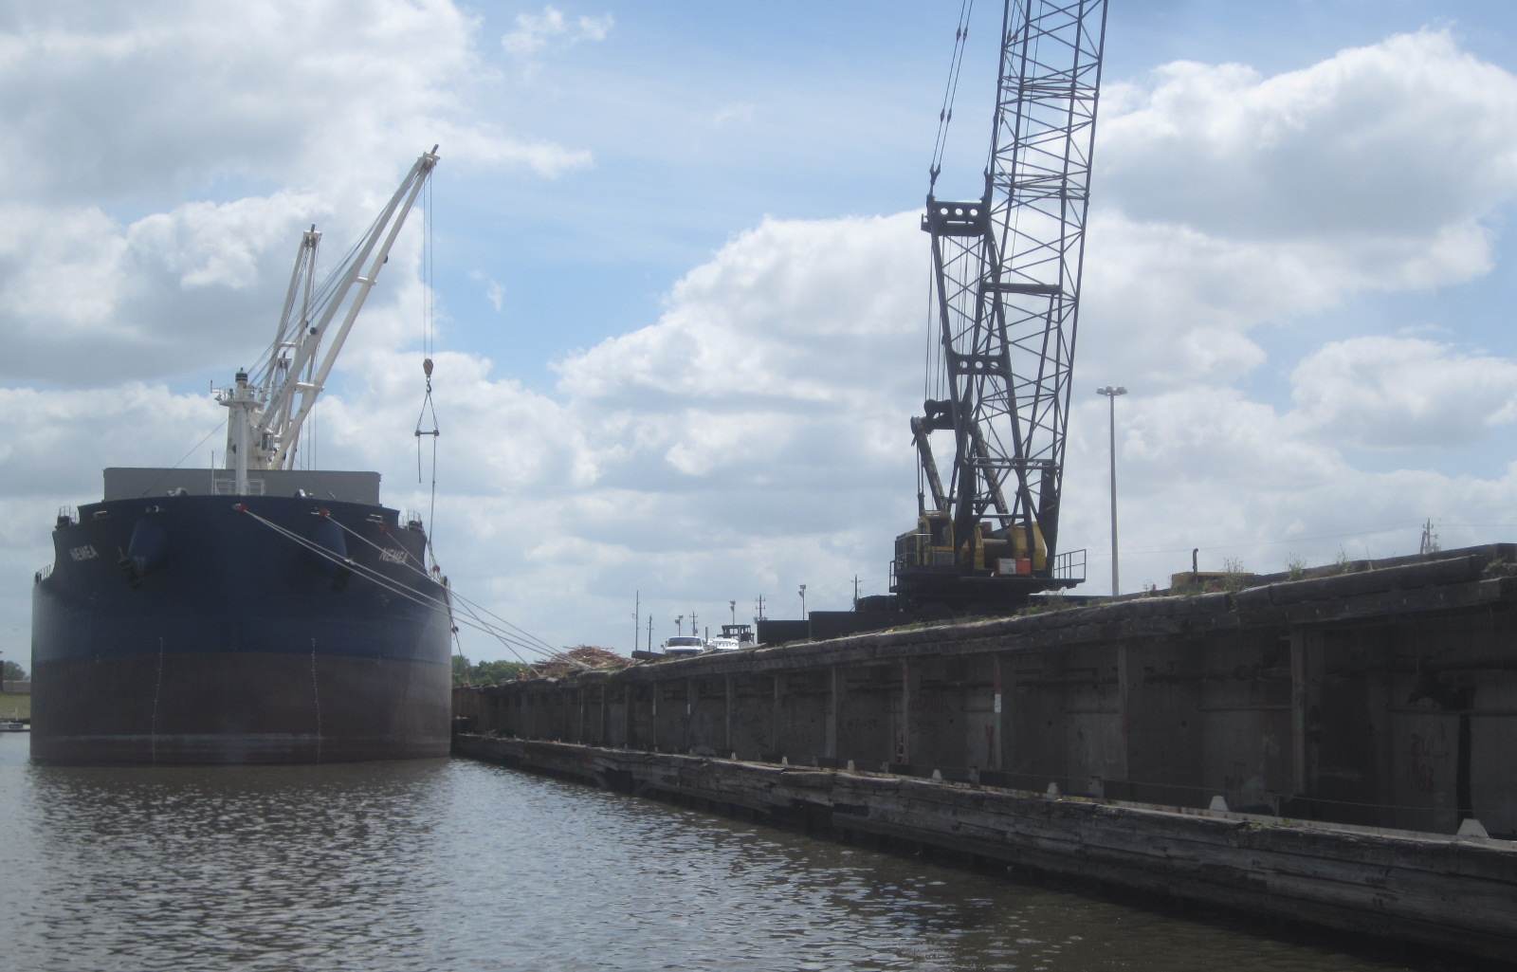
RFQ 683-Structural Analysis of Eleven Turing Basin Terminal Wharf Structures

Slide 2
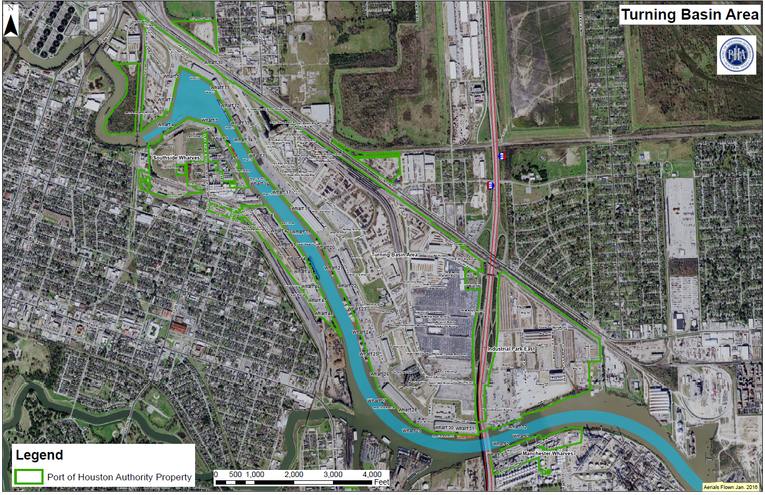
You Are Here

Slide 3
Wharves No. 16, 17, 20, 23, 24, 25, 26, 29, 30, 31, and 32

Slide 4
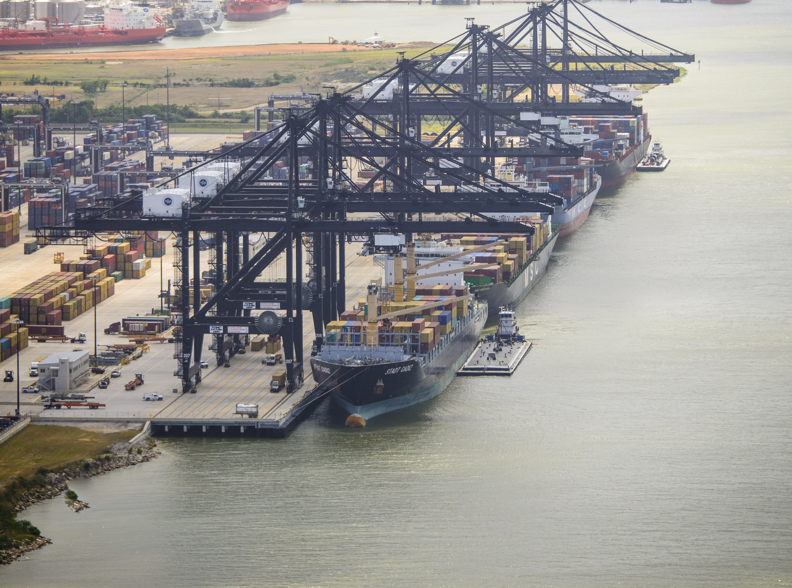
THANK YOU
Eddy Kharrazi, P.E.
Project Manager
Port Houston
Questions?
www.PortHouston.com
111 East Loop North
Houston, TX 77029

