Slide 1
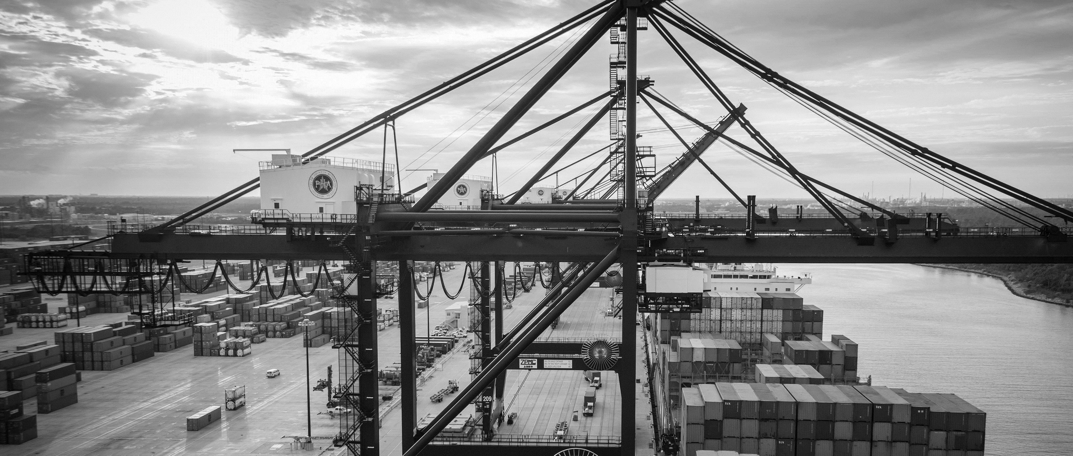
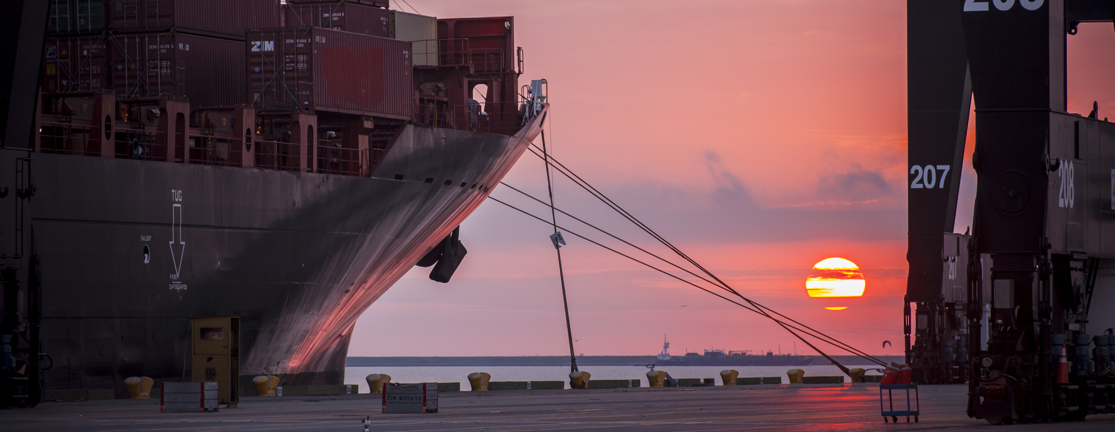
RFQ-630 Professional Engineering Services to Construct
Container 1 North and Container 2 North at Barbours Cut Terminal
Barbara H. Smith, PE | Project Manager | Project & Construction Management (PCM)

Slide 2
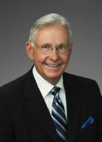
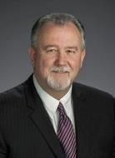
Port Commission
John D. Kennedy
Dean E. Corgey
Clyde Fitzgerald
Janiece M. Longoria
Chairman
Theldon R. Branch, III
Stephen H. DonCarlos
Roy D. Mease
WELCOME MESSAGE | 2
Notes:
Janiece Longoria is the Chairman for the Port of Houston Authority Commission Board.

Slide 3
RFQ-630
Introductions
Procurement
Selection Criteria
Scope of Services
Photos
Questions
All attendees must sign in and indicate attendance for site visit and TWIC cardholders
Notes:
Please see how the meeting with flow this morning. You will hear from procurement and I highlight portions of the selection criteria. Before we get started with the presentation, let’s see who is present in the room. Start from my right and work your way around the room. Then, you will hear from PHA, team starting with me.

Slide 4
RFQ-630
PHA Personnel:
Jeff Davis - Chief of Operations
Yvette Camel-Smith - Director of Procurement
Roger H. Hoh, P.E. - Director, Project & Construction Management
B. H. Smith, P.E., - Project Manager
Pedro Gonzales - Small Business Development
Harvey Ross - Construction Manager
Notes:
Names of our team and most of them are here in the room. This presentation will made available for your reference.

Slide 5
RFQ-630
Procurement:
Request for Qualifications (RFQ) due February 14, 2018 no later than 11:00 A.M.
Eight (8) hard copies packaged in one sealed envelope
Facsimile copies are not acceptable
All responses to the RFQ will be dated and the time received recorded upon
receipt. PHA will not be responsible for late or incomplete responses due to
mistakes or delays of the Respondent or carrier used by the Respondent or
weather delays. A postmark is not sufficient.
LATE SUBMITTALS WILL NOT BE EVALUATED.
Notes:
You will hear from the procurement department at this time.

Slide 6
RFQ-630 Selection Criteria
Most Highly Qualified Provider
Using Criteria and Relative Weight
CRITERIA
RESPONDENT’S REPUTATIONS AND QUALITY OF SERVICES
PRESONNEL QUALIFICATIONS AND EXPERIENCE
PERFORMANCE PLAN AND OTHER BENEFITS
OVERALL COMPLIANCE WITH PORT AUTHORITY POLICIES
RELATIVE WEIGHT
25%
35%
35%
5%
100%
Notes:
R
We need to know the Background of the respondent, including reputation and quality of services. Provide the availability and dedication of resources to Port for this project.
PQ.
Background, reputation, qualifications, and experience of personnel.
Availability and dedication of personnel, including, if required, the ability to perform multiple projects at the same time.
PP
The methodology proposed to perform services. Plan for communicating with the Port. Design schedule timeline for the (30%, 60%, 100%) package.
O
Demonstrated understanding of the RFQ and its objective. The team will be looking for clarity of the Response. Thoroughness of the Response.

Slide 7
RFQ-630 Scope of Services
Prepare specifications and plans to rehabilitate the existing pavement at Container Yard 1 North and Container Yard 2 North at Barbours Cut Container Terminal.
Design plans to include demolition, grading, excavation, underground utilities, electrical work and the installation of concrete pavement.
PHA will provide the original geotechnical report and Barbours Cut Pavement Study.

Slide 8
RFQ-630 Scope of Services (cont’d)
Preparation of all construction-related documents, including assistance in preparing competitive sealed proposals (CSP), competitive sealed bids (CSB), or any other solicitation packages for any related PHA construction projects.
Proposal- and construction-phase services in support of pre-proposal, preconstruction, and other meetings; develop submitted log and review of submittals and shop drawings; responses to Requests for Information (RFI); assistance with change orders; and documentation of as-built archives.

Slide 9
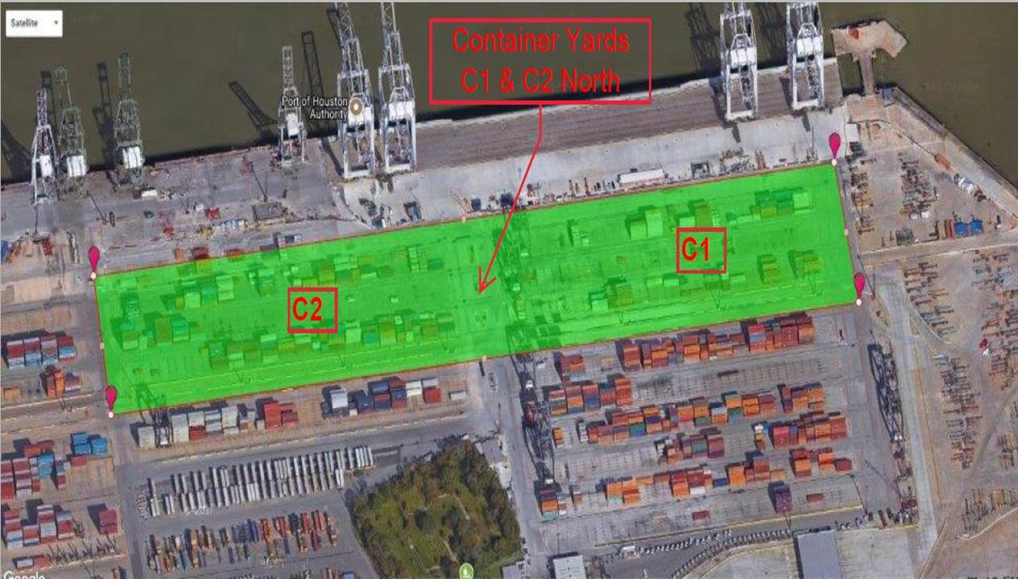
RFQ-630 Photos
Notes:
This is an exhibit depicting the boundaries of Container 1 North and Container 2 North. The total acres for the project is approximately 20. Container 2 North will be constructed first due to its existing condition.

Slide 10
THANK YOU
Barbara H. Smith, PE
Project Manager
Port Houston
Questions?
713.670.2483
email@poha.com
www.PortHouston.com
111 East Loop North
Houston, TX 77029
WELCOME MESSAGE | 4

