Slide 1
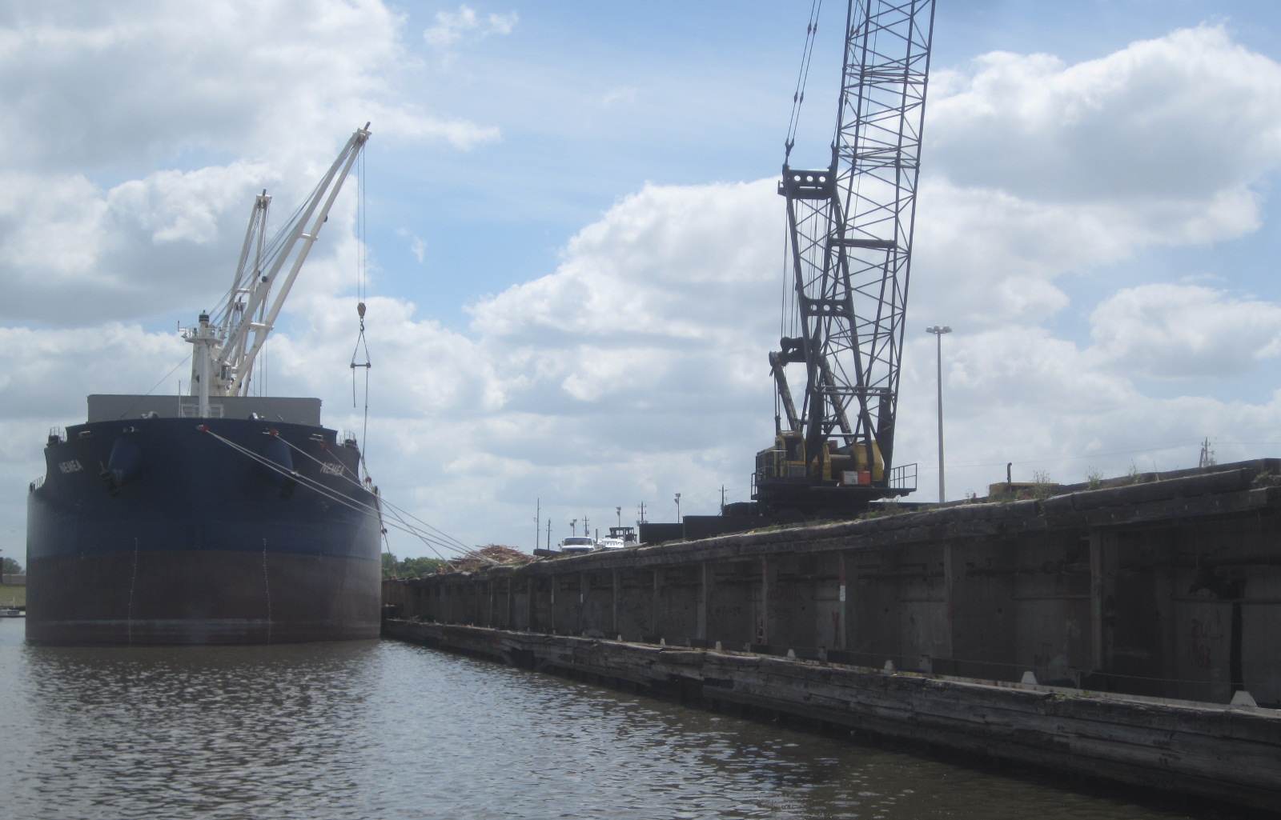
ANALYSIS AND DESIGN FOR THE REHABILITATION AND REPAIR OF WHARF 9 AT TURNING BASIN TERMINAL (RFQ-575).

Slide 2
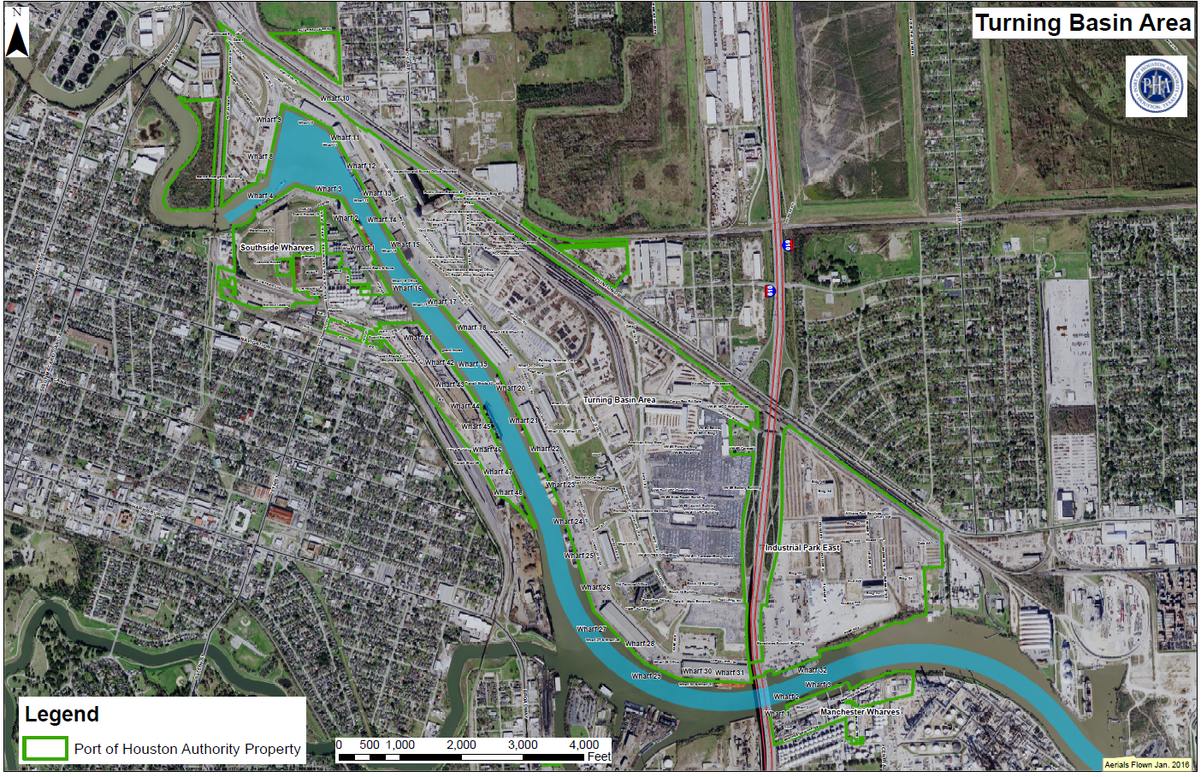
You Are Here

Slide 3
Background
Constructed in 1948
Solid-fill wharf
585 ft in length
200 ft concrete apron slab
3 rail lines

Slide 4
Previous Modifications
Original Construction:
  Cofferdam cells

Slide 5
Previous Modifications
Original Construction:
  Cofferdam cells
Modified in 1969:
  Pile cap extension
  Battered tiebacks
Large areas with no battered piles

Slide 6
Repair Considerations
750 PSF
Repair must:
  Address pile cap separation
  Increase slope stability
  Replace deteriorating fender
  Withstand 750 psf gravity loads
  Repair corroding bearing piles

Slide 7
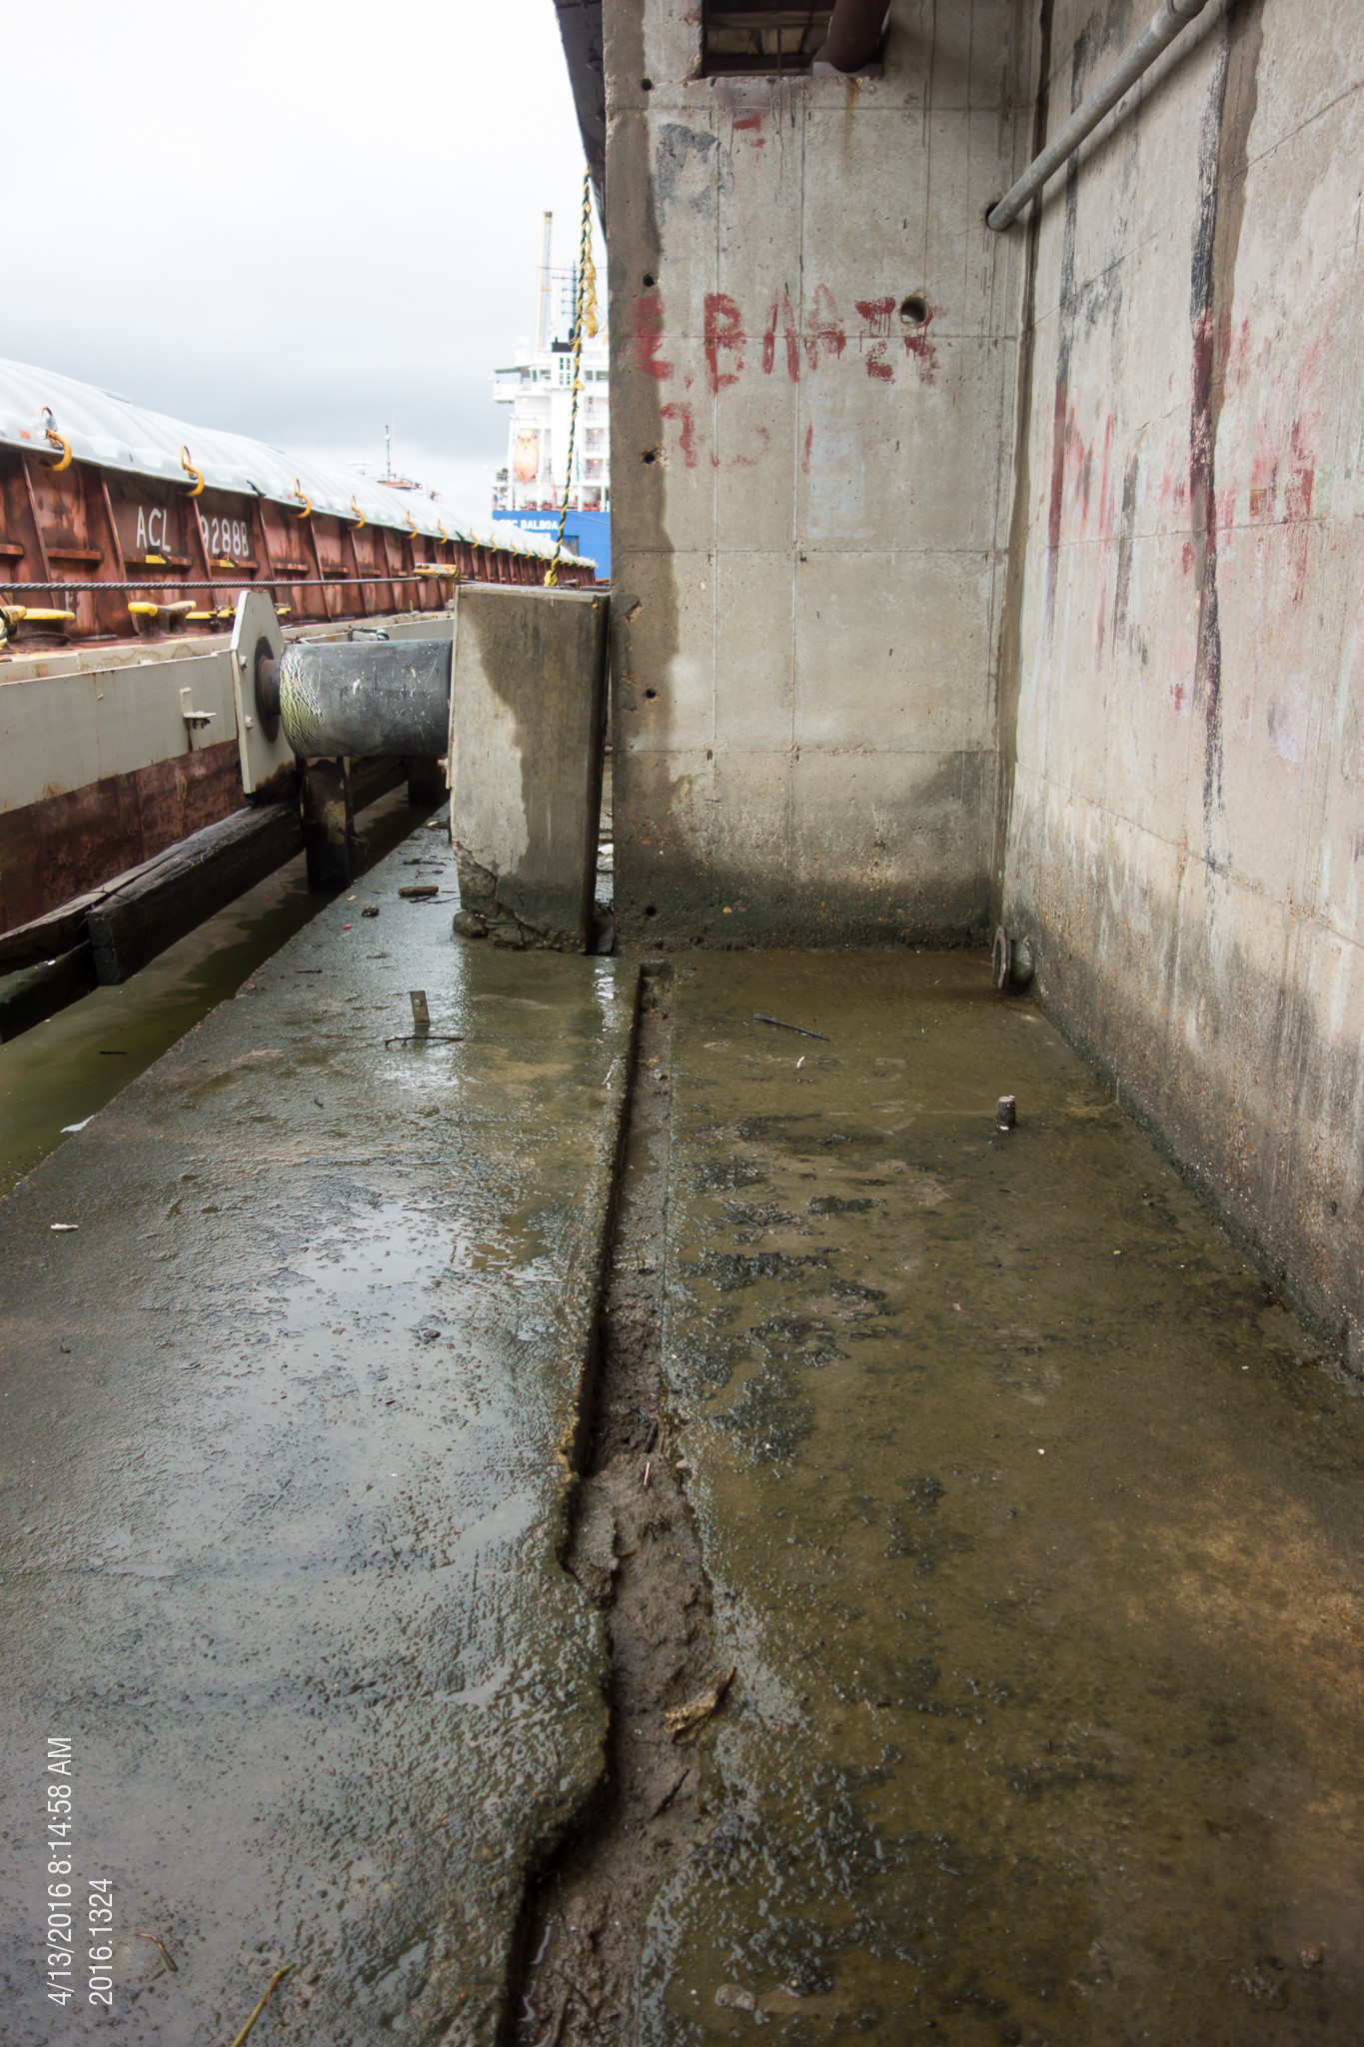
CD-09 Existing Condition
Pile cap separation at locations without augercast piles

Slide 8
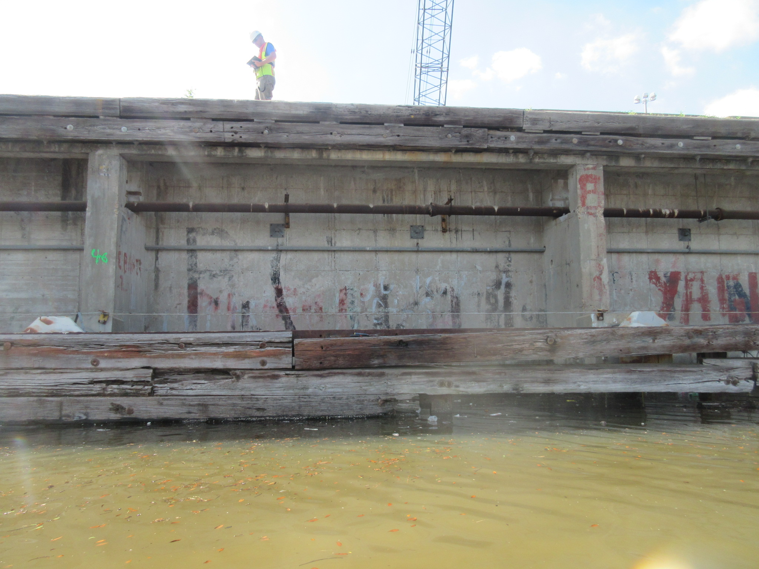
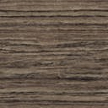
CD-09 Existing Condition
Fender disrepair

Slide 9
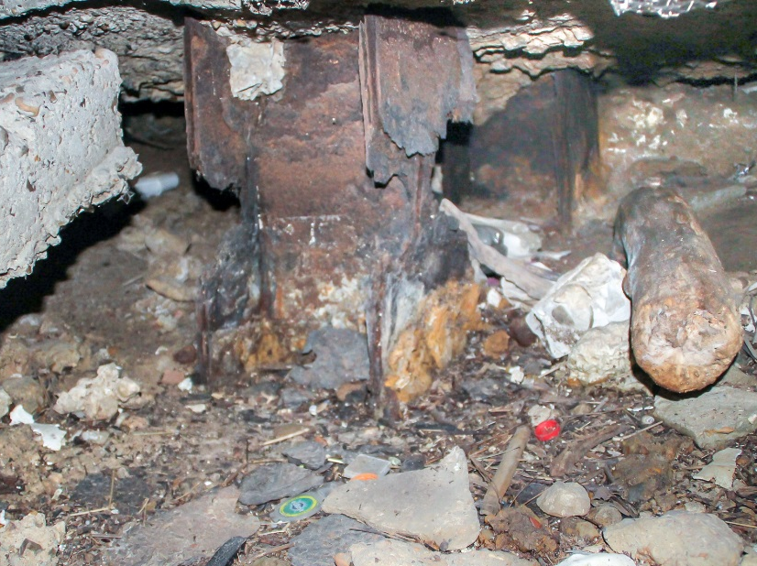
CD-09 Existing Condition
Severe pile section loss at CD-08/CD-09 joint

Slide 10
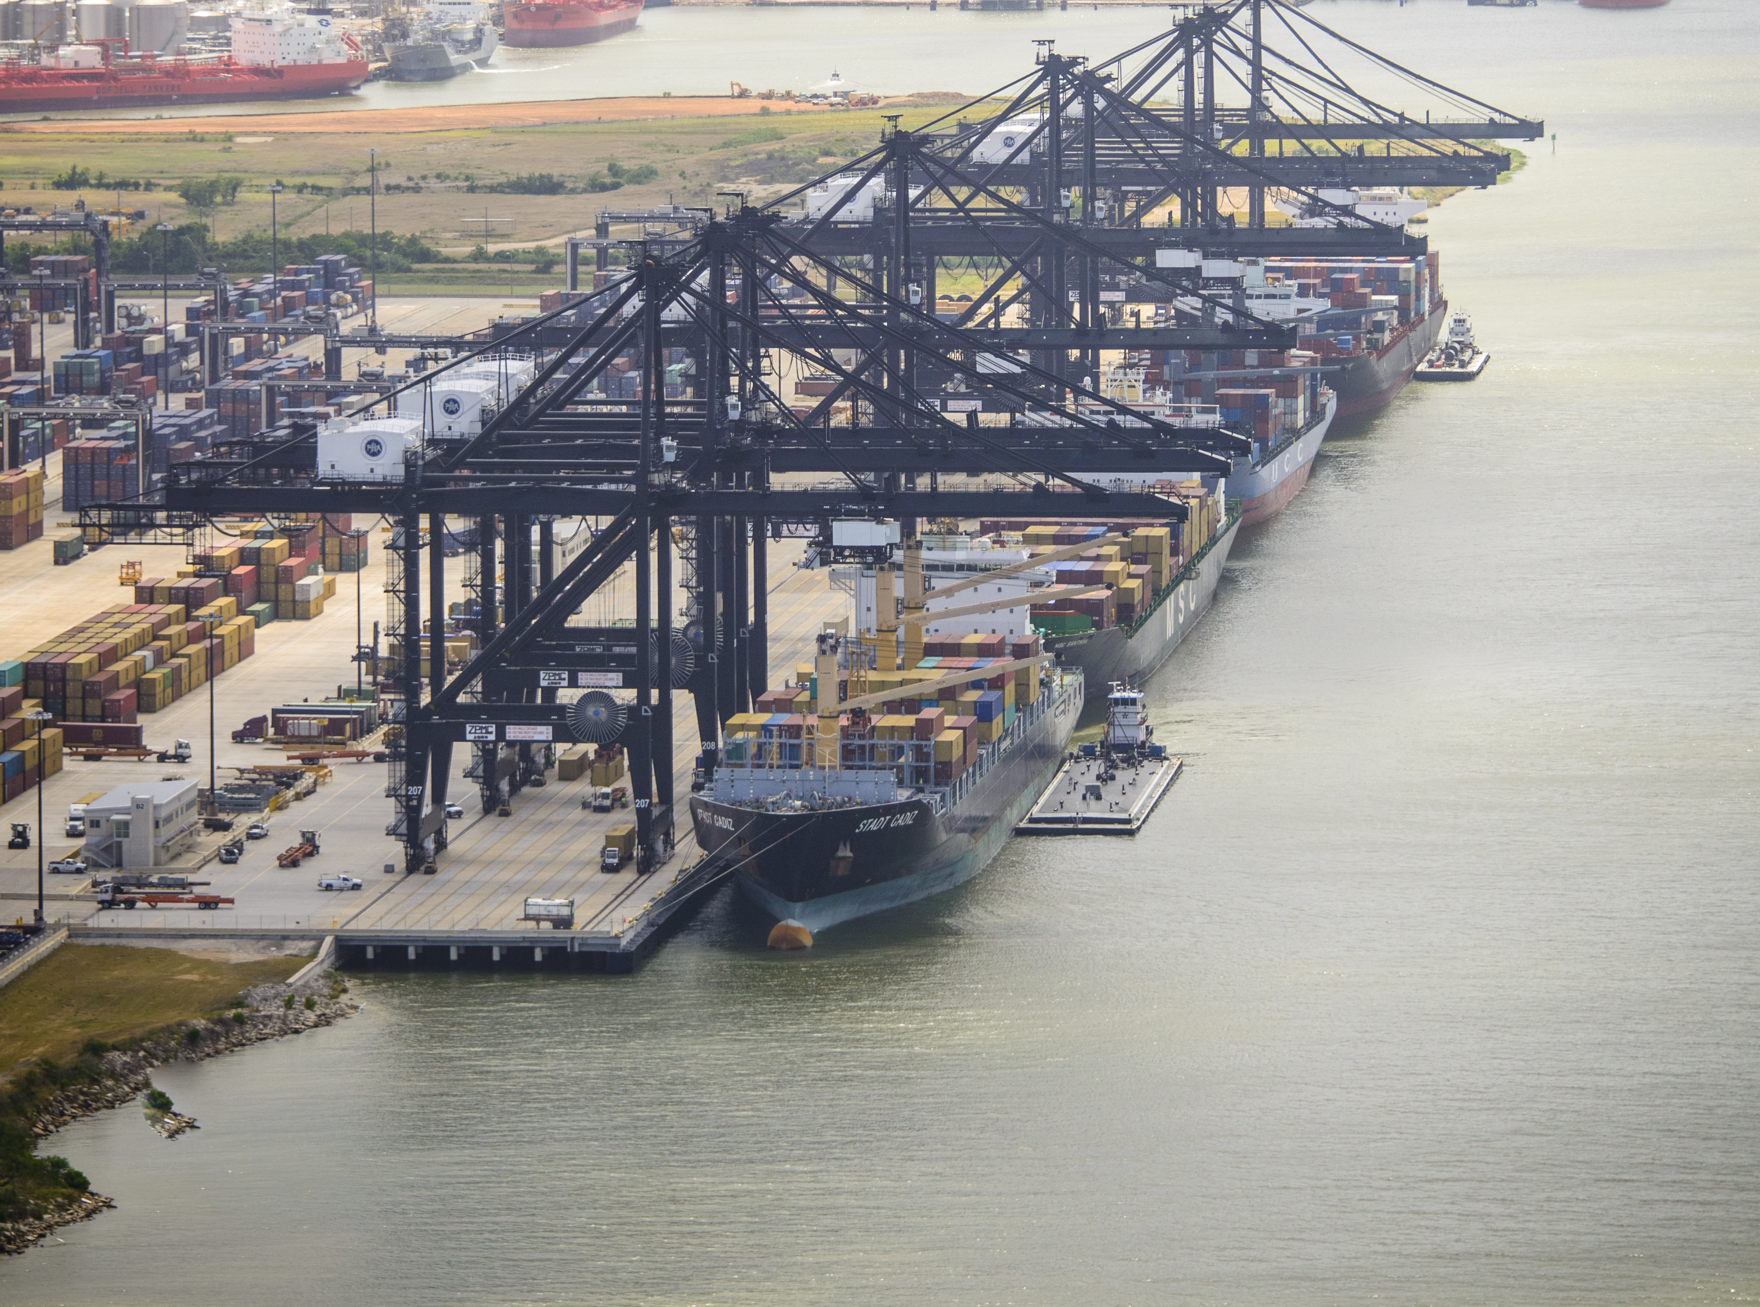
THANK YOU
Eddy Kharrazi, P.E.
Project Manager
Port Houston
Questions?
www.PortHouston.com
111 East Loop North
Houston, TX 77029

