Slide 1
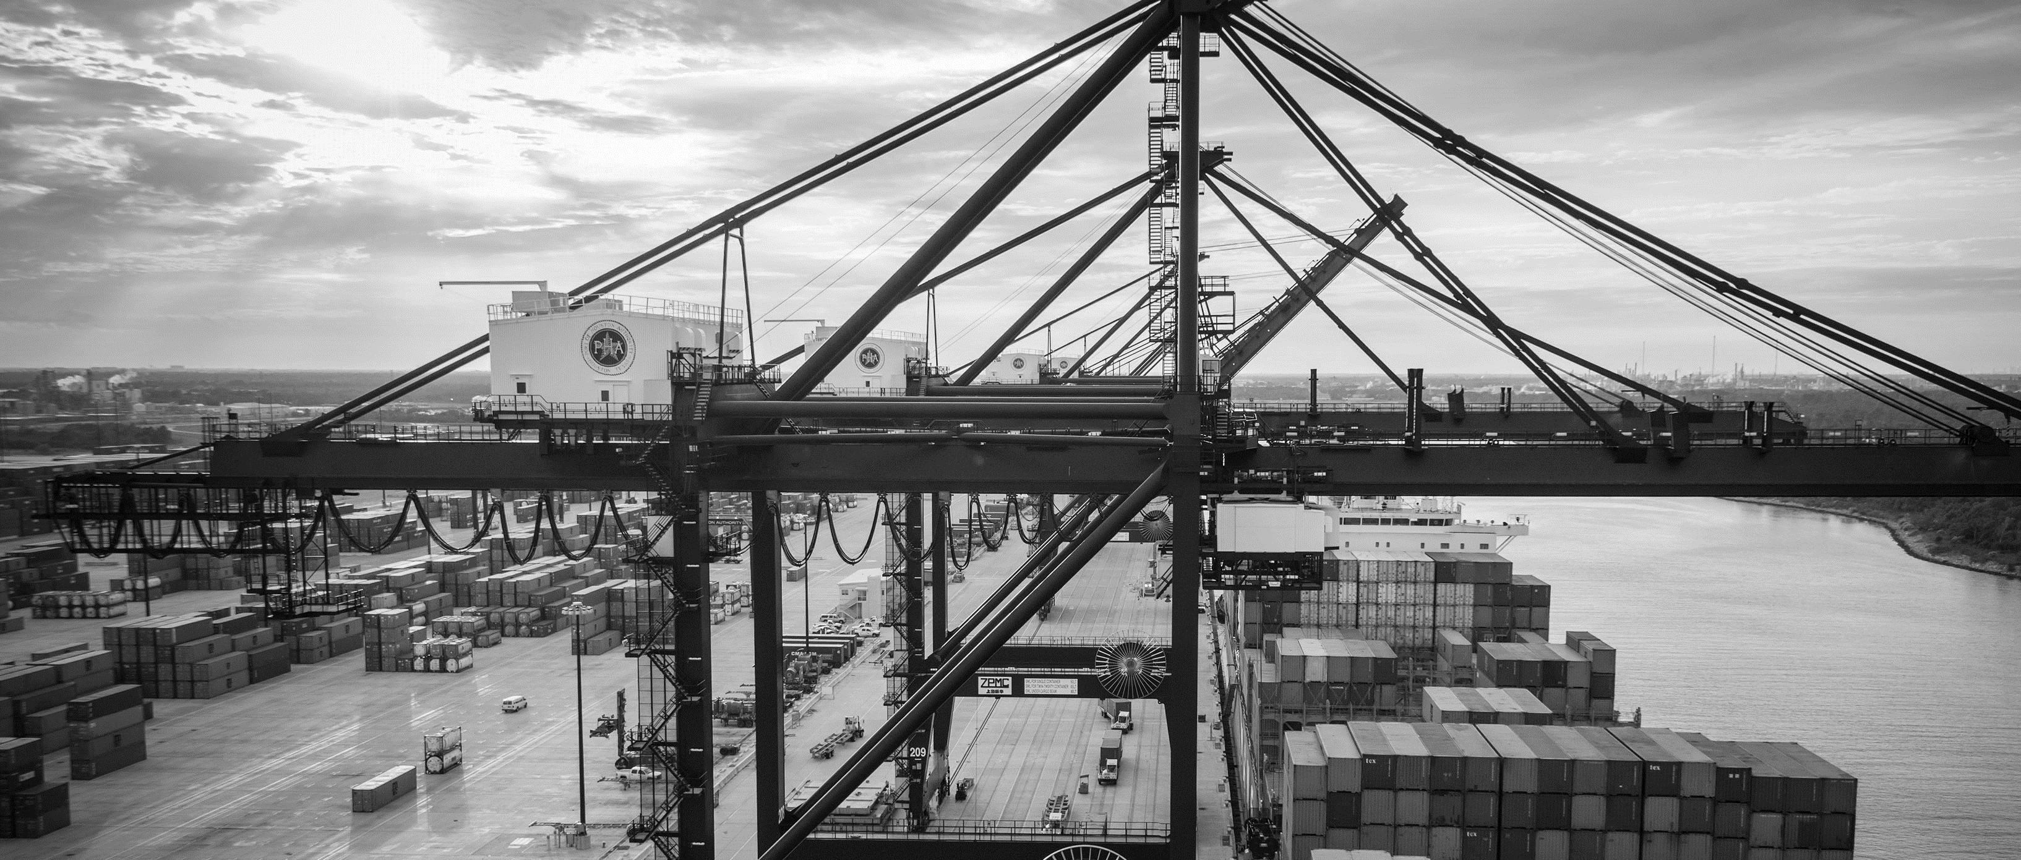
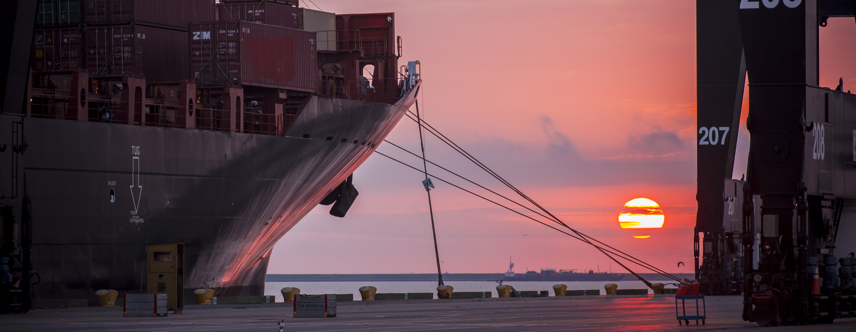
RFQ-569 Re-Design of the Entry Gates at Barbours Cut Terminal
Alvin J. Jackson, PE | Project Manager | Project & Construction Management (PCM)

Slide 2
Port Commission
John D. Kennedy
Dean E. Corgey
Clyde Fitzgerald
Janiece M. Longoria
Chairman
Theldon R. Branch, III
Stephen H. DonCarlos
Roy D. Mease
WELCOME MESSAGE | 2

Slide 3
RFQ-569
Introductions
Procurement
Selection Criteria
Scope of Services
Photos
Questions
All attendees must sign in and indicate attendance for site visit and TWIC cardholders

Slide 4
RFQ-569
PHA Personnel:
Alvin Jackson, P.E., - Project Manager
Pedro Gonzales – Small Business Development
Yvette Camel-Smith – Director of Procurement

Slide 5
RFQ-569
Procurement:
Request for Qualifications (RFQ) due December 6, 2017 no later than 11:00 A.M.
Eight (8) hard copies packaged in one sealed envelope
Facsimile copies are not acceptable
All responses to the RFQ will be dated and the time received recorded upon
receipt. PHA will not be responsible for late or incomplete responses due to
mistakes or delays of the Respondent or carrier used by the Respondent or
weather delays. A postmark is not sufficient.
LATE SUBMITTALS WILL NOT BE EVALUATED.

Slide 6
RFQ-569 Selection Criteria
Most Highly Qualified Provider
Using Criteria and Relative Weight
CRITERIA
RESPONDENT’S REPUTATIONS AND QUALITY OF SERVICES
PERSONNEL QUALIFICATIONS AND EXPERIENCE
PERFORMANCE PLAN AND OTHER BENEFITS
OVERALL COMPLIANCE WITH PORT AUTHORITY POLICIES
RELATIVE WEIGHT
40%
45%
10%
5%
100%

Slide 7
RFQ-569 Scope of Services
Perform site investigations of the existing gate property footprint to determine the gate lanes requirements and develop inbound and outbound gate layouts to design all elements included in the project scope.
Prepare preliminary and final plans and specifications for the proposed facilities, including basis of design, submittal logs, calculations, estimates, and construction schedules.
Design the gate facilities in order to increase the capacity to handle future throughput at the terminal. This would include additional inbound gate lanes and modifying the gate processing model currently used at the Bayport gate along with state of the art technology identified in the study, grading, paving, drainage, lighting, electrical service distribution, communication systems, signage, striping, and other features necessary for the function identified in the study.

Slide 8
RFQ-569 Scope of Services (cont’d)
Provide recommendations on construction methods and construction sequencing so as to minimize disruptions to the operations of the terminal.
Provide design services for any pre-outage work required to minimize disruption to the operations of the terminal as a consequence of the construction of the project.
Proposal- and construction-phase services in support of pre-proposal, preconstruction, and other meetings; review of submittals and shop drawings; responses to Requests for Information (RFI); assistance with change orders; and documentation of as-built archives.

Slide 9
RFQ-569 Photos

Slide 10
RFQ-569 Drawings

Slide 11
THANK YOU
Alvin J. Jackson, PE
Project Manager
Port Houston
Questions?
713.670.2895
email@poha.com
www.PortHouston.com
111 East Loop North
Houston, TX 77029
WELCOME MESSAGE | 4

