Slide 1
RFQ-546 Removal and Replacement of Ramp Road 7 Speed Gate
Alvin J. Jackson, PE | Project Manager | Project & Construction Management (PCM)

Slide 2
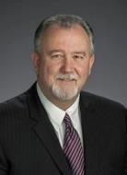
Port Commission
John D. Kennedy
Dean E. Corgey
Clyde Fitzgerald
Janiece M. Longoria
Chairman
Theldon R. Branch, III
Stephen H. DonCarlos
Roy D. Mease
WELCOME MESSAGE | 2

Slide 3
RFQ-546
Introductions
Procurement
Selection Criteria
Scope of Services
Photos
Questions
All attendees must sign in and indicate attendance for site visit and TWIC cardholders

Slide 4
RFQ-546
PHA Personnel:
Alvin Jackson, P.E., - Project Manager
Pedro Gonzales – Small Business Development
Yvette Camel-Smith – Director of Procurement

Slide 5
RFQ-546
Procurement:
Request for Qualifications (RFQ) due November 15, 2017 no later than 11:00 A.M.
Five (5) hard copies packaged in one sealed envelope
Facsimile copies are not acceptable
All responses to the RFQ will be dated and the time received recorded upon
receipt. PHA will not be responsible for late or incomplete responses due to
mistakes or delays of the Respondent or carrier used by the Respondent or
weather delays. A postmark is not sufficient.
LATE SUBMITTALS WILL NOT BE EVALUATED.

Slide 6
RFQ-546 Selection Criteria
Most Highly Qualified Provider
Using Criteria and Relative Weight
CRITERIA
RESPONDENT’S REPUTATIONS AND QUALITY OF SERVICES
PRESONNEL QUALIFICATIONS AND EXPERIENCE
OVERALL COMPLIANCE WITH PORT AUTHORITY POLICIES
RELATIVE WEIGHT
45%
50%
5%
100%

Slide 7
RFQ-546 Scope of Services
Prepare demolition plans to disconnect all power, conduit, access control, card readers, and cameras, including the demolition of the foundation to grade and removal of the speed gate to controller.
Design plans to include a new drill shaft foundation for the new speed gate and reconnection of the existing conduits to all the access infrastructure, lighting, card reader, ground loops, power, cameras, and the main control panel.
Coordinate design plans with PHA’s Information Technology department such that all access control programming, interfacing, and connectivity with the security network can be implemented with that department’s personnel or its contractor.

Slide 8
RFQ-546 Scope of Services (cont’d)
PHA will provide the original geotechnical report. The original design documents that installed the existing gate including foundation and infrastructure.
Preparation of all construction-related documents, including assistance in preparing competitive sealed proposals (CSP), competitive sealed bids (CSB), or any other solicitation packages for any related PHA construction projects.
Proposal- and construction-phase services in support of pre-proposal, preconstruction, and other meetings; review of submittals and shop drawings; responses to Requests for Information (RFI); assistance with change orders; and documentation of as-built archives.

Slide 9
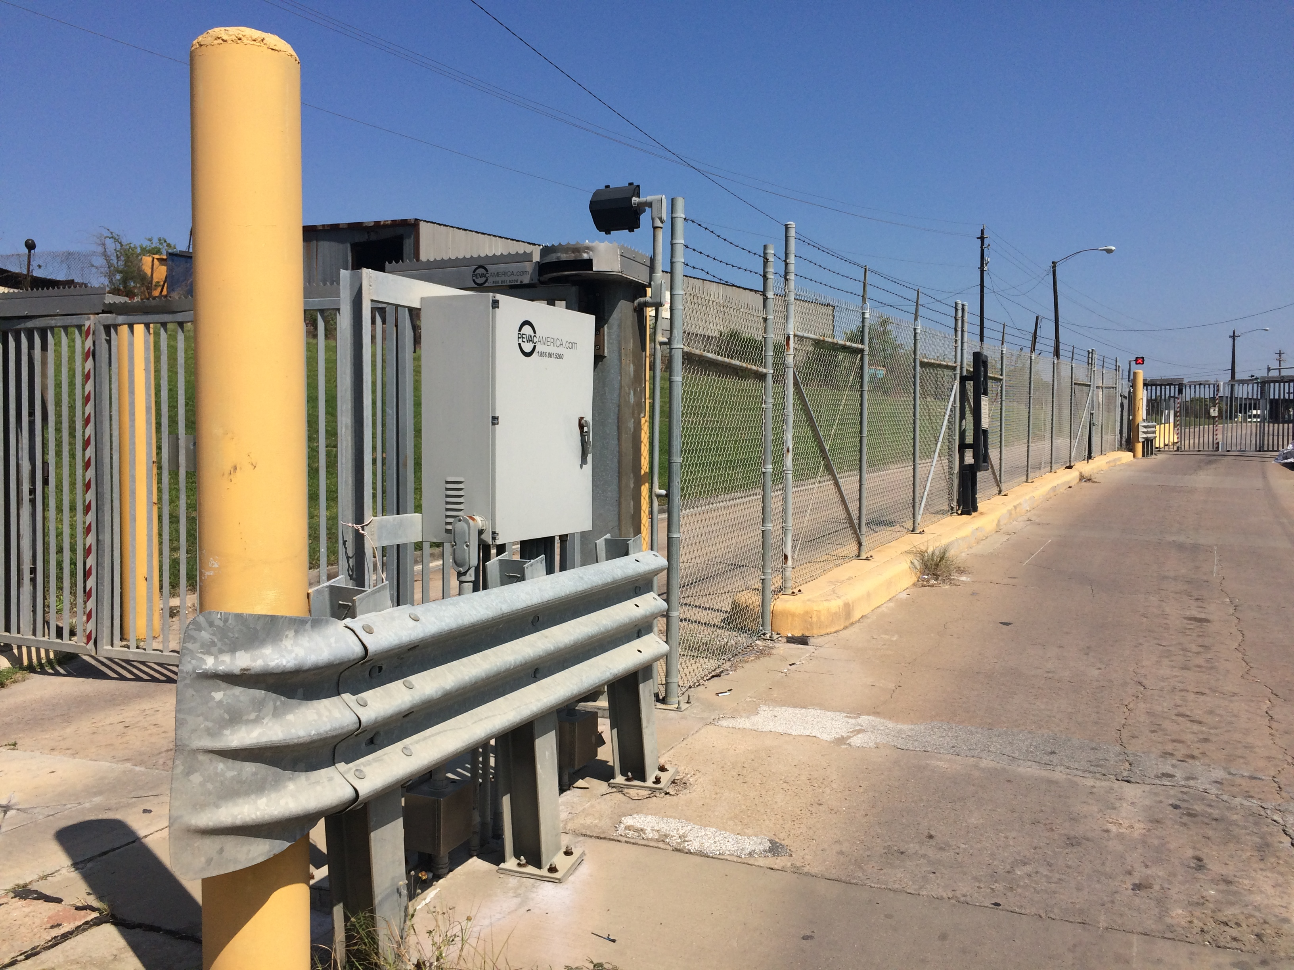
RFQ-546 Photos

Slide 10
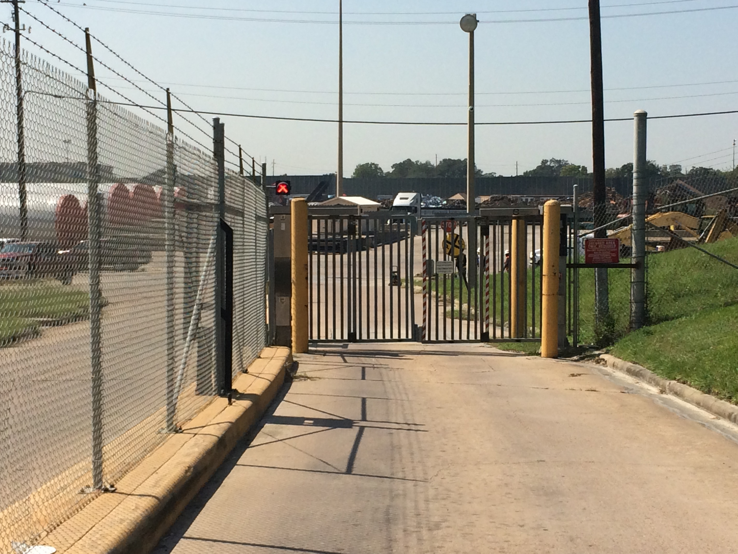
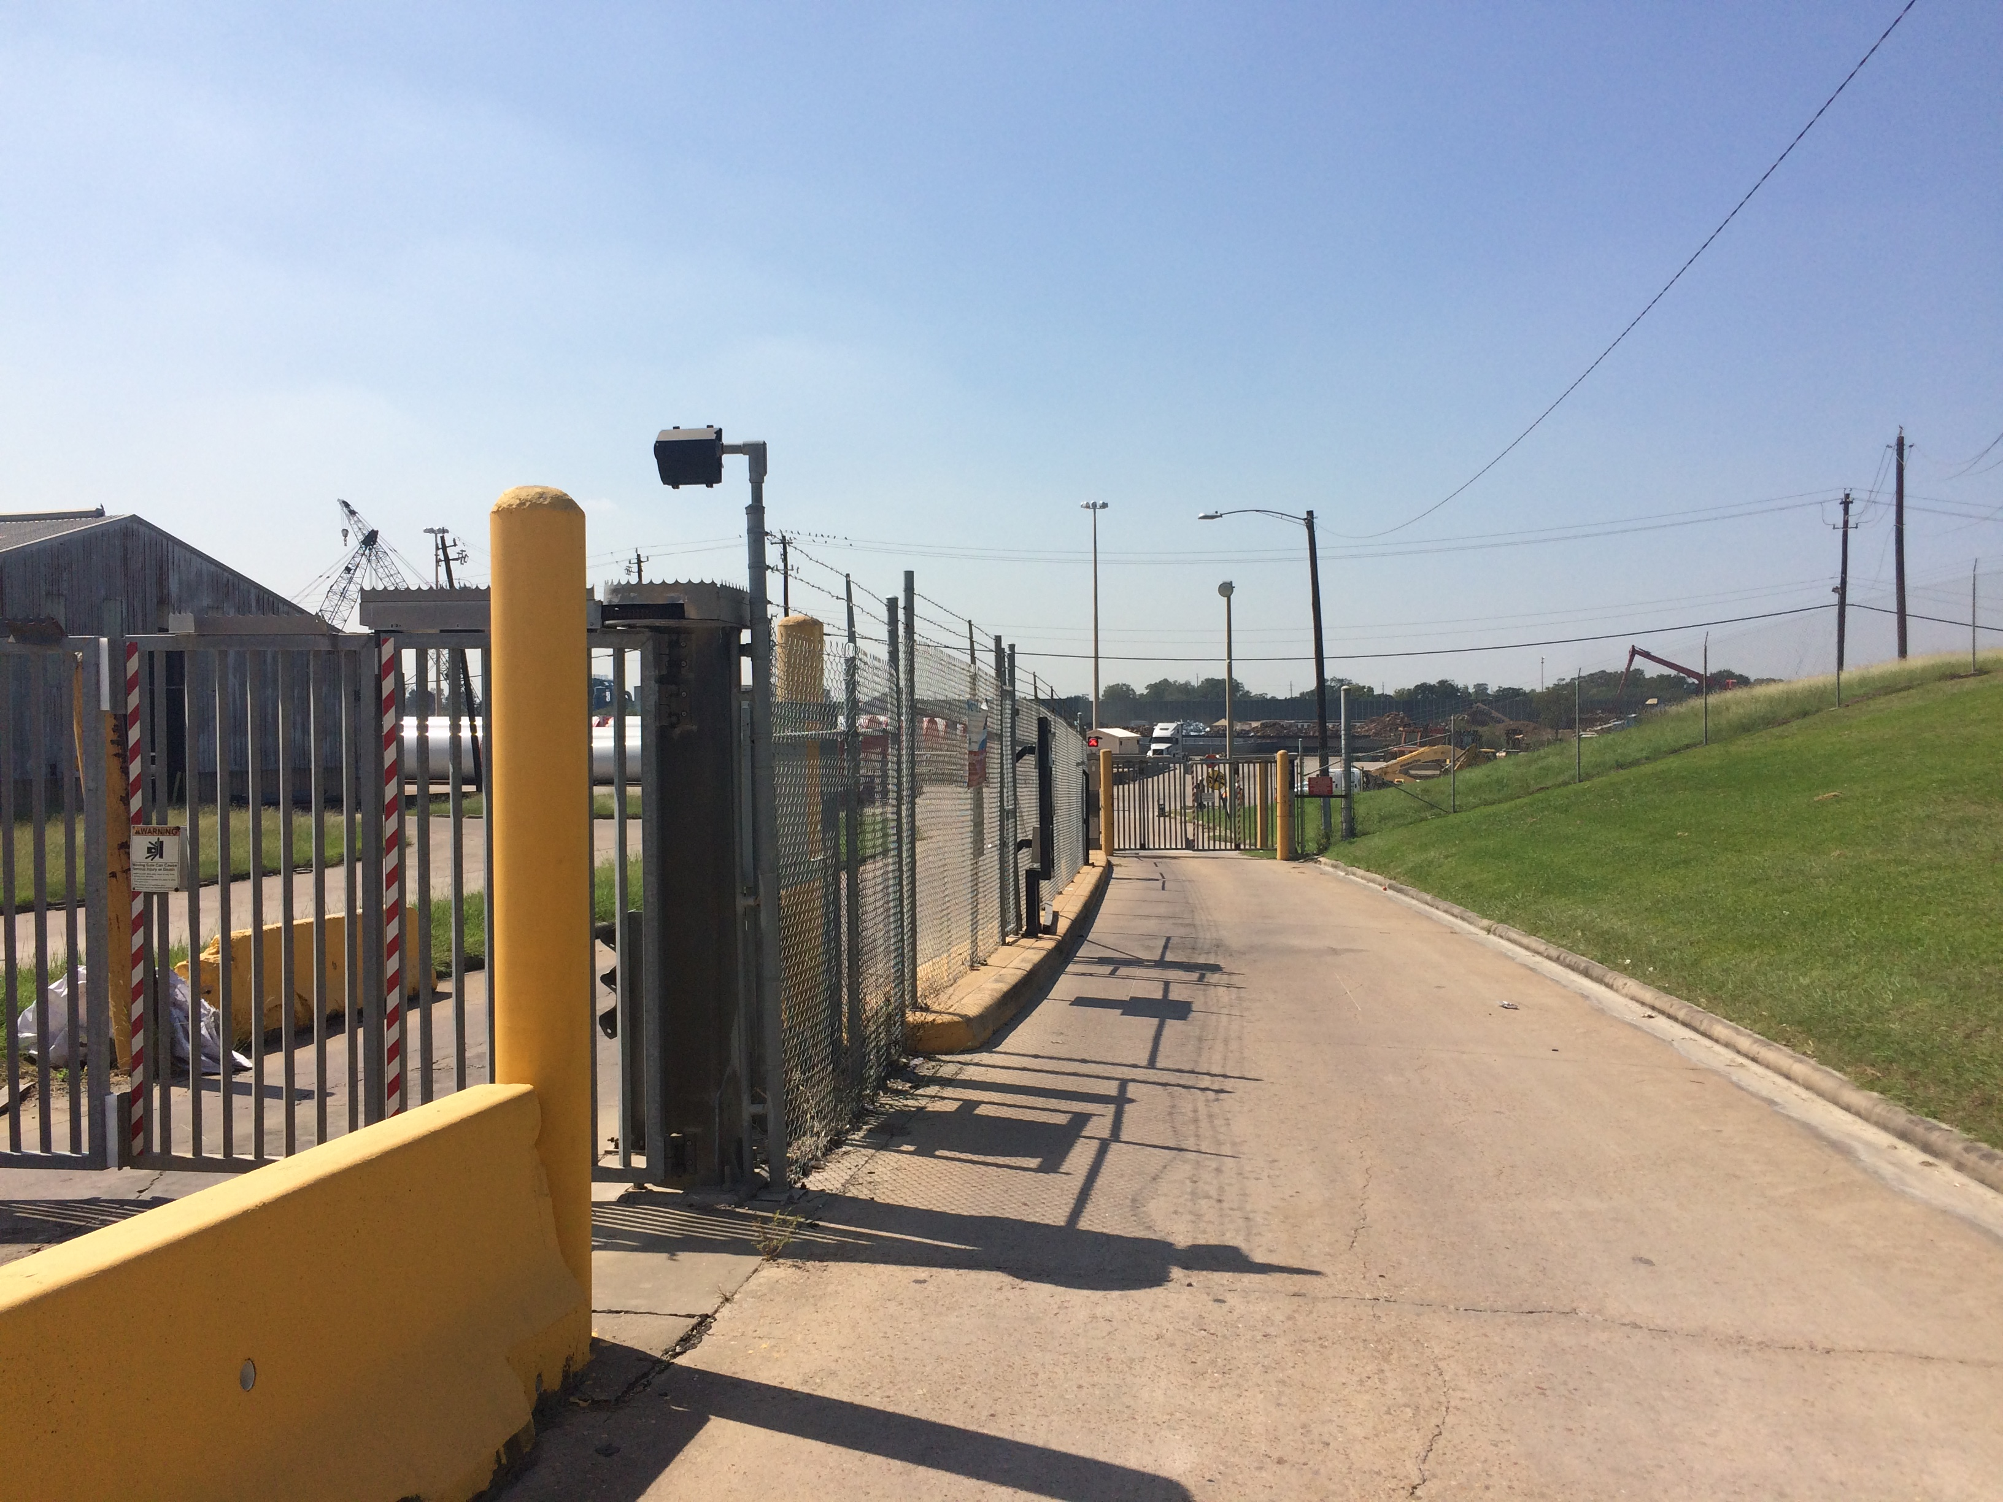
RFQ-546 Photos (cont’d)

Slide 11
RFQ-546 Drawings

Slide 12
RFQ-546 Drawing (cont’d)

Slide 13
THANK YOU
Alvin J. Jackson, PE
Project Manager
Port Houston
Questions?
713.670.2895
email@poha.com
www.PortHouston.com
111 East Loop North
Houston, TX 77029
WELCOME MESSAGE | 4

