Slide 1
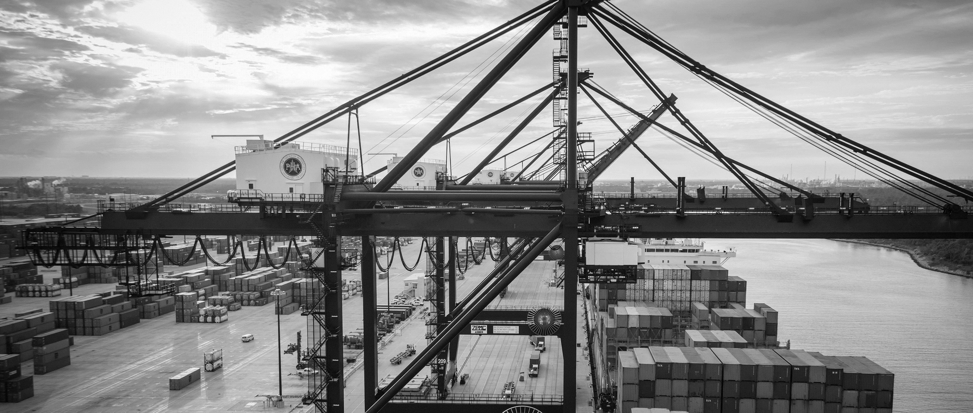
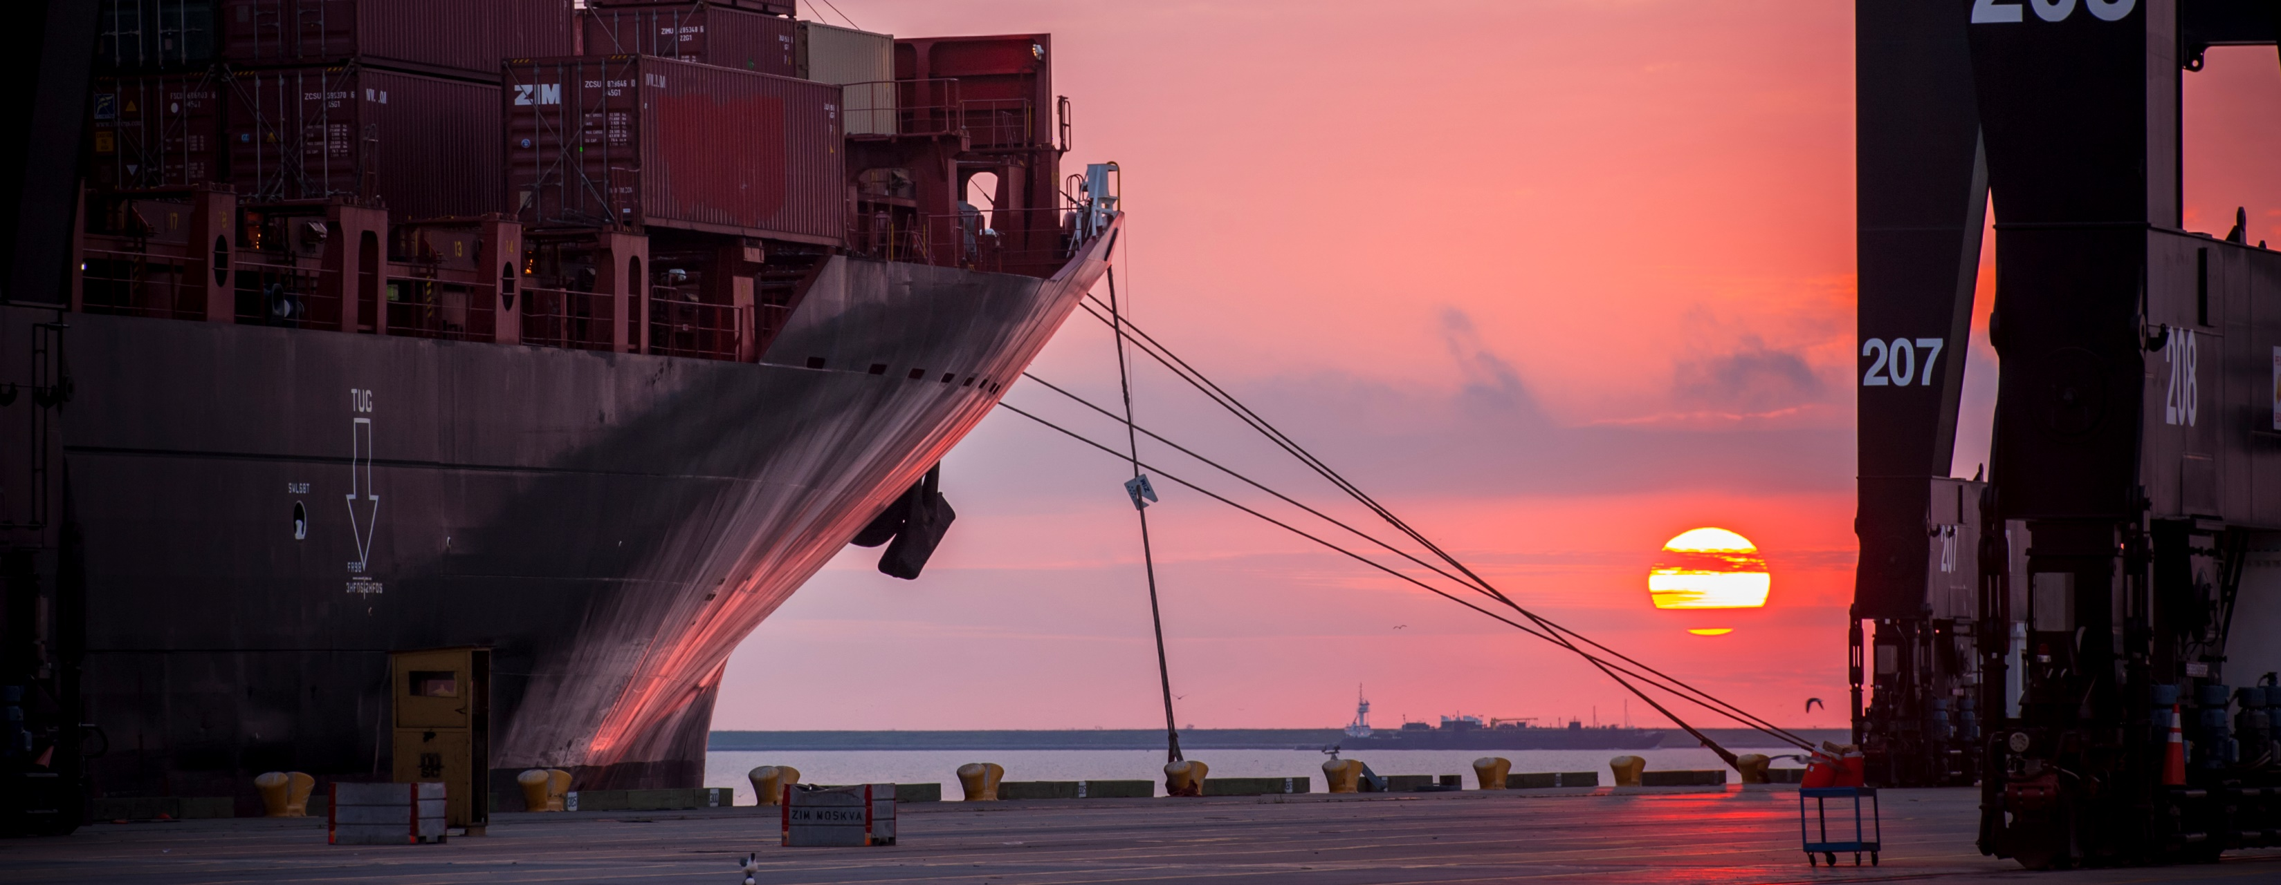
Introductory Meeting for RFQ-1662 Design of Trenchless Tunneling at Turning Basin Terminal
Jessica Shambra | Project Manager | Project & Construction Management (PCM)

Slide 2
Preliminary Meeting House Rules
Attendees will begin the meeting in listen-only mode.
There will be a Q&A session at the end of today’s presentation.
If you have any questions during the presentation, you may submit your Questions through the WebEx chat feature and they will be addressed at the end of the presentation.
This session is being recorded and will be sent out to all registered attendees.

Slide 3
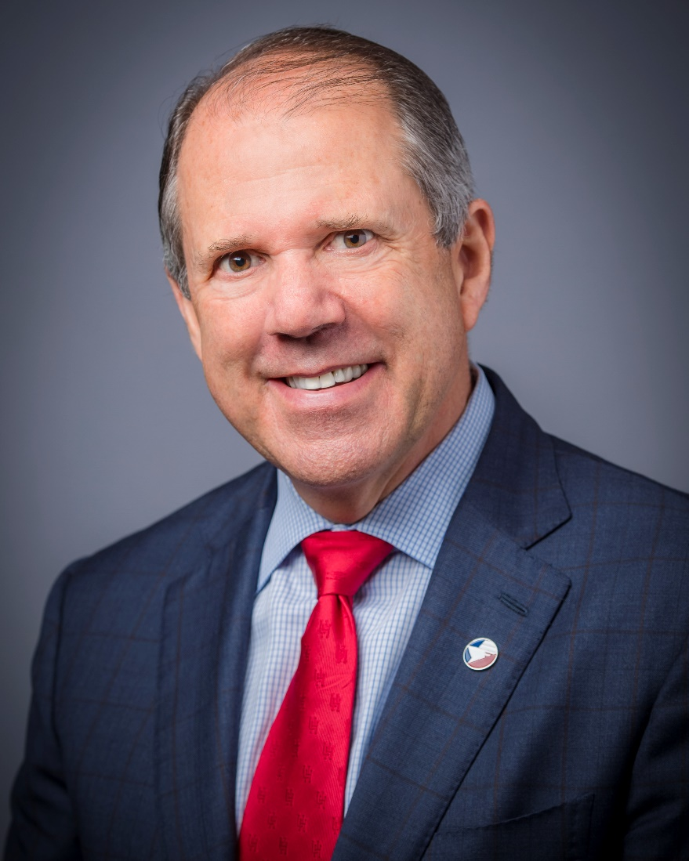
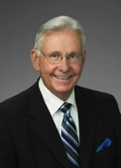
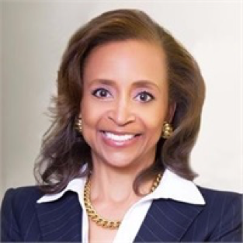
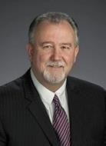
Port Commission
Dean E. Corgey
Clyde Fitzgerald
Cheryl D. Creuzot
Rick Campos
Chairman
Stephen H. DonCarlos
Roy D. Mease
Wendy Montoya
Cloonan
WELCOME MESSAGE | 2

Slide 4
RFQ-1662 Design of Trenchless Tunneling at Turning Basin Terminal
AGENDA
Introductions
Procurement
Project Scope Review
Questions

Slide 5
RFQ-1662 Design of Trenchless Tunneling at Turning Basin Terminal
Procurement:
No Contact Period-no communication between interested vendors and PHA staff upon the release of the solicitation
Technical questions should be submitted via BuySpeed
Proposal submittal questions should be submitted to: procurement@porthouston.com
Do not be late! Responses are due no later than 11 a.m. on the date specified!

Slide 6
RFQ-1662 Design of Trenchless Tunneling at Turning Basin Terminal
Procurement Continued:
Proposers submit their proposals electronically via email to:
Procurementproposals@porthouston.com
Proposals Due-December 2, 2020
Anticipated Award Date-January 26, 2020

Slide 7
RFQ-1662 Design of Trenchless Tunneling at Turning Basin Terminal
Evaluation Criteria:

Slide 8
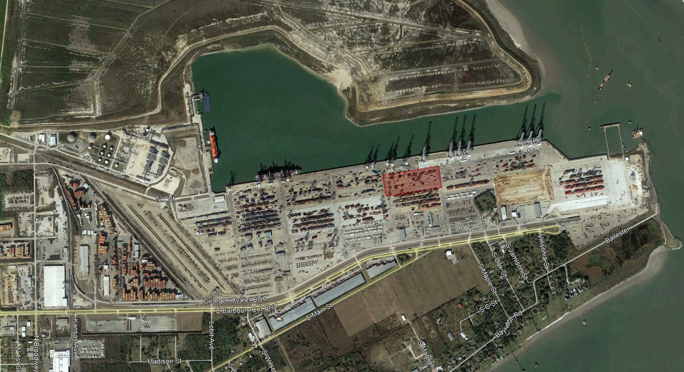
Rehabilitation of Container Yard 3 at Barbours Cut Terminal
Project Location
Container Yard 3
Barbours Cut Blvd

Slide 9
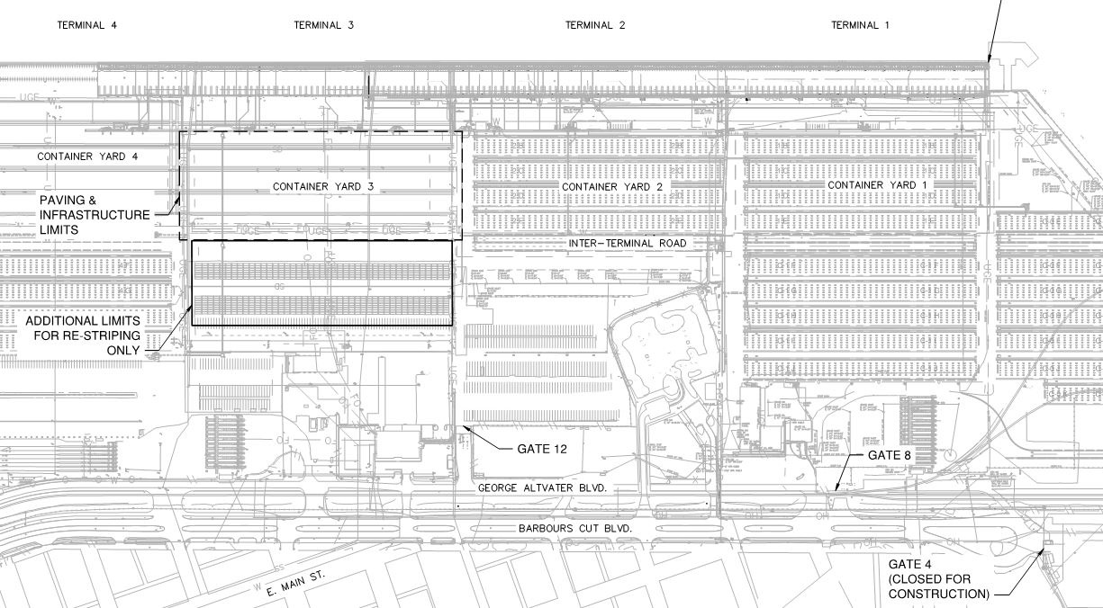
Rehabilitation of Container Yard 3 at Barbours Cut Terminal
Project Limits

Slide 10
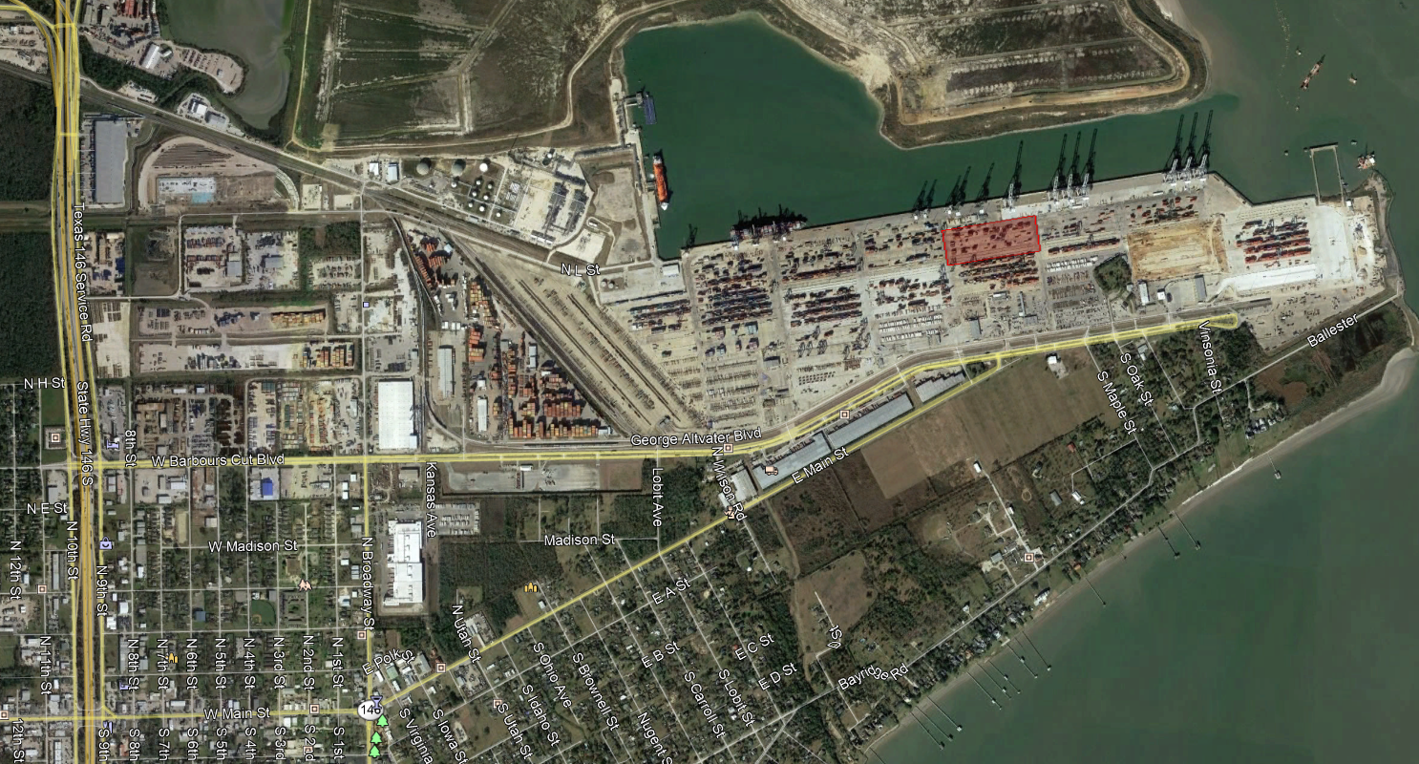
Rehabilitation of Container Yard 3 at Barbours Cut Terminal
Site Access
Contractor to Lease space outside Terminal for Laydown Yard & Batch Plant

Slide 11
Major Project Components
Rehabilitation of Container Yard 3 at Barbours Cut Terminal
Demo and Reconstruct Container Yard 3 – 10 acres
Install trench drains, junction boxes and small diameter RCP lines
Install 8” & 12” water lines
Install 2” sanitary sewer force main
Install 3 high mast lights
Install 48 RTG tie-downs for rubber tire gantry cranes
Install electrical ductbanks from Container Yard 2 to 4
Install communications ductbanks from Container Yard 2 to 4
Install 18” jointed reinforced (JRC) pavement
Install 18” roller compacted concrete (RCC) pavement

Slide 12
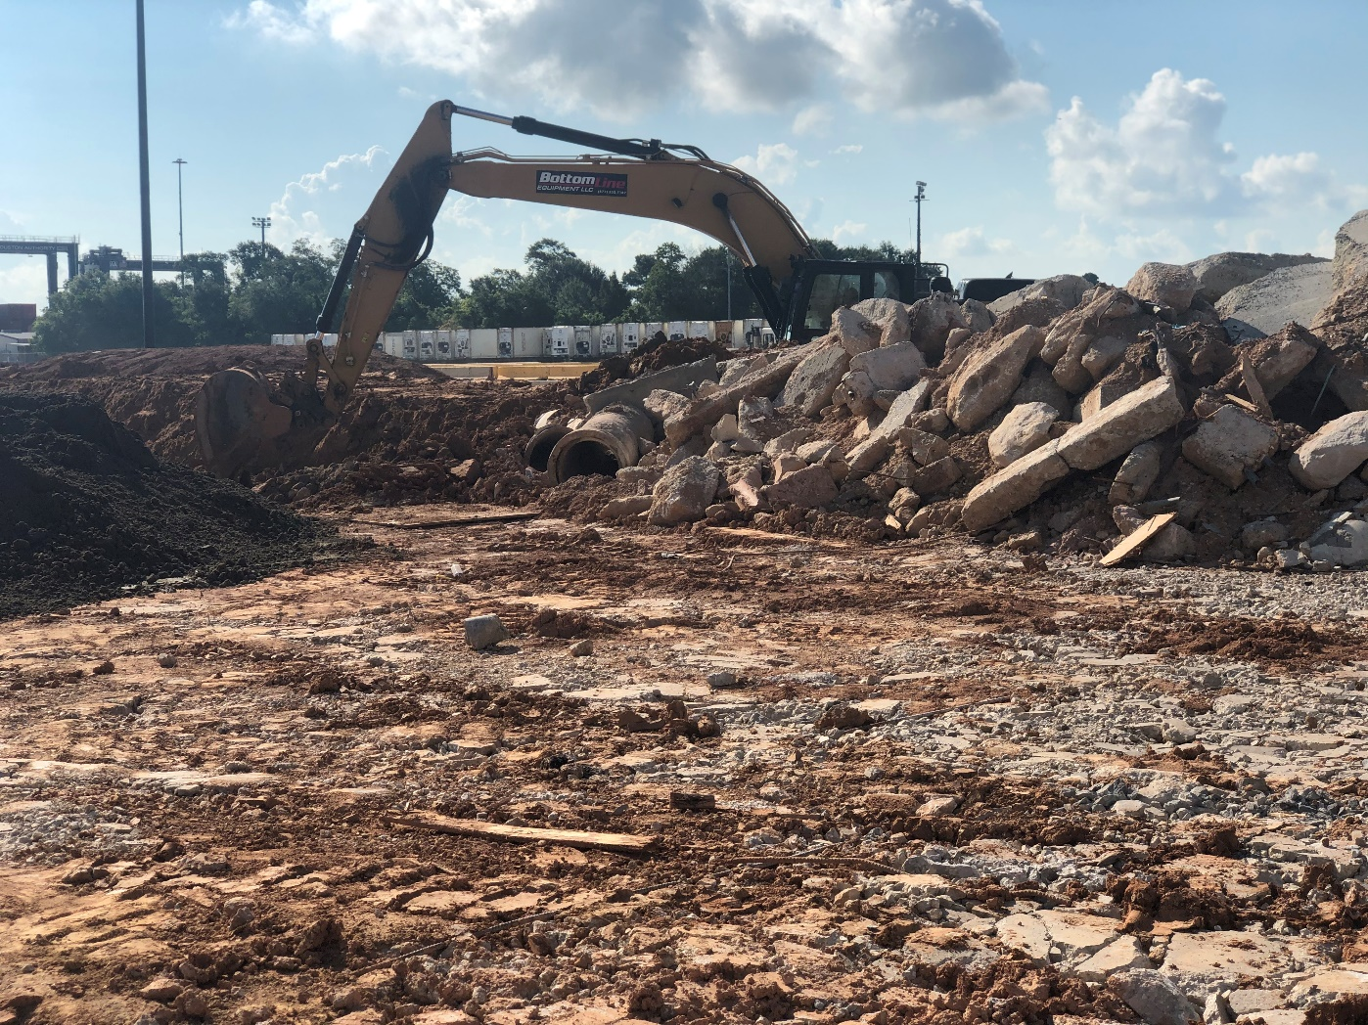
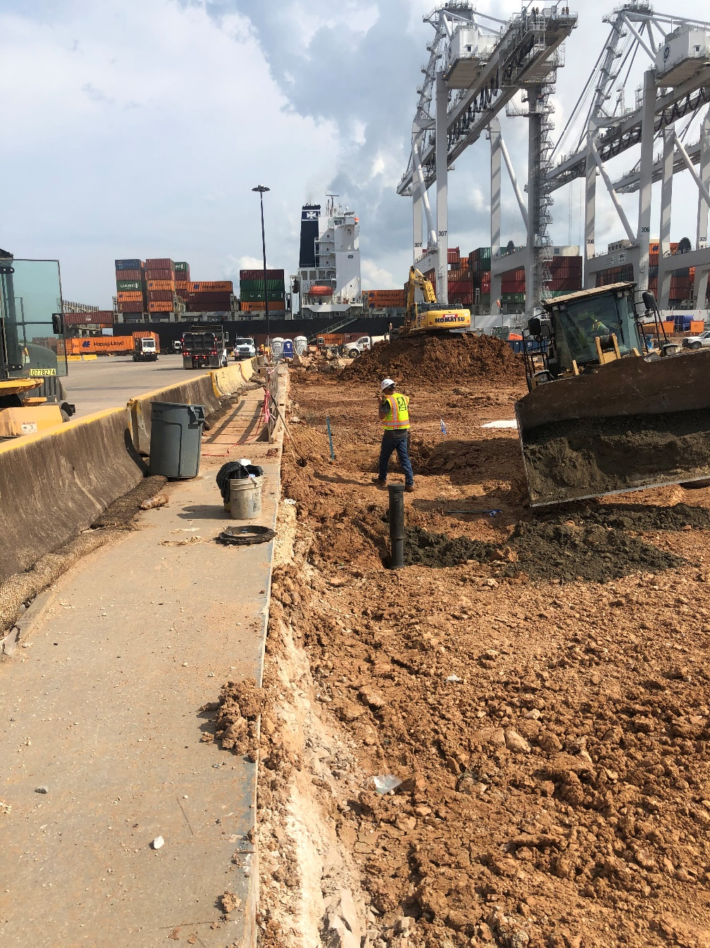
Rehabilitation of Container Yard 3 at Barbours Cut Terminal
Major Elements
Demo Pavement
47,000 SY Concrete Pvmt
850 SY Asphalt Pvmt
Demo 980 LF of Trench Drain
Remove existing utilities
8” & 12” Water
2” Sanitary Sewer Force Main
Underground electric and fiber
Cut below subgrade
24 RTG Tie-Down Anchors
4 HMP Foundations

Slide 13
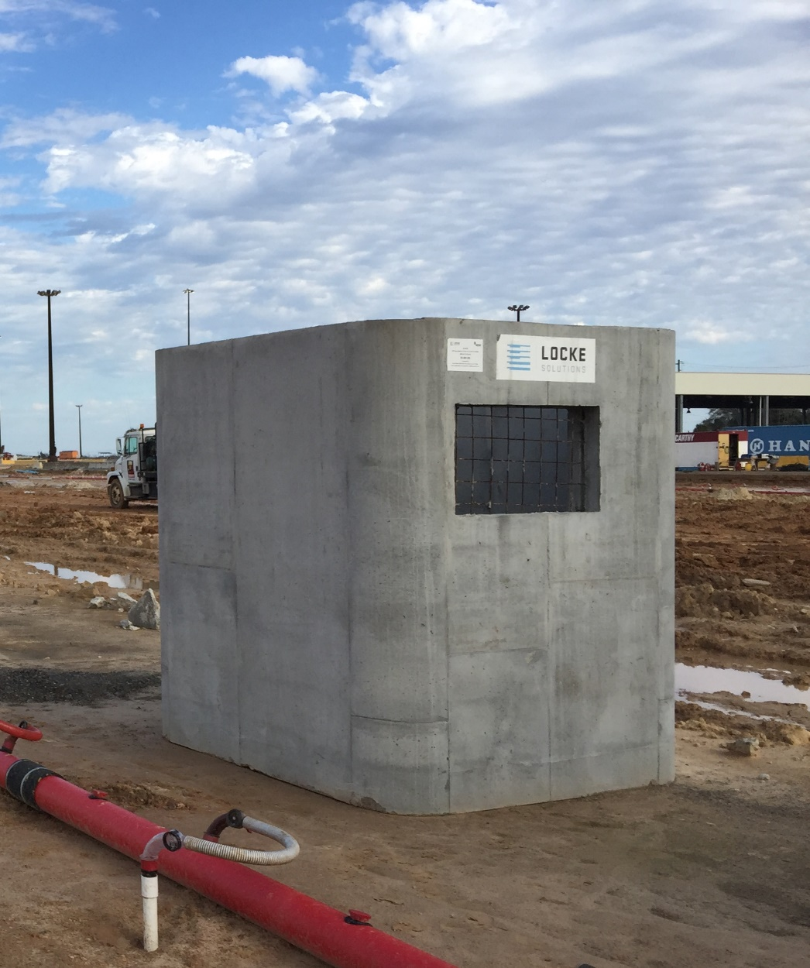
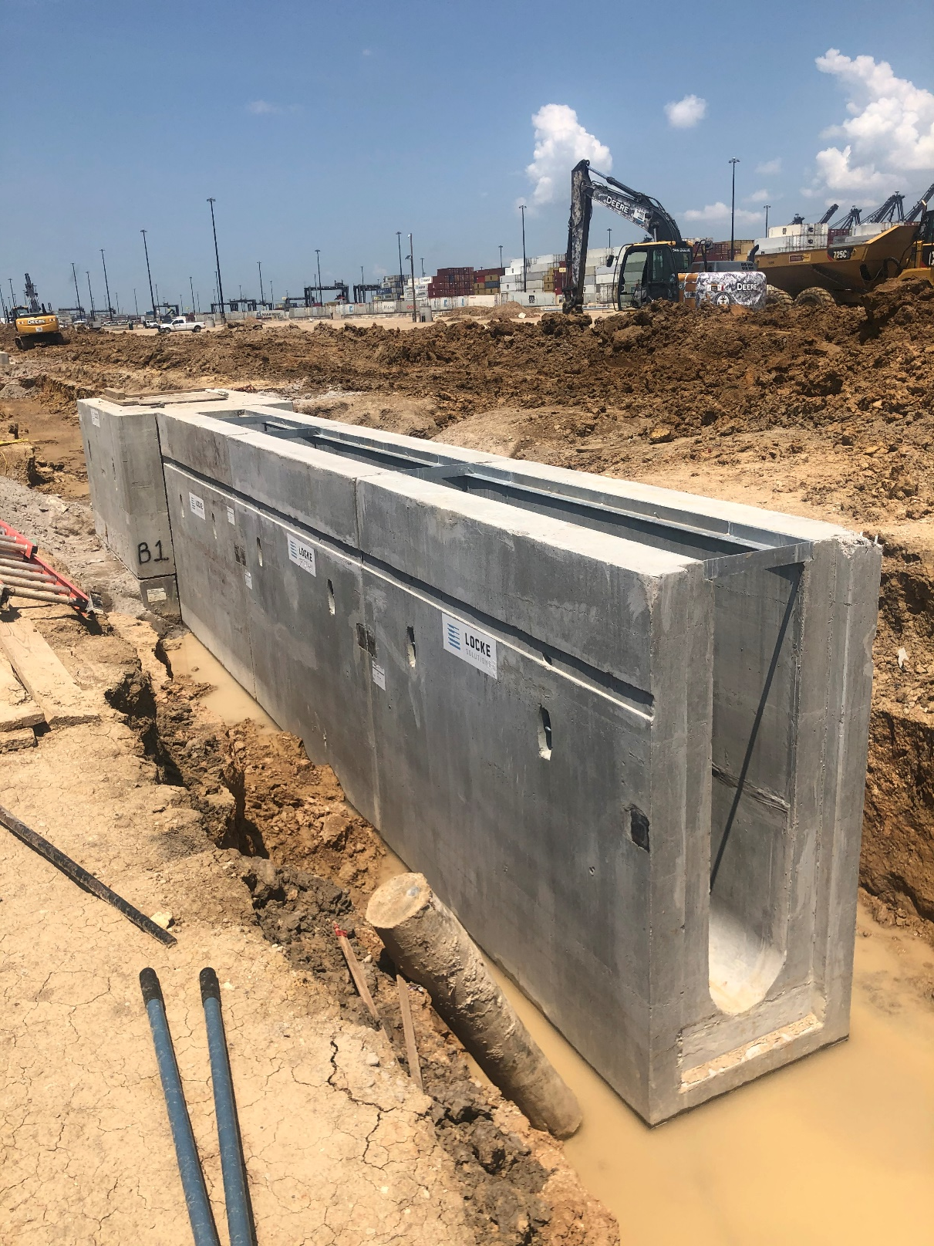
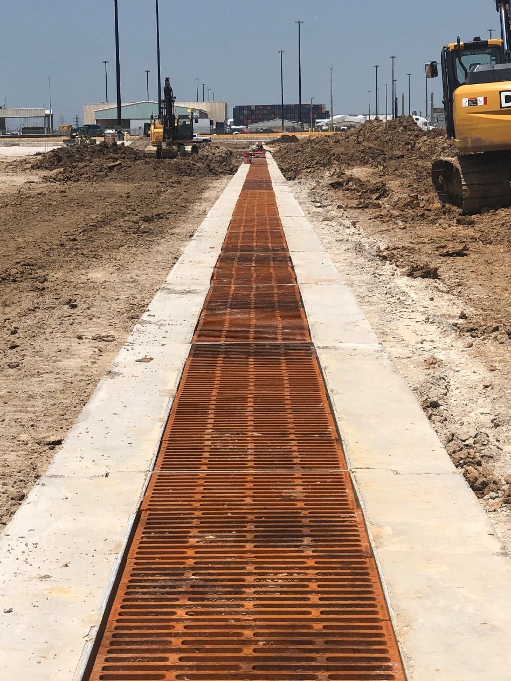
Rehabilitation of Container Yard 3 at Barbours Cut Terminal
Major Elements
Junction Boxes & Trench Drains

Slide 14
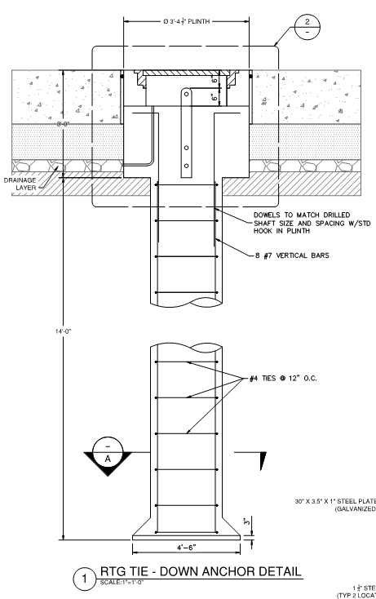
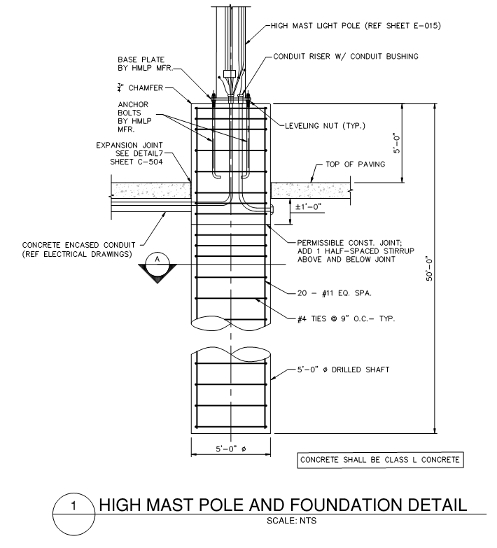
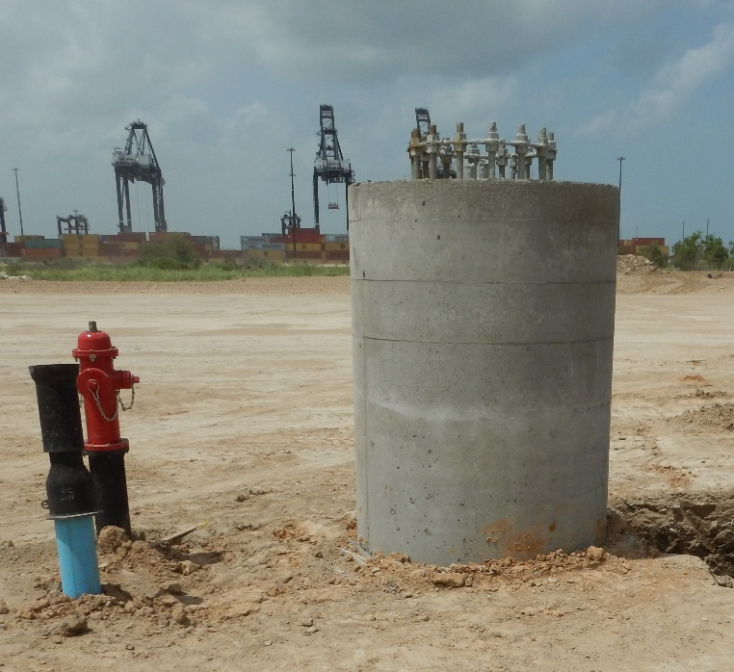
Rehabilitation of Container Yard 3 at Barbours Cut Terminal
Major Elements
RTG Tie-Down Anchor
High Mast Pole Foundation

Slide 15
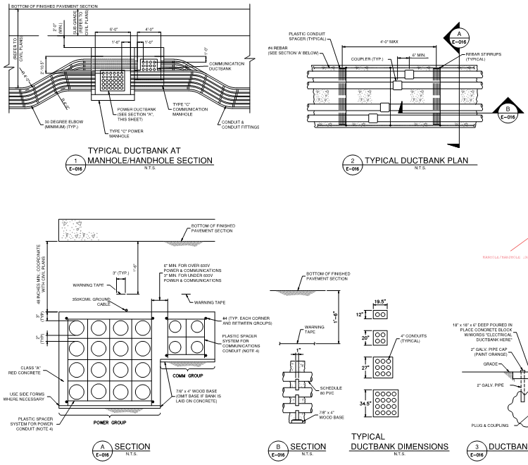
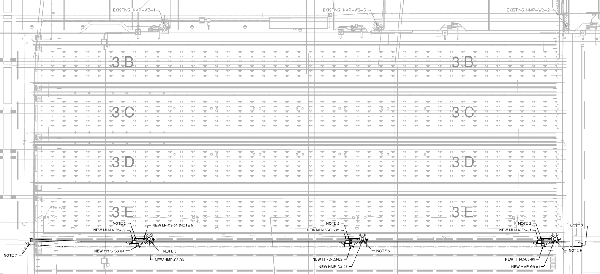
Rehabilitation of Container Yard 3 at Barbours Cut Terminal
Major Elements
Electric and Communications Ductbank

Slide 16
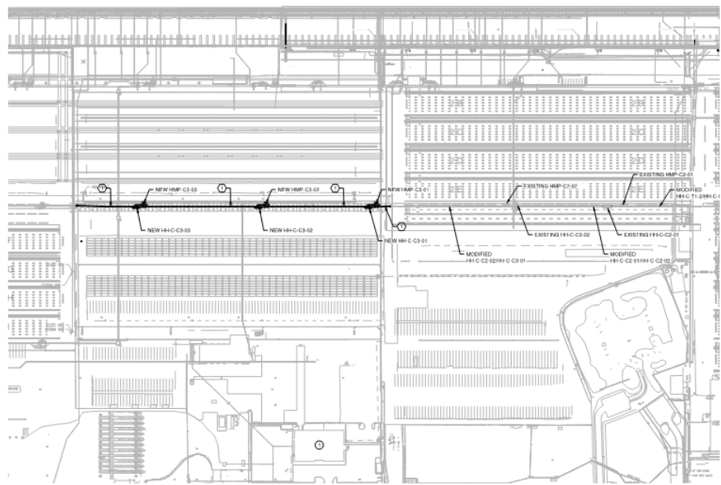
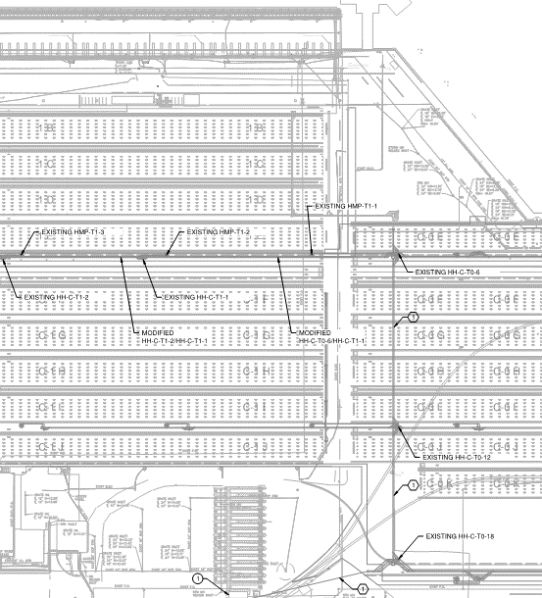
Rehabilitation of Container Yard 3 at Barbours Cut Terminal
Major Elements
Fiber Routing Plan
Container Yard 3
Secondary Lane Boss Bldg

Slide 17
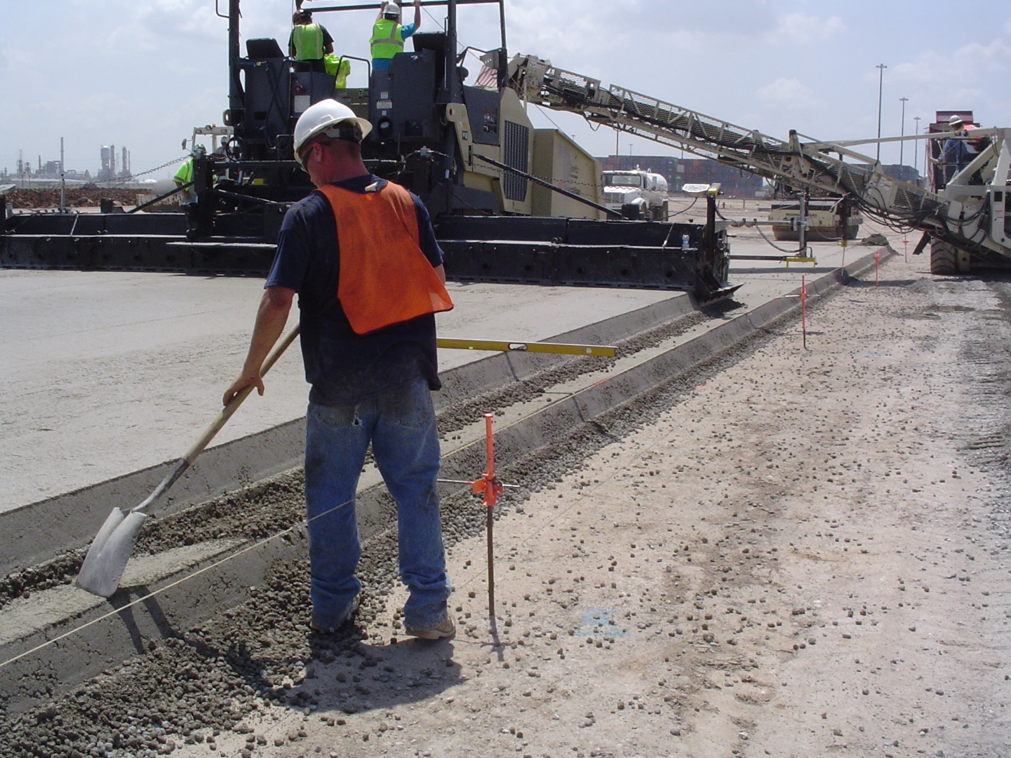
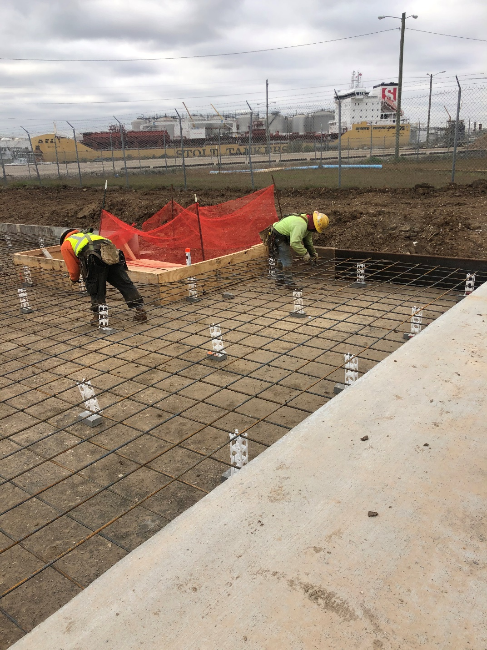
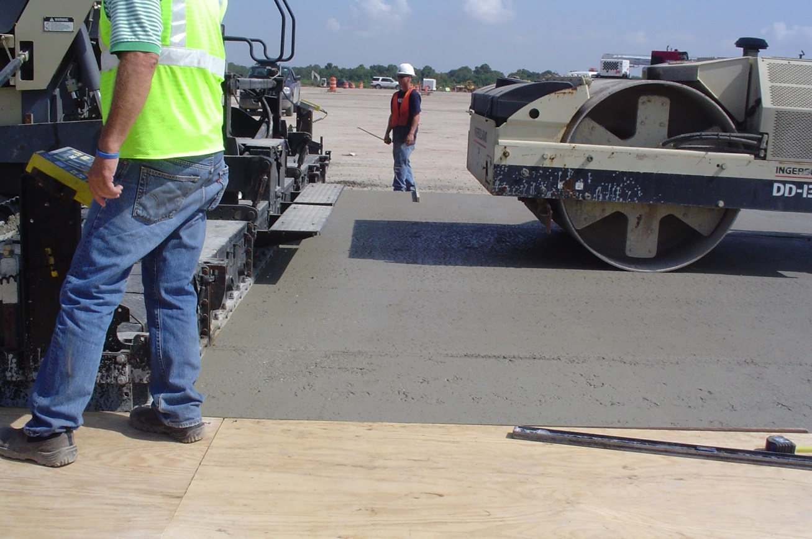
Rehabilitation of Container Yard 3 at Barbours Cut Terminal
Major Elements
Roller Compacted Concrete (RCC) Paving
Jointed Reinforced Concrete (JRC) Paving

Slide 18
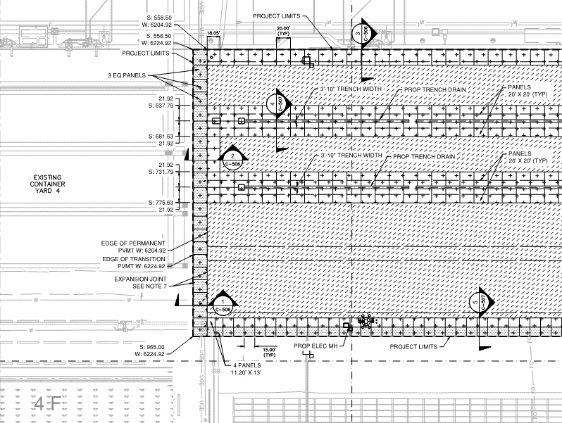
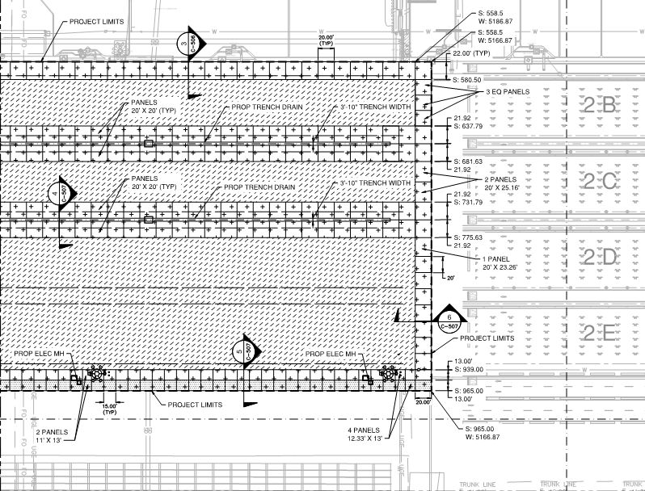
Rehabilitation of Container Yard 3 at Barbours Cut Terminal
Major Elements
Pavement
16,300 SY JRC
30,700 SY RCC

Slide 19
Questions & Answers
$$?$$
Port Houston
Small Business Program
Phone: 713-670-2400
smallbusiness@porthouston.com
Port Houston
Procurement Services
Phone: 713-670-2464
procurement@porthouston.com
Slide 13

Slide 20
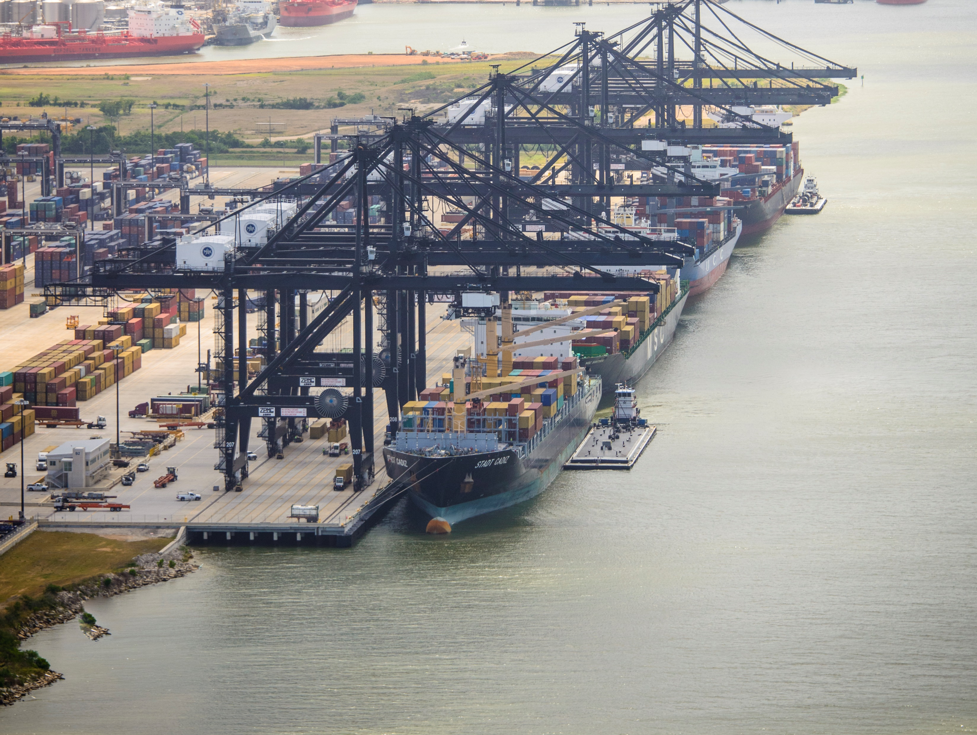
THANK YOU
Derek Garrett
Project Manager
Port Houston
www.PortHouston.com
111 East Loop North
Houston, TX 77029

