Slide 1
Container Freight Station, Utilities and Drainage at Bayport Container Terminal
(RFQ-148)
Brenda Trevino, P.E.
Project Manager
October 11, 2016

Slide 2
Container Freight Station, Utilities and Drainage at Bayport Container Terminal
Agenda
Introductions
Procurement Services
Selection Process
Submittal Requirements
Selection Criteria
Tentative Procurement Schedule
Scope of Services
Questions

Slide 3
Container Freight Station, Utilities and Drainage at Bayport Container Terminal
PHA Personnel:
Jeff Davis – Chief of Operations
Roger H. Hoh, P.E. – Director, Project & Construction Management
Brenda Trevino, P.E. – Project Manager
Yvette Camel-Smith – Director of Procurement Services
Pedro Gonzalez – Small Business

Slide 4
Container Freight Station, Utilities and Drainage at Bayport Container Terminal
Format and Delivery Requirements
RFQ Due Date: October 19, 2016 Before 11:00 A.M.
Late Submittals Will Not Be Evaluated
Eight (8) Hard Copies & 1 Electronic Copy

Slide 5
SELECTION PROCESS
1st
Internal preliminary rank and evaluate meeting, short listing firms/teams
2nd
Short listed firms/teams may personally present their qualifications to PHA
3rd
PHA will select most highly qualified firm/team from short list based on demonstration competence and qualifications (Commission Award)

Slide 6
SUBMITTAL REQUIREMENTS
Format & Delivery
Example: Completeness of requested information; organization and ease of identifying content
Corporate Expectation of Respondent
Example: Proof of licensing and registration; required ownership information; list of similar projects completed by firm within the last 5 years
Experience of Staff
Example: Qualified individuals with backgrounds in similar projects; identification of current workload; Texas PE Project Manager
A
B
C

Slide 7
SUBMITTAL REQUIREMENTS(Cont’d)
Project Team Organization
Example: Project organization chart; firm/team functions and responsibilities
Performance Plan
Example: Details of the methods of accomplish project requirements
Other Benefits
Example: Unique or special processes; special staff qualifications or capabilities; special technical utilization
D
E
F

Slide 8
SELECTION CRITERIA
CRITERIA
RESPONDENT’S REPUTATIONS AND QUALITY OF SERVICES
PERSONNEL QUALIFICATIONS AND EXPERIENCE
PERFORMANCE PLAN AND
OTHER BENEFITS
OVERALL COMPLIANCE WITH PORT AUTHORITY POLICIES
TOTAL
RELATIVE WEIGHT
25%
40%
20%
15%
100%

Slide 9
TENTATIVE PROCUREMENT SCHEDULE (SUBJECT TO CHANGE)
October 19, 2016
RFQ Due Date
October 20, 2016 to November 17, 2016
PHA Evaluation Period
December 13, 2016 or January 24, 2017
Port Commission Meeting to Award Contract

Slide 10
Container Freight Station, Utilities and Drainage at Bayport Container Terminal
Background:
The Port of Houston Authority has developed a Master Plan that requires the
development of engineering recommendations into preliminary and final design
drawings, specifications and supporting documents for procurement of
construction to install utilities related to future business opportunities along
Freight Station Road and the Bayport Terminal south of Port Road. Engineering
services will be required to incorporate the recommendations from the Master
Plan, geotechnical, environmental, permitting, rail, communications, safety,
security and operational considerations into the utilities project.
Scope of Services:
Utilize existing Master Plan reports and Special Studies as background to understand the requirements of the project
Perform additional specific topographical and geotechnical investigations to determine the design requirements for the utilities for the PHA properties south of Port Road
Perform a brief alternatives analysis for use of the information provided
Provide a utility installation plan with phasing
Coordinate with the appropriate agencies, where required, to approve the plan and provide a road map for any permitting required
Provide preliminary design documents (30% level), if authorized separately
Prepare construction documents of selected option(s), if authorized separately
Provide construction phase services, if authorized separately

Slide 11
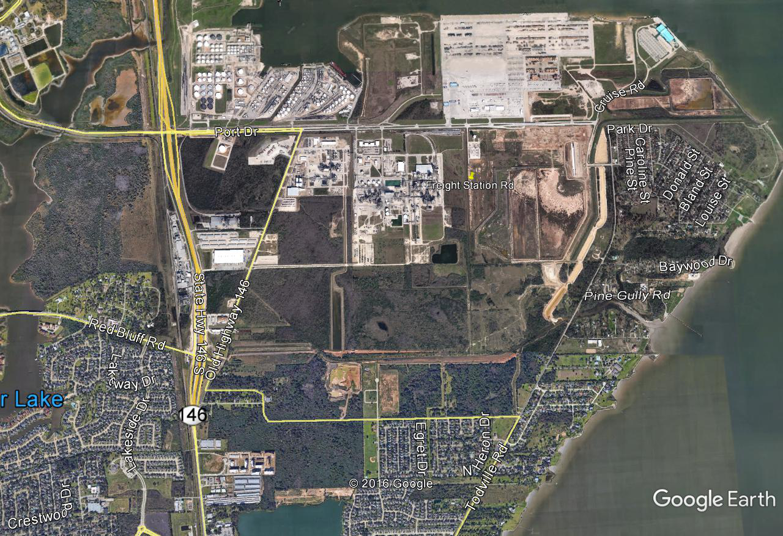
Container Freight Station, Utilities and Drainage at Bayport Container Terminal

Slide 12
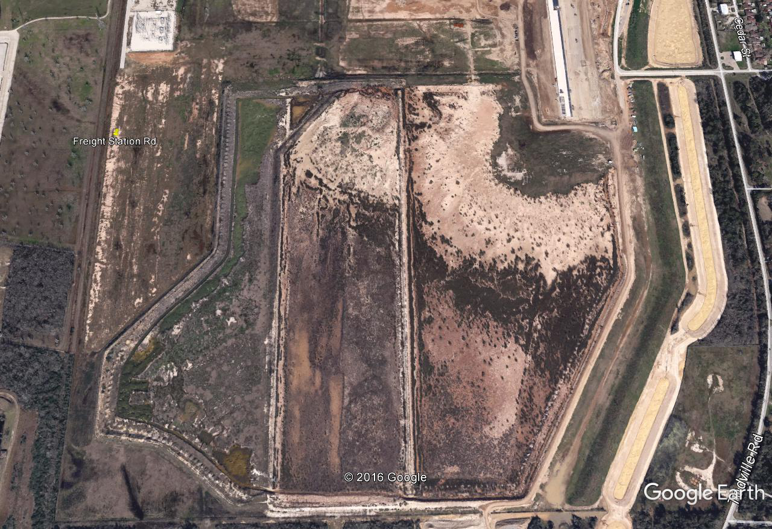
Container Freight Station, Utilities and Drainage at Bayport Container Terminal

Slide 13
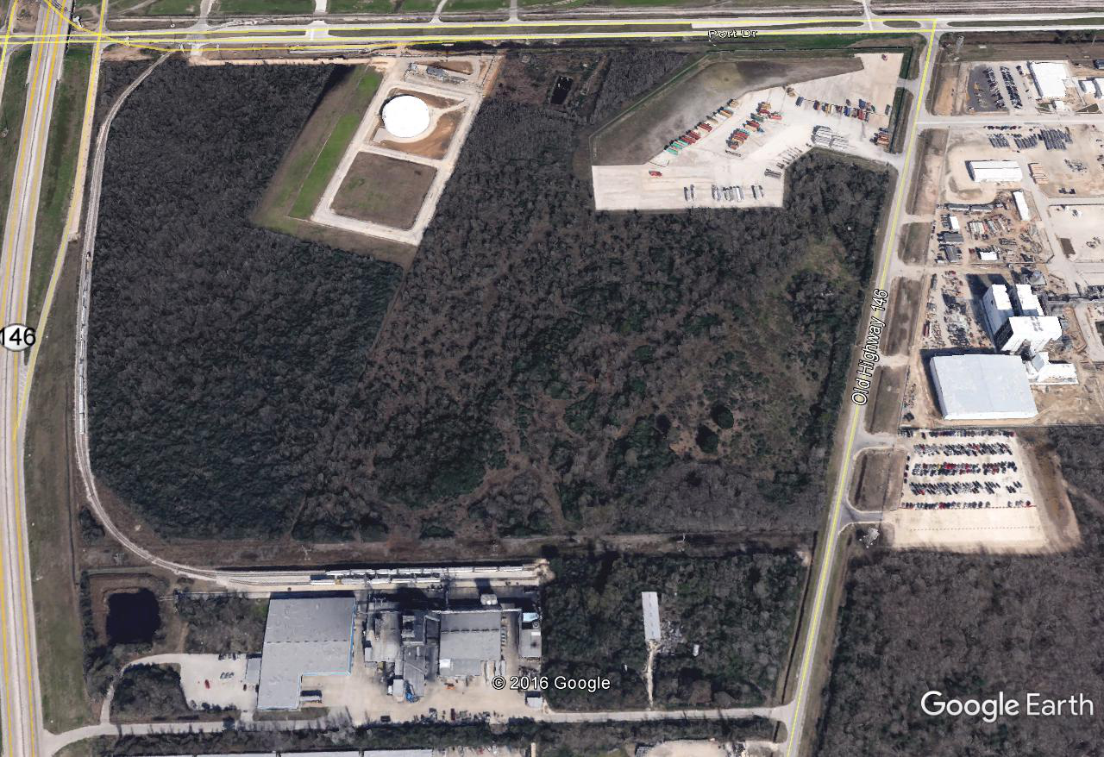
Container Freight Station, Utilities and Drainage at Bayport Container Terminal

Slide 14
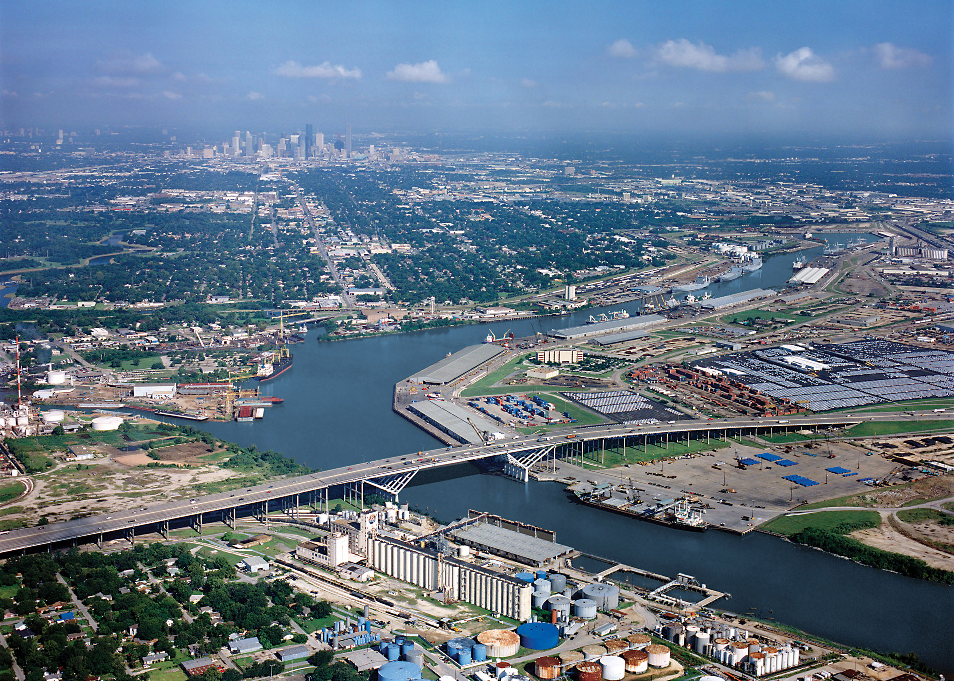
Thank You
&
Questions

