Slide 1

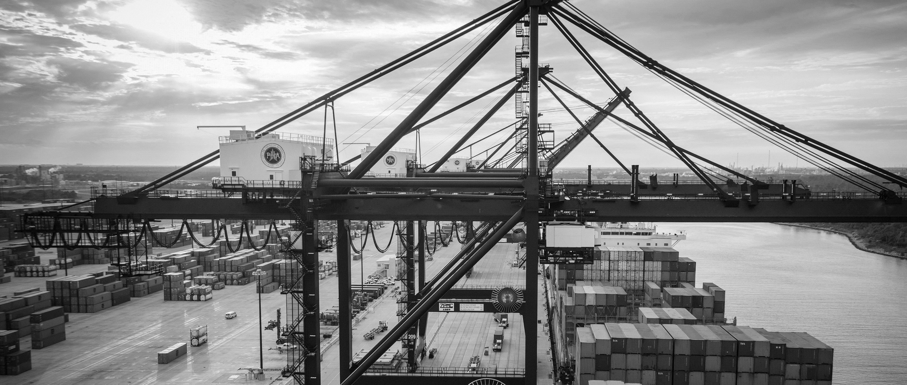

Preliminary Meeting RFQ-1453 In-Depth Structural Assessment and
Repair Design Of Wharves 20, 21, 24, 25, & 26 At TBT
Eddy Kharrazi, P.E. | Project Manager | Project & Construction Management (PCM)

Slide 2
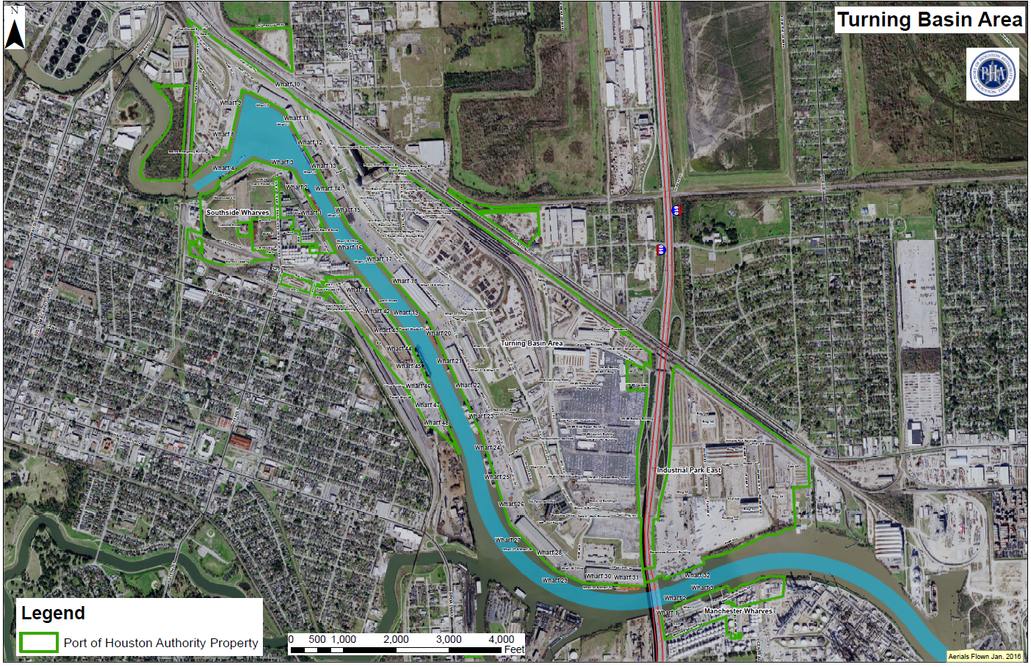
Preliminary Meeting RFQ-1453 In-Depth Structural Assessment and
Repair Design Of Wharves 20, 21, 24, 25, & 26 At TBT
You Are Here

Slide 10
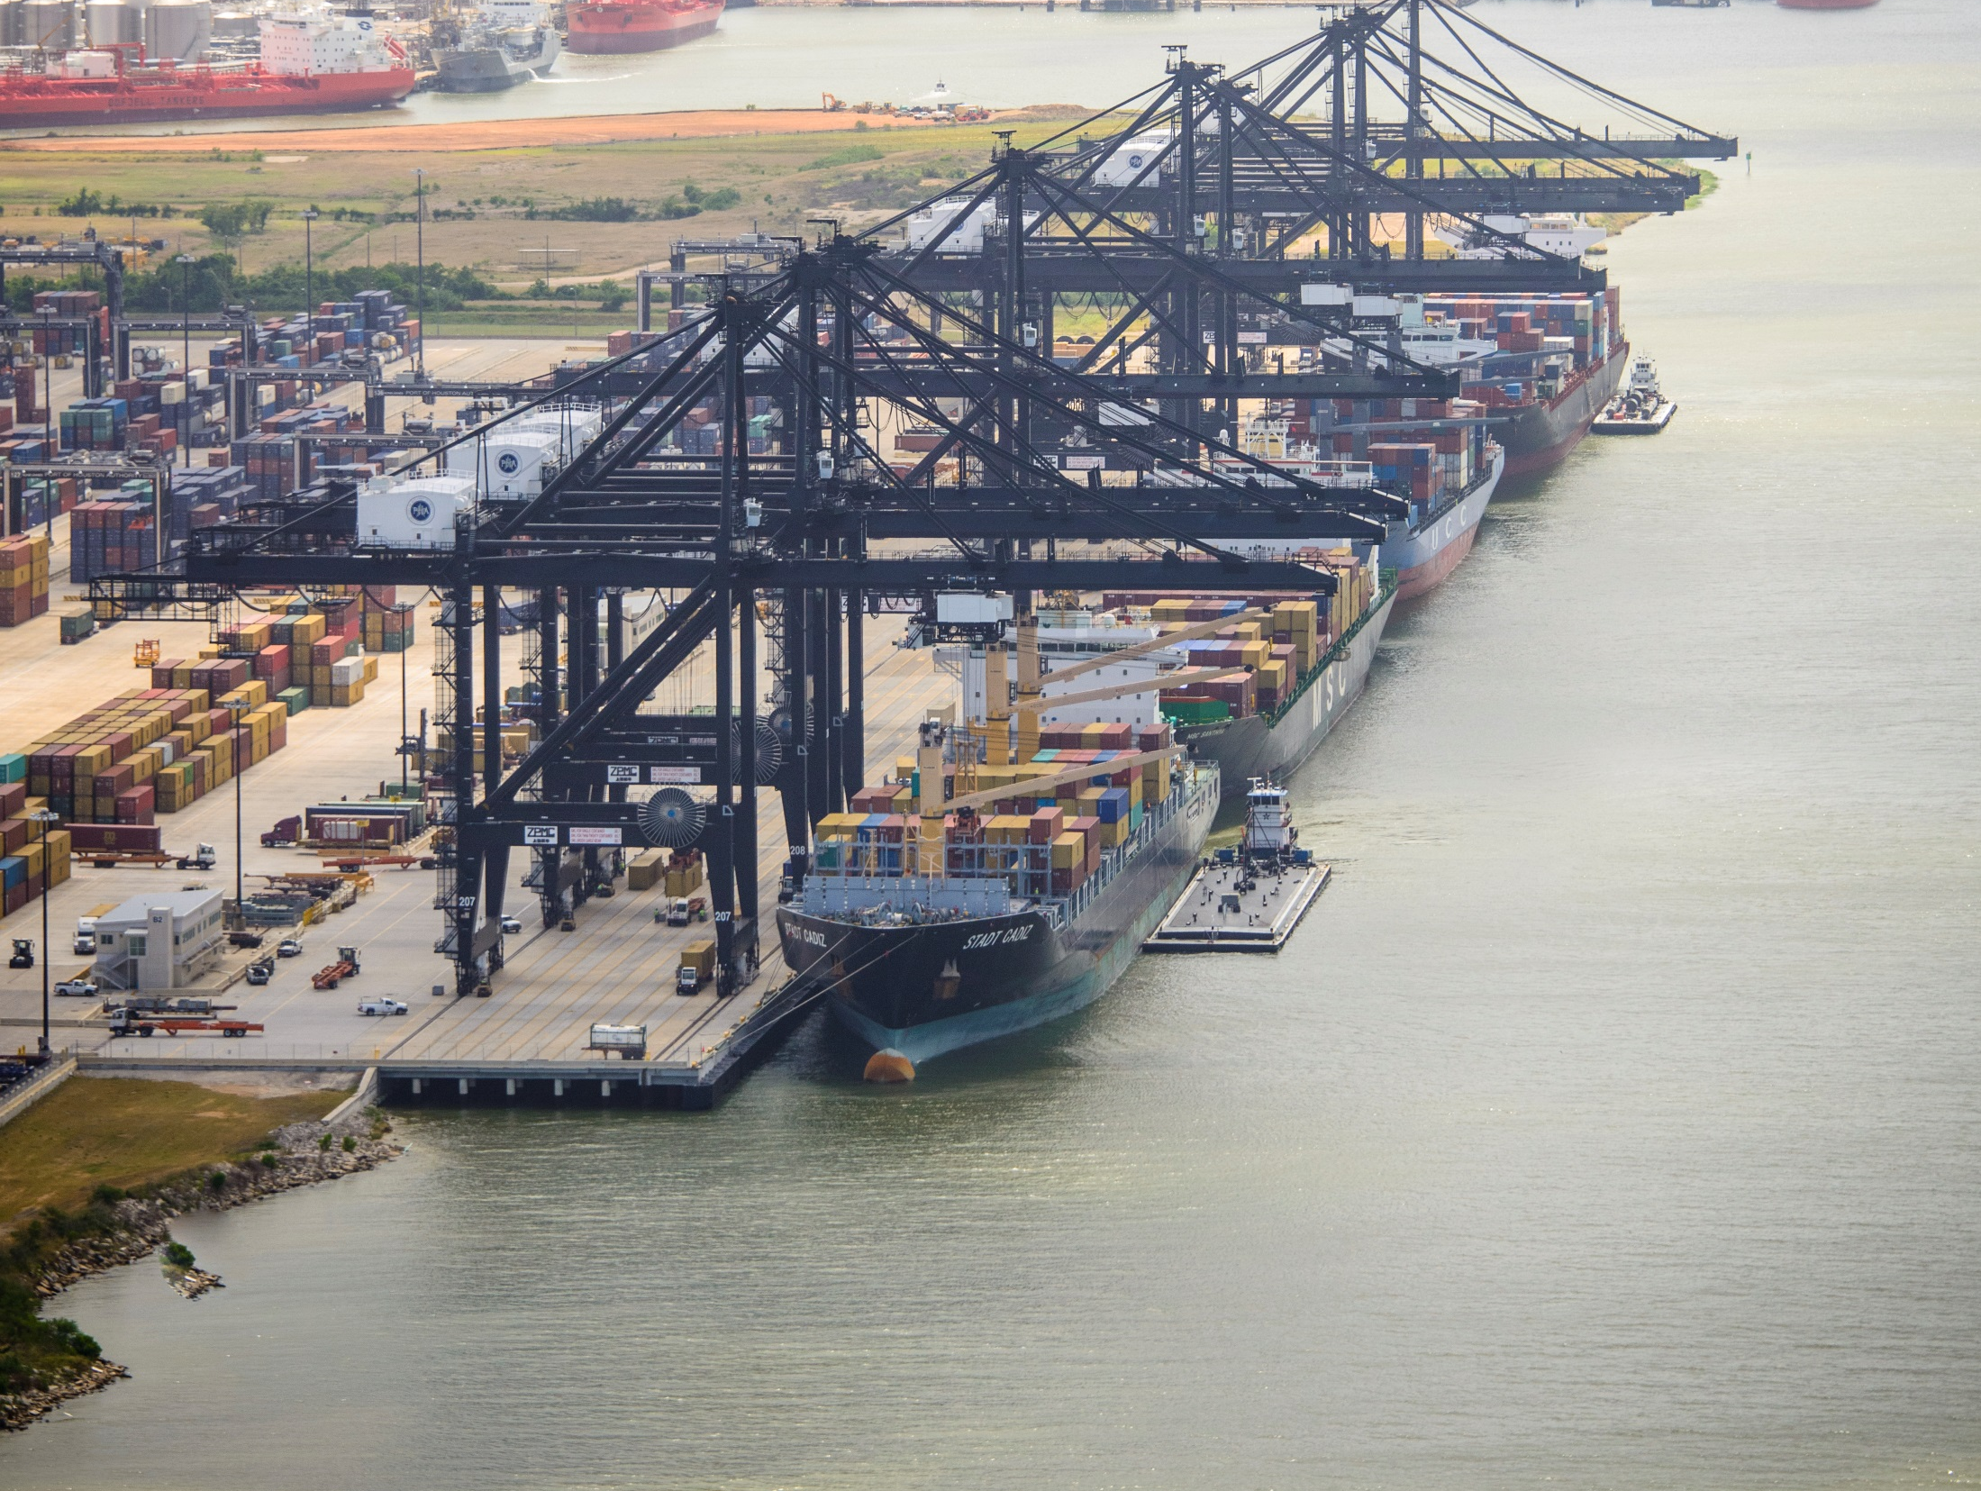

THANK YOU
Eddy Kharrazi, P.E.
Project Manager
Port Houston
Questions?
www.PortHouston.com
111 East Loop North
Houston, TX 77029

