Slide 1
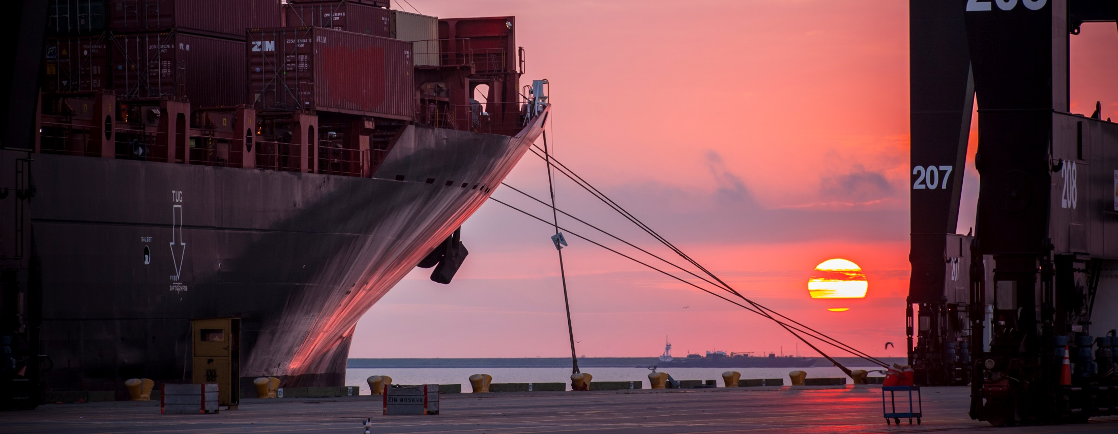
Preliminary Meeting RFQ-1410
Professional Engineering Services for the Design for Repair of Bridge at Spilman Island
Eddy Kharrazi, P.E. | Project Manager | Project & Construction Management (PCM)

Slide 2
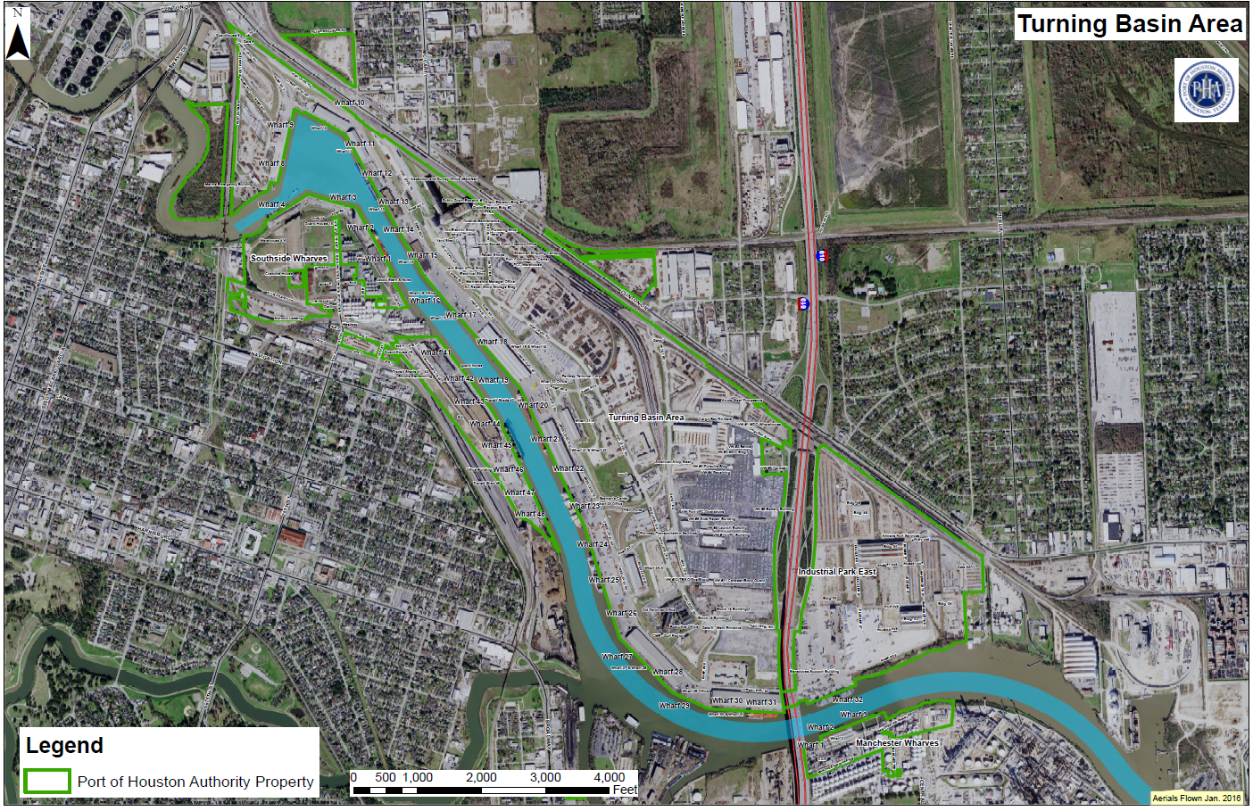
Preliminary Meeting RFQ-1410 Professional Engineering Services for the Design for Repair of Bridge at Spilman Island
You Are Here

Slide 3
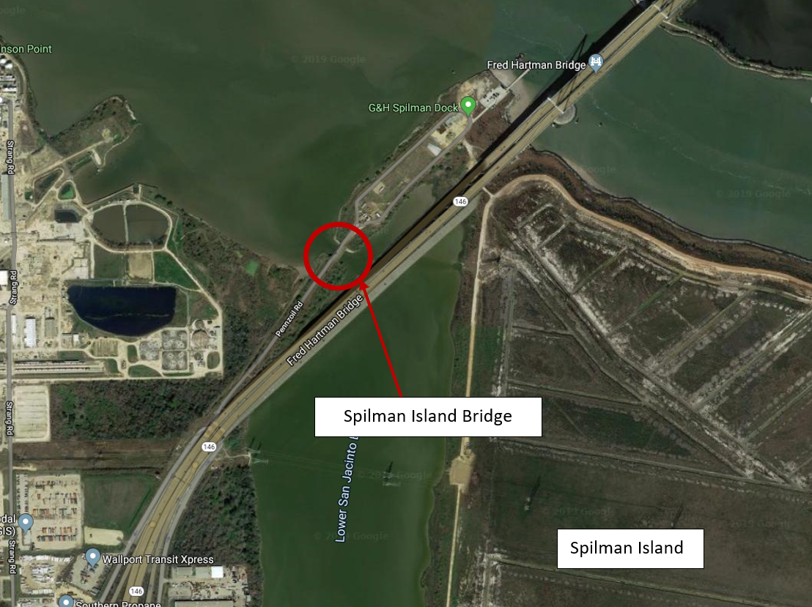
Preliminary Meeting RFQ-1410 Professional Engineering Services for the Design for Repair of Bridge at Spilman Island

Slide 4
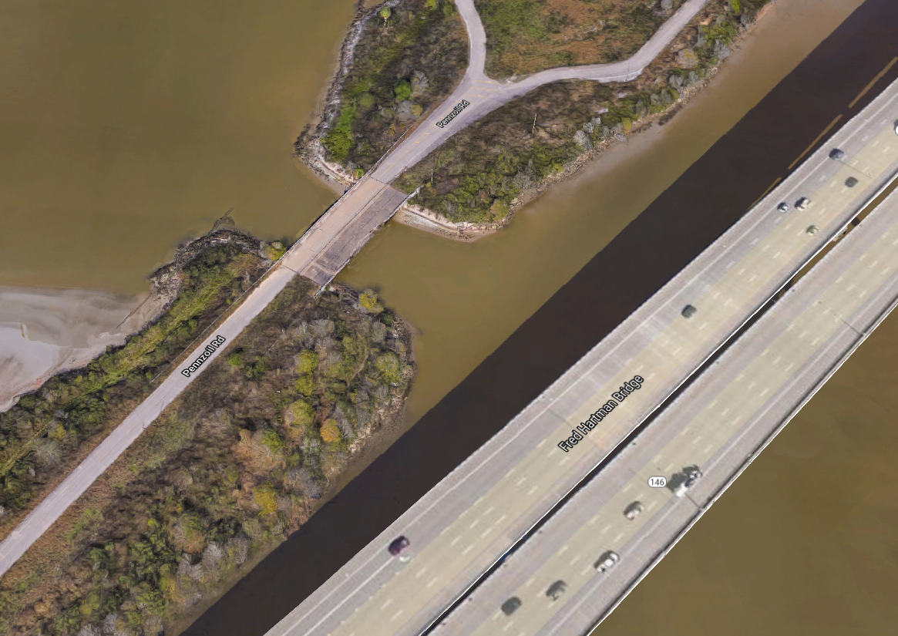

Slide 5
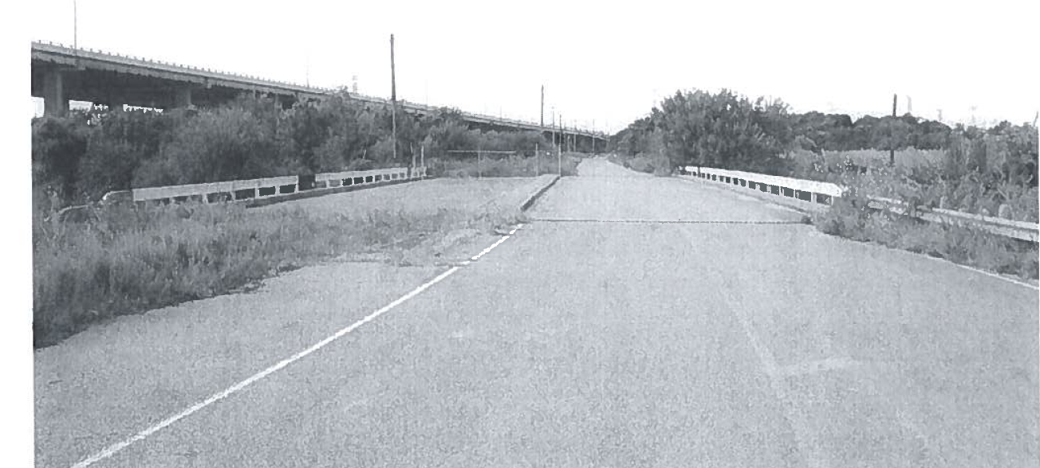

Slide 6
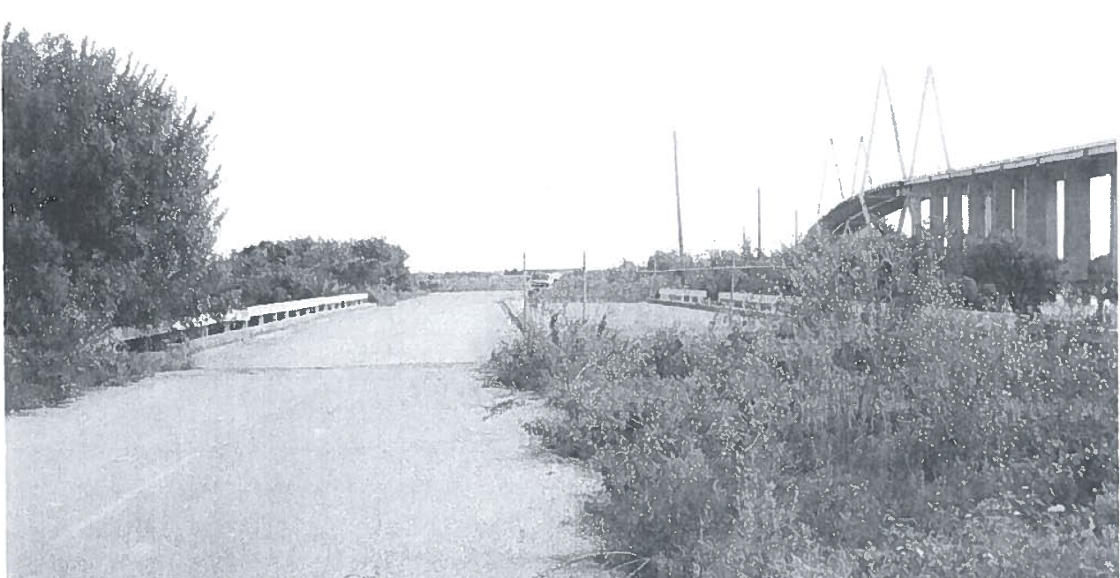

Slide 7
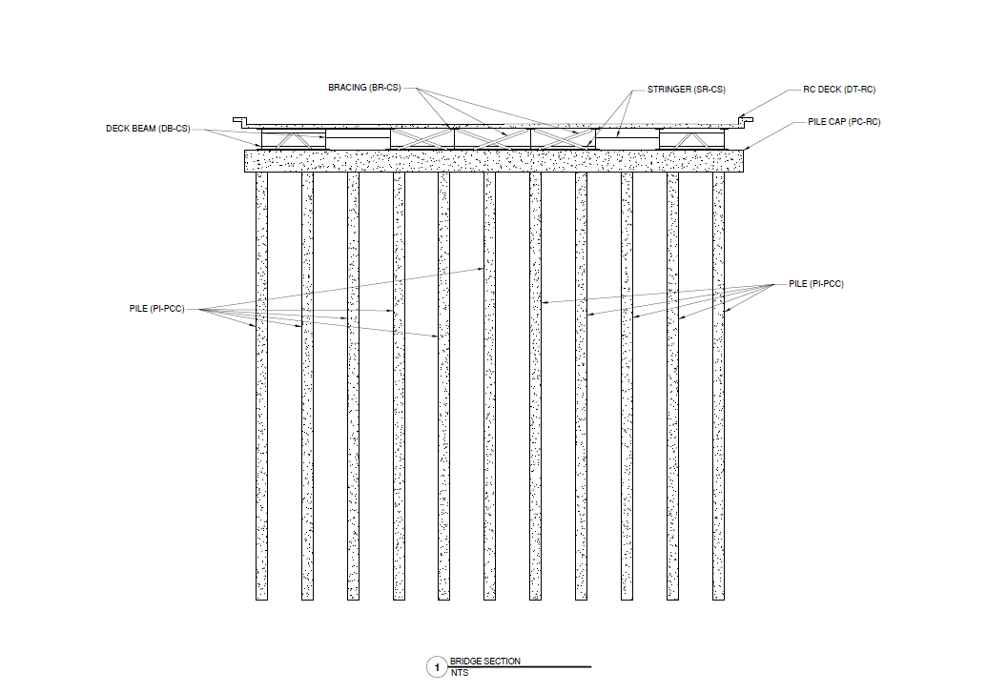

Slide 8
Sample Repair

Slide 9
Sample Repair

Slide 10
Sample Repair

Slide 11
Sample Repair

Slide 12
Sample Repair

Slide 13
Sample Repair

Slide 14
THANK YOU
Eddy Kharrazi, P.E.
Project Manager
Port Houston
Questions?
www.PortHouston.com
111 East Loop North
Houston, TX 77029

