Slide 1
RFQ-1383 Professional Engineering and Auditing Services on an As-Needed Basis to Support the Houston Ship Channel Deepening and Widening Project
Channel Improvement | Infrastructure
January 21, 2020

Slide 2
Introduction
PHA is accelerating the HSC project to allow for an accelerated implementation (by January 2021) of the feasibility study for construction before the anticipated USACE start in 2024.
RFQ Scope of Work:
Supplement Port Houston staff with a strong USACE (regulatory, design, construction) background and experience level.
Detailed third-party design review, in accord with all applicable USACE guidance documentation and regulations.
Proactive guidance and strategic advice.
Project control oversight, third-party review, and strategic advice on schedule, financial, and deliverables.
Provide external (and licensed) auditing of Port Houston’s HSC files.

Slide 3
PHA Accelerated Schedule
OCT ‘19
JAN ‘20
APR
JUL
OCT
2021
FEDERAL & USACE
Agency Technical Review
(To Nov 11)
Feasibility Report Complete
(Dec 11)
HQ Reviews
Policy Review 6 Weeks
State & Agencies Review 60 Days
(Dec to April 2020)
Chief’s Report Signed by Apr 29
Congressional Authorizations WRDA Fall 2019
New-Start Appropriation TBD
WRDA Preparations
PORT & USACE
Work in Kind
Agreement
Design Review
Agreement
Advance Construction
Agreement
Project Partnership Agreements
Design Work
PHA-Led, USACE Reviews
Procurement Prep
Construction Contracts
PORT &
PORT-INDUSTRY
Approve Advanced Design Work $28 MM*
September – Geotech & Surveys: $5.5 MM
November – Technical Designs: $22 MM
Funding Models Development – Ongoing
Funding Agreements
Federal Advocacy -- Ongoing

Slide 4
HSC Design Submittal Schedule
Table 1. Design Team Submittal and Review Schedule
PHA Accelerated Schedule
Date | Milestone
11/13/2019 | Contract Award
11/20/2019 | Project Kickoff
12/11/2019 | Feasibility Report Submitted to HQ
1/13/2020 | Feasibility Report Submitted for State & Agency Review
2/26/2020 | 35% Design - JV
3/13/2020 | 35% Design – HDR
4/29/2020 | Chief Signs Chief of Engineers Report
4/29/2020 | 65% Design – JV
5/13/2020 | ASA Signs Record of Decision
5/15/2020 | 65% Design – HDR
7/8/2020 | 95% Design – JV
7/24/2020 | 95% Design – HDR
9/10/2020 | 100% Design (Interim) – JV
11/3/2020 | 100% Design – JV
9/28/2020 | 100% Design (Interim) – HDR
11/20/2020 | 100% Design – HDR

Slide 5
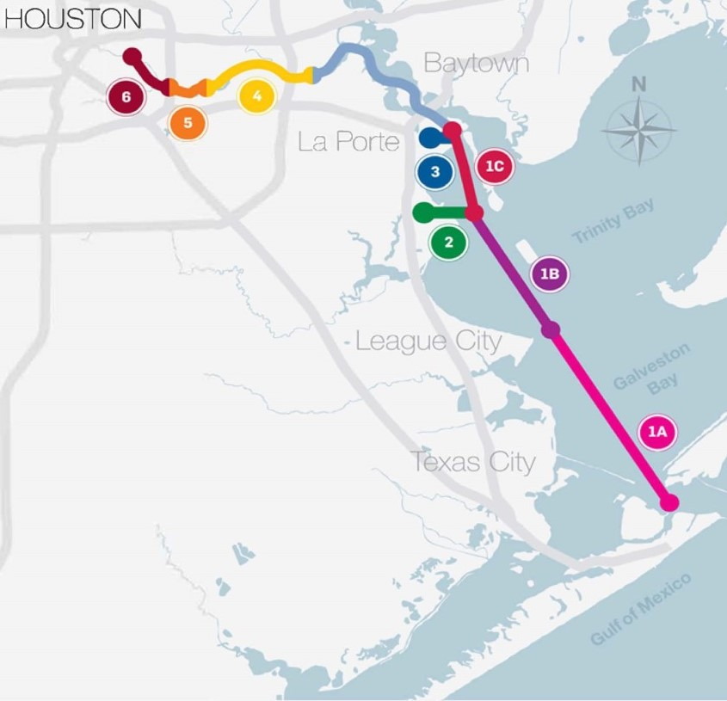
HSC Widening & Deepening
SEGMENT 1: Bolivar Roads to Barbours Cut
Four bend easing locations with associated relocation of barge lanes
Widen the HSC main channel between Bolivar Roads and Barbours Cut from 530 to 700 ft
Inclusion into the Federal Project, the Greens Bayou Channel, a 1.6-mile-long combination 41.5-ft and 16.5 ft deep channel
SEGMENT 2: Bayport Ship Channel
Widen Bayport Ship Channel on north side of channel to 455 ft
SEGMENT 3: Barbours Cut
Widen BCC on north side of channel 455 ft
Widen BCC flare on north and south to create an 1,800-ft diameter turning basin
USACE-Led
Port Houston-Led
Segment | Proposed Improvements
1 | Widen HSC to 700 ft
2 | Widen BSC to 455 ft
3 | Widen BCC to 455 ft, 1,800 ft Turning Basin

Slide 6
HSC Widening & Deepening
SEGMENT 4: Boggy Bayou to Sims Bayou
Deepen the HSC main channel from Boggy Bayou to Hunting Bayou (before Washburn Tunnel) up to 46.5 ft
Widen the HSC main channel from Boggy Bayou to Greens Bayou from 400-ft up to 530 ft
Inclusion into the Federal Project, the Jacintoport Channel measuring 0.76-mile long by 41.5 ft deep
SEGMENT 5: Sims Bayou to I-610
Deepen the HSC main channel from Sims Bayou to I-610 Bridge up to 41.5 ft
SEGMENT 6: I-610 to Turning Basin
Deepen the HSC main channel from I-610 Bridge to Main Turning Basin up to 41.5 ft
Improve Brady’s Island turning basin to 900-ft
USACE-Led
Port Houston-Led
Segment | Proposed Improvements
4 | Deepen to 46.5 ft, Widen to 530 ft
5 | Deepen to 41.5 ft
6 | Deepen to 41.5 ft, 900-ft Turning Basin

Slide 7
RFQ Schedule
Item | Anticipated Date
Advertise RFQ | January 9, 2020
Pre-Proposal Meeting | January 21, 2020
Deadline for Submitting Questions | February 12, 2020
Proposal Due Date | February 19, 2020, 11 am
Oral presentations/Web-Meeting (if required) Only short-listed will be notified by February 21, 2020 | March 9, 2020
Proposal Evaluation Completed | March 12, 2020
Port Commission Meeting/Authorization | March 24, 2020
Commencement of Services | April 7, 2020
Completion of Services | No later than April 7, 2021

Slide 8
RFQ Selection
Weight (%) | Criteria | Components
25 | Reputation and Quality | Background of Respondent Reputation of Respondent Reference Quality of Respondent’s services Availability and dedication of resources
50 | Qualifications and Experience | Background, reputation, qualifications Availability and dedication of qualified personnel Certifications, registrations, and licenses Personnel’s past performance.
20 | Performance Plan | The methodology proposed Plan for communicating with Port Authority Any unique or specialized processes
5 | Compliance with PHA Policies | Demonstrated understanding of the RFQ Clarity and brevity of the Response Thoroughness of Response

Slide 9
Questions
December 2019 USACE Feasibility Report – Expected to be available for release by mid-February
Additional project information: https://www.expandthehoustonshipchannel.com/
Submit all questions in writing via BuySpeed
All communication during the Bid Period to be directed to Dean Ainuddin nainuddin@porthouston.com

