Slide 1


RFQ 483: Prepare Site Specific Baseline Plans for FICAP
RFQ 476: Perform Inspection And Professional Engineering Consulting Services for FICAP 2017
Eddy Kharrazi, P.E. | Project Manager | Project & Construction Management (PCM)

Slide 2







Port Commission
John D. Kennedy
Dean E. Corgey
Clyde Fitzgerald
Janiece M. Longoria
Chairman
Theldon R. Branch, III
Stephen H. DonCarlos
Roy D. Mease
WELCOME MESSAGE | 2

Slide 3
AGENDA
Introductions
Harris County
Small Business
Procurement Services
Selection Criteria
[Site] Parameters
Questions
All attendees must sign-in and indicate attendance for site visit and TWIC cardholders

Slide 4
PHA Personnel
Roger H. Hoh, P.E. – Director, PCM
Charlie Jenkins, P.E. – Director, AM
Eddy Kharrazi, P.E. – Project Manager

Slide 5
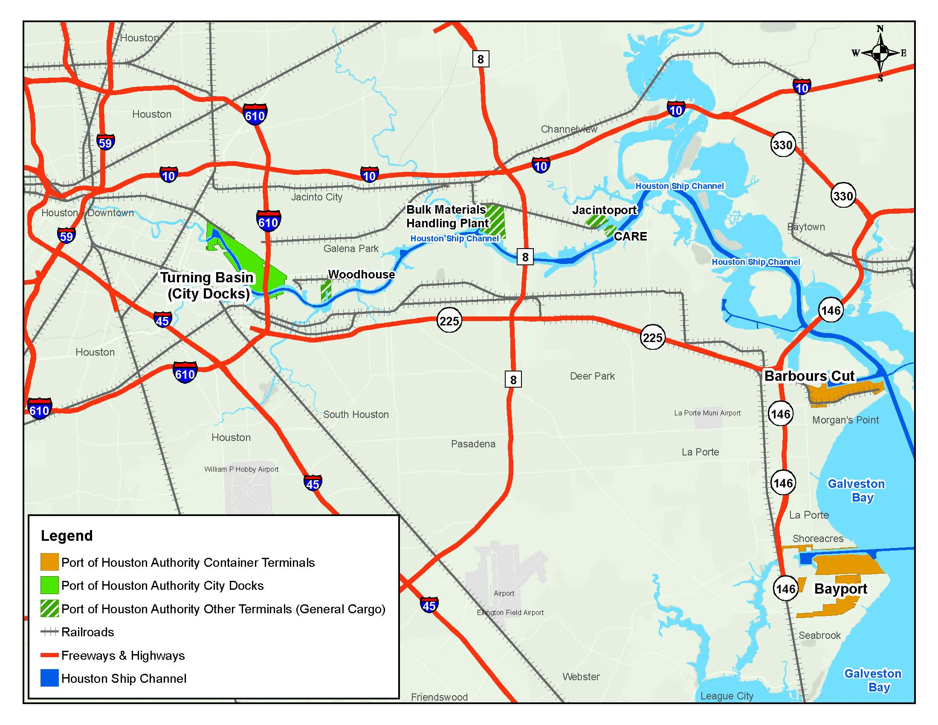
Port Houston

Slide 6
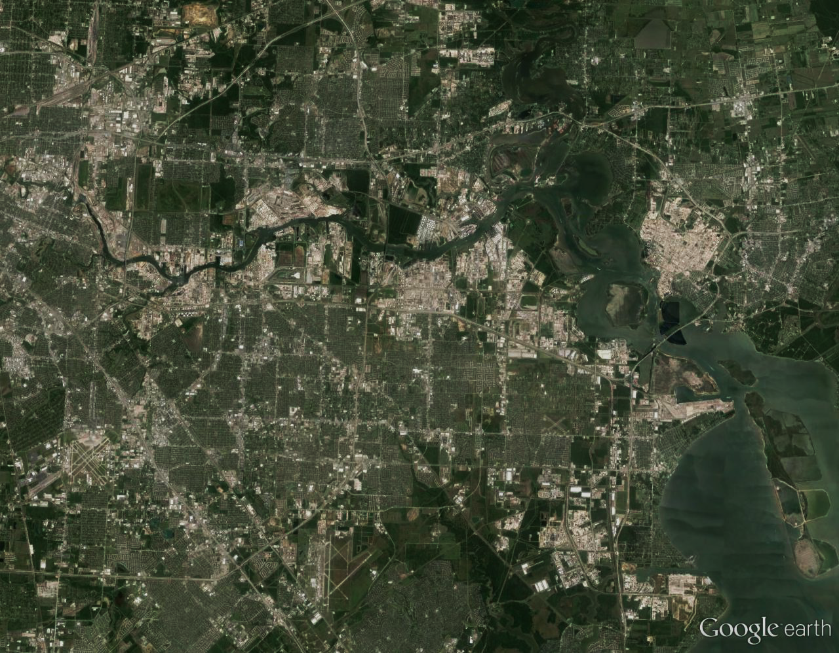
Port Houston Terminals
Turning Basin
Bulk Handling
Jacintoport
CARE
Woodhouse
Grain Elevator
Barbours Cut
Bayport
Notes:
The Port of Houston Authority operates two Container Terminals and leases 6 general cargo facilities.

Slide 7



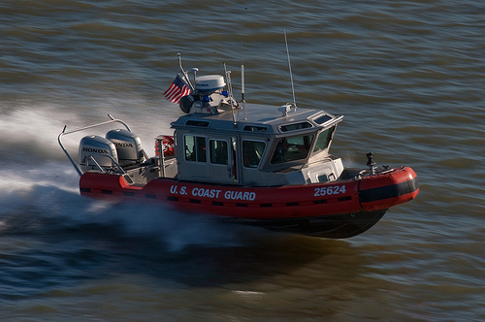

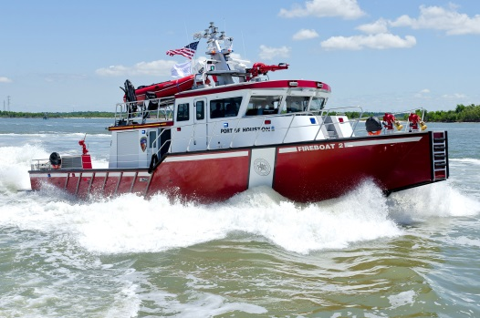
Security Enforcement
First to achieve ISO 28000 compliance for security management system
U.S. COAST GUARD | WATERSIDE AND FACILITIES
U.S. CUSTOMS & BORDER PROTECTION | Cargo and ship personnel
PHA POLICE | Landside terminals
PRIVATE REGULATED CORPORATE FACILITIES | Supported by U.S. Coast Guard and local law enforcement
HOUSTON SHIP CHANNEL SECURITY DISTRICT | Texas governmental entity, public/private partnership, security system and infrastructure

Slide 8
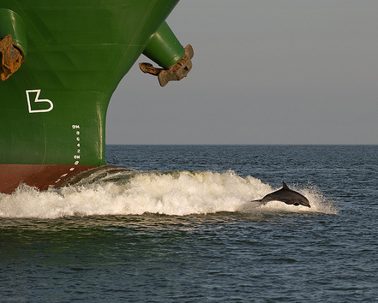
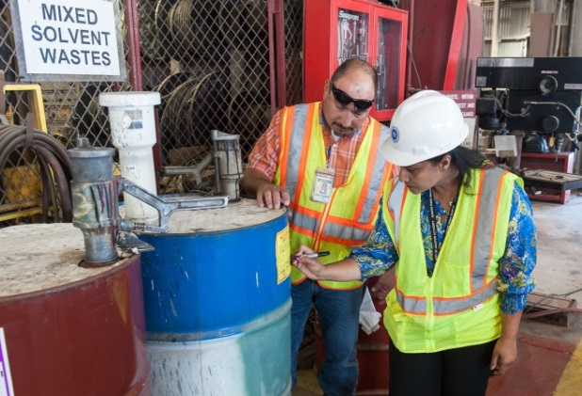

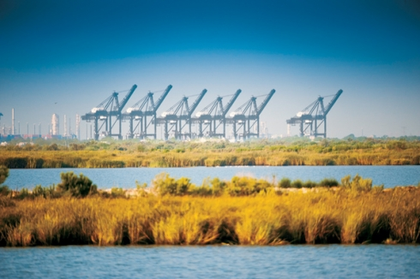

Environmental Commitment
First to achieve ISO14001 compliance for environmental management system
WASTE MINIMIZATION
ENERGY EFFICIENCY
STORM WATER POLLUTION CLEANUP PROGRAM
LEED STANDARDS
DREDGED MATERIAL AREA MANAGEMENT

Slide 9
Overview
As part of the overall Asset Management Program, PHA has planned to determine the baseline condition of all its marine assets over the span of the next three years.
Introduction to PHA
Introduction to PHA FICAP
Scope of PHA FICAP Manual
  Organization of FICAP
  System Hierarchy
  Element-Based Approach
  Types of Inspections & Condition Assessments
  Baseline, Routine & In-Depth Inspections
  Digital Inspection Database Hierarchy
Request for Qualifications (“RFQ”)
FICAP RFQ 467
FICAP RFQ 483
Question / Answer Period

Slide 10
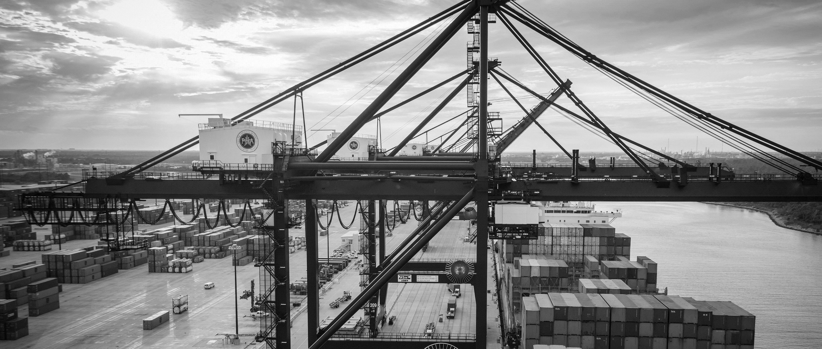
Introduction to PHA
PHA by the numbers:
8 public terminals managed
25 miles of complex
150+ private & public industrial terminals
8,000 vessels
200,000 barges
200 million tons of cargo
Some terminals are +100 yrs

Slide 11
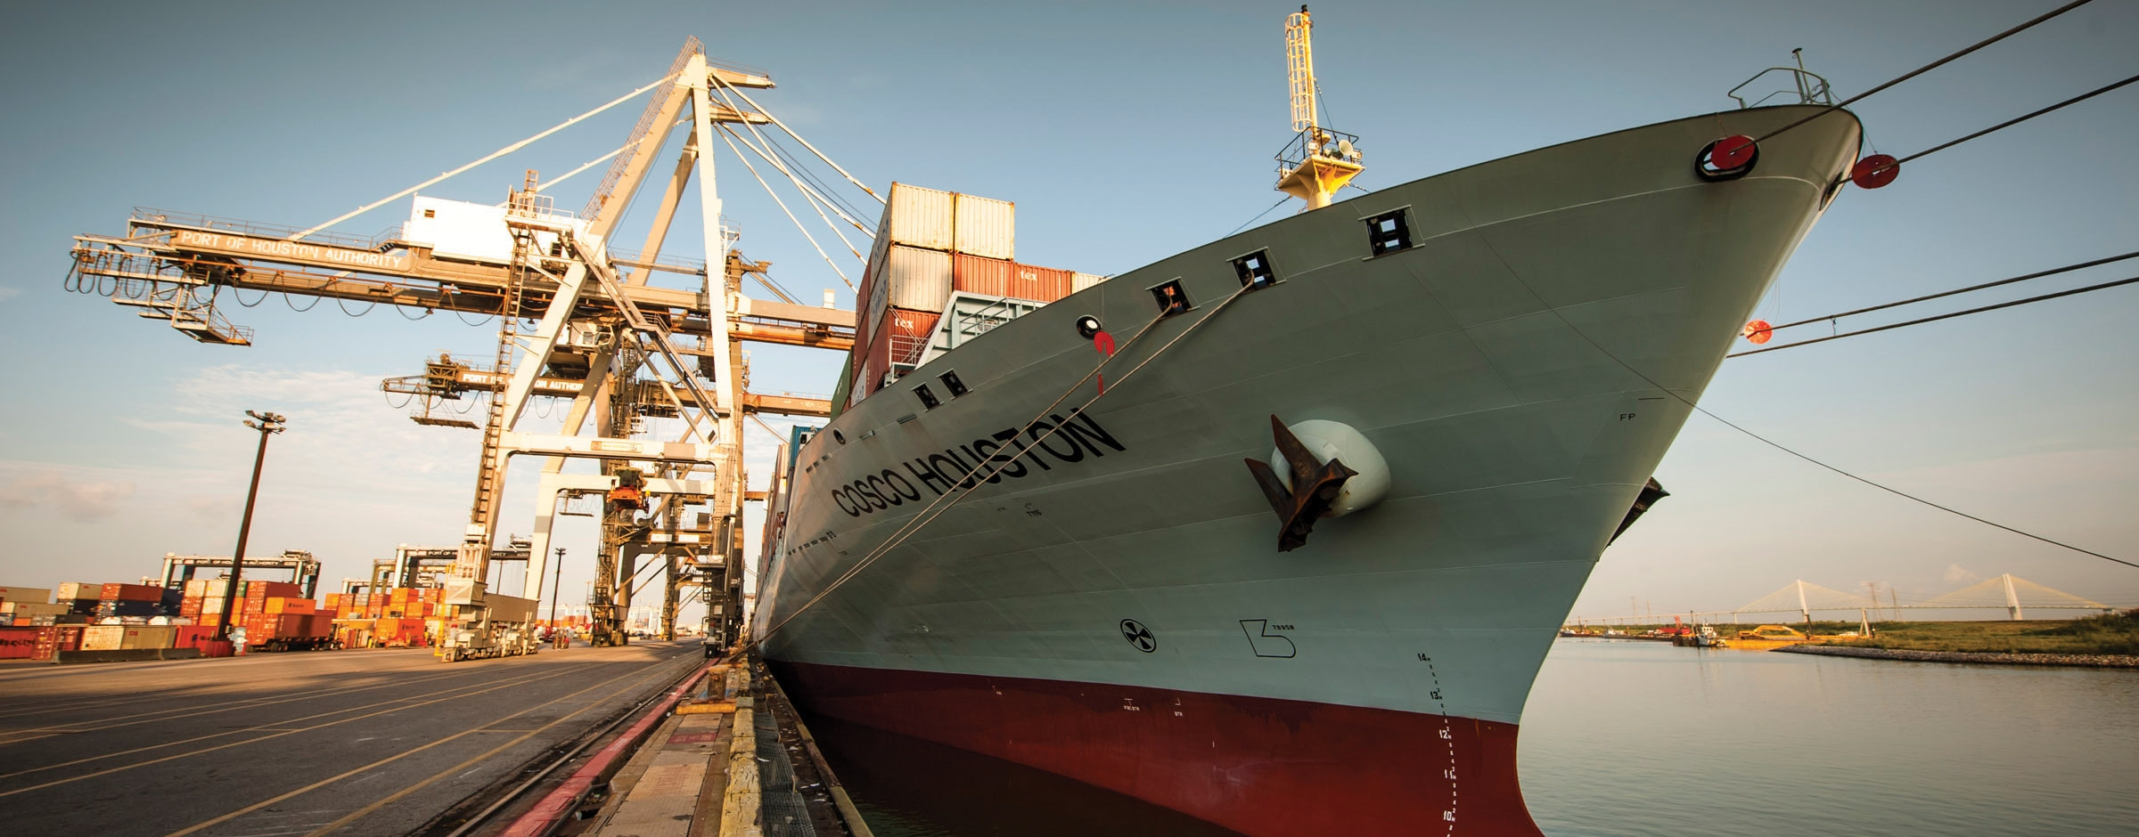
Introduction to PHA
Variety of marine assets managed:
Cargo wharves
Barge landing areas
Small boat docks
Bulkhead
Riprap shoreline
Vehicle barge

Slide 12

Introduction to PHA
Variety of functions served:
Handling of bulk materials, liquids, materials, and containers
Boat landing areas
Boat docks
Bulkheads for soil retention
Vehicle traffic

Slide 13
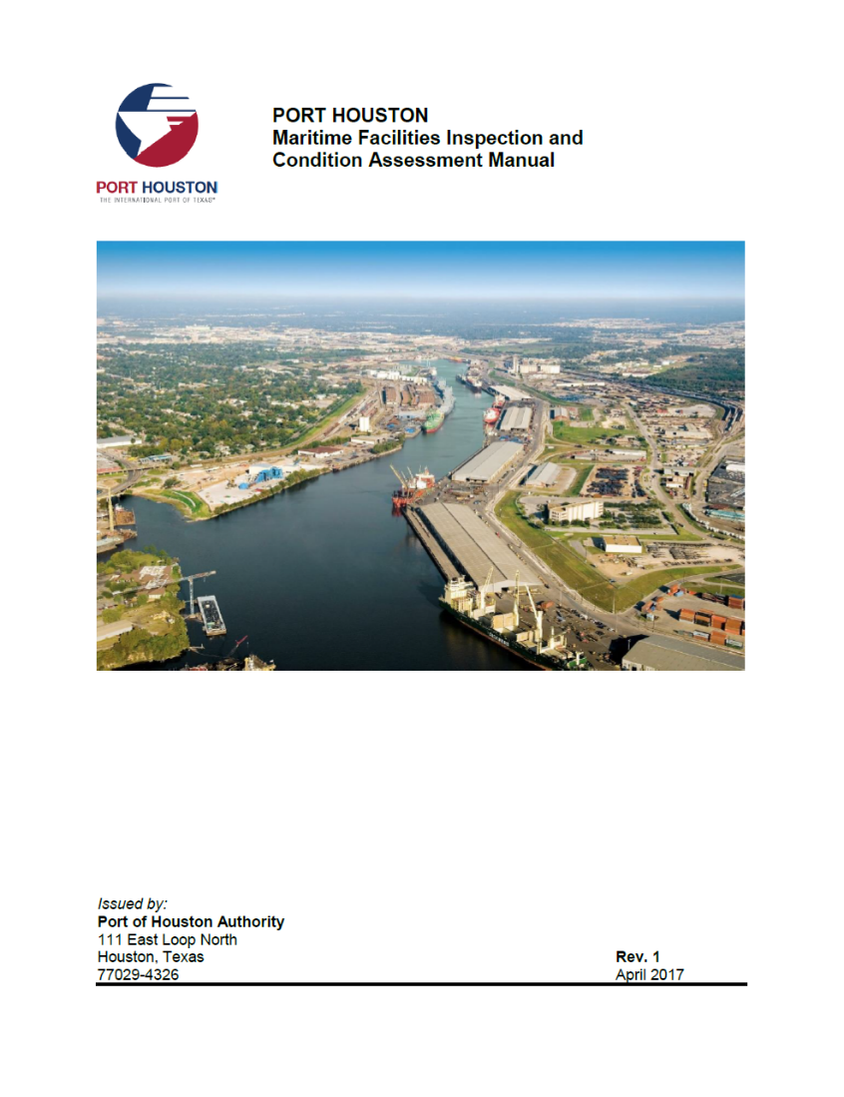
Introduction to PHA FICAP
Maritime assets managed by PHA are inspected and assessed through the FICAP:
  Facilities
  Inspection and
  Condition
  Assessment
  Program

Slide 14
Introduction to PHA FICAP
  Facilities
  Inspection and
  Condition
  Assessment
  Program
Why FICAP?
Define condition of PHA asset at a point in time
Identify conditions that may compromise operations due to complete or partial structural failure
Identify conditions that may lead to property or environmental damage
Evaluate functional adequacy of an asset
Assess conditions that require maintenance, repair, or replacement
Program work in terms of allocating funds and assigning priorities

Slide 15
Introduction to PHA FICAP
  Facilities
  Inspection and
  Condition
  Assessment
  Program
FICAP Objectives
Provide uniform guidance for inspection teams to carry out baseline and routine (structural) visual inspections and conditions assessments of maritime assets owned by PHA
Provide inspection and assessment information necessary for PHA management to determine timing of some preventative and remedial actions required to maintain desired level of service

Slide 16
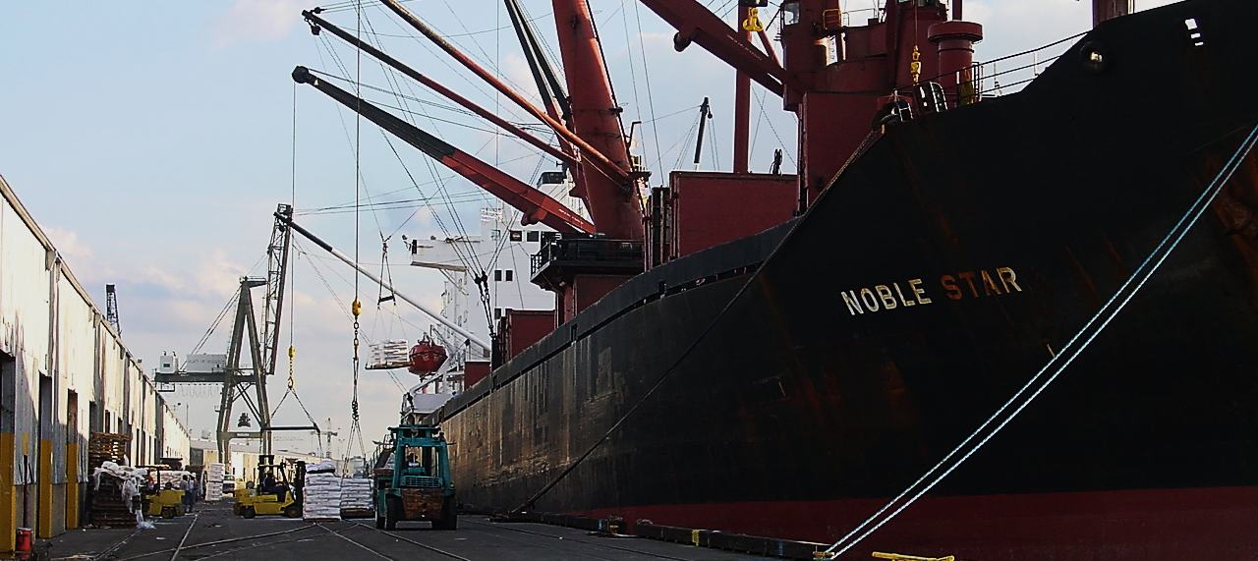
Introduction to PHA FICAP
Facilities
Inspection and
Condition
Assessment
Program
Process by which a qualified team leader carries out or supervises the observation, classification, and documentation of the physical condition of a maritime asset.

Slide 17
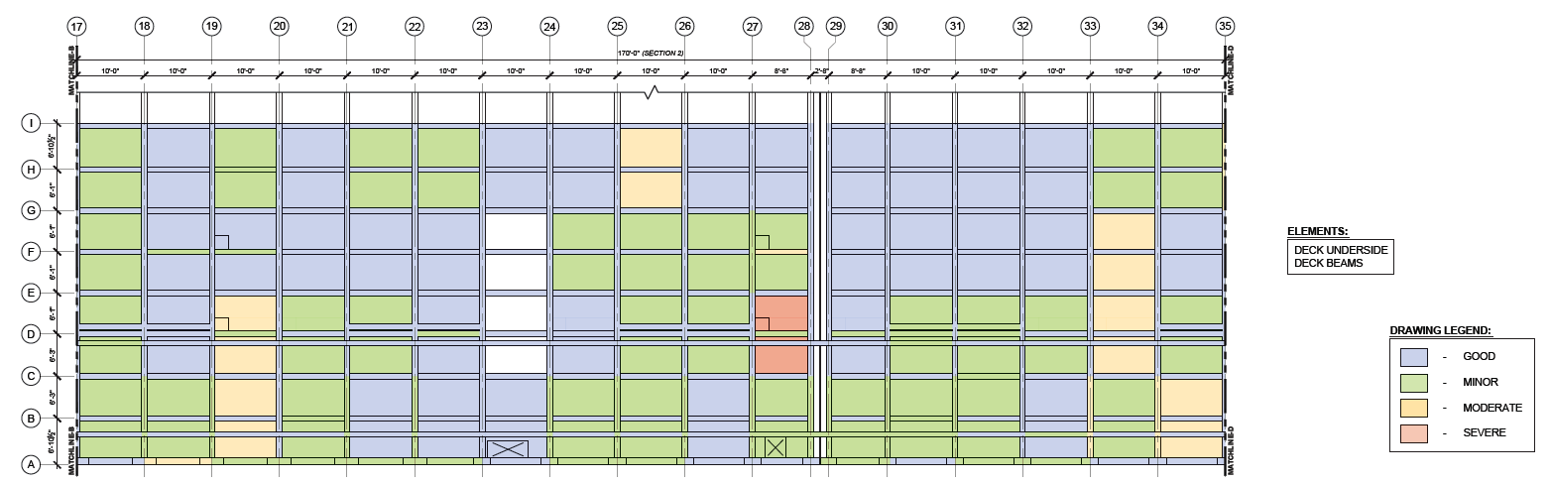
Introduction to PHA FICAP
Evaluation based on engineering judgment, which considers qualitative and quantitative inspection findings.
Facilities
Inspection and
Condition
Assessment
Program

Slide 18
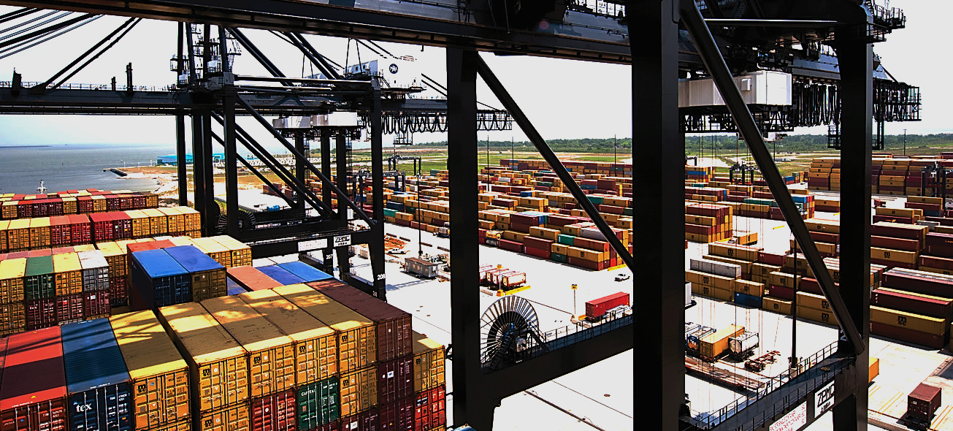
Scope of PHA FICAP Manual
The FICAP Manual defines processes, procedures, and requirements for completing inspections and condition assessments in a consistent manner and level of detail to meet the needs of the PHA.
Included in Scope:
Cargo wharves
T-docks
Boat and barge docks
Bulkheads
Protected and unprotected shoreline
Rail loading platforms
Bridges owned and
maintained by PHA
Not Included in Scope:
Cathodic protection systems
Mechanical, electrical, and plumbing systems
Buildings and sheds
Mechanical operations of crane and train rails
Wharf cranes and other mechanized equipment
Security components

Slide 19
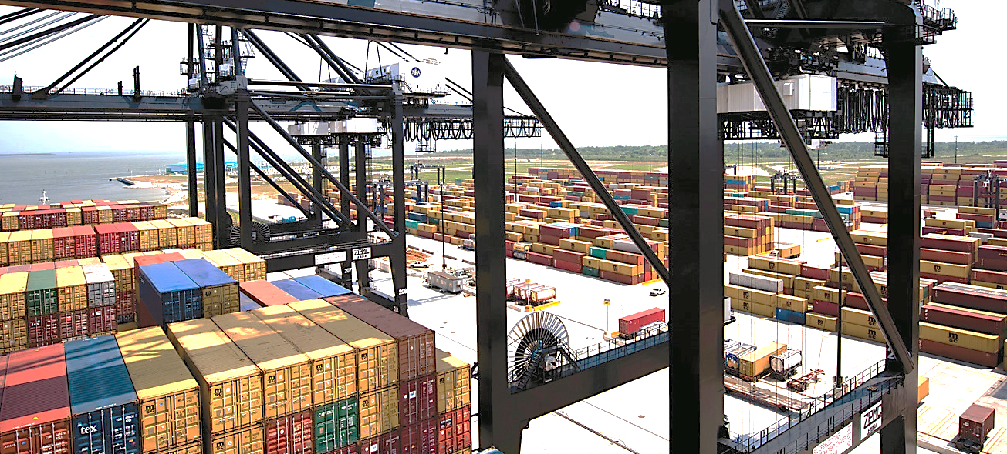
Scope of PHA FICAP Manual
The FICAP inspection and condition assessment is typically limited to a visual inspection approach, and does not involve other in-depth inspection methods, such as material sampling and coring, or non-destructive evaluation techniques including impact echo, impulse response, ultrasonic techniques, ground penetrating radar, radiography, infrared thermography, electrical resistivity, half-cell potentials, corrosion rate measurements, etc.

Slide 20

Organization of FICAP
Content
Introduction
Inspection Types
Elements and Element Conditions
Component Types
Maritime Asset Types
Assessment and Rating Approach
Recommended Follow-Up Action Guidelines
Documentation and Reporting
Administrative Requirements
References
Appendices:
Asset List
Glossary
Element Descriptions
Condition States (Alphabetical)
Condition States (by Material)
Template Documents and Forms

Slide 21
System Hierarchy
Applied to Hypothetical Bulk Terminal

Slide 22
Element-Based Approach
Level | Purpose | Comment
Asset | Overall asset condition assessment guides follow-up actions and asset management decisions. | Overall asset condition is described as a numerical rating and is supplemented by a qualitative (descriptive) assessment.
Component | Component condition assessment indicates condition of structural and non-structural systems in the asset. Provide basis to determine overall asset condition. | Numerical component rating is based on an engineering interpretation of the element condition states and their corresponding implication(s) on structural and/or functional condition of the component.
Element | Condition states document occurrence of damage, deterioration, or defects at time of inspection in terms of: Type of condition(s) (i.e. damage mechanism) Severity of defect (i.e. moderate, severe) Extent of defect (i.e. localized or general) Correlates conditions to element and material type. Tracks conditions over time as indicated by inspections conducted at regular intervals. Provides basis for component rating. | Detailed visual inspections are conducted at the element level. Element condition states are assigned based on predefined categories and quantified to define element condition.

Slide 23
Types of Inspections and
Condition Assessments
Baseline: Inspection to establish asset inventory information and provide a baseline condition assessment for new assets and for existing assets where no previous inspection exists.
Routine: Regularly-scheduled inspection to define asset condition at a point in time.
Special: Inspection in response to specific situations, including Post-event Inspection to assess condition after an extreme event (e.g., hurricane, vessel impact); Due Diligence Inspection to assess condition at times of change of ownership, lease, insurance, etc.; and In-Depth Inspection to determine the cause and significance of damage or deterioration and to provide the condition information necessary to complete designs for repair and/or strengthening.

Slide 24
Baseline, Routine & In-Depth Inspections

Slide 25
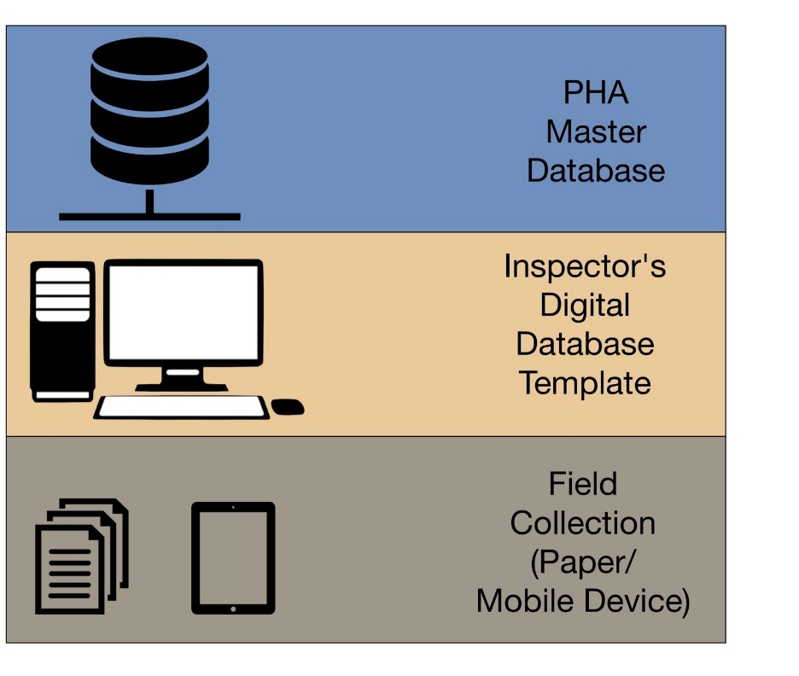
Digital Inspection
Database Hierarchy

Slide 26
Request for Qualifications (“RFQ”)
FICAP 2017
RFQ 483
Prepare Site Specific Baseline Plans of all Assets for FICAP
RFQ 476
Perform Inspection and Professional Engineering Consulting Services for FICAP 2017
Contract #1
RFQ 476
Perform Inspection and Professional Engineering Consulting Services for FICAP 2017
Contract #2
RFQ 476
Perform Inspection and Professional Engineering Consulting Services for FICAP 2017
Contract #3
RFQ 476
Perform Inspection and Professional Engineering Consulting Services for FICAP 2017
Contract #N
Limited number of Assets
Divisible
…

Slide 27

FICAP RFQ 476
The focus of this program is not in-depth inspection, engineering analysis, or remedial design of the assets.
However, if PHA identifies the need of such services, the engineering consultant is expected to be able to provide service.
Nevertheless, awarding a contract does not warrant future in-depth inspection, engineering analysis, or remedial design of the assets.

Slide 28

SCOPE OF SERVICES
RFQ 476
As part of the overall Asset Management Program, PHA wants to determine the baseline condition of all its marine assets over the span of the next three years.
PHA has approximately 140 assets ¥ and is targeting to complete the assessment of approximately 39 assets ¥ in 2017.
The Respondent(s) selected under this RFQ 467 are expected to assist with the inspection and assessment of those approximately 39 assets ¥.
¥ Number marine assets are subject to change.

Slide 29
SCOPE OF SERVICES
RFQ 476
The scope of the FICAP program includes the above water and underwater inspections and the associated condition assessment of the structural and non-structural components of PHA’s marine assets.
The underwater inspections will be conducted after completion of above water inspection.
The need for underwater inspection will be determined based on the results from above-water inspection and is to the discretion of PHA.

Slide 30
SCOPE OF SERVICES
RFQ 476
To provide marine asset inspection services for above water inspections and underwater inspections, and any other inspection required activities, as outlined by FICAP, including but not limited to:
  planning the inspection,
  organizing project execution plan,
  managing inspection activity,
  inspecting, taking pictures,
  collecting inspection data,
  performing QA/QC of baseline drawings for the assets
  performing QA/QC of the data,
  recording the collected data in FICAP database,
  assessing asset condition,
  preparing report
To assess and evaluate the condition of and to prepare condition assessment reports for the PHA assets using data and information collected through the inspection by following the FICAP manual.

Slide 31

Corporate Expectation of Respondent
RFQ 476
Respondent(s) or their subcontractors must have experience in:
Structural inspection (with experience exceeding 10 years) for above water inspections and underwater inspections, and any other inspection required activities as outlined by FICAP, including but not limited to: planning the inspection, organizing project execution plan, managing inspection activity, inspecting, taking pictures, collecting inspection data, performing QA/QC of the data, recording the collected data in FICAP database, preparing reports, assessing asset condition, etc.
Working knowledge and experience with AASHTO Manual for Bridge Element Inspection and ASCE Practice No. 101 Underwater Investigations Standard Practice Manual.
Firm should have proven experience and proficient
staff in utilizing Esri GIS ArcGIS software technologies
and Esri GIS Geodatabase formats for potential GIS
related tasks.
The selected Respondents’ team must take and pass the FICAP training provided by PHA
(at Respondent’s own expense)

Slide 32

Qualifications for RFQ 476
Inspection and Condition Assessment Project Manager
Registered Professional Engineer licensed in the State of Texas,
Specialized and experienced in civil or structural engineering,
A minimum of 10 years of experience in the inspection of structures, including maritime or waterfront assets, and
Successfully completed the Port of Houston Maritime Facility Inspection Training Program.
Inspection Team Leader
Successfully completed the Port of Houston Maritime Facility Inspection Training Program, and
Registered Professional Engineer, or a minimum of 5 years of experience in inspection of civil structures, including maritime or waterfront assets.
Inspection Team Member
Successfully completed the Port of Houston Maritime Facility Inspection Training Program, and
Graduate of a four-year engineering curriculum in civil or structural engineering and certified as an engineer-in-training (EIT) or a minimum of 2 years of experience in inspection of civil structures, including maritime or waterfront facilities.
Underwater Inspection Team Leader
Same minimum qualifications as defined for Team Leader,
Hold diver certification from a recognized training organization (e.g., ADC accredited commercial, US Military, or PADI/NAUI dive school), and
At least 5 years of commercial underwater inspection experience under conditions similar to the inspection site, which may include low visibility, high currents, and confined spaces.
Underwater Inspection Team Member
Same minimum qualifications as defined for Inspection Team Member, and
Trained commercial diver holding certification from a recognized training organization (e.g., ADC accredited commercial, US Military, or PADI/NAUI dive school).

Slide 33
Corporate Expectation of Respondent
RFQ 476 and RFQ 483
As part of the FICAP certification, the project team of all the selected Respondents are expected to take the FICAP training provided by PHA (at their own expense) and must pass the FICAP exam conducted by PHA, in order to start the work.
Prior FICAP knowledge will not be evaluated or considered in both RFQ selection process.
Successful completion of a FICAP training program and PHA certification will be required of all FICAP selected participants (after they are selected) before inspection work may begin.

Slide 34
SCOPE OF SERVICES
RFQ 483
PHA has approximately 140 marine assets¥ and needs proper inspection drawings for all the properties as outlined in FICAP manual.
The Respondent selected under RFQ 483 is expected to create and provide such drawings and communicate them with the inspection contractors and PHA PCM.
¥ Number marine assets are subject to change.

Slide 35
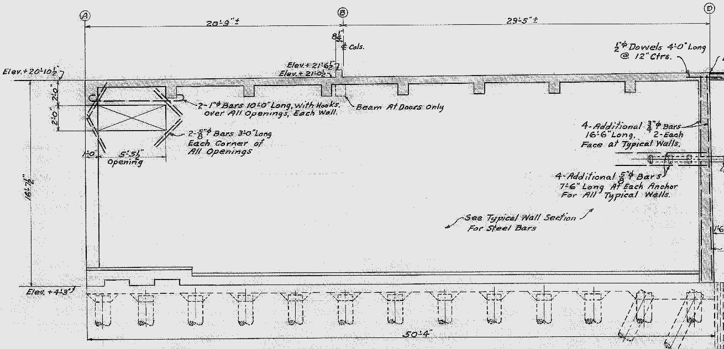
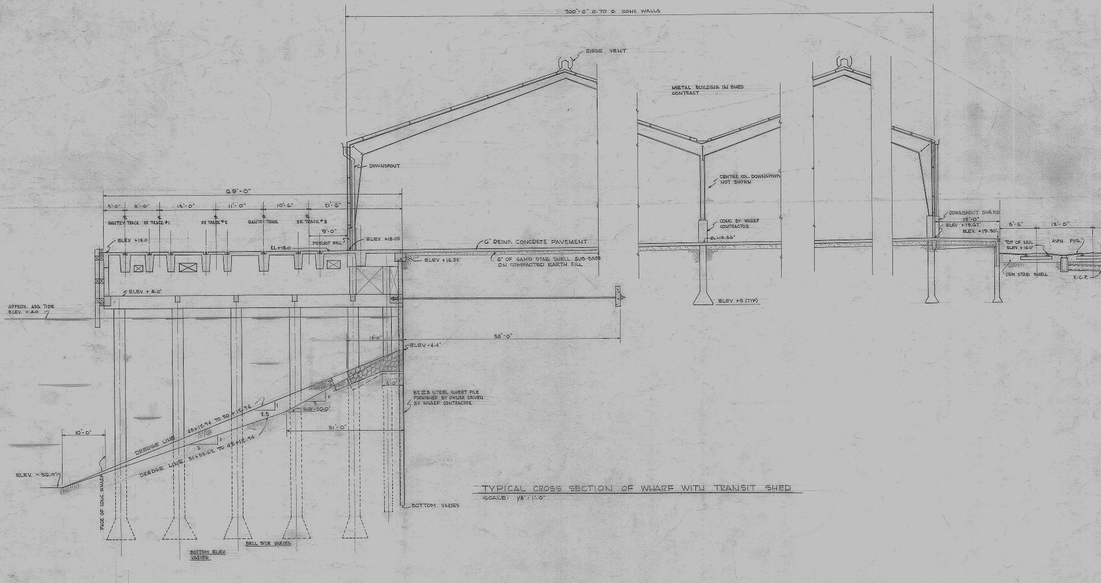
Sample PHA Drawing
RFQ 483

Slide 36
Sample FICAP Inspection Drawing
RFQ 483

Slide 37
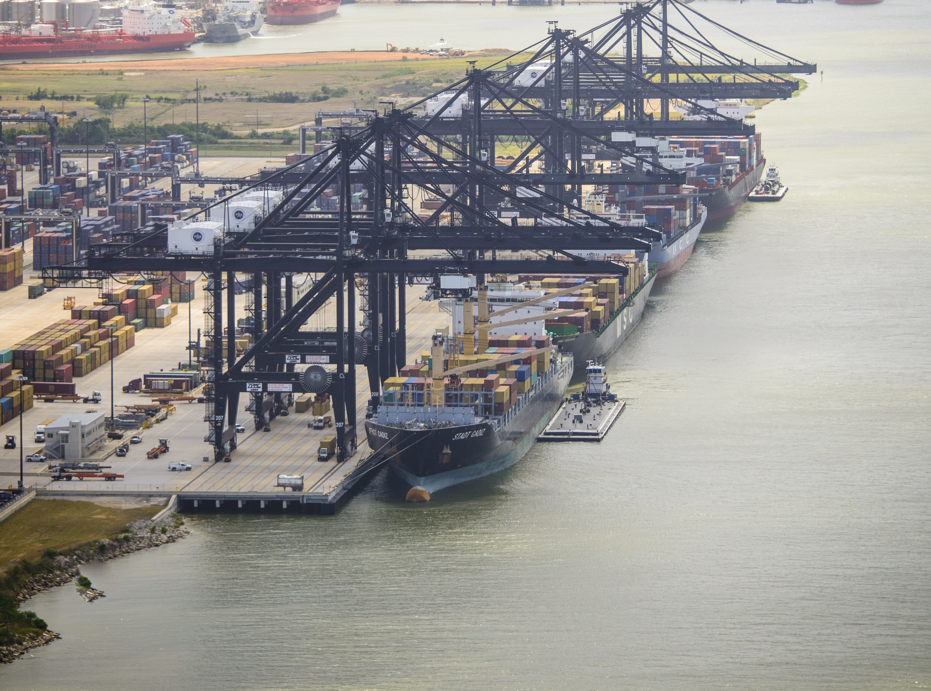
THANK YOU
Eddy Kharrazi, P.E.
Project Manager
Port Houston
Questions?
www.PortHouston.com
111 East Loop North
Houston, TX 77029

Slide 38
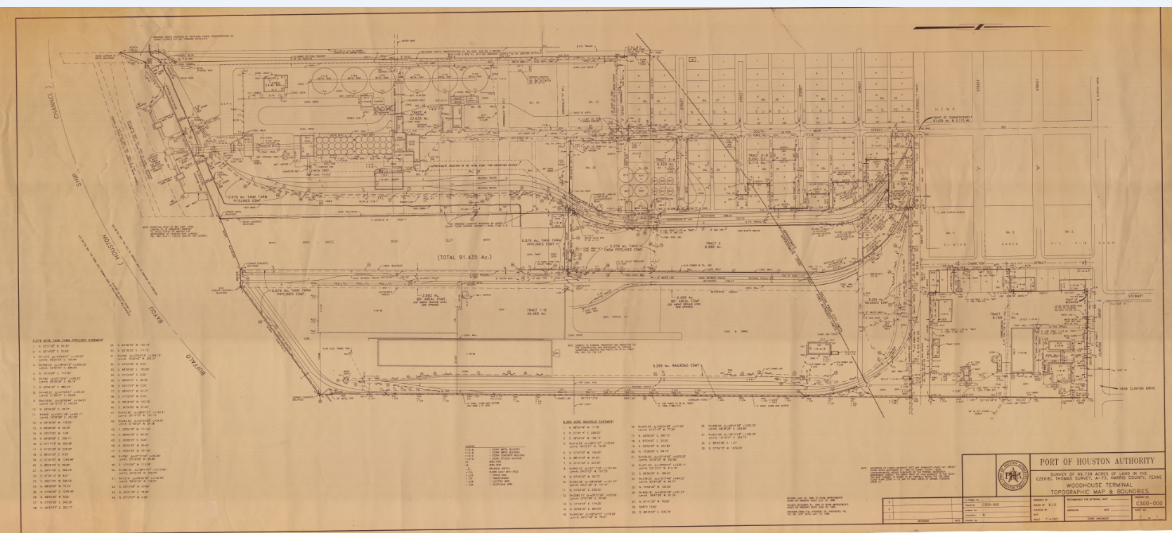
Sample Drawing
RFQ 483

Slide 39
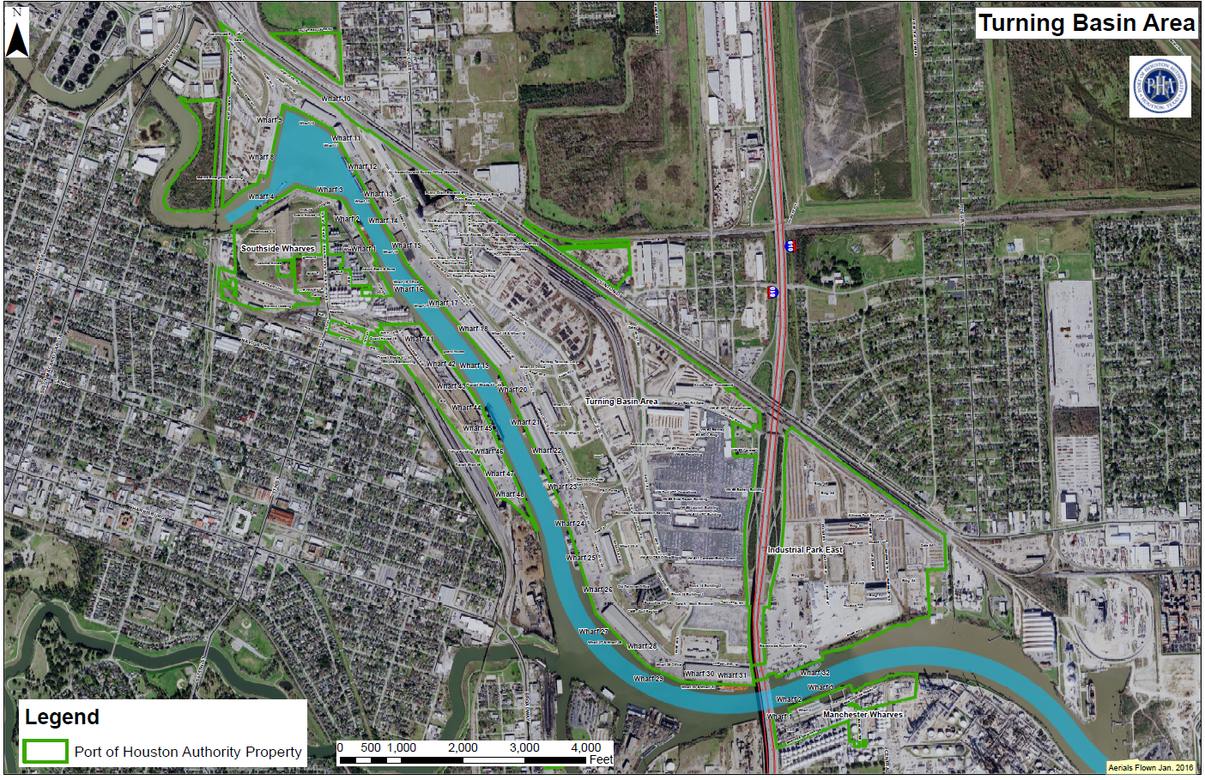
Turning Basin Terminals
You Are Here

