Slide 1
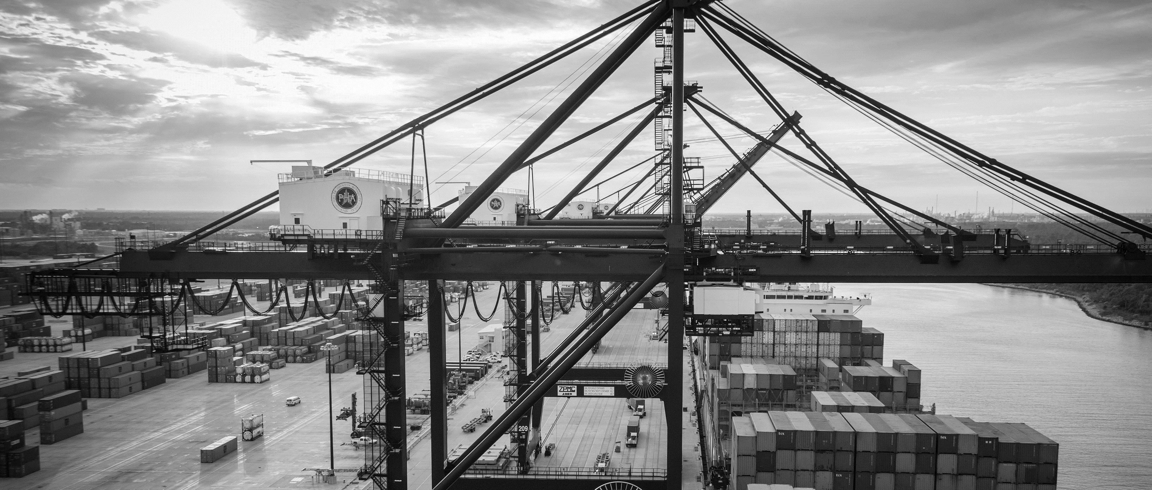
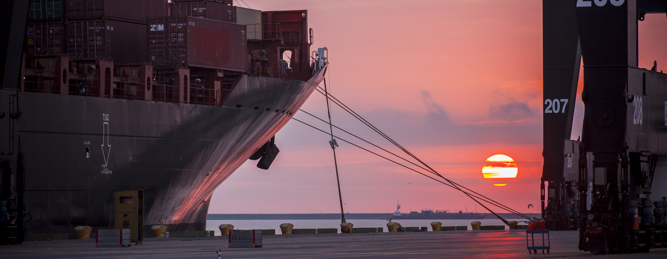
RFP -945 CLEANING SERVICES FOR THE EXECUTIVE OFFICE BUILDING, PORT COORDINATION CENTER, SAM HOUSTON PAVILION, AND TEN GATEHOUSES AT TURNING BASIN TERMINAL
Adrian Price | Manager | Office Services Department

Slide 2
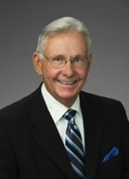
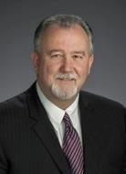
Port Commission
John D. Kennedy
Dean E. Corgey
Clyde Fitzgerald
Janiece M. Longoria
Chairman
Theldon R. Branch, III
Stephen H. DonCarlos
Roy D. Mease
WELCOME MESSAGE | 2

Slide 3
RFP-945 CLEANING SERVICES FOR THE EXECUTIVE OFFICE BUILDING, PORT COORDINATION CENTER, SAM HOUSTON PAVILION, AND TEN GATEHOUSES AT TURNING BASIN TERMINAL
AGENDA
Introductions
Procurement Services
Small Business
Selection Criteria
Scope of Work
Questions
All attendees must sign-in

Slide 4
RFP-945 CLEANING SERVICES FOR THE EXECUTIVE OFFICE BUILDING, PORT COORDINATION CENTER, SAM HOUSTON PAVILION, AND TEN GATEHOUSES AT TURNING BASIN TERMINAL
PHA Personnel:
Jessica Shaver– Chief People Officer
Adrian Price – Project Manager
Mike Ziesemer – Facility Security Manager
Pedro Gonzales – Small Business Development
Yvette Camel-Smith – Director of Procurement

Slide 5
RFP-945 CLEANING SERVICES FOR THE EXECUTIVE OFFICE BUILDING, PORT COORDINATION CENTER, SAM HOUSTON PAVILION, AND TEN GATEHOUSES AT TURNING BASIN TERMINAL
Small Business Requirement:
Target Participation Goal for this Project = 35% of the Purchase Price
12 pts. out of 100 points available for SB.
PHA-Enrolled Small Businesses receive a minimum of 2/3 pts. available for SB.
Non PHA-Enrolled SB-based on direct ratio formula

Slide 6
RFP-945 CLEANING SERVICES FOR THE EXECUTIVE OFFICE BUILDING, PORT COORDINATION CENTER, SAM HOUSTON PAVILION, AND TEN GATEHOUSES AT TURNING BASIN TERMINAL

Slide 7
RFP-945 CLEANING SERVICES FOR THE EXECUTIVE OFFICE BUILDING, PORT COORDINATION CENTER, SAM HOUSTON PAVILION, AND TEN GATEHOUSES AT TURNING BASIN TERMINAL

Slide 8
RFP-945 CLEANING SERVICES FOR THE EXECUTIVE OFFICE BUILDING, PORT COORDINATION CENTER, SAM HOUSTON PAVILION, AND TEN GATEHOUSES AT TURNING BASIN TERMINAL

Slide 9
RFP-945 CLEANING SERVICES FOR THE EXECUTIVE OFFICE BUILDING, PORT COORDINATION CENTER, SAM HOUSTON PAVILION, AND TEN GATEHOUSES AT TURNING BASIN TERMINAL
Procurement:
Request of Proposals (RFP) are due on January 9, 2019, no later than 11:00 A.M.
One original and five copies, packaged in one sealed envelope

Slide 10
RFP-945 CLEANING SERVICES FOR THE EXECUTIVE OFFICE BUILDING, PORT COORDINATION CENTER, SAM HOUSTON PAVILION, AND TEN GATEHOUSES AT TURNING BASIN TERMINAL
Selection Criteria
The Port Commission will award the contract to the responsible proposer that offers the best value to the Port Authority.
Purchase Price- 20%
Vendor’s Reputation, Quality of Services and/or Product, Safety Record- 35%
Benefit to Port Authority- 22%
Small Business Participation- 12%
Overall Compliance with Port Authority Policies- 8%
Local Business Participation- 3%

Slide 11
RFP-945 CLEANING SERVICES FOR THE EXECUTIVE OFFICE BUILDING, PORT COORDINATION CENTER, SAM HOUSTON PAVILION, AND TEN GATEHOUSES AT TURNING BASIN TERMINAL
General Scope of Services:
Contractor must dedicate a sufficient number of staff and staff hours to ensure that the Scope of Work is met.
Windows/Doors. All interior and exterior glass in partitions, panels, and doors must be cleaned. Windows on the main entrance, lunchrooms, and other perimeter glass door entrances must be washed.
Sweeping and Mopping. All bare floors will be swept and mopped with clean water and approved products so that the floors are free of litter, debris, dust, and other dirt.
Restroom Floors. All restroom floors, including, but not limited to, areas around all toilets, urinals, baseboards, and corners, must be mopped, rinsed, and sanitized with disinfecting mopping solution.
Vacuuming. Carpeting on all areas where there is carpet (including lobby or entrance area rugs and mats) will be vacuumed daily so that the carpets are free of all litter, debris, lint, obvious dust, and dirt and spot-cleaned to remove gum, tar, coffee, and other stains. Staples and other debris on the carpets not removed by vacuuming shall be removed by hand and discarded.

Slide 12
RFP-945 CLEANING SERVICES FOR THE EXECUTIVE OFFICE BUILDING, PORT COORDINATION CENTER, SAM HOUSTON PAVILION, AND TEN GATEHOUSES AT TURNING BASIN TERMINAL
General Scope of Services (continued):
Carpet Maintenance. All carpet stains must be removed immediately after notification by the Port Authority or if observed by a Janitorial Worker.
Trash, Recycling, and Bathroom Receptacles. Janitorial Workers should empty all trash containers and replace the liners with new liners, which are provided by Contractor. In cases where the used liner had leaked or the trash container became soiled in any way, the Janitorial Worker should clean the interior of the trash container prior to inserting a new liner.
Dusting. Dust or wipe down the vents and exterior of any standalone air conditioning units, including, but not limited to, all air conditioning units in the Gatehouses.
Kitchens, Lunchrooms, Coffee Bars, Lactation Rooms, Break Rooms, and Restrooms. Sanitize and scour all commodes, commode seats, urinals, washbasins, countertops, and showers.
Paper Products and Other Supplies. Replenish restroom paper towels, seat covers, and toilet paper furnished by Port Houston.

Slide 14
THANK YOU
Procurement Services
Port Houston
Questions?
713.670.2464
procurement@poha.com
www.PortHouston.com
111 East Loop North
Houston, TX 77029
WELCOME MESSAGE | 4

