Slide 1
Pre Proposal Meeting:
Lighting Infrastructure & Renovation Assessment
Port Houston
Houston, TX
02.02.2018

Slide 2
Safety Moment

Slide 3
Timeline and scope of work
TIMELINE: 30 Days
SCOPE:
A. ASSESSING INVENTORY
Conduct an inventory of poles and fixtures, listing relevant attributes including but not limited to location, connected meter ID, pole height, fixture size, lamp type, wattage, power rating, annual usage time, and safety and security standards.
B. PRESCRIBING RENOVATION OPTIONS
Develop and rank potential implementation models to renovate existing lighting infrastructure with DSL-certified LEDs by evaluating alternatives, including but not limited to replacing existing lamps at the end of life, and turnkey project solutions. For evaluating alternatives, use business case analysis, that consider key decision variables, including but not limited to capital costs, energy and cost savings, potential incentives, project execution time, labor requirements, and control solutions.
Timeline & Scope
Aerial Maps
Deliverables & Schedule
Questions
Notes:
Business case: capex, roi, incentives

Slide 4
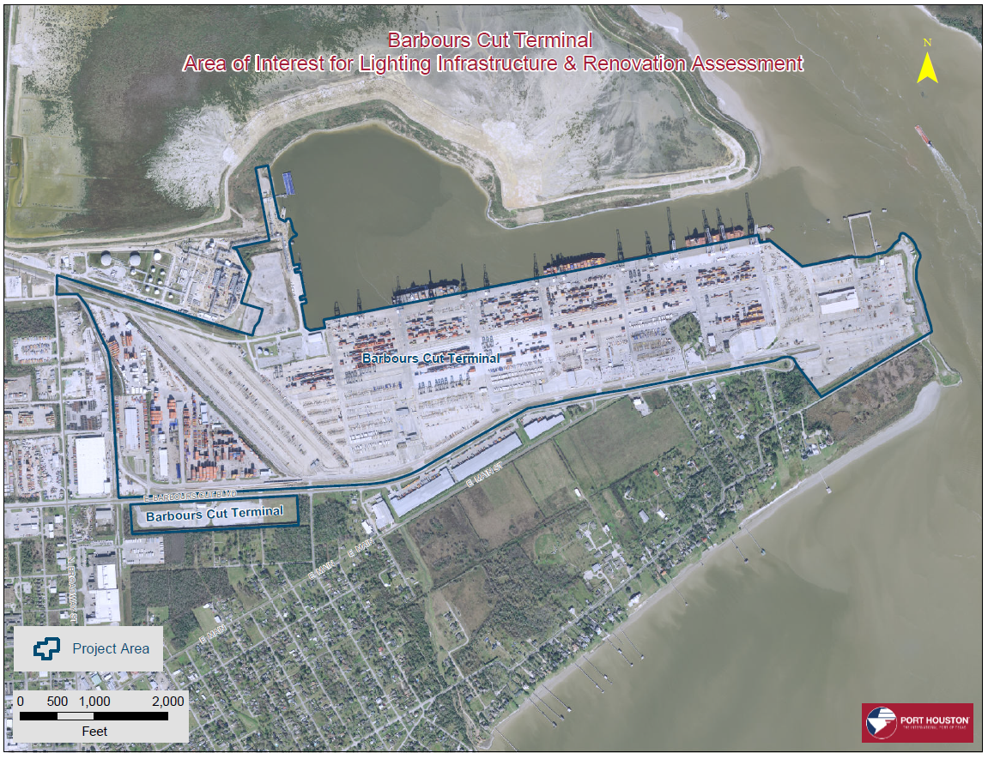
Aerial Maps for Project Area: Barbours Cut Terminal
Timeline & Scope
Aerial Maps
Deliverables & Schedule
Questions

Slide 5
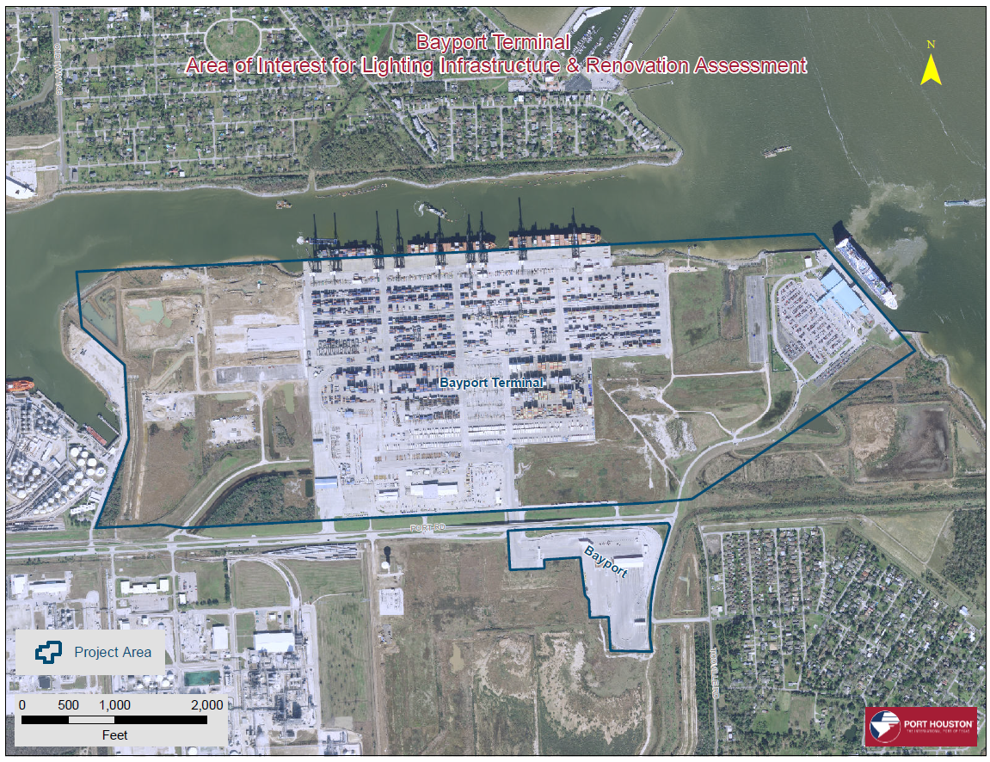
Aerial Maps for Project Area: Bayport Terminal
Timeline & Scope
Aerial Maps
Deliverables & Schedule
Questions

Slide 6
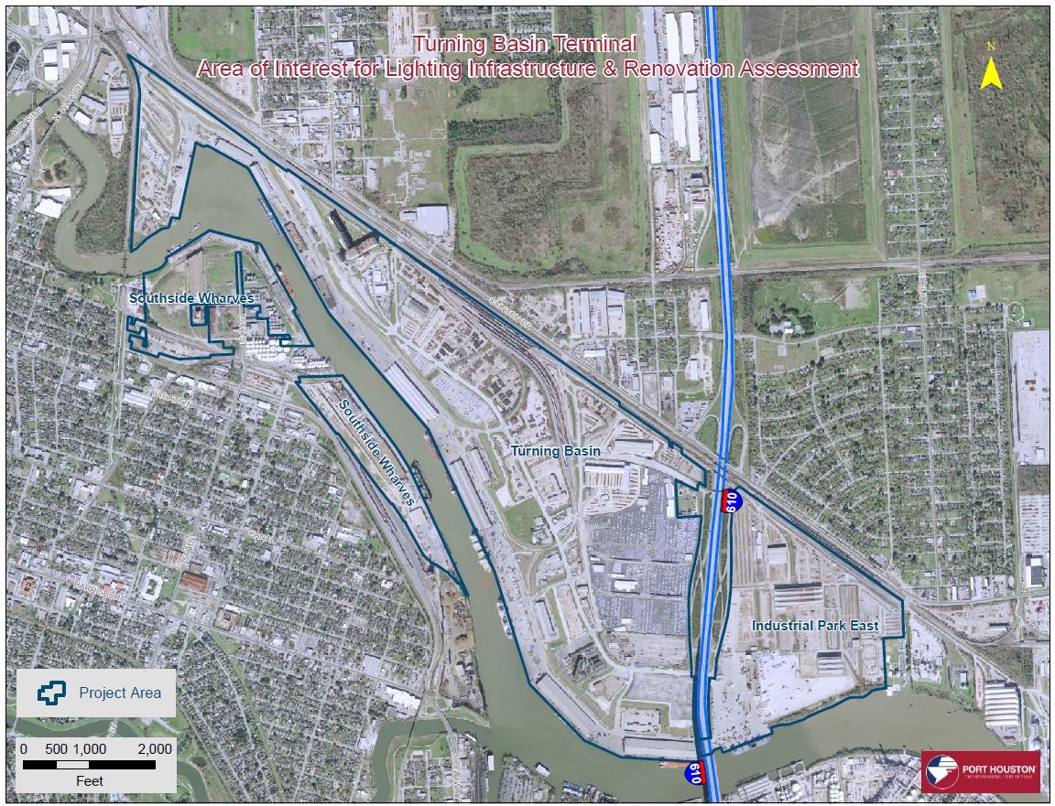
Aerial Maps for Project Area: Turning Basin Terminal
Timeline & Scope
Aerial Maps
Deliverables & Schedule
Questions

Slide 7
Deliverables and Schedule
Deliverables
Inventory list of lighting infrastructure Business cases for renovation options (not more than 3) Level 3 Cost for each option Level 3 Schedule for each option Availability to provide any clarification after project submission
Tentative Schedule Contractor KO meeting 02.14.18 Inventory and Business Case Submission 03.15.18 Contractor available for any clarification until 04.30.18
Timeline & Scope
Aerial Maps
Deliverables & Schedule
Questions

Slide 8
Questions?
THANK YOU
Timeline & Scope
Aerial Maps
Deliverables & Schedule
Questions

