Slide 1
RFP - 472 Enterprise Asset Software Capabilities Assessment Project
Eric Barron, Project Management | Asset Management
8.3.17

Slide 2
Agenda
Introductions
Procurement Services
Selection Criteria
Scope of Work
Questions
All attendees must sign-in and indicate attendance

Slide 3
PHA Personnel
Key Stakeholders:
Eric Barron – Asset Manager
Charlie Jenkins – Director, Asset Management
Charles Thompson – Chief Information Officer
Chris Brown – Director, Information Technology
Yvette Camel-Smith – Director, Procurement
Tanika Chukwumerije- Manager, Contracts
Angela Drisdale - Contract Administrator

Slide 4
Procurement
Key Considerations:
Request of Proposals (RFP) are due on August 16, 2017, no later than 11:00 A.M.
One original and five copies, packaged in one sealed envelope
“No Contact Period”-Prospective proposers are prohibited from contacting PHA staff concerning an active solicitation
Use the forms included in the solicitation package
Check BuySpeed for any addenda issued and include the signed acknowledgment in the proposal submission

Slide 5
Selection Criteria
The Port Commission will award the contract to the responsible proposer that offers the best value to the Port Authority.
Purchase Price - 15%
Vendor’s Reputation, Quality of Services and/or Product, Safety Record - 37%
Benefit to Port Authority - 30%
Overall Compliance with Port Authority Policies - 15%
Local Business Participation - 3%

Slide 6
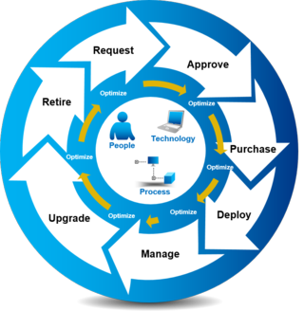
Asset Management Objectives
AM Key Responsibilities
Build strong strategic Asset Management Capabilities
Strengthen business foundations
Support Stakeholders
Measure and continually improve
Develop Asset Management culture
Deploy decision support tools
Key Informational Systems
Revenue
Operational Expenses
Maintenance Expenses
Inventory Management
Accounts Receivable
Accounts Payable
Asset Utilization
Accurate Data
For Quality Decisions
Notes:
6

Slide 7
Project Objectives
Project Objectives
Phase I – Front Development
Incorporating best practices and industry expertise that support asset management to further strengthen PHA’s business goals.
Maximize the functionality of existing systems, eliminating redundancy and manual effort to pull reliable information for fact-based decision making.
Gain a better understanding of the current informational systems and determining what information is critical to generate key performance indicators.
Identify 3 feasible concepts for a recommended informational architecture and providing justification for Phase II.
This Project is NOT:
Implementation
Software programming

Slide 8
Project Execution
Current State (14 Systems)
Review identified existing systems (M5, JDE, etc.) deemed critical for the management of assets – Appendix B, “Current State Diagram”
Meet with Departmental Subject Matter Experts.
Needs Assessment:
Perform a functionality and data needs assessment of the existing systems
Identify weaknesses and perform a gap analysis based on industry expertise
Future State:
Deliver 3 feasible concepts with supporting technical and business justification as input into the next project phase.

Slide 9
Impacted Departments
10 Departments
Projects and Construction Management
Maintenance
Operations
Human Resources
Procurement
Risk Management
Information Technology
Asset Management
Legal
Finance/Accounting
PHA Core Systems (6): JD Edwards (Finance/Accounting)
GIS (Graphic Informational System) SharePort (Legal)
Buyspeed (Procurement)
Navis N4 (Operations)
Kronos (Payroll)

Slide 10
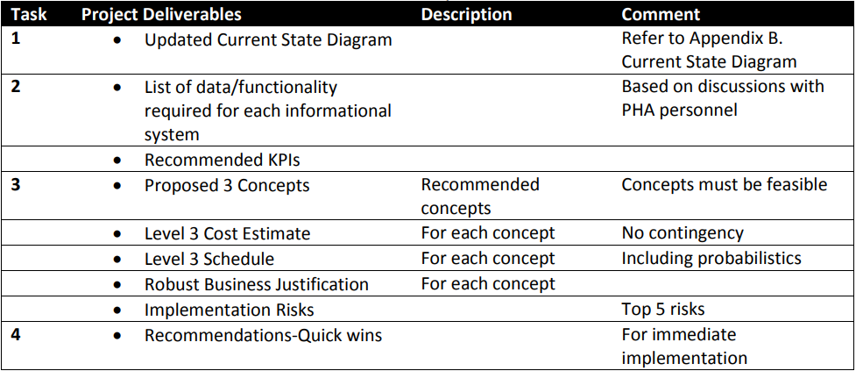
Deliverables

Slide 11
Schedule
Milestones | Dates
Contractor Award | 9/26/17
KO Meeting | 11/1/17
Current State | 12/15/17
Future Concepts and Deliverables | 2/15/18
Final Report | 3/15/18

Slide 12
Key Considerations
Project Team
Independent review of PHA’s systems
Experience in Asset Management/Systems
Experience with the type of Informational Systems utilized by PHA
Industry experience helpful but not required
Front End Development
Experience working with both Project Teams and Executive Teams
Systems Integration/Process Development
Implementation Experience

Slide 13
THANK YOU
Eric Barron
Asset Management
Port Houston
Questions?
713.670.2464
procurement@poha.com
www.PortHouston.com
111 East Loop North
Houston, TX 77029
WELCOME MESSAGE | 4

