Slide 1
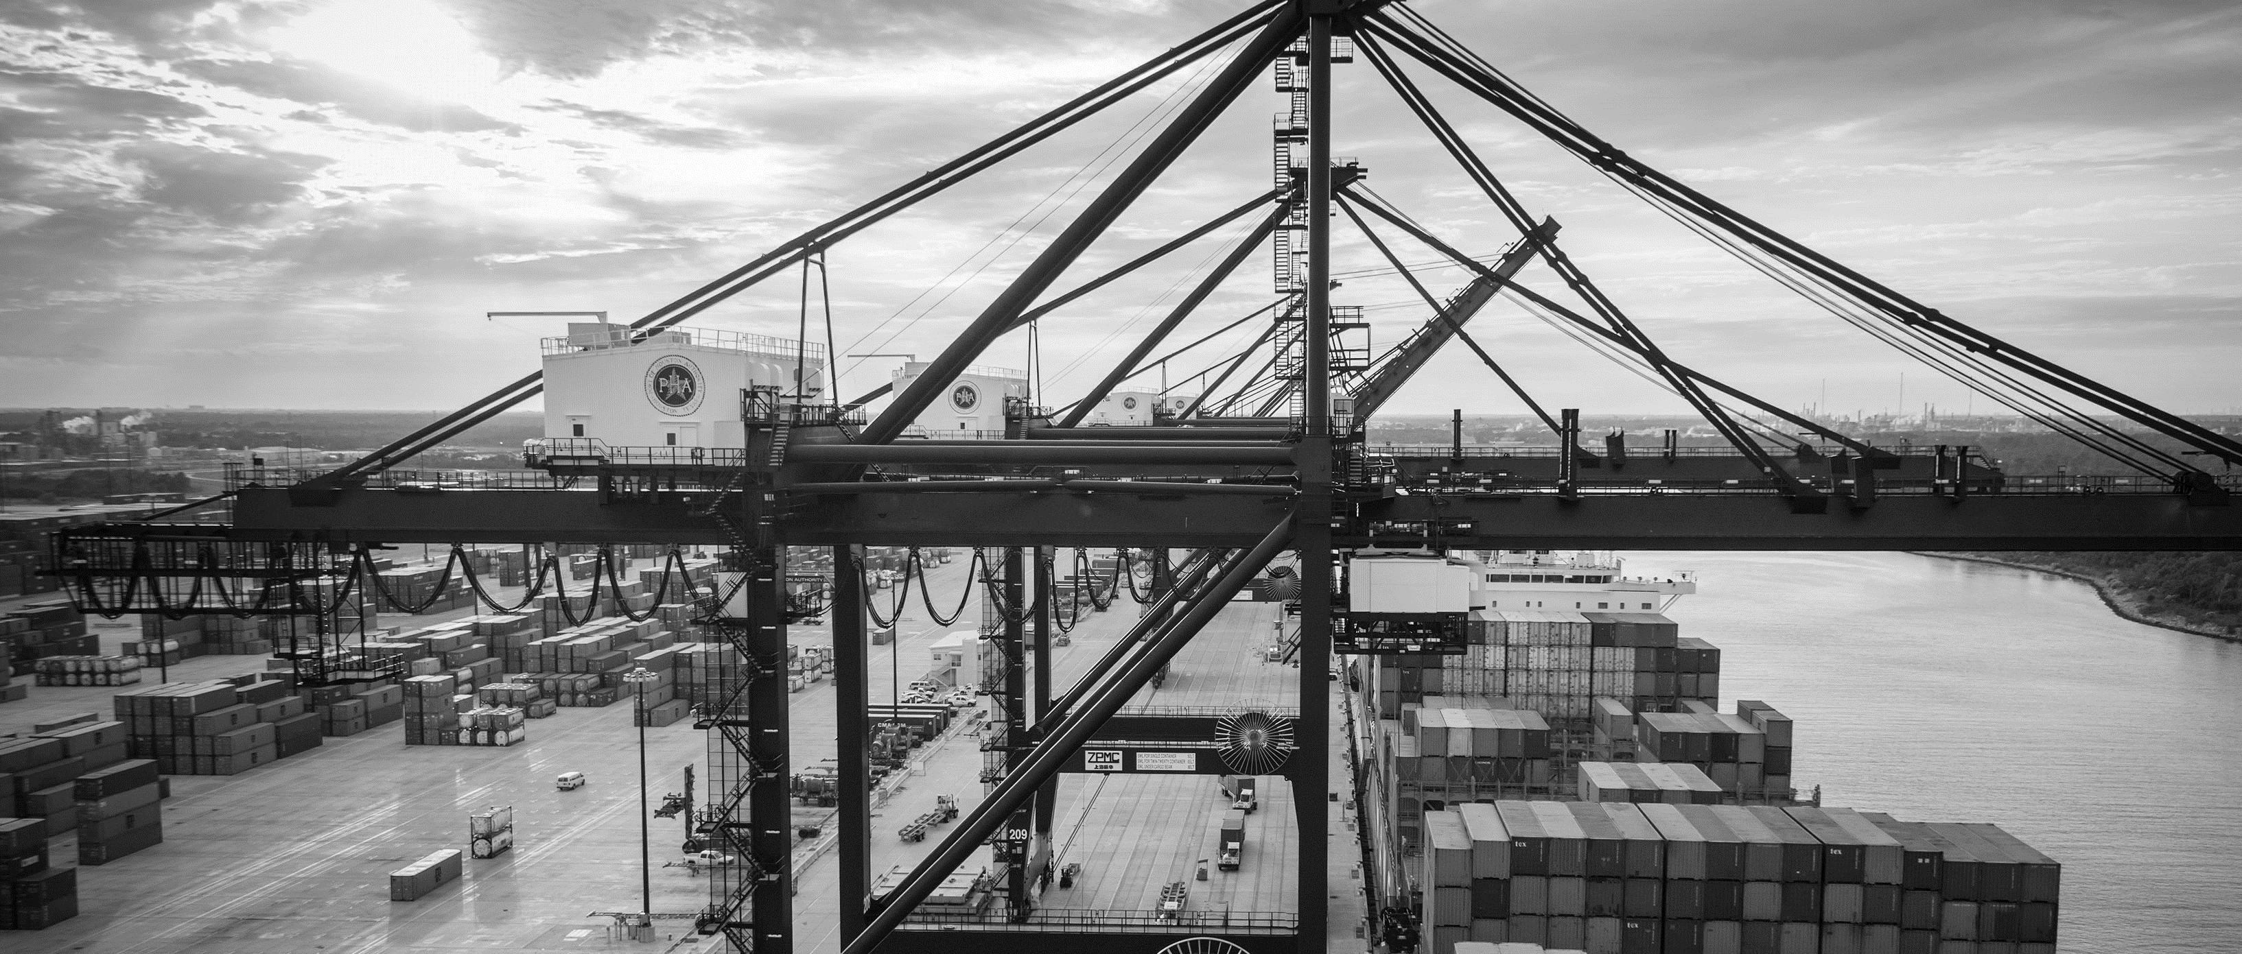
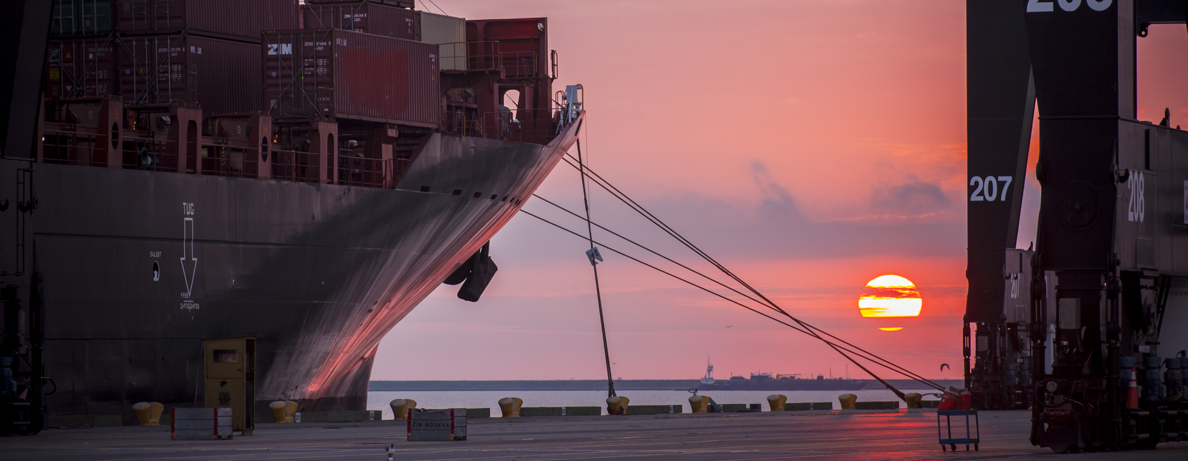
RFP-464 Container Capacity Assessment and Operational Options Study
Mark Griffin| Director Facility Planning

Slide 2
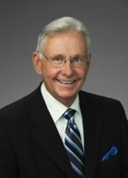
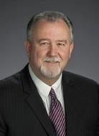
Port Commission
John D. Kennedy
Dean E. Corgey
Clyde Fitzgerald
Janiece M. Longoria
Chairman
Theldon R. Branch, III
Stephen H. DonCarlos
Roy D. Mease
WELCOME MESSAGE | 2

Slide 3
Container Capacity Assessment and Operational Options Study
AGENDA
Introductions
Procurement Services
Selection Criteria
Scope of Work
Questions
All attendees please sign-in

Slide 4
Container Capacity Assessment and Operational Options Study
PHA Personnel:
Richard Byrnes – Chief Infrastructure Officer
Jeff Davis – Chief Port Operations Officer
Ryan Mariacher – Director Container Terminals
Bryan Seitz – Manager of Analysis & Planning
Yvette Camel-Smith – Director, Procurement
Tanika Chukwumerije – Manager, Contracts
Mark Griffin – Director, Facility Planning

Slide 5
Container Capacity Assessment and Operational Options Study
Small Business Requirement:
This project has been deemed “Exempt” from the Small Business Development Program.

Slide 6
Container Capacity Assessment and Operational Options Study
Procurement:
Request of Proposals (RFP) are due on August 16, 2017, no later than 11:00 A.M.
One original and five copies, packaged in one sealed envelope

Slide 7
Container Capacity Assessment and Operational Options Study
Selection Criteria
The Port Commission will award the contract to the responsible proposer that offers the best value to the Port Authority.
Purchase Price- 20%
Vendor’s Reputation, Quality of Services and/or Product, Safety Record- 40%
Benefit to Port Authority- 30%
Overall Compliance with Port Authority Policies- 7%
Local Business Participation- 3%

Slide 8
Container Capacity Assessment and Operational Options Study
General Scope of Services:
Task 1A: Assess current and potential capacities of BCT & BPT
Task 1B: Develop integrated terminal throughput capacity model—configurations, operations, technologies
Task 2: Evaluate operational and technological options—density and intensity
Task 3: Extend model to include terminal expansion options
Task 4: Integrate CAPEX/OPEX analysis capability

Slide 9
THANK YOU
Mark Griffin
Director Facility Planning
Port Houston
Questions?
713.670.2464
procurement@poha.com
www.PortHouston.com
111 East Loop North
Houston, TX 77029
WELCOME MESSAGE | 4

