Slide 1
RFP 2996 – HOUSTON SHIP CHANNEL (HSC), EXPANSION CHANNEL IMPROVEMENT PROJECT (ECIP), PROJECT 11: BAYPORT TO MORGANS POINT, HSC STA 16+000 TO HSC BAYOU STA 27+48.18
Pre-Proposal Meeting
November 2, 2023
11:30 a.m.
PORT HOUSTON

Slide 2
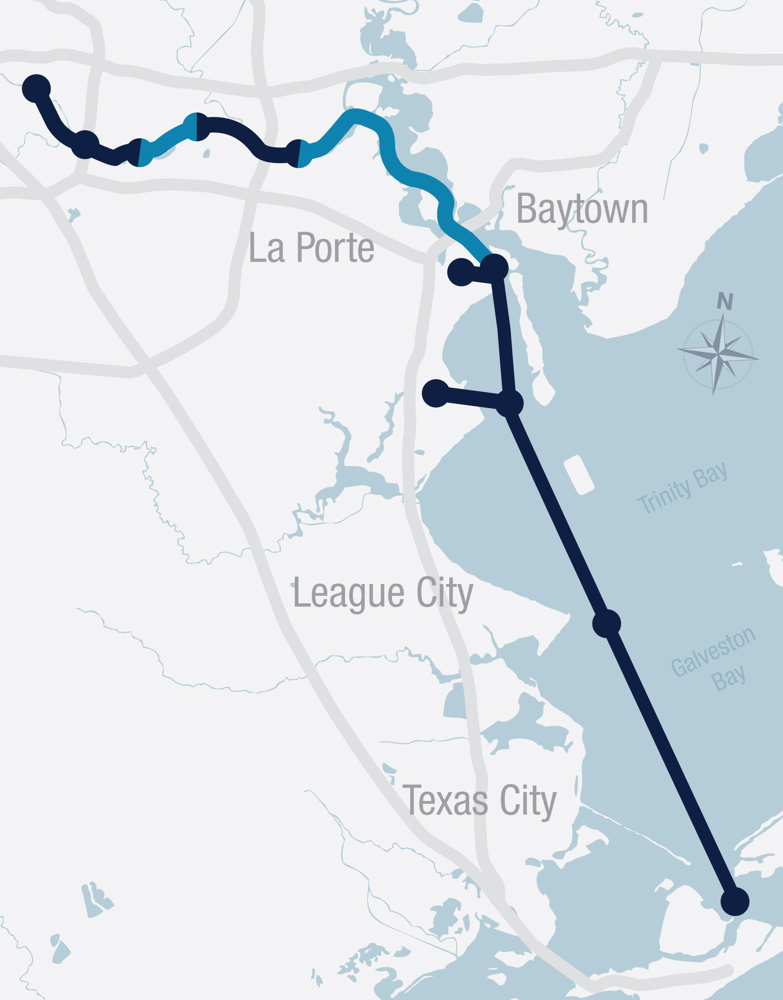
PROJECT 11
HOUSTON SHIP CHANNEL EXPANSION
6
5
4
Q4 2026
1A
Bolivar Roads to Redfish​
• Approximately 11.5 miles in length​
• Widen Channel to 700 feet​
• Bend easing​
• Construct New Bird Island​
• Mitigate for oyster habitat loss
Redfish to Bayport Ship Channel​
• Approximately 8.3 miles in length​
• Widen Channel to a minimum of 700 feet​
• Bend easing​
• Construct marshes and three bird islands in Galveston Bay ​
• Mitigate for oyster habitat loss​
• Currently not in the proposed federal plan, so must be built by local interests
Bayport Ship Channel to Barbours Cut
• Approximately 5 miles in length​
• Widen Channel to 700 feet​
• Construct additional marshes​
• Mitigate for oyster habitat loss​
• Currently not in the proposed federal plan, so must be built by local interests
2
Bayport Ship Channel
• Approximately 4 miles in length​
• Widen Channel to approximately 455 feet ​
• Construct marshes and three bird islands in Galveston Bay ​
• Mitigate for oyster habitat loss ​
• Modify channel entrance to reduce shoaling
Barbours Cut Ship Channel
• Widen Channel to approximately 455 feet ​
• Construct additional marshes on
Atkinson Island​
• Modify channel entrance
Boggy Bayou (BW 8) to Sims Bayou*
• Widen Channel to approximately 530 feet through Greens Bayou confluence​
• Deepen from existing 41 feet to 46.5 feet from
Boggy Bayou to Hunting Bayou (last Turning
Basin before reaching Washburn Tunnel)
Sims Bayou to IH 610*
• Deepen from existing 37 feet to 41.5 feet
IH 610 to Turning Basin*
• Deepen from existing up to 41.5 feet​
• Increase Brady Island Turning Basin
3
USACE
Barbours Cut
Pending Federal Appropriation
1C
Q1 2025
2
Q4 2023
Bayport
1B
3
1B
Q3 2024
4
Q1 2023
1A
1C
5
PORT HOUSTON
6
No work planned in these areas
*
Pending federal appropriations

Slide 3
AGENDA
Pre-Proposal Meeting House Rules
Introductions
Business Equity
Procurement Services
Evaluation Criteria
Project Scope
Questions

Slide 4
PRE-PROPOSAL MEETING HOUSE RULES
Attendees will begin the meeting in listen-only mode.
There will be a Q&A session at the end of today’s presentation.
If you have any questions during the presentation, you may submit your Questions through the Teams Chat feature and they will be addressed at the end of the presentation.
This presentation recording will be posted on the BuySpeed homepage under “Pre-Bid/Proposal Conference Information.”

Slide 5
PHA PERSONNEL
Charlie Jenkins – Chief, Channel Infrastructure Officer
Lori Brownell – Director, Channel Improvement
Amanda Hamrick – Project Manager, Channel Improvement
Yvette Camel-Smith – Director, Procurement
Alberto Foster – Manager Contracts, Procurement
Sommer Freeman – Contract Administrator, Procurement
Brenda Ruiz – Business Equity Supplier Diversity Manager
NON PHA PERSONNEL
Matt McCollum – Ports and Navigation Engineer, US West Water, AECOM
Chester Hedderman – Project Engineer/ Surveyor, GBA

Slide 6
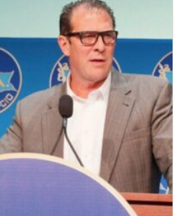
PORT COMMISSION
Dean E. Corgey
Commissioner
Clyde Fitzgerald
Commissioner
Stephen H. DonCarlos
Commissioner
Ric Campo
Chairman of the Port Commission
Alan A, Robb
Commissioner
Wendy Montoya Cloonan
Commissioner
Cheryl D. Creuzot
Commissioner
Notes:
So let’s talk about Port Houston. First, we are governed by a seven-member Commission, led by Chairman Ric Campo.

Slide 7
BUSINESS EQUITY

Slide 8
BUSINESS EQUITY
S/MWBE INITIATIVE
Business Equity Division provides resources to small, minority- and woman-owned businesses (S/MWBE) seeking to participate in Port Houston procurements and contracts.
Port Houston promotes business opportunities for all sectors of the community and recognizes the importance of vendor and suppler diversity in its contracts.
Port Houston has established an organizational ​35% Small Business participation goal and a​ 30% Minority-and Woman Business Enterprise (MWBE) aspirational goal.
35%
SBE participation goal
30%
MWBE aspirational goal

Slide 9
BUSINESS ENTERPRISE DEFINITIONS
Small Business Enterprise (SBE)
Gross revenues or number of employees, averaged over the past three years does not exceed the size standards defined by SBA.
The net worth of the owner must be less than $1.32 million, excluding the owner’s primary residence and assets of the business.
Minority Business Enterprise (MBE)
At least 51% Owned by one or more Minority Individuals, or at least 51% of the equity is Owned by one or more Minority Individuals.
Both the management and daily business operations are carried out and controlled by one or more of the Minority Individuals who own it.
Woman-Owned Business Enterprise (WBE)
At least 51% Owned by one or more Women, or at least 51% of the equity is Owned by one or more Women
Both the management and daily business operations are carried out and controlled by one or more of the Women who own it.
Notes:
As a contractor Contractor you are agrees to:
• Placing qualified S/MWBEs on solicitation lists; S/MWBEs must perform a Commercially Useful Function (CFU) to be counted towards goals. CANNOT BE A PASS THROUGH

Slide 10
CERTIFYING PARTNERS
City of Houston *
Houston Minority Supplier Development Council
METRO *
National Minority Supplier Development Council & Affiliates
Small Business Administration 8(a) *
South Central Texas Regional Certification Agency – SCTRCA *
Texas Comptroller of Public Accounts – HUB Certification
Texas Department of Transportation – TxDOT *
Women’s Business Enterprise Alliance
Women’s Business Enterprise National Council & Affiliates – WBENC
* No fee to apply
Notes:
Port Houston is not a certifying entity but we accept the certifications from our certifying partners . Meeting the certification requirements for any of the listed partners is a requirement to be part of the Port of Houston S/MWBE Program. After certification has been verified, interested business must complete an enrollment process to be inducted into the S/MWBE Program.

Slide 11
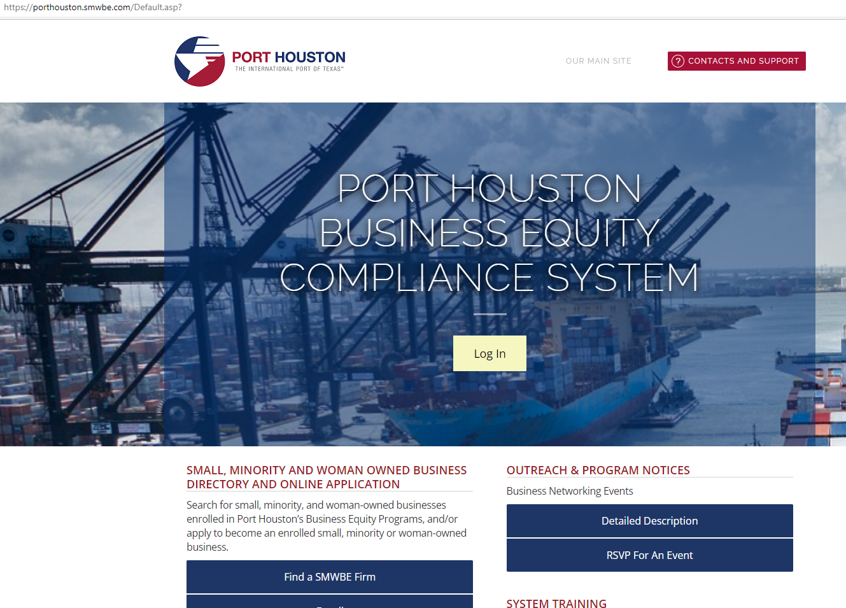
PORT HOUSTON S/MWBE ENROLLMENT DIRECTORY
How do I identify Port Houston enrolled small,
minority- and woman-owned businesses
(S/MWBE)?
Search for businesses in 2 easy steps:
Visit https://porthouston.smwbe.com. Under the section on the left labeled Small, Minority and Woman Owned Business Directory and Online Application select the blue button labeled, "Find a S/MWBE Firm".
2. You will need to complete at least one of the fields in the popup window titled, Port Houston S/MWBE Enrollment Directory and Search.
www.porthouston.smwbe.com
Notes:
Search for small, minority, and woman-owned businesses enrolled in Port Houston’s Business Equity Programs
NAIC Codes
Download our directory.

Slide 12
BUSINESS EQUITY CONTRACT REQUIREMENTS
This project does not have any Business Equity requirements.
All dollars awarded and committed to enrolled S/MWBEs count towards Port Houston's S/MWBE goals regardless of whether the individual solicitation includes criteria for small, minority, woman-owned business participation.
Notes:
An Enrolled Small Business prime receives all SB points.

Slide 13
TIPS TO INCREASE S/MWBE PARTICIPATION
Establish relationships with S/MWBE’s in advance ​
Use the Port of Houston Directory.
Advertise opportunities
Offer assistance and use the services and assistance, as appropriate, of such organizations as the Small Business Administration and the Minority Business Development Agency of the Department of Commerce.​
What subcontractors have you done business in the past and do they qualify?
Notes:
As a contractor Contractor you are agrees to:
• Placing qualified S/MWBEs on solicitation lists; S/MWBEs must perform a Commercially Useful Function (CFU) to be counted towards goals. CANNOT BE A PASS THROUGH

Slide 14
PROCUREMENT

Slide 15
PROCUREMENT
No Contact Period – No communication between interested vendors and Port Houston staff during the active period
Technical questions should be submitted via BuySpeed
Last day to submit questions: 7 days before due date 11/29/2023
Responses are due no later than 11 a.m. CT on 12/6/2023
Proposals must be submitted electronically via email to: procurementproposals@porthouston.com
Use forms in the package
Anticipated award date: 1/24/2024

Slide 16
EVALUATION CRITERIA
The Port Commission will award the contract to the Respondent whose Response provides the best value in consideration of the evaluation factors set forth below.
Relative Importance of price and other evaluation factors, in accordance with Section 60.405 of the Texas Water Code, the Request for Proposals form lists the proposal evaluation criteria in the order of their relative importance, with the most important listed first.
Price
Benefit to PHA
Respondent
Overall Compliance with PHA Policies

Slide 17
SCOPE OF WORK OVERVIEW

Slide 18
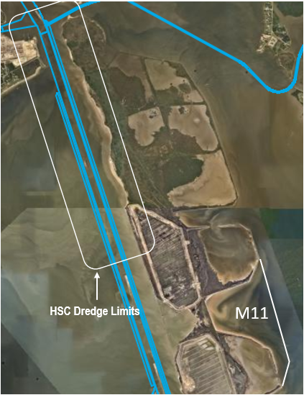
PROJECT SCOPE
BAYPORT TO MORGANS POINT, HSC STA. 16+000 TO HSC BAYOU STA. 27+48.18
Channel widening from 530 to 700 feet
Dredging 3.27 million CY to construct new M11 cell
8,013 LF of new dike construction at M11
8,595 LF of dike rehabilitation of existing M7/8/9/10
129,780 Tons of shore protection
Replacement of outfall structure
Seeding and fertilization

Slide 19
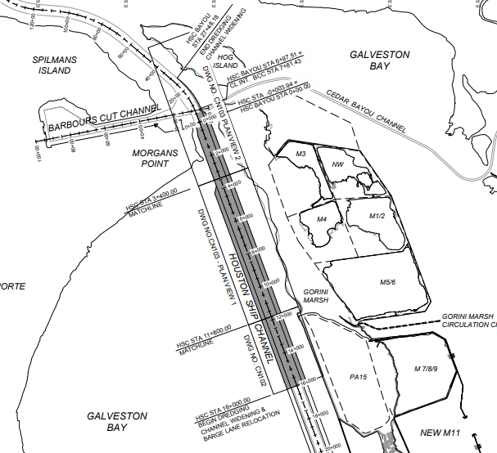
PROJECT SCOPE
BAYPORT TO MORGANS POINT, HSC STA. 16+000 TO HSC BAYOU STA. 27+48.18
Channel widening from 530 to 700 feet
Dredging 3.27 million CY to construct new M11 cell
8,013 LF of new dike construction at M11
8,595 LF of dike rehabilitation of existing M7/8/9/10
129,780 Tons of shore protection
Replacement of outfall structure
Seeding and fertilization

Slide 20
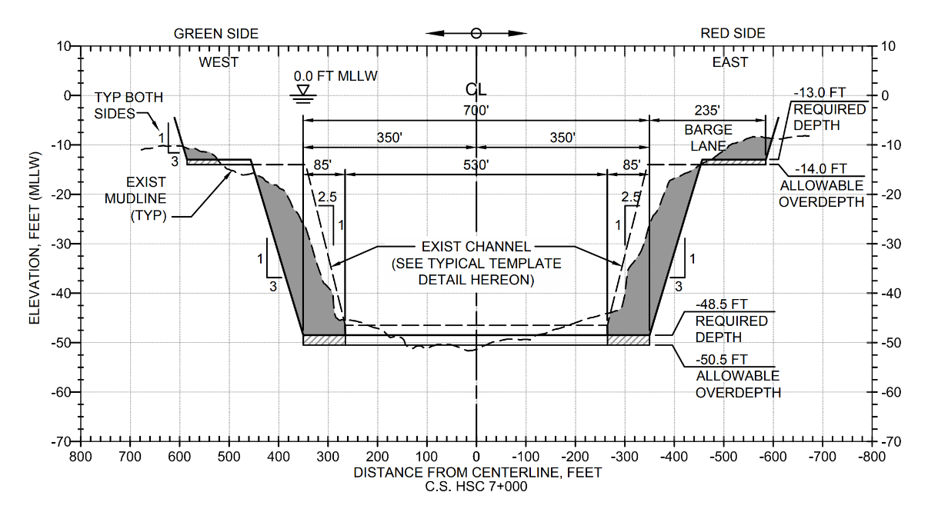
PROJECT SCOPE
HSC TYPICAL CROSS SECTION

Slide 21
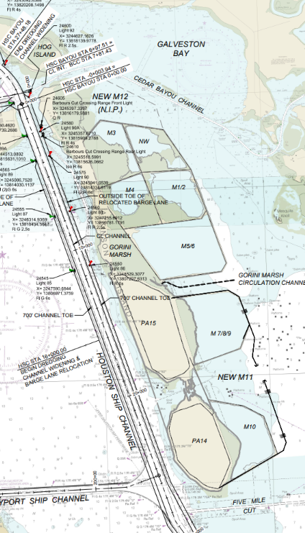
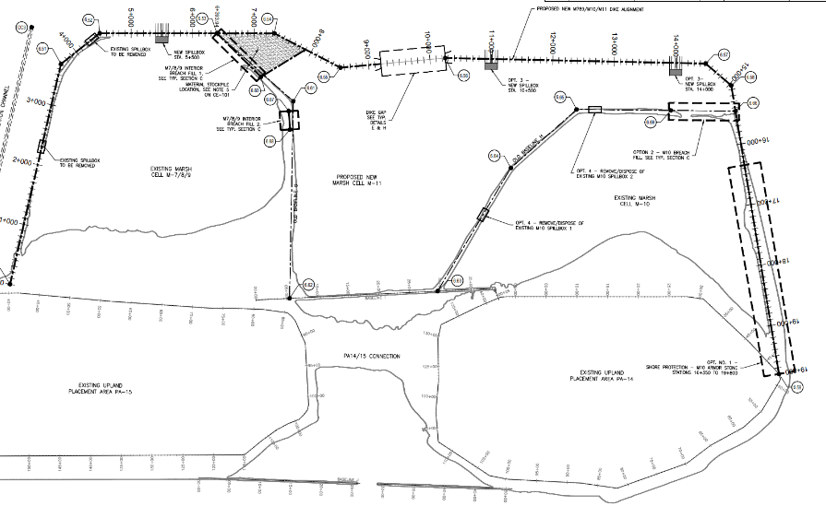
PROJECT SCOPE
PLACEMENT AREA OVERVIEW

Slide 22
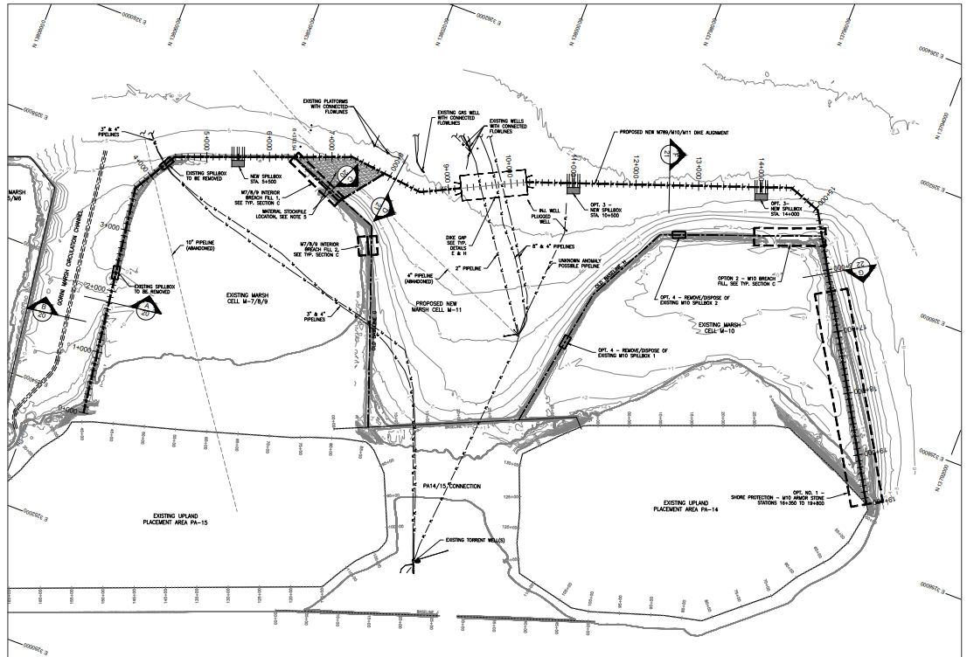
PROJECT SCOPE
PIPELINE OVERVIEW
Notes:
3.27 MCY of dredging

Slide 23
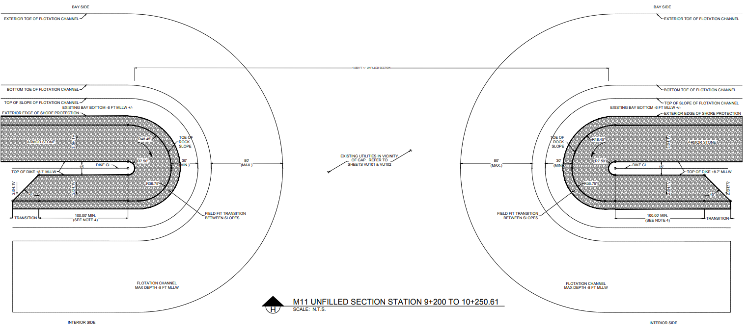
PROJECT SCOPE
PLACEMENT AREA TYPICAL CROSS SECTION

Slide 24
QUESTIONS?
Procurement Services
Email: procurement@porthouston.com
Phone: (713) 670- 2464
New BuySpeed URL: https://buyspeed.porthouston.com
Notes:
Turned back over to Sandy

