Slide 1
Pre-Proposal Meeting:
RFP 2988 - SEDIMENT SAMPLING AND ANALYTICAL REPORT – ODMDS PERMITTING
October 16, 2023
11:00 a.m.
PORT HOUSTON

Slide 2
AGENDA
Pre-Proposal Meeting House Rules
Introductions
Business Equity
Procurement Services
Selection Criteria
Project Scope
Questions

Slide 3
PRE-PROPOSAL MEETING HOUSE RULES
Attendees will begin the meeting in listen-only mode.
There will be a Q&A session at the end of today’s presentation.
If you have any questions during the presentation, you may submit your Questions through the Teams Chat feature and they will be addressed at the end of the presentation.
This presentation recording will be posted on the BuySpeed homepage under “Pre-Bid/Proposal Conference Information.”

Slide 4
PHA Personnel:
Garry McMahan – Director, Channel Operations
Amanda Hamrick– HSC Project Manager, Channel Improvement
Yvette Camel-Smith – Director, Procurement Services
Alberto Foster– Manager Contracts, Procurement Services
Sommer Freeman – Contract Administrator, Procurement
Dr. Sabeeta Bidasie-Singh - Director, Business Equity
Brenda Ruiz – Manager, Business Equity
Nicole Jones – Compliance Analyst, Business Equity
Eduardo Mejia – Compliance Analyst, Business Equity

Slide 5
PORT COMMISSION
Dean E. Corgey
Commissioner
Clyde Fitzgerald
Commissioner
Stephen H. DonCarlos
Commissioner
Ric Campo
Chairman of the Port Commission
Roy D. Mease
Commissioner
Wendy Montoya Cloonan
Commissioner
Cheryl D. Creuzot
Commissioner
Notes:
So let’s talk about Port Houston. First, we are governed by a seven-member Commission, led by Chairman Ric Campo.

Slide 6
BUSINESS EQUITY

Slide 7
BUSINESS EQUITY
S/MWBE INITIATIVE
Business Equity Division provides resources to small, minority- and woman-owned businesses (S/MWBE) seeking to participate in Port Houston procurements and contracts.
Port Houston promotes business opportunities for all sectors of the community and recognizes the importance of vendor and suppler diversity in its contracts.
Port Houston has established an organizational ​35% Small Business participation goal and a​ 30% Minority-and Woman Business Enterprise (MWBE) aspirational goal.
35%
SBE participation goal
30%
MWBE aspirational goal

Slide 8
BUSINESS ENTERPRISE DEFINITIONS
Small Business Enterprise (SBE)
Gross revenues or number of employees, averaged over the past three years does not exceed the size standards defined by SBA.
The net worth of the owner must be less than $1.32 million, excluding the owner’s primary residence and assets of the business.
Minority Business Enterprise (MBE)
At least 51% Owned by one or more Minority Individuals, or at least 51% of the equity is Owned by one or more Minority Individuals.
Both the management and daily business operations are carried out and controlled by one or more of the Minority Individuals who own it.
Woman-Owned Business Enterprise (WBE)
At least 51% Owned by one or more Women, or at least 51% of the equity is Owned by one or more Women
Both the management and daily business operations are carried out and controlled by one or more of the Women who own it.
Notes:
As a contractor Contractor you are agrees to:
• Placing qualified S/MWBEs on solicitation lists; S/MWBEs must perform a Commercially Useful Function (CFU) to be counted towards goals. CANNOT BE A PASS THROUGH

Slide 9
CERTIFYING PARTNERS
City of Houston *
Houston Minority Supplier Development Council
METRO *
National Minority Supplier Development Council & Affiliates
Small Business Administration 8(a) *
South Central Texas Regional Certification Agency – SCTRCA *
Texas Comptroller of Public Accounts – HUB Certification
Texas Department of Transportation – TxDOT *
Women’s Business Enterprise Alliance
Women’s Business Enterprise National Council & Affiliates – WBENC
* No fee to apply
Notes:
Port Houston is not a certifying entity but we accept the certifications from our certifying partners . Meeting the certification requirements for any of the listed partners is a requirement to be part of the Port of Houston S/MWBE Program. After certification has been verified, interested business must complete an enrollment process to be inducted into the S/MWBE Program.

Slide 10
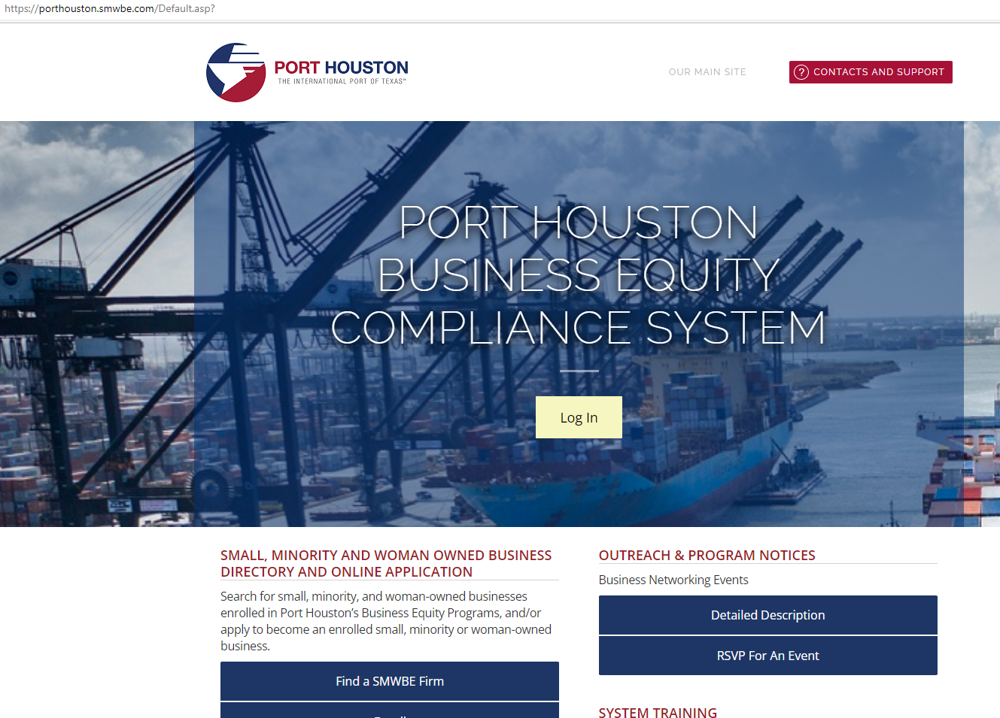
PORT HOUSTON S/MWBE ENROLLMENT DIRECTORY
How do I identify Port Houston enrolled small,
minority- and woman-owned businesses
(S/MWBE)?
Search for businesses in 2 easy steps:
1. Visit https://porthouston.smwbe.com Under the section on the
left labeled Small, Minority and Woman Owned Business
Directory and Online Application select the blue button labeled,
"Find a S/MWBE Firm".
2. You will need to complete at least one of the fields in the popup
window titled, Port Houston S/MWBE Enrollment Directory
and Search.
www.porthouston.smwbe.com
Notes:
Search for small, minority, and woman-owned businesses enrolled in Port Houston’s Business Equity Programs
NAIC Codes
Download our directory.

Slide 11
BUSINESS EQUITY CONTRACT REQUIREMENTS
This project has a Small Business 30% goal, weight 10 points.
Notes:
An Enrolled Small Business prime receives all SB points.

Slide 12
TIPS TO INCREASE S/MWBE PARTICIPATION
Establish relationships with S/MWBE’s in advance ​
Use the Port of Houston Directory.
Advertise opportunities
Offer assistance and use the services and assistance, as appropriate, of such organizations as the Small Business Administration and the Minority Business Development Agency of the Department of Commerce.​
What subcontractor's have you done business in the past and do they qualify?
Notes:
As a contractor Contractor you are agrees to:
• Placing qualified S/MWBEs on solicitation lists; S/MWBEs must perform a Commercially Useful Function (CFU) to be counted towards goals. CANNOT BE A PASS THROUGH

Slide 13
PROCUREMENT

Slide 14
PROCUREMENT
No Contact Period – No communication between interested vendors and Port Houston staff during the active period.
Technical questions should be submitted via BuySpeed
Last day to submit questions: 7 days before due date (10/18/2023)
Responses are due no later than 11 a.m. on 10/25/2023
Proposals must be submitted electronically via email to: procurementproposals@porthouston.com
Use forms in the package
Anticipated award date: 12/12/2023

Slide 15
EVALUATION CRITERIA
Port Houston will select the provider of the services offering the best value to Port Houston. The criteria and relative weights that will be considered by Port Houston in evaluating each Response are as follows:

Slide 16
SCOPE OF WORK OVERVIEW

Slide 17
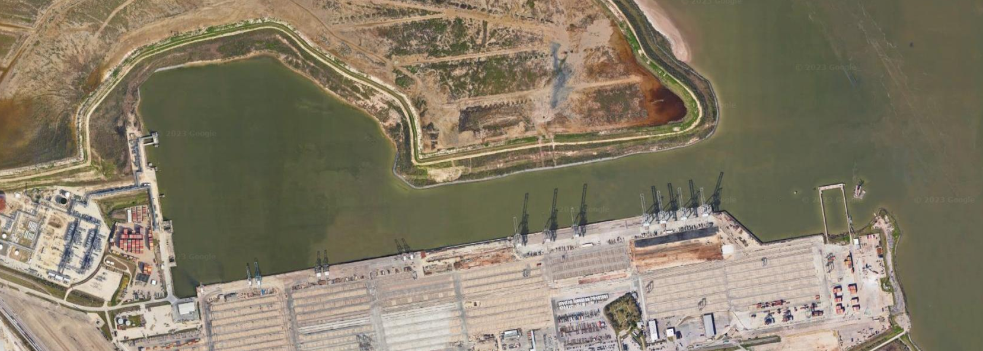
SCOPE OF WORK
Barbours Cut Terminal
DMMU 1
DMMU 2
DMMU 3

Slide 18
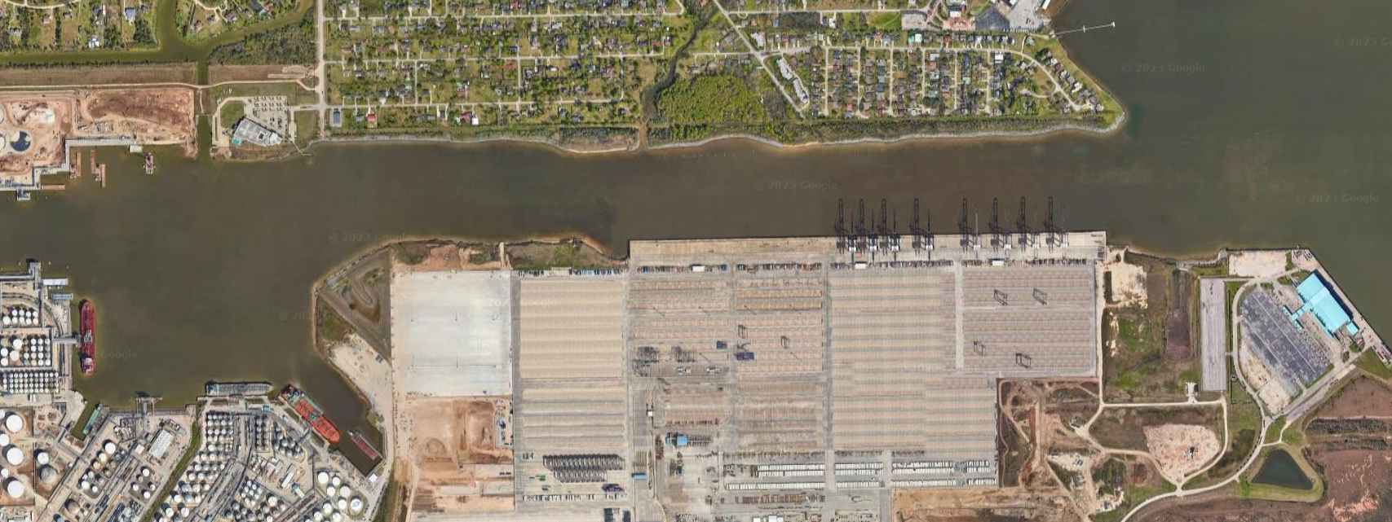
SCOPE OF WORK
Bayport Terminal
DMMU 1
DMMU 2

Slide 19
Procurement Services
Email: procurement@porthouston.com
Phone: (713) 670- 2464
New BuySpeed URL: https://buyspeed.porthouston.com
QUESTIONS?
PORT HOUSTON

