Slide 1
Pre-Proposal Conference:
RFP-2243 Terminal 3 Site Selection Study
May 23, 2022
11 a.m.
PORT HOUSTON

Slide 2
AGENDA
Pre-Proposal Conference House Rules
Introductions
Business Equity
Procurement Services
Selection Criteria
Project Scope
Questions

Slide 3
PRE-PROPOSAL CONFERENCE HOUSE RULES
Attendees will begin the meeting in listen-only mode.
There will be a Q&A session at the end of today’s presentation.
If you have any questions during the presentation, you may submit your Questions through the WebEx Q&A feature and they will be addressed at the end of the presentation.
This presentation recording will be posted on the BuySpeed homepage under “Pre-Bid/Proposal Conference Information.”

Slide 4
PHA Personnel:
Rohit Saxena – Director, Facility Planning
Yvette Camel-Smith – Director, Procurement
Dean Ainuddin – Procurement Contract Manager
Gilda Ramirez – Director, Business Equity
Brenda Ruiz – Manager Supplier Diversity, Business Equity

Slide 5
PORT COMMISSION
Dean E. Corgey
Commissioner
Clyde Fitzgerald
Commissioner
Stephen H. DonCarlos
Commissioner
Ric Campo
Chairman of the Port Commission
Roy D. Mease
Commissioner
Wendy Montoya Cloonan
Commissioner
Cheryl D. Creuzot
Commissioner
Notes:
So let’s talk about Port Houston. First, we are governed by a seven-member Commission, led by Chairman Ric Campo.

Slide 6
BUSINESS EQUITY

Slide 7
BUSINESS EQUITY
S/MWBE INITIATIVE
Business Equity Division provides resources to small, minority- and woman-owned businesses (S/MWBE) seeking to participate in Port Houston procurements and contracts.
Port Houston promotes business opportunities for all sectors of the community and recognizes the importance of vendor and suppler diversity in its contracts.
Port Houston has established an organizational ​35% Small Business participation goal and a​ 30% Minority-and Woman Business Enterprise (MWBE) aspirational goal.
35%
SBE participation goal
30%
MWBE aspirational goal

Slide 8
BUSINESS EQUITY
All dollars awarded and committed to enrolled S/MWBEs count towards Port Houston's S/MWBE goals regardless of whether the individual solicitation includes criteria for small, minority, woman-owned business participation.
Notes:
Initiative will reduce barriers to MBEs and WBEs who want to engage in business with Port Houston
Port Houston is working to identify and contact qualified S/MWBEs to meet our participation goals
Implemented race- and gender-neutral measures to ensure equal opportunities for all contractors and subcontractors
Port Houston is continuing to provide training, mentorship, networking and development assistance to all S/MWBEs

Slide 9
BUSINESS EQUITY DEFINITIONS
Small Business Enterprise (SBE)
Gross revenues or number of employees, averaged over the past three years does not exceed the size standards defined by SBA.
The net worth of the owner must be less than $1.32 million, excluding the owner’s primary residence and assets of the business.
Minority Business Enterprise (MBE)
At least 51% Owned by one or more Minority Individuals, or at least 51% of the equity is Owned by one or more Minority Individuals.
Both the management and daily business operations are carried out and controlled by one or more of the Minority Individuals who own it.
Woman-Owned Business Enterprise (WBE)-
At least 51% Owned by one or more Women, or at least 51% of the equity is Owned by one or more Women
Both the management and daily business operations are carried out and controlled by one or more of the Women who own it.
Notes:
As a contractor Contractor you are agrees to:
• Placing qualified S/MWBEs on solicitation lists; S/MWBEs must perform a Commercially Useful Function (CFU) to be counted towards goals. CANNOT BE A PASS THROUGH

Slide 10
CERTIFYING PARTNERS
Small and M/WBEs must meet certain criteria and be certified with one of the following partner agencies:
Local Presence
Harris
Montgomery
Waller
Ft. Bend
Brazoria
Galveston
Chambers
Liberty
City of Houston *
Houston Minority Supplier Development Council
METRO *
National Minority Supplier Development Council & Affiliates
Small Business Administration 8(a) *
South Central Texas Regional Certification Agency – SCTRCA *
Texas Comptroller of Public Accounts – HUB Certification
Texas Department of Transportation – TxDOT *
Women’s Business Enterprise Alliance
Women’s Business Enterprise National Council & Affiliates – WBENC
* No fee to apply
Notes:
Port Houston is not a certifying entity but we accept the certifications from our certifying partners . Meeting the certification requirements for any of the listed partners is a requirement to be part of the Port of Houston S/MWBE Program. After certification has been verified, interested business must complete an enrollment process to be inducted into the S/MWBE Program.

Slide 11
CONTRACTOR RESPONSIBILITES
Placing qualified S/MWBEs on solicitation lists; S/MWBEs must perform a Commercially Useful Function (CFU) to be counted towards goals;
Assuring that S/MWBEs are solicited whenever they are potential sources; ​
Dividing total requirements, when economically feasible, into smaller tasks or quantities to permit maximum participation by S/MWBE’s;​
Establishing delivery schedules, where the requirement permits, which encourage participation by S/MWBE’s;
Using the services and assistance, as appropriate, of such organizations as the Small Business Administration and the Minority Business Development Agency of the Department of Commerce.​
Notes:
As a contractor Contractor you are agrees to:
• Placing qualified S/MWBEs on solicitation lists; S/MWBEs must perform a Commercially Useful Function (CFU) to be counted towards goals. CANNOT BE A PASS THROUGH
“Commercially Useful Function” means Contract work that a Business controls and executes or for which it is directly responsible for executing by actually performing, managing, and supervising the work, including negotiating price, determining quality and quantity, ordering, installing, and paying for materials, supplies, and services as applicable.

Slide 12
BUSINESS EQUITY CONTRACT REQUIREMENTS
RFP-2243 Terminal 3 Site Selection Study
Small Business Enterprise (SBE) participation target/goal is 20% with 5 points.
Notes:
This project has a Small Business target/goal of 20% with 5 points. You must meet the 20% or demonstrate adequate Good Faith Efforts.

Slide 13
GFE- Good Faith Efforts (Attachment 10)
“Good Faith Efforts” or “GFE” means efforts to achieve an SBE, MBE or WBE (as applicable) participation goal, which efforts, by their scope, intensity, and appropriateness, can reasonably be expected to fulfill the applicable Program requirement.

Slide 14
GFE- Good Faith Efforts (Attachment 10)
Good Faith Efforts are to be demonstrated by a successful bidder on goal-oriented contracts PRIOR to the award.
If a bidder anticipates it cannot or will not meet the contract goal prior to the award, a Good Faith Effort demonstration is REQUIRED to be eligible for the award.

Slide 15
EVALUATING GFE- Good Faith Efforts (Attachment 10)
Did Bidder attend pre-bid/pre-proposal meetings?
Did Bidder ask questions about meeting Contract Goal, either at Pre-Proposal meeting or in BuySpeed’s Q&A?
Follow-up with S/MWSBEs attending the meetings to discuss subcontracting opportunities.
Contact S/MWSBEs found on PHA online directory to discuss subcontracting opportunities.
Advertise subcontracting opportunities in news media, general circulation, trade, professional association, and/or S/MWBE-focused traditional and social media regarding subcontracting opportunities?
Notes:
Women Contractors Association • Hispanic Contractor’s Association • National Association of Minority Contractors • Chambers of Commerce • Houston Minority Supplier Development Council • Women’s Business Enterprise Alliance

Slide 16
EVALUATING GFE- Good Faith Efforts (Attachment 10)
Conduct outreach with S/MWBE organizations no less than 10 business days before solicitation due date.
Does the documentation show that Bidder provided interested S/MWBEs with adequate information about the project’s plans, specifications, scope of work, and requirements?
DOCUMENT EFFORTS
Notes:
In other words, EVIDENCE of a genuine attempt to meet the contract goal.

Slide 17
PROCUREMENT

Slide 18
PROCUREMENT
No Contact Period – No communication between interested vendors and Port Houston staff during the active period.
Technical questions should be submitted via BuySpeed
Last day to submit questions: 7 days before due date (6/8/2022)
Responses are due no later than 11 a.m. on 6/15/2022
Proposals must be submitted electronically via email to: procurementproposals@porthouston.com
Use forms in the package
Anticipated award date: 7/26/2022

Slide 19
EVALUATION CRITERIA
Port Houston will select the provider of the services offering the best value to Port Houston. The criteria and relative weights that will be considered by Port Houston in evaluating each Response are as follows:
Evaluation Criteria | Relative Weight (%)
Price | 20
Respondent | 60
Benefit to Port Authority | 15
Small Business Participation | 5

Slide 20
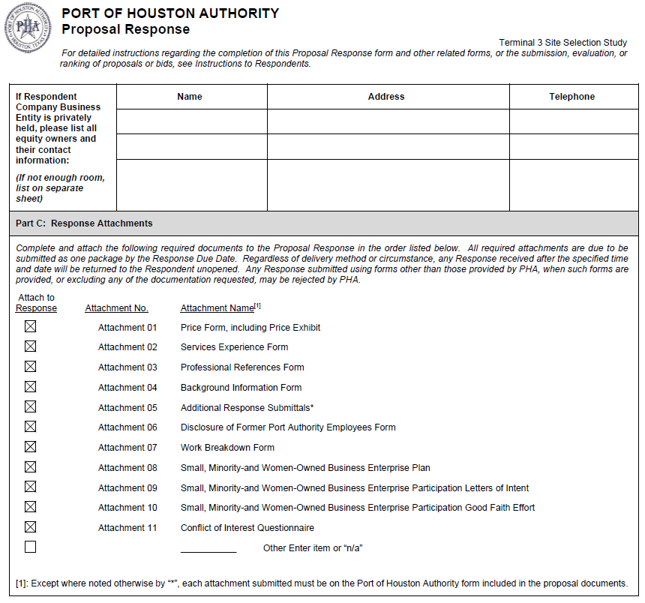
DOCUMENT CHECKLIST
Proposal Response form:
(Page 18 of Solicitation Package)
Page 2 of the Proposal Response Form – Required Attachments

Slide 21
SCOPE OF WORK OVERVIEW

Slide 22
BACKGROUND
Record Growth in Containerized Cargo
Capacity Constraints at Existing Container Terminals
Increase Port Houston’s Cargo Handling Capacity
Cost-Effective Direct Connections w/East and South-East Asia
Carriers Deploying Larger Vessels

Slide 23
SCOPE OF WORK
Site Selection and Evaluation (Minimum 200-acre Tracts)
- New Greenfield Sites
- Brownfield Conversion
- Multiple Site Options
- Other Alternatives
Analysis of Existing and Potential Markets
Evaluate Potential Locations Based on Defined Criteria
Identify Top Potential Sites with Conceptual Level Costs
Timing Considerations for Development
Recommendation of Preferred Site(s)

Slide 24
Procurement Services
Email: procurement@porthouston.com
Phone: (713) 670- 2464
QUESTIONS?
PORT HOUSTON

