Slide 1
RFP-2148 Professional Services for the Design & Implementation of Incentive Pay (Variable Pay) Structure and Performance Management Program Review for Best Practices and Streamlined Design
PRE-PROPOSAL CONFERENCE:
March 15, 2022
1:00 p.m. (CST)

Slide 2
AGENDA
Pre-Proposal Conference House Rules
Port Commission
Business Equity
Procurement Services
Scope of Services
Q & A

Slide 3
PRE-PROPOSAL HOUSE RULES
Attendees will begin the meeting in listen-only mode.
There will be a Q&A session at the end of today’s presentation.
If you have any questions during the presentation, you may submit your Questions through the WebEx Q & A feature and they will be addressed at the end of the presentation.
This presentation recording will be posted on the BuySpeed homepage under “Pre-Bid/Proposal Conference Information.”

Slide 4
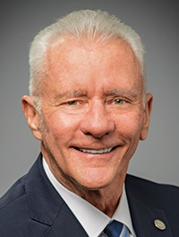
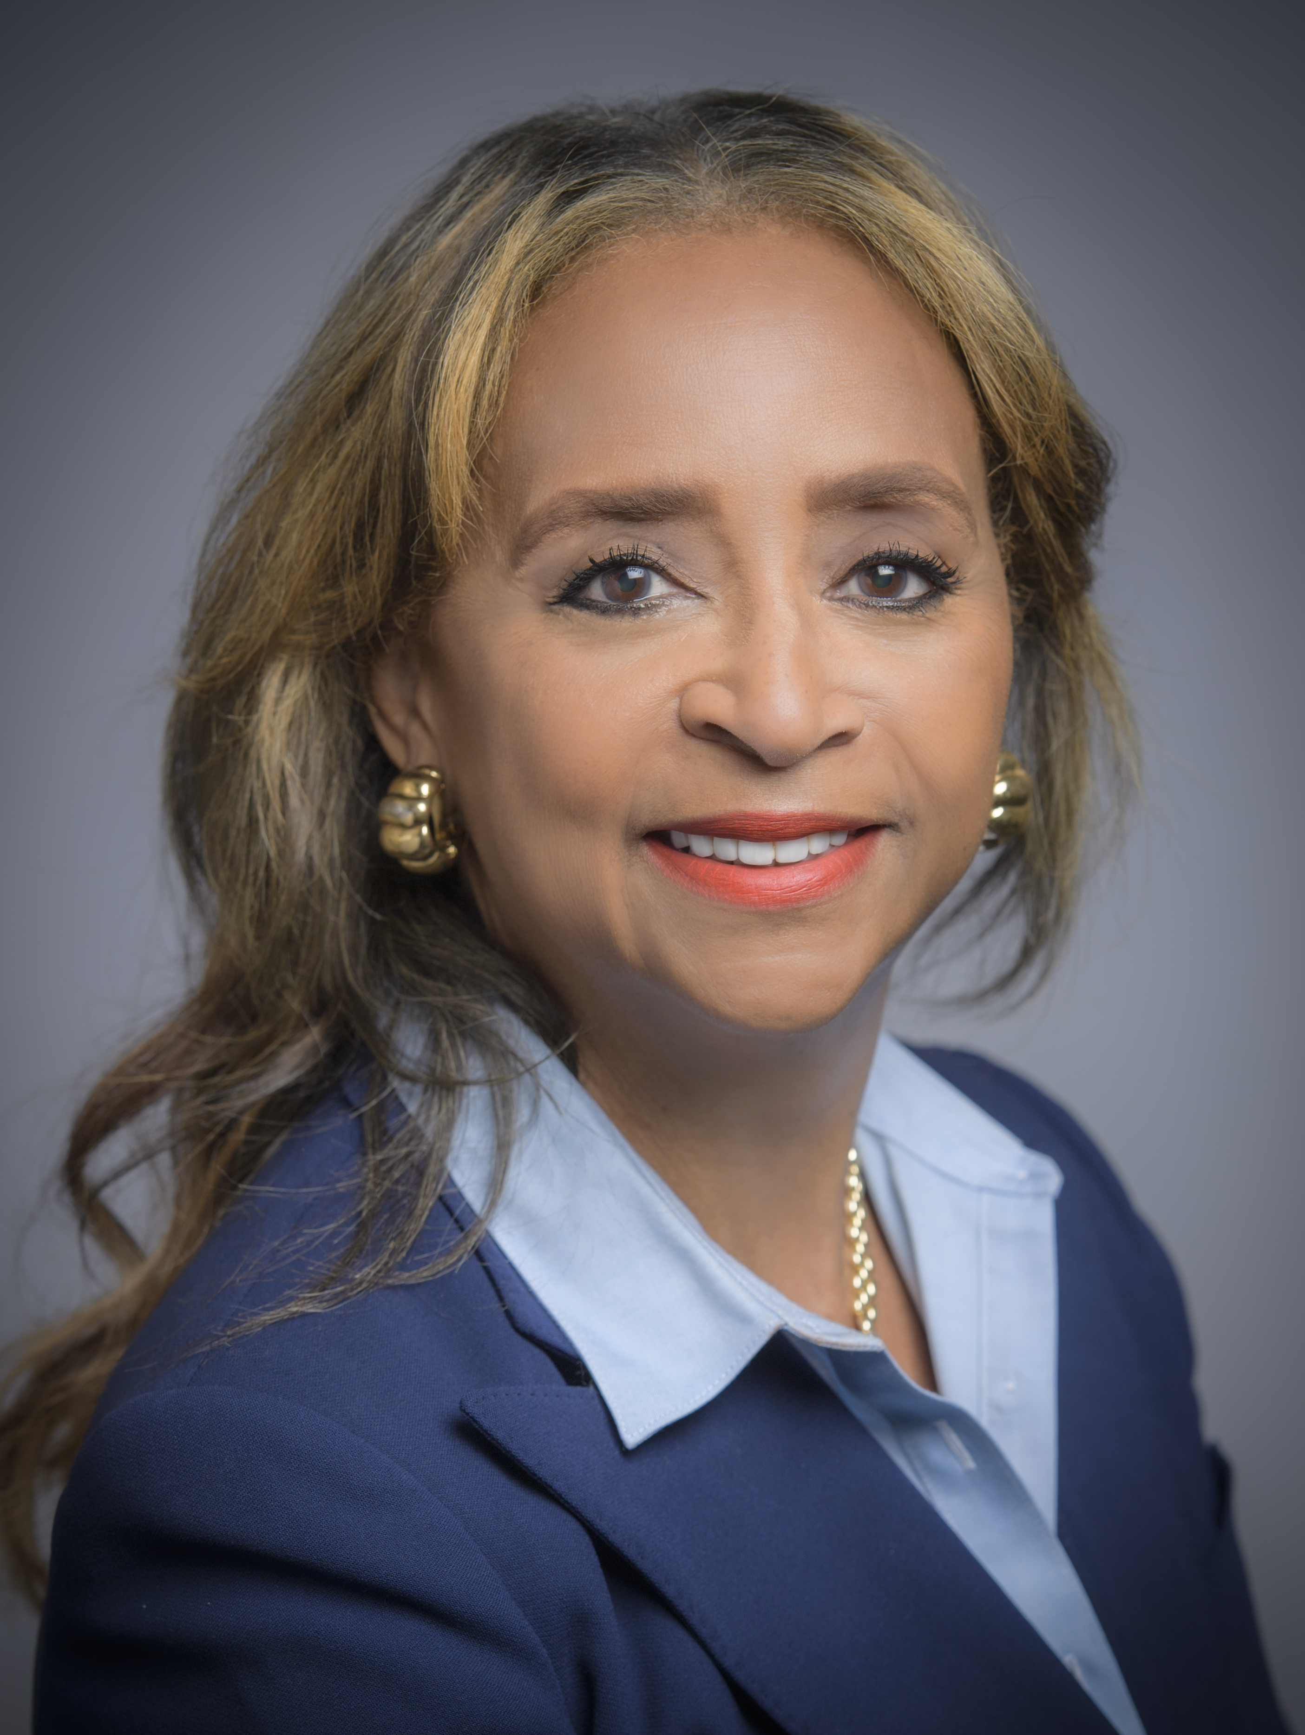
PORT COMMISSION
Dean E. Corgey
Commissioner
Clyde Fitzgerald
Commissioner
Stephen H. DonCarlos
Commissioner
Ric Campo
Chairman
Roy D. Mease
Commissioner
Wendy Montoya Cloonan
Commissioner
Cheryl D. Creuzot
Commissioner
Notes:
So let’s talk about Port Houston. First, we are governed by a seven-member Commission, led by Chairman Ric Campo. Since this procurement is a formal procurement, meaning the contract value is above $50,000, the Port Commission will be responsible for approving or rejecting the staff’s award recommendation.

Slide 5
Business Equity

Slide 6
BUSINESS EQUITY, S/MWBE PROGRAMS
Port Houston promotes business opportunities for all sectors of the community and recognizes the importance of vendor and suppler diversity in its contracts.
Port Houston has established an organizational
35% Small Business participation goal and a
30% Minority-and Woman Business Enterprise (MWBE) aspirational goal.
Notes:
The Port Commission, at its April 27, 2021 meeting, approved the NEW Minority- and Woman-Owned Business Enterprise Development Policy and the Amended and Restated Small Business Development Policy.
Initiative will reduce barriers to MBEs and WBEs who want to engage in business with Port Houston
Port Houston is working to identify and contact qualified S/MWBEs to meet our participation goals
Implemented race- and gender-neutral measures to ensure equal opportunities for all contractors and subcontractors
Port Houston is continuing to provide training, mentorship, networking and development assistance to all S/MWBEs

Slide 7
AWARDS & COMMITTMENTS
All dollars awarded and committed to enrolled S/MWBEs count towards Port Houston's S/MWBE goals regardless of whether the individual solicitation includes criteria for small, minority, woman-owned business participation.

Slide 8
BUSINESS EQUITY DEFINITIONS
Small Business Enterprise (SBE) means a firm whose gross revenues or number of employees, averaged over the past three years, inclusive of any affiliates as defined by 13 CFR § 121.103, does not exceed the size standards defined in Section 3 of the Federal Small Business Act and applicable Small Business Administration regulations related to the size standards found in 12 CFR §121. The net worth of the owner must be less than $1.32 million, excluding the owner’s primary residence and assets of the business.
Minority Business Enterprise (MBE) means a Business that is at least 51% Owned by one or more Minority Persons, or for which at least 51% of the equity is Owned by one or more Minority Persons, and both the management and daily business operations are carried out and controlled by one or more of the Minority Persons who own it.
Woman Business Enterprise (WBE means a Business that is at least 51% Owned by one or more females, or for which at least 51% of the equity is owned by one or more females, and both the management and daily business operations are carried out and controlled by one or more of the females who own it.
MWBE and SBE Policies: The Port Commission, at its April 27, 2021, meeting, approved the NEW Minority-Amended and Restated Small Business Development Policy.

Slide 9
PARTNER CERTIFYING AGENCIES
Small and MWBEs must meet certain criteria and be certified with one of the following partner agencies:
*City of Houston (SBE, MBE, WBE)
Houston Minority Supplier Development Council (MBE)
*METRO (SBE)
*SBA 8(a) (SDB)
*State of Texas HUB Certification (HUB)
South Texas Central Regional Certification Agency (SBE, MBE, WBE)
*Texas Department of Transportation (SBE)
Women’s Business Enterprise Alliance (WBE)
*No fee to apply

Slide 10
S/MWBE CONTRACTOR REQUIREMENTS
Contractor is encouraged to and agrees it will endeavor to:
Placing qualified small and minority businesses and women’s business enterprises on solicitation lists;
Assuring that small and minority businesses, and women’s business enterprises are solicited whenever they are potential sources;
Dividing total requirements, when economically feasible, into smaller tasks or quantities to permit maximum participation by small and minority businesses, and women’s business enterprises;
Establishing delivery schedules, where the requirement permits, which encourage participation by small and minority businesses, and women’s business enterprises;
Using the services and assistance, as appropriate, of such organizations as the Small Business Administration and the Minority Business Development Agency of the Department of Commerce.

Slide 11
S/MWBE CONTRACTOR REQUIREMENTS
This project has the following goal requirements:

Slide 12
Procurement Services
Tanika Chukwumerije
Manager, Contracts

Slide 13
PROCUREMENT
No Contact Period – No communication between interested vendors and Port Houston staff during the active period.
Technical questions should be submitted via BuySpeed
Last day to submit questions: 7 days before due date (4/6/2022)
Responses are due no later than 11 a.m. on 4/13/2022
Proposals must be submitted electronically via email to: procurementproposals@porthouston.com
Use forms in the package
Anticipated award date: 5/24/2022

Slide 14
PROCUREMENT
Evaluation Criteria
Port Houston will select the provider of the services offering the best value to Port Houston. The criteria and relative weights that will be considered by Port Houston in evaluating each Response are as follows:
Evaluation Criteria | Relative Weight (%)
Price | 22
Vendor Reputation, Quality of Services and/or Product, Safety Record | 38
Benefit to Port Authority | 30
Overall Compliance with Port Authority Policies and Instructions | 10
TOTAL | 100

Slide 15
Scope of Services
Alia O’Neill
Manager, Talent Management

Slide 16
Project Description & Background
Enhance Incentive Program
Complement current compensation program by enhancing incentive program
Transition from flat percentage to tiered/variable percentage based on level in organization
Review and Update Performance Management Best Practices
Review current manual practice
Make recommendations and resources to update best practices that offer a better method for both the managers and employees with the ability to collect and deliver performance management evaluations in a consistent method.

Slide 17
Project Scope of Work
Enhance Incentive Program
Review current incentive program
Develop transition plan to variable incentive plan, including communication plan and program structure
Review and Update Performance Management Best Practices
Review current manual practice
Develop transitional assessment form (manual)
Develop communication/training for rating calibration and consistency among leaders

Slide 18
QUESTIONS?

Slide 19
THANK YOU
Port Houston
Questions?
Procurement@porthouston.com

