Slide 1
RFP-2141 CLEANING SERVICES FOR BARBOURS CUT AND BAYPORT CONTAINER TERMINALS
PRE-PROPOSAL CONFERENCE:
March 9, 2022
10:00 a.m. (CST)

Slide 2
AGENDA
Pre-Proposal Conference House Rules
Port Commission
Business Equity
Procurement Services
Scope of Services
Q & A

Slide 3
PRE-PROPOSAL HOUSE RULES
Attendees will begin the meeting in listen-only mode.
There will be a Q&A session at the end of today’s presentation.
If you have any questions during the presentation, you may submit your Questions through the WebEx Q & A feature and they will be addressed at the end of the presentation.
This presentation recording will be posted on the BuySpeed homepage under “Pre-Bid/Proposal Conference Information.”

Slide 4
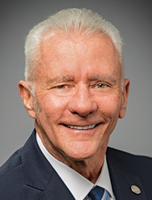
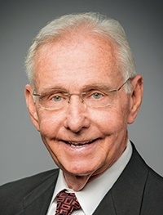
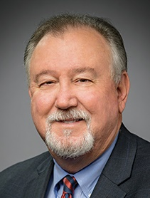
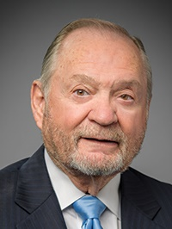
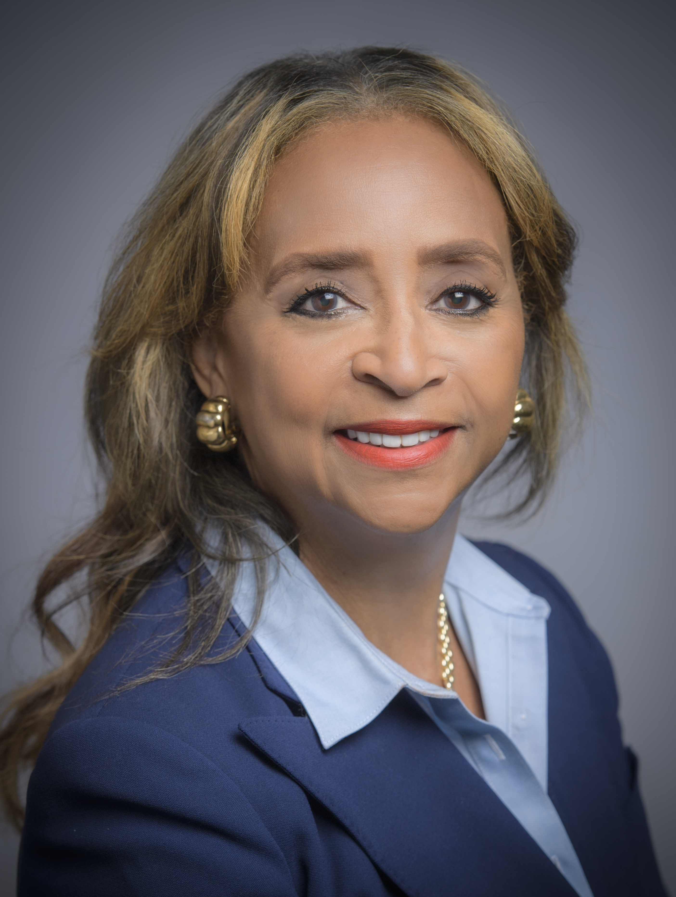
PORT COMMISSION
Dean E. Corgey
Commissioner
Clyde Fitzgerald
Commissioner
Stephen H. DonCarlos
Commissioner
Ric Campo
Chairman
Roy D. Mease
Commissioner
Wendy Montoya Cloonan
Commissioner
Cheryl D. Creuzot
Commissioner
Notes:
So let’s talk about Port Houston. First, we are governed by a seven-member Commission, led by Chairman Ric Campo. Since this procurement is a formal procurement, meaning the contract value is above $50,000, the Port Commission will be responsible for approving or rejecting the staff’s award recommendation.

Slide 5
Business Equity

Slide 6
BUSINESS EQUITY, S/MWBE PROGRAMS
Port Houston promotes business opportunities for all sectors of the community and recognizes the importance of vendor and suppler diversity in its contracts.
Port Houston has established an organizational
35% Small Business participation goal and a
30% Minority-and Woman Business Enterprise (MWBE) aspirational goal.
Notes:
The Port Commission, at its April 27, 2021 meeting, approved the NEW Minority- and Woman-Owned Business Enterprise Development Policy and the Amended and Restated Small Business Development Policy.
Initiative will reduce barriers to MBEs and WBEs who want to engage in business with Port Houston
Port Houston is working to identify and contact qualified S/MWBEs to meet our participation goals
Implemented race- and gender-neutral measures to ensure equal opportunities for all contractors and subcontractors
Port Houston is continuing to provide training, mentorship, networking and development assistance to all S/MWBEs

Slide 7
AWARDS & COMMITTMENTS
All dollars awarded and committed to enrolled S/MWBEs count towards Port Houston's S/MWBE goals regardless of whether the individual solicitation includes criteria for small, minority, woman-owned business participation.

Slide 8
BUSINESS EQUITY DEFINITIONS
Small Business Enterprise (SBE) means a firm whose gross revenues or number of employees, averaged over the past three years, inclusive of any affiliates as defined by 13 CFR § 121.103, does not exceed the size standards defined in Section 3 of the Federal Small Business Act and applicable Small Business Administration regulations related to the size standards found in 12 CFR §121. The net worth of the owner must be less than $1.32 million, excluding the owner’s primary residence and assets of the business.
Minority Business Enterprise (MBE) means a Business that is at least 51% Owned by one or more Minority Persons, or for which at least 51% of the equity is Owned by one or more Minority Persons, and both the management and daily business operations are carried out and controlled by one or more of the Minority Persons who own it.
Woman Business Enterprise (WBE means a Business that is at least 51% Owned by one or more females, or for which at least 51% of the equity is owned by one or more females, and both the management and daily business operations are carried out and controlled by one or more of the females who own it.
MWBE and SBE Policies: The Port Commission, at its April 27, 2021, meeting, approved the NEW Minority-Amended and Restated Small Business Development Policy.

Slide 9
PARTNER CERTIFYING AGENCIES
Small and MWBEs must meet certain criteria and be certified with one of the following partner agencies:
*City of Houston (SBE, MBE, WBE)
Houston Minority Supplier Development Council (MBE)
*METRO (SBE)
*SBA 8(a) (SDB)
*State of Texas HUB Certification (HUB)
South Texas Central Regional Certification Agency (SBE, MBE, WBE)
*Texas Department of Transportation (SBE)
Women’s Business Enterprise Alliance (WBE)
*No fee to apply

Slide 10
S/MWBE CONTRACTOR REQUIREMENTS
Contractor is encouraged to and agrees it will endeavor to:
Placing qualified small and minority businesses and women’s business enterprises on solicitation lists;
Assuring that small and minority businesses, and women’s business enterprises are solicited whenever they are potential sources;
Dividing total requirements, when economically feasible, into smaller tasks or quantities to permit maximum participation by small and minority businesses, and women’s business enterprises;
Establishing delivery schedules, where the requirement permits, which encourage participation by small and minority businesses, and women’s business enterprises;
Using the services and assistance, as appropriate, of such organizations as the Small Business Administration and the Minority Business Development Agency of the Department of Commerce.

Slide 11
S/MWBE CONTRACTOR REQUIREMENTS
This project has the following goal requirements:
Small Business Enterprise (SBE) goal participation of 35%

Slide 12
Procurement Services
Tanika Chukwumerije
Manager, Contracts

Slide 13
PROCUREMENT
No Contact Period – No communication between interested vendors and Port Houston staff during the active period.
Technical questions should be submitted via BuySpeed
Last day to submit questions: 7 days before due date (4/6/2022)
Responses are due no later than 11 a.m. on 4/13/2022
Proposals must be submitted electronically via email to: procurementproposals@porthouston.com
Use forms in the package
Anticipated award date: 5/24/2022

Slide 14
PROCUREMENT
Evaluation Criteria
Port Houston will select the provider of the services offering the best value to Port Houston. The criteria and relative weights that will be considered by Port Houston in evaluating each Response are as follows:
Evaluation Criteria | Relative Weight (%)
Price | 20
Vendor Reputation, Quality of Services and/or Product, Safety Record | 45
Benefit to Port Authority | 21
Overall Compliance with Port Authority Policies and Instructions | 10
Small Business Participation | 4
TOTAL | 100

Slide 15
Scope of Services
Trish Baker
Assistant Manager,
Maintenance

Slide 16
Project Description & Background
Both Terminals are Restricted access, TWIC required
To provide cleaning services for Barbours Cut and Bayport Container Terminals, including all Administrative and Maintenance offices, tenant spaces and outlying terminal support buildings
Barbours Cut and Bayport Container Terminals operate 24 hours a day, 7 days a week, recognizing only two Holidays that we are closed: Christmas Day and Labor Day
Janitorial Services are required five (5) days a week (Monday-Friday), contractor may begin at 5:00 pm and work until finished (Two Logistics departments are not available until 7:00 pm)
Contractor shall provide two teams of five (5) Janitorial Workers, plus one (1) Service Manager who has authority to supervise and direct the Services, to perform Routine Services and other Services as directed by Port Authority (Use this staffing for calculations)
Contractor shall use the Square Footage lists on page 69 and 77 for ALL calculations
Spaces in Group B (**) are currently not covered in this contract; however, ARE used to calculate square footage

Slide 17
Project Description & Background
Contractor must provide transportation within the terminals for Janitorial employees
Golf Carts may not be used on Terminal for the safety of Janitorial employees
Port Houston supplied products are delivered on a weekly basis

Slide 18
Project Scope of Work
Daily scope of work to include:
Dusting, Sweeping, Mopping, Vacuuming, Carpet Maintenance, Trash & Recycling removal, cleaning all restrooms, and kitchens, coffee bars, breakrooms, replenish Port supplied paper products and other supplies.
Weekly scope of work to include:
Baseboard cleaning, spot wash all doors, woodwork and wall areas around switch plates, sweep/damp mop all stairwells and stairs, spot wash any interior glass panels, dust or vacuum all high ledges, tops of doors, window frames, vents, grills and light fixtures, remove all spider webs and insects.
Monthly scope of work to include:
Clean all trash receptacles, dust walls and partitions, dust or vacuum all venetian blinds
Requested items to include:
Floor maintenance (vinyl flooring and carpet) Refrigerators, and Mother’s Rooms
(This is addressed in further detail in the Scope of Work in Exhibit “B” )
Cleaning supplies are required to be provided by the Contractor, reference Exhibit “C” (page 84) for allowable products. Any substitutions to these products MUST be approved in advance and MSDS must be provided for review. “Green” products are preferred. Port Houston provides all paper products, hand soap and trash liners

Slide 19
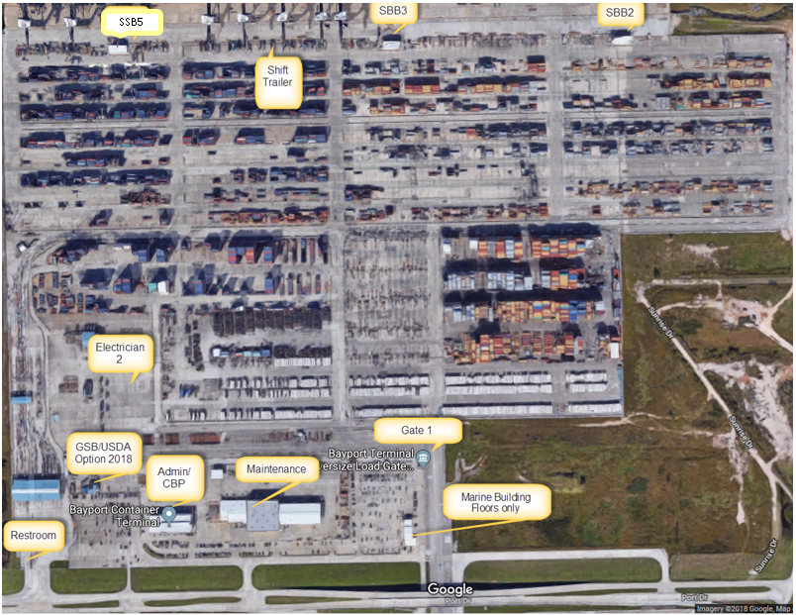
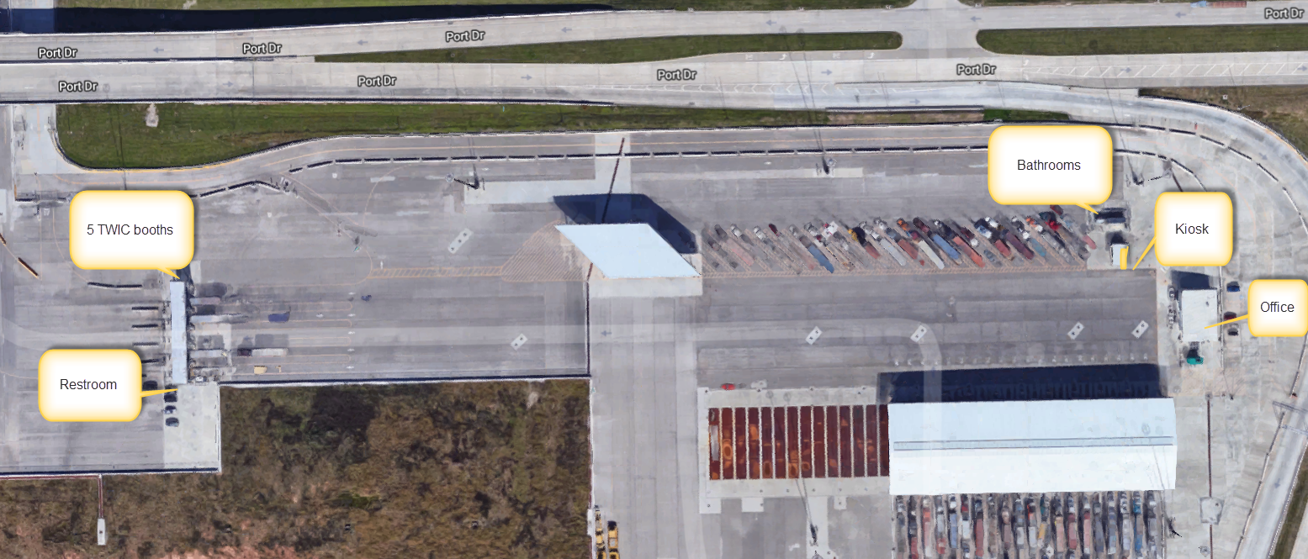
Bayport Container Terminal Locations
Bayport Container Terminal
12703 Port Road, Pasadena, TX 77586

Slide 20
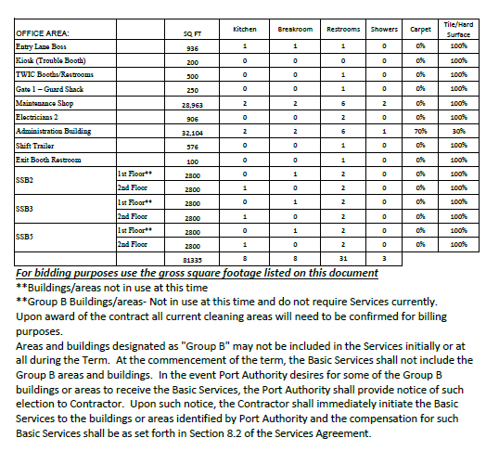
Bayport Building Square Footage

Slide 21
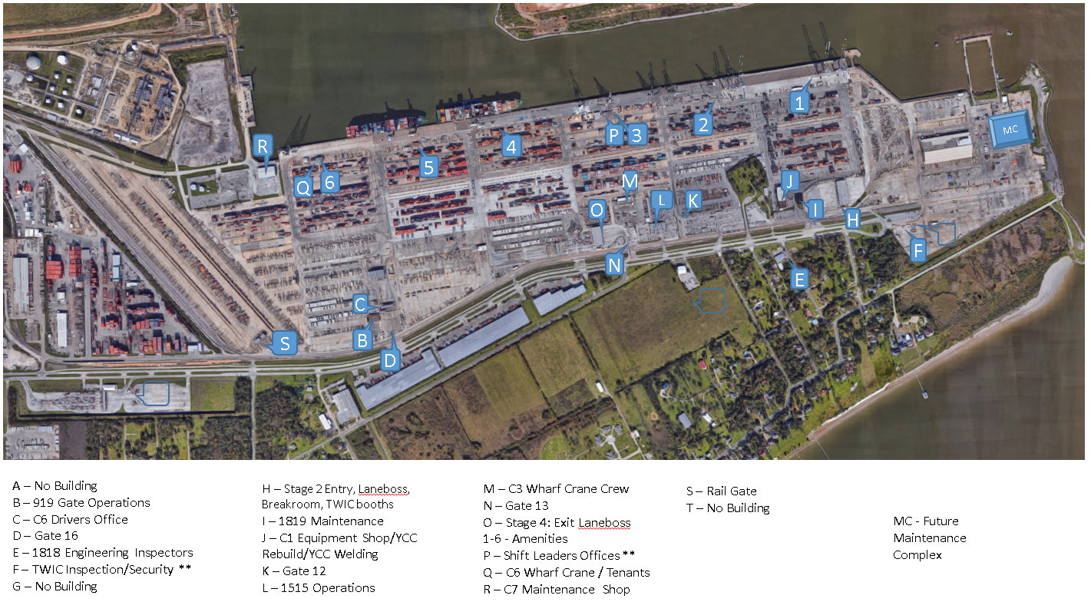
Barbours Cut Container Terminal Locations
Barbours Cut Container Terminal
1819 E Barbours Cut Blvd
LaPorte, TX 77571

Slide 22
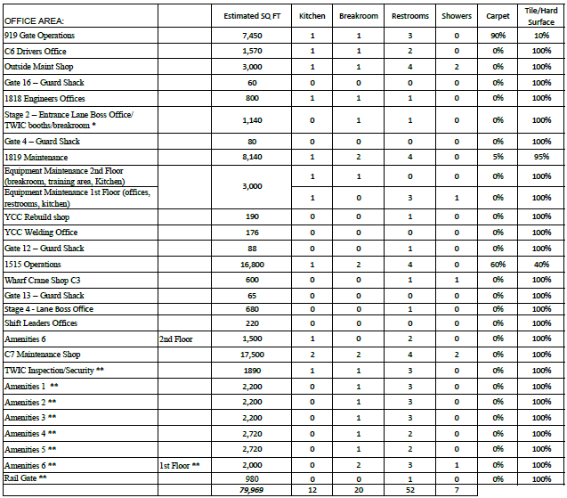
Barbours Cut Building Square Footage

Slide 23
Virtual Site Visit
Bayport Site Video
Barbours Cut Site Video

Slide 24
QUESTIONS?

Slide 25
THANK YOU
Port Houston
Questions?
Procurement@porthouston.com

