Slide 1
Houston Ship Channel (HSC) Expansion Channel Improvement Project (ECIP) Project 11: Redfish to Bayport HSC STA 78+844 to HSC STA 16+000 & Bayport Ship Channel
PORT HOUSTON
RFP-2048
December 9, 2021 @ 10 AM

Slide 2
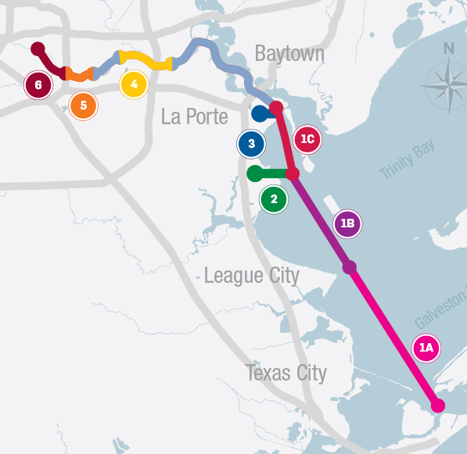
Project Overview
Bolivar Roads to Redfish
1A
Bayport Ship Channel
2
Approximately 11.3 miles in length
Widen Channel to 700 feet
Bend easing
Construct New Bird Island
Mitigate for oyster habitat loss
Approximately 4 miles in length
Widen Channel to 455 feet
Construct marshes and three bird islands in Galveston Bay
Mitigate for oyster habitat loss
Modify channel entrance
DP 1, 3/4A
DP 4B/5
Redfish to Bayport Ship Channel
1B
Barbours Cut Ship Channel
Approximately 9.5 miles in length
Widen Channel to 700 feet
Bend easing
Construct marshes and three bird islands in Galveston Bay
Mitigate for oyster habitat loss
Currently not in the proposed federal plan, so must be built by local interests
3
DP 4B/5
Widen Channel to 455 feet
Construct additional marshes on Atkinson Island
Modify channel entrance
DP 7
Boggy Bayou (BW 8) to Sims Bayou
4
Widen Channel to approximately 530 feet through Greens Bayou confluence
Deepen from existing 41 feet to 46.5 feet from Boggy Bayou to Hunting Bayou (last Turning Basin before reaching Washburn Tunnel)
DP 2, 8, 9
Bayport Ship Channel to Barbours Cut
1C
Approximately 5.4 miles in length
Widen Channel to 700 feet
Construct additional marshes
Mitigate for oyster habitat loss
Currently not in the proposed federal plan, so must be built by local interests
DP 6
Sims Bayou to IH 610
5
Deepen from existing 37 feet to 41.5 feet
DP 10, 11, 12
IH 610 to Turning Basin
6
No improvement planned in these areas
Deepen from existing up to 41.5 feet
Increase Brady Island Turning Basin
DP 10, 11, 12

Slide 3
Agenda
Pre-Proposal Conference House Rules
Business Equity
Procurement Services
Scope of Services
Questions

Slide 4
Pre-Proposal Conference House Rules
Attendees will begin the meeting in listen-only mode.
There will be a Q&A session at the end of today’s presentation.
If you have any questions during the presentation, you may submit your Questions through the WebEx chat feature and they will be addressed at the end of the presentation.
This session is being recorded and will be posted on the BuySpeed homepage under “Pre-Bid/Proposal Conference Information.”

Slide 5
Business Equity
Port Houston:
RFP-2048
Notes:
Welcome, thank you for being here today.
Introduce yourself

Slide 6
Business Equity, S/MWBE Programs
Port Houston promotes business opportunities for all sectors of the community and recognizes the importance of vendor and suppler diversity in its contracts.
Port Houston has established an organizational 35% Small Business participation goal and a 30% Minority-and Woman Business Enterprise (MWBE) aspirational goal.

Slide 7
Awards & Commitments
All dollars awarded and committed to enrolled S/MWBEs count towards Port Houston's S/MWBE goals regardless of whether the individual solicitation includes criteria for small, minority, woman-owned business participation.

Slide 8
Business Equity Definitions
Small Business Enterprise (SBE) means a firm whose gross revenues or number of employees, averaged over the past three years, inclusive of any affiliates as defined by 13 CFR § 121.103, does not exceed the size standards defined in Section 3 of the Federal Small Business Act and applicable Small Business Administration regulations related to the size standards found in 12 CFR §121. The net worth of the owner must be less than $1.32 million, excluding the owner’s primary residence and assets of the business.
Minority Business Enterprise (MBE) means a Business that is at least 51% Owned by one or more Minority Persons, or for which at least 51% of the equity is Owned by one or more Minority Persons, and both the management and daily business operations are carried out and controlled by one or more of the Minority Persons who own it.
Woman Business Enterprise (WBE) means a Business that is at least 51% Owned by one or more females, or for which at least 51% of the equity is owned by one or more females, and both the management and daily business operations are carried out and controlled by one or more of the females who own it.
MWBE and SBE Policies: The Port Commission, at its April 27, 2021, meeting, approved the NEW Minority-Amended and Restated Small Business Development Policy.

Slide 9
Partner Certifying Agencies
Small and MWBEs must meet certain criteria and be certified with one of the following partner agencies:
*City of Houston (SBE, MBE, WBE)
Houston Minority Supplier Development Council (MBE)
*METRO (SBE)
*SBA 8(a) (SDB)
*State of Texas HUB Certification (HUB)
South Texas Central Regional Certification Agency (SBE, MBE, WBE)
*Texas Department of Transportation (SBE)
Women’s Business Enterprise Alliance (WBE)
*No fee to apply

Slide 10
S/MWBE Contractor Expectations
Contractor is encouraged to and agrees it will endeavor to:
Placing qualified small, minority, and woman-owned (S/MWBE) businesses;
Assuring that S/MWBEs are solicited whenever they are potential sources;
Dividing total requirements, when economically feasible, into smaller tasks or quantities to permit maximum participation by S/MWBEs; and,
Establishing delivery schedules, when the requirement permits, which encourage participation by S/MWBEs.

Slide 11
Procurement Services
Port Houston:
Dean Ainuddin, PHA Contract Manager
RFP-2048

Slide 12
Procurement Services
No Contact Period-No communication between interested vendors and PHA staff during the active period
Technical questions should be submitted via BuySpeed
Last day to submit questions: 7 calendar days before due date
Responses are due no later than 11 a.m. on 1/12/2022
Proposals must be submitted electronically via email to:
procurementproposals@porthouston.com
Use the forms in the package
Anticipated Port Commission Approval date: March 2022

Slide 13
Procurement Services (continued)
Evaluation Criteria
The Port Commission will award the contract to the Respondent whose Response provides the best value in consideration of the evaluation factors set forth below. Relative Importance of price and other evaluation factors: In accordance with Section 60.405 of the Texas Water Code, the Request for Proposals form lists the proposal evaluation criteria in the order of their relative importance, with the most important listed first.
Price
Benefit to PHA
Respondent
Overall Compliance with PHA Policies

Slide 14
Procurement Services (continued)
For ease of download, the solicitation is separated into 5 parts, separated into 24 attachments:
RFP Document
General Conditions
Special Conditions
Technical Specifications
Plans
Segment 1 Pipeline Report (16 subparts)
Segment 2 Pipeline Report

Slide 15
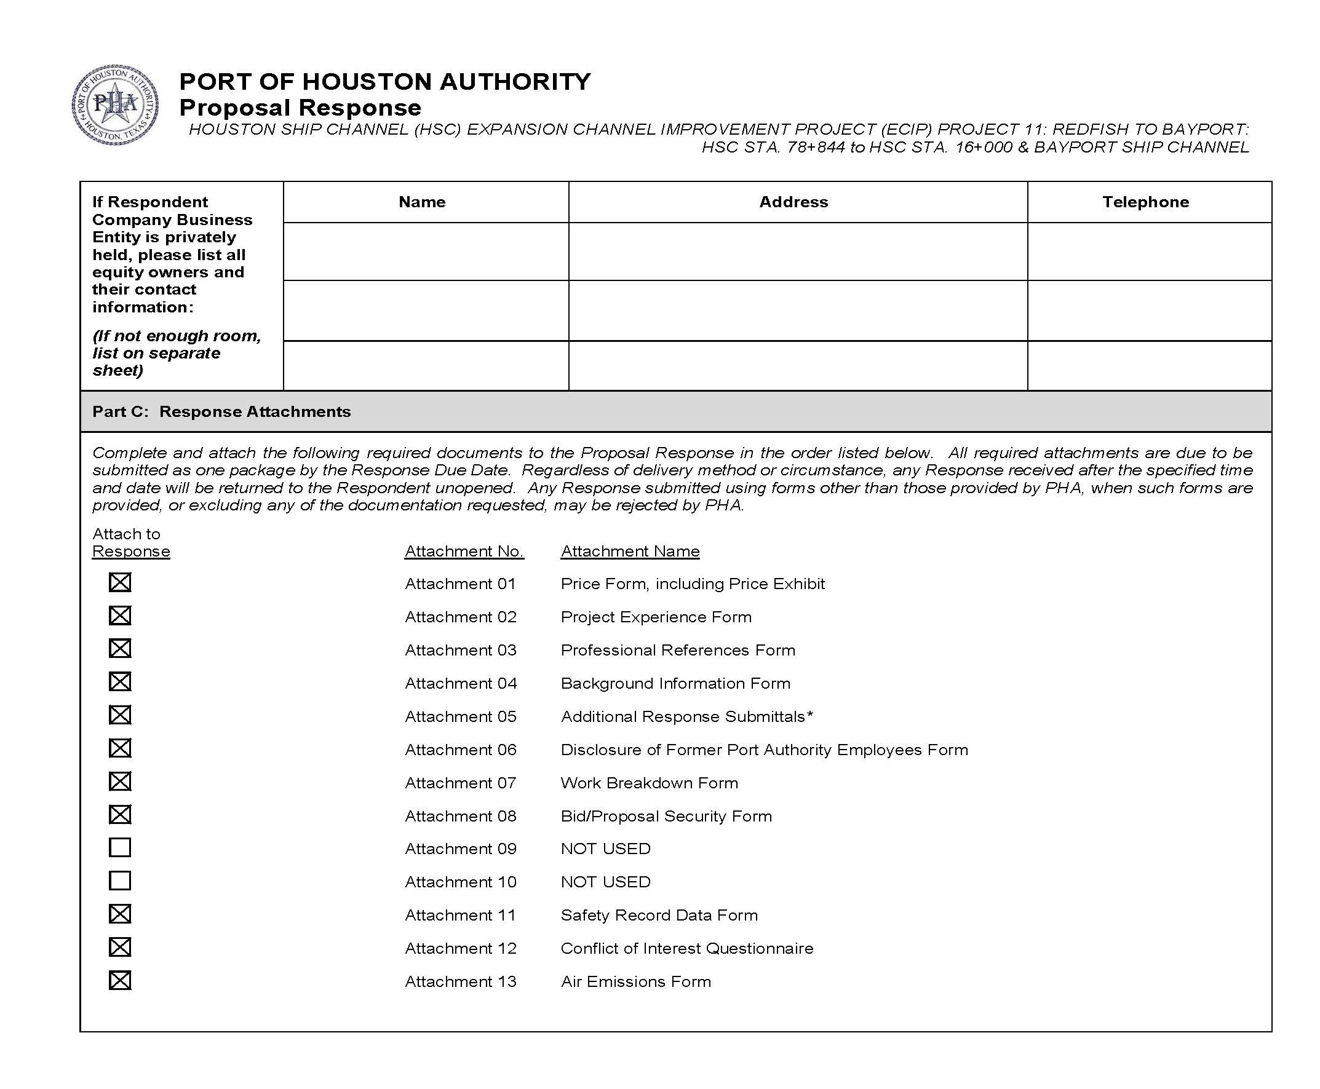
Procurement (continued)
Proposal Response form:
(Page 17 of RFP Document)
Page 2 of the Proposal Response
Form – Required Attachments
Checklist

Slide 16
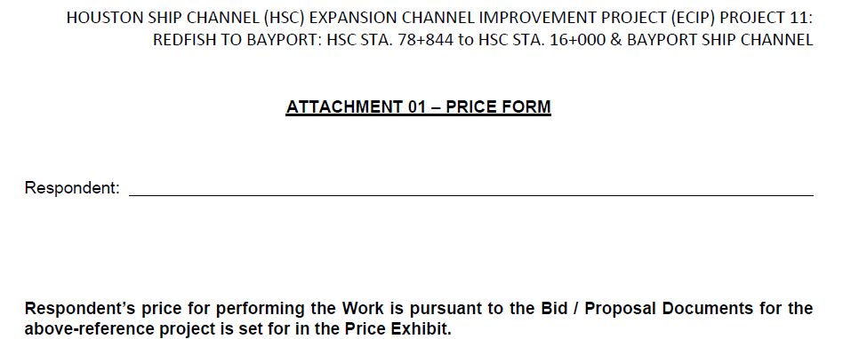
Procurement (continued)
Proposal Response form:
(Page 20 of RFP Document)
Select one or more alternatives

Slide 17
Scope of Services
Port Houston:
Lori Brownell, PHA Channel Improvement Director
Chester Hedderman, Joint Venture Engineer
RFP-2048

Slide 18
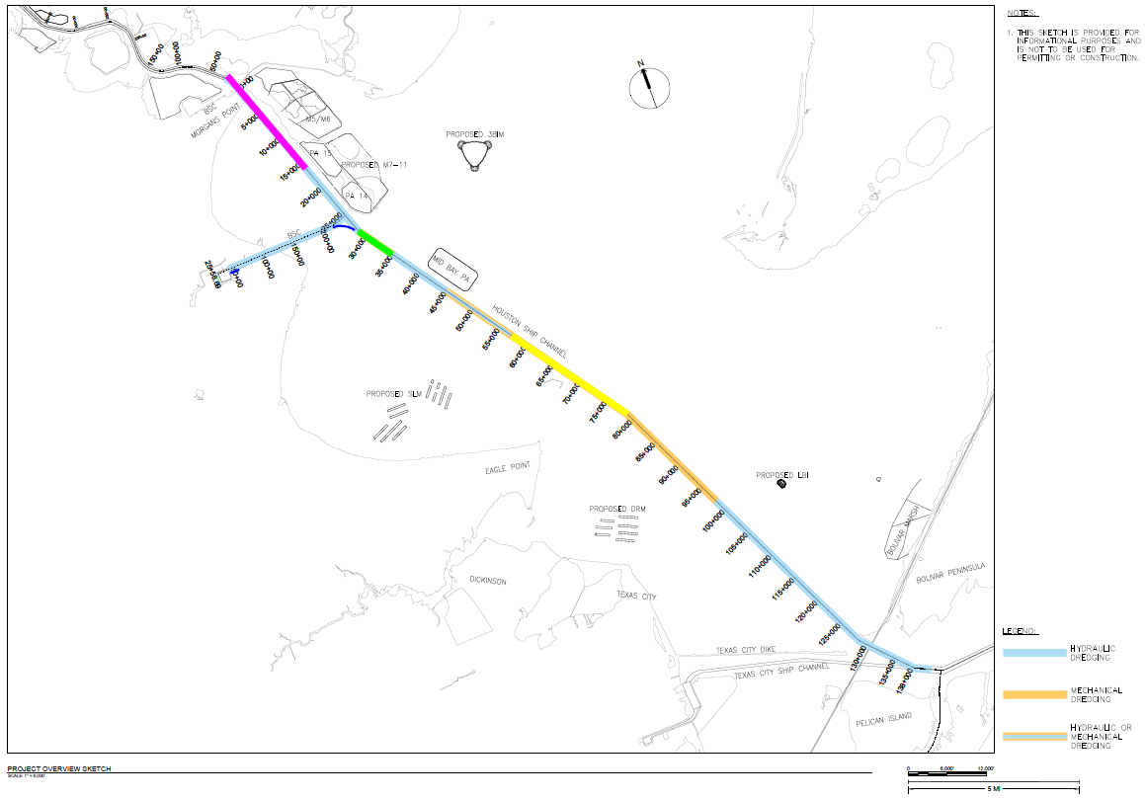
P11 Design Package 4B/5 – Overview
Three-Bird
Island Marsh
Houston Ship Channel:
Approximate project limits (dredging)
Bayport Ship Channel: Approximate project limits (dredging)
San Leon Oyster Mitigation
Stations | Dredge Equipment | Disposal Location | Bid Quantity (CY)
45+000 to 78+844 | Mechanical | ODMDS | 3,186,000
28+605 to 35+000 | Mechanical | Oyster Mitigation Sites | 1,356,000
16+000 to 57+000 | Hydraulic | TBI Marsh | 5,260,000
Bayport | Hydraulic | TBI Marsh | 3,017,000
Dollar Reef Oyster Mitigation
Notes:
HSC STA 78+844 to HSC STA 16+000, Bayport Ship Channel
Include discussion on Alternative Proposals A-E and Options
In addition to conforming proposals:
PHA is interested in alternative proposals that would ensure/achieve project completion earlier than the days allowed for in the solicitation/RFP;
PHA recognizes that accommodating HSC dredging for oyster mitigation may present potential scheduling challenges in view of the “five-mile rule” and coordination with the pilots;
PHA is in discussion with the pilots [and other stakeholders] toward the goal of potentially realizing P-11 benefits sooner than provided for in the RFP, in particular as a result of any relief from the “five-mile rule” for the section of the Project between HSC stations 28+000 – 35+000.
PHA therefore requests alternative proposals that assume partial relief from the “five-mile rule” — and any other proposal that aligns with the PHA goals for earlier project delivery and cost effectiveness — as it would otherwise apply for that section, for the PHA’s consideration and potential discussion with proposers as part of the proposal/procurement process.

Slide 19
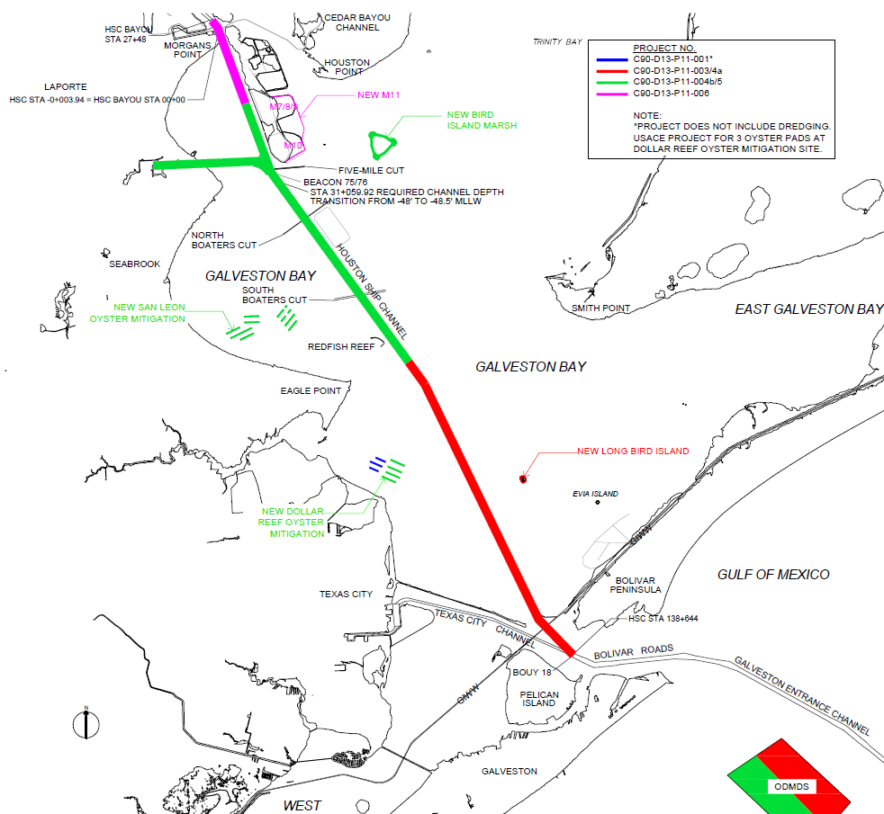
P11 Design Package 4B/5 – Overview
Activities:
Channel widening from 530 to 700 feet (HSC) and 350/400 to 455 feet wide (BSC)
Dredging
Excavating 13.4 million CY of dredged material (10.4 million CY HSC and
3 million CY BSC)
Relocation of barge lanes (HSC)
Construct bird island/marsh complex and oyster mitigation beds
155,000 tons of rip-rap installation for shore protection
425,000 tons of crushed limestone for 15 oyster mitigation pads placed as a veneer on a raised bed constructed with dredged material

Slide 20
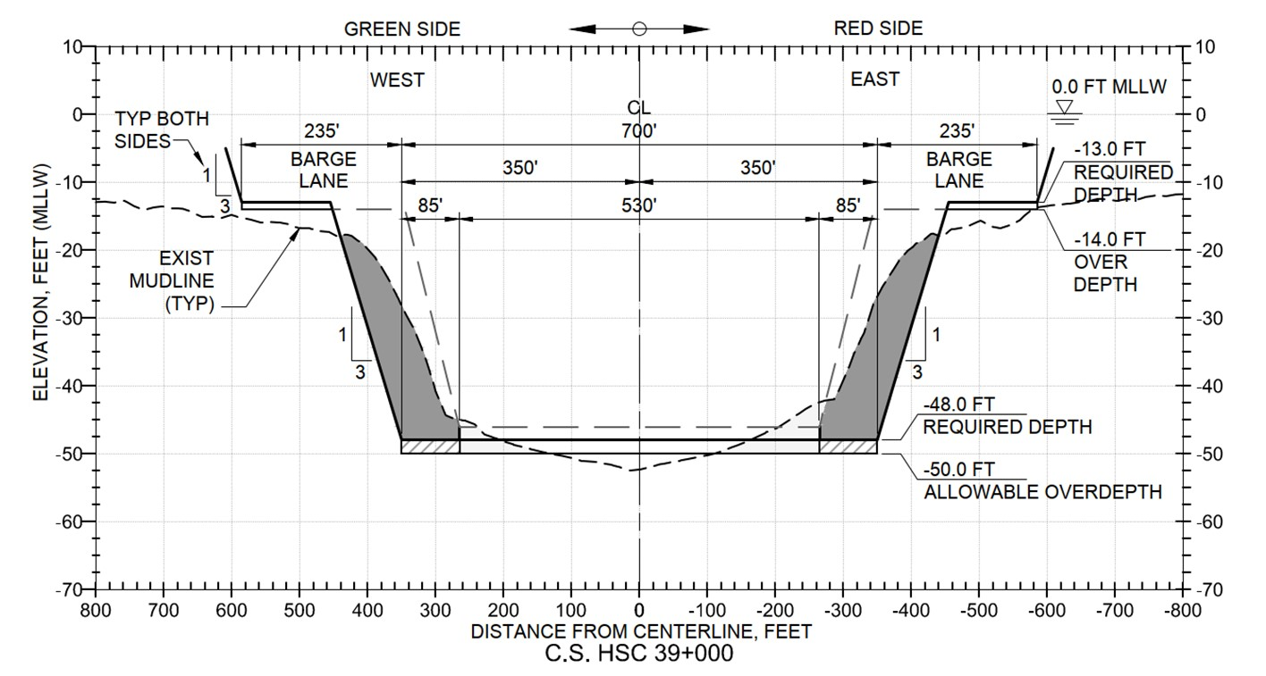
Houston Ship Channel, Typical Cross-Section

Slide 21
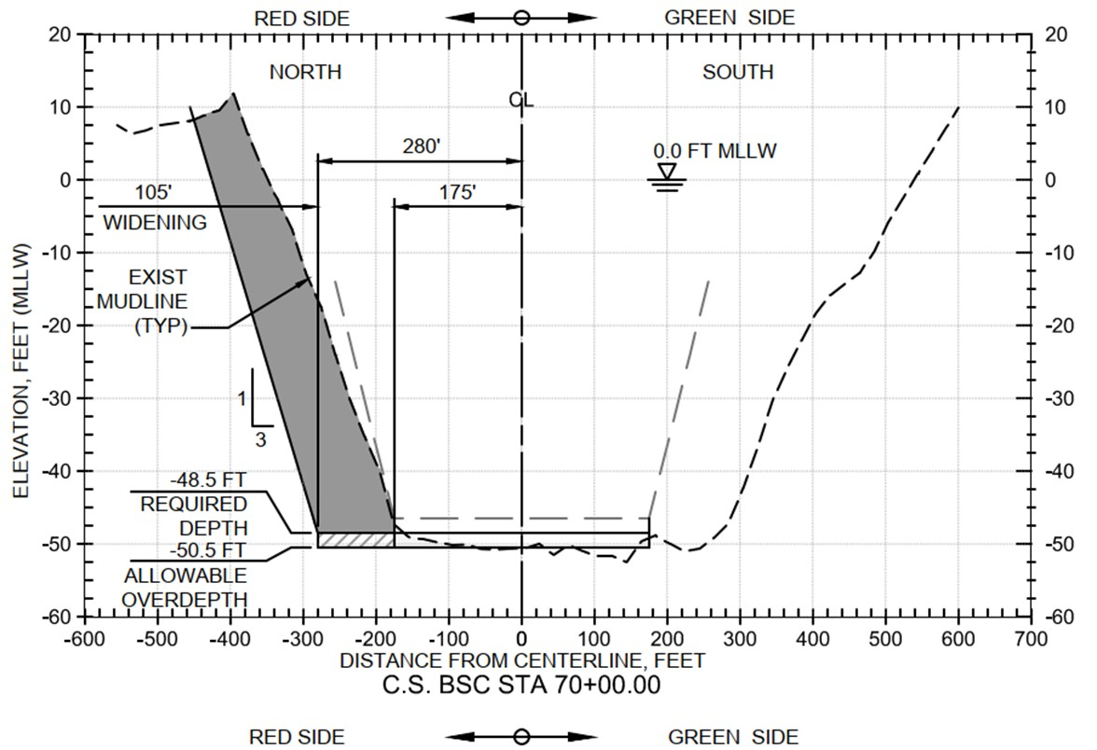
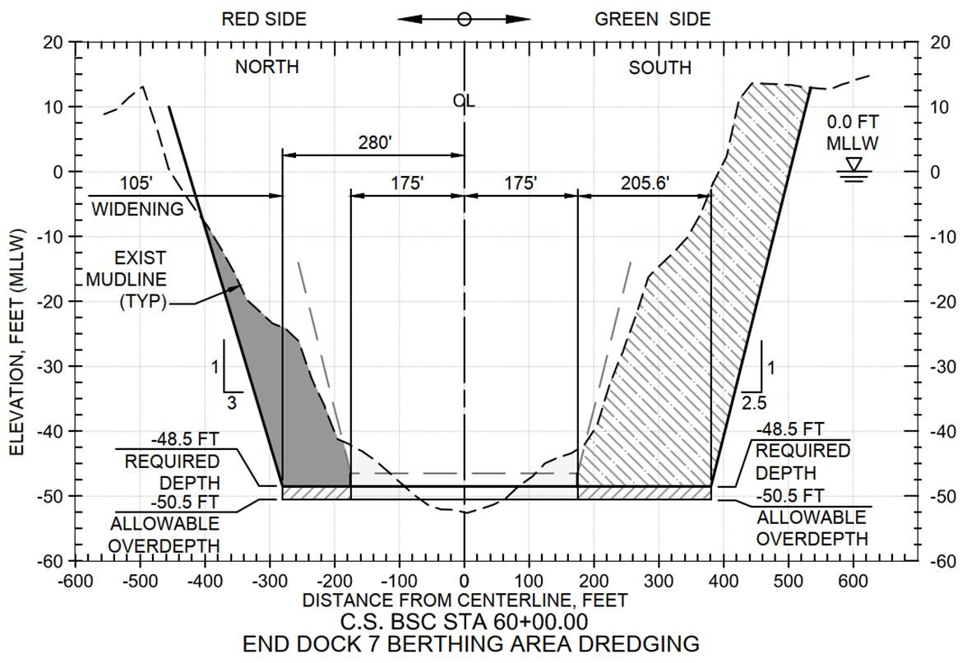
Bayport Ship Channel, Typical Cross-Sections

Slide 22
Three Bird Island, Typical Cross-Sections
Three Bird Island Marsh Island and Wave Trip Typical Section
Three Bird Island Marsh Dike Typical Section

Slide 23
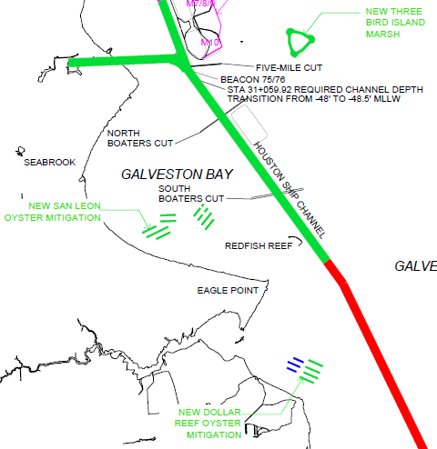
Oyster Pads, Typical Cross-Section
Mechanical Fill Oyster Pad Typical Section

Slide 24
Questions?
Visit the Project 11 Webpage
https://www.expandthehoustonshipchannel.com/
Email the Project 11 Team
Project11@PortHouston.com
Register for Buyspeed
https://buyspeed.poha.com/

