Slide 1
RFP-1972 MEDIA BUY SERVICES
PRE-PROPOSAL CONFERENCE:
8/19/21 1:00 p.m. (CST)

Slide 2
AGENDA
Pre-Bid Conference House Rules
Port Commission
Business Equity
Procurement Services
Scope of Services
Q/A

Slide 3
PRE-PROPOSAL CONFERENCE HOUSE RULES
Attendees will begin the meeting in listen-only mode.
There will be a Q&A session at the end of today’s presentation.
If you have any questions during the presentation, you may submit your Questions through the WebEx chat feature and they will be addressed at the end of the presentation.
This presentation will be posted on the BuySpeed homepage under “Pre-Bid/Proposal Conference Information.”

Slide 4
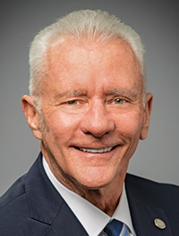
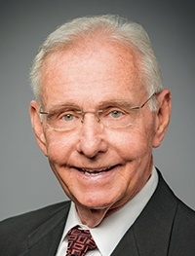
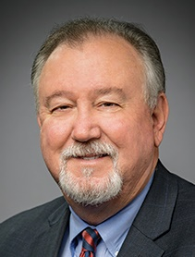
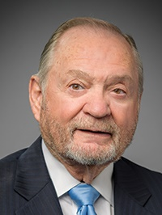
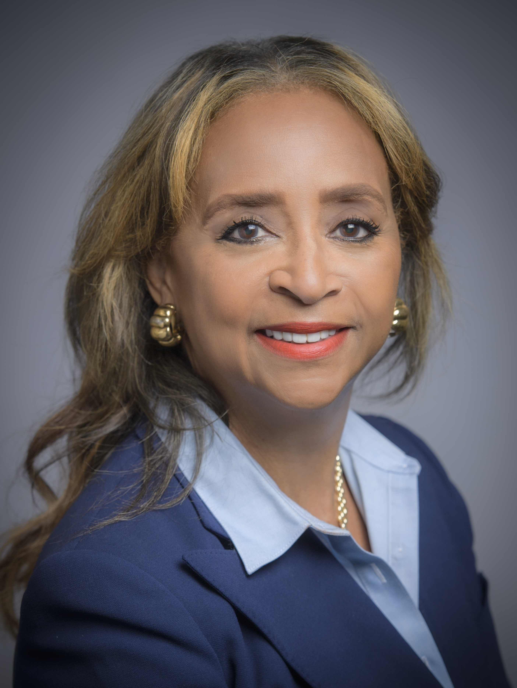
PORT COMMISSION
Dean E. Corgey
Commissioner
Clyde Fitzgerald
Commissioner
Stephen H. DonCarlos
Commissioner
Ric Campo
Chairman
Roy D. Mease
Commissioner
Wendy Montoya Cloonan
Commissioner
Cheryl D. Creuzot
Commissioner
Notes:
We are governed by a seven-member Port Commission, led by Chairman Ric Campo. Because this project is has a dollar value of over $50,000, the staff’s award recommendation will be approved by the Port Commission.

Slide 5
Business Equity
RFP-1972 Media Buy Services
Pedro Gonzalez, P.E.,
Manager, Mentoring Program

Slide 6
BUSINESS EQUITY, S/MWBE INITIATIVE
The New Business Equity Division provides resources to small, minority- and woman-owned businesses (S/MWBE) seeking to participate in Port Houston procurements and contracts
Our goal is to maintain a 35% overall Small Business (SBE) participation and aspire to reach a 30% Minority- and Woman-Owned Business (MWBE) participation
Notes:
The Port Commission, at its April 27, 2021 meeting, approved the NEW Minority- and Woman-Owned Business Enterprise Development Policy and the Amended and Restated Small Business Development Policy.
Initiative will reduce barriers to MBEs and WBEs who want to engage in business with Port Houston
Port Houston is working to identify and contact qualified S/MWBEs to meet our participation goals
Implemented race- and gender-neutral measures to ensure equal opportunities for all contractors and subcontractors
Port Houston is continuing to provide training, mentorship, networking and development assistance to all S/MWBEs

Slide 7
BUSINESS EQUITY
Small Business Enterprise (SBE)
Small Business Enterprise “SBE” means a firm whose gross revenues or number of employees, averaged over the past three years, inclusive of any affiliates as defined by 13 CFR § 121.103, does not exceed the size standards defined in Section 3 of the Federal Small Business Act and applicable Small Business Administration regulations related to the size standards found in 12 CFR §121. The net worth of the owner must be less than $1.32 million, excluding the owner’s primary residence and assets of the business.
Minority Business Enterprise (MBE)
Minority-Owned Business Enterprise “MBE” means a Business that is at least 51% Owned by one or more Minority Persons, or for which at least 51% of the equity is Owned by one or more Minority Persons, and both the management and daily business operations are carried out and controlled by one or more of the Minority Persons who own it.

Slide 8
BUSINESS EQUITY
Woman Business Enterprise (WBE)
Woman-Owned Business Enterprise “WBE” means a Business that is at least 51% Owned by one or more female American citizens, or for which at least 51% of the equity is Owned by one or more female American citizens, and both the management and daily business operations are carried out and controlled by one or more of the female American citizens who own it.
MWBE and SBE Policies
The Port Commission, at its April 27, 2021 meeting, approved the NEW Minority- and Woman-Owned Business Enterprise Development Policy and the Amended and Restated Small Business Development Policy.

Slide 9
PARTNER AGENCIES
Small and MWBEs must meet certain criteria and be certified with one of the following partner agencies:
*City of Houston (SBE, MBE, WBE)
Houston Minority Supplier Development Council (MBE)
*METRO (SBE)
National Minority Supplier Development Council
*SBA 8(a) (SDB)
*State of Texas HUB Certification (HUB)
South Texas Central Regional Certification Agency (SBE, MBE, WBE)
*Texas Department of Transportation (SBE)
Women’s Business Enterprise Alliance (WBE)
*No fee to apply

Slide 10
S/MWBE REQUIREMENTS
Contractor is encouraged to and agrees it will endeavor to:
Placing qualified small and minority businesses and women’s business enterprises on solicitation lists;
Assuring that small and minority businesses, and women’s business enterprises are solicited whenever they are potential sources;
Dividing total requirements, when economically feasible, into smaller tasks or quantities to permit maximum participation by small and minority businesses, and women’s business enterprises;

Slide 11
S/MWBE REQUIREMENTS CONT.
Establishing delivery schedules, where the requirement permits, which encourage participation by small and minority businesses, and women’s business enterprises;
Using the services and assistance, as appropriate, of such organizations as the Small Business Administration and the Minority Business Development Agency of the Department of Commerce; and
Requiring the prime contractor, if subcontracts are to be let, to take the affirmative steps listed in paragraphs (b)(1) through (5) of this section.

Slide 12
S/MWBE REQUIREMENTS CONT.
Place qualified small businesses and MWBEs on subcontractor and supplier solicitation lists;
Attempt to solicit small businesses and MWBEs whenever they are potential participants in the Work;
Divide total work requirements, when economically feasible, into smaller tasks or quantities to permit maximum participation by small businesses and MWBEs;
Establish delivery schedules, where requirements permit, which encourage participation by small businesses and MWBEs; and
Use the services and assistance, as appropriate, of Port Houston’s Business Equity Division in such aspirational efforts.

Slide 13
S/MWBE REQUIREMENTS CONT.
This project has 5 points available for those Small Business Prime contractors who submit a proposal for this Request for Proposal procurement. No points will be available for small business subcontractors or suppliers.

Slide 14
Procurement Services
RFP-1972 Media Buy Services
Tanika Chukwumerije,
Manager, Contracts

Slide 15
PROCUREMENT
No Contact Period – No communication between interested vendors and Port Houston staff during the active period.
Technical questions should be submitted via Buyspeed
Last day to submit questions: 7 days before due date (9/8/2021)
Responses are due no later than 11 a.m. on 9/15/2021
Proposals must be submitted electronically via email to: procurementproposals@porthouston.com
Use forms in the package
Anticipated award date: 10/26/2021

Slide 16
PROCUREMENT
Evaluation Criteria
The Port Commission will award the contract to the Respondent whose Response provides the best value in consideration of the evaluation factors set forth below.
Evaluation Criteria | Relative Weight %
Price | 30
Vendor’s Reputation, Quality of Services and Personnel | 35
Benefit to the Port Authority | 20
Overall Compliance with Port Authority Policies and Instructions | 10
Small Business Participation | 5
TOTAL | 100

Slide 17
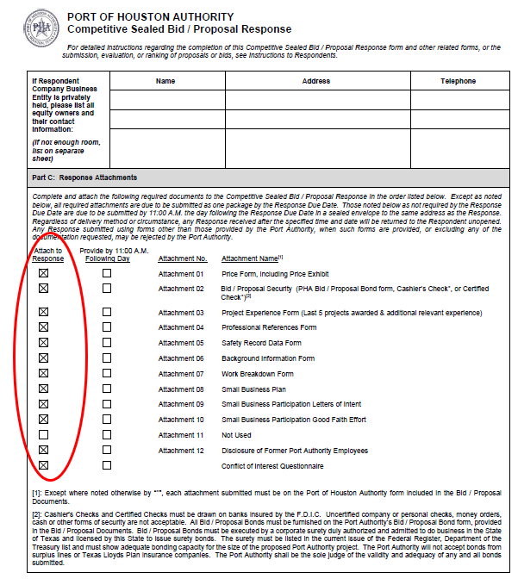
PROCUREMENT
Proposal Response form:
(Page 17 of RFP Document)
Page 2 of the Proposal Response Form – Required Attachments

Slide 18
Scope of Services
RFP-1972 Media Buy Services
Fatima De Leon
Manager, Marketing, Branding & External Communications

Slide 19
SCOPE OF SERVICES
The Port Authority is seeking proposals from qualified service providers to conduct media purchases for radio, print, digital, and television spots to promote Port Houston.
Contract Term: Fourteen (14) months, with one (1) year renewal option.
The goal of Port Houston’s digital and traditional advertising is to increase brand awareness and affinity, lease properties, inform about major projects, generate cost-effective, quality customer inquiries and other goals related to Port Houston’s business and community efforts.

Slide 20
SCOPE OF SERVICES
Advertising media buying services: As needed, the awarded vendor shall provide advertising media buying services (the “Services”) in local, regional, and national markets. The digital and traditional advertising media buying services may include, but are not limited to, any of the following:
Radio and television
Outdoor
Paid search
Display (Prospecting, Retargeting, Native and Online Video/Audio)
Mobile
Paid social
Print (primary focus on industry/trade publications)

Slide 21
SCOPE OF SERVICES
Account Management. At a minimum, Port Houston expects the following personnel assigned to Port Houston’s account for projects as they arise:
Account Lead: Be responsible for day-to-day management of all work associated with the account; manage problem escalation and provide resolution(s); have capability of assigning additional staff resources, as needed.
• Reporting. Provide data on all purchased media with associated tracking

Slide 22
RECOMMENDATIONS
Clearly type responses in the provided forms, handwritten forms are highly discouraged
Provide dependable recommendation sources that can speak to previous work and experience
Be concise in your response packet
Read out other posted questions from all vendors to avoid asking an already answered question

Slide 23
RFP-1972 MEDIA BUY SERVICES
QUESTIONS?

Slide 24
Thank You

