Slide 1
Port Houston
RFP-1930 Website Redesign Services
Christopher Virk-Brown
Project Manager, Marketing
July 12, 2021- Time:11:00 a.m.

Slide 2
Agenda
Pre-Proposal Conference House Rules
Port Commission
Business Equity
Procurement Services
Project Goals & Scope
Q/A
Notes:
This is not a “Lift and Shift” but rather an effort to “lift and standardize our business processes and remove the “People Interrupt” (ie. The manual intervention in a standard workflow).

Slide 3
Pre-Proposal Conference House Rules
Attendees will begin the meeting in listen-only mode.
There will be a Q&A session at the end of today’s presentation.
If you have any questions during the presentation, you may submit your Questions through the WebEx chat feature and they will be addressed at the end of the presentation.
The session is being recorded and will be posted on the BuySpeed homepage under “Pre-Bid/Proposal Conference Information.”
Notes:
This is not a “Lift and Shift” but rather an effort to “lift and standardize our business processes and remove the “People Interrupt” (ie. The manual intervention in a standard workflow).

Slide 4
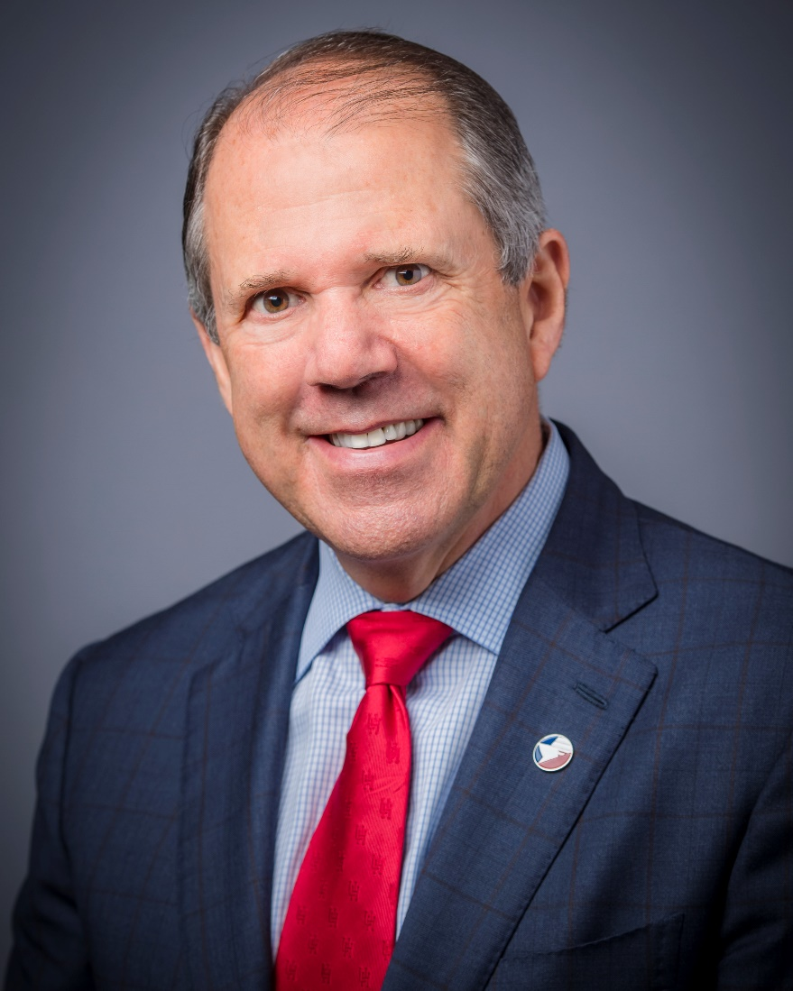
Port Commission
Dean E. Corgey
Clyde Fitzgerald
Cheryl D. Creuzot
Rick Campos
Chairman
Stephen H. DonCarlos
Roy D. Mease
Wendy Montoya
Cloonan
WELCOME MESSAGE | 2

Slide 5
Small, Minority- and women-owned DEFINITIONS
Small Business Enterprise (SBE)
Small Business Enterprise “SBE” means a firm whose gross revenues or number of employees, averaged over the past three years, inclusive of any affiliates as defined by 13 CFR § 121.103, does not exceed the size standards defined in Section 3 of the Federal Small Business Act and applicable Small Business Administration regulations related to the size standards found in 12 CFR §121. The net worth of the owner must be less than $1.32 million, excluding the owner’s primary residence and assets of the business. SBE has an aspirational goal of 35%.
Minority Business Enterprise (MBE)
Minority-Owned Business Enterprise “MBE” means a Business that is at least 51% Owned by one or more Minority Persons, or for which at least 51% of the equity is Owned by one or more Minority Persons, and both the management and daily business operations are carried out and controlled by one or more of the Minority Persons who own it.
Woman Business Enterprise (WBE)
Woman-Owned Business Enterprise “WBE” means a Business that is at least 51% Owned by one or more female American citizens, or for which at least 51% of the equity is Owned by one or more female American citizens, and both the management and daily business operations are carried out and controlled by one or more of the female American citizens who own it.
“MWBEs” means MBEs and WBEs, with an aspirational goal of 30%

Slide 6
Certifying Agencies
Small and MWBEs must meet certain criteria and be certified with one of the following partner Agencies:
City of Houston
Houston Minority Supplier Development Council
METRO
SBA 8(a)
State of Texas HUB Certification
South Texas Central Regional Certification Agency
Texas Department of Transportation
Women’s Business Enterprise Alliance

Slide 7
Small and Minority- and Women-owned Business Enterprise Policies
The Port Commission, at its April 27, 2021 meeting, approved the NEW Minority- and Woman-Owned Business Enterprise Development Policy and the Amended and Restated Small Business Development Policy.

Slide 8
Small Business Criteria
Small Business Requirement:
10 Percent (%) “SB-Prime” Basis

Slide 9
Procurement
No Contact Period-No communication between interested vendors and PHA staff during the active period
Technical questions should be submitted via BuySpeed
Proposal submittal questions should be submitted to: procurement@porthouston.com
Responses are due no later than 11 a.m. on 8/18/2021
Proposals must be submitted electronically via email to:
procurementproposals@porthouston.com
Anticipated award date: 9/29/2021

Slide 10
Procurement (Cont.d)
Evaluation Criteria
The Port Commission will award the contract to the Respondent whose Response provides the best value in consideration of the evaluation factors set forth below.
EVALUATION CRITERIA | RELATIVE WEIGHT %
Price | 30
Respondent | 30
Benefit to PHA | 20
Overall Compliance w/PHA Policies | 10
Small Business Participation | 10
TOTAL | 100

Slide 11
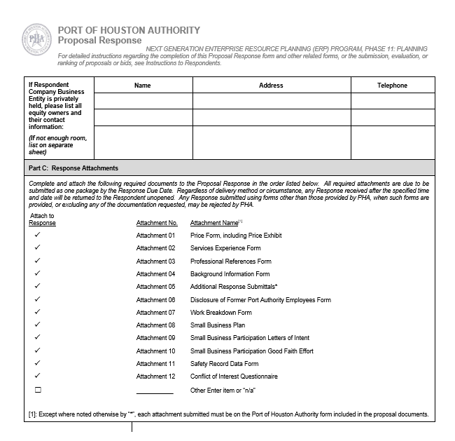
Procurement (Cont.d)
Proposal Response form:
(Page 20 of solicitation)
Page 2 of the Proposal Response
Form– Required Attachments

Slide 12
Project Goals
Improve communications between Port Houston and its constituents
Enhance Port Houston’s online brand image and identity
Make it easy for constituents to find documents, forms and information about Port Houston
Develop a more-friendly interface and tool for all users

Slide 13
Scope Details
Completely redesign website up to 300 pages
Meet with stakeholders to go over needs/wants
Must meet cybersecurity and ADA standards
Integrate third-party apps and websites
Provide a new web hosting solution
Migrate the Port Houston blog
Provide web maintenance, training and support after website launch at least up to 1 year

Slide 14
Questions

Slide 15
Port Houston
Christopher Virk-Brown
Project Manager
www.porthouston.com

