Slide 1
Houston Ship Channel (HSC) Expansion Channel Improvement Project (ECIP) Project 11: Bolivar Roads to Redfish HSC STA 138+369 to HSC STA 73+476
PORT HOUSTON
RFP-1922
July 12, 2021 @ 10 AM
Notes:
Welcome, thank you for being here today.
Introduce yourself

Slide 2
Agenda
Pre-Proposal Conference House Rules
Port Commission
Business Equity
Procurement Services
Scope
Q/A

Slide 3
Pre-Proposal Conference House Rules
Attendees will begin the meeting in listen-only mode.
There will be a Q&A session at the end of today’s presentation.
If you have any questions during the presentation, you may submit your Questions through the WebEx chat feature and they will be addressed at the end of the presentation.
This session is being recorded and will be posted on the BuySpeed homepage under “Pre-Bid/Proposal Conference Information.”

Slide 4
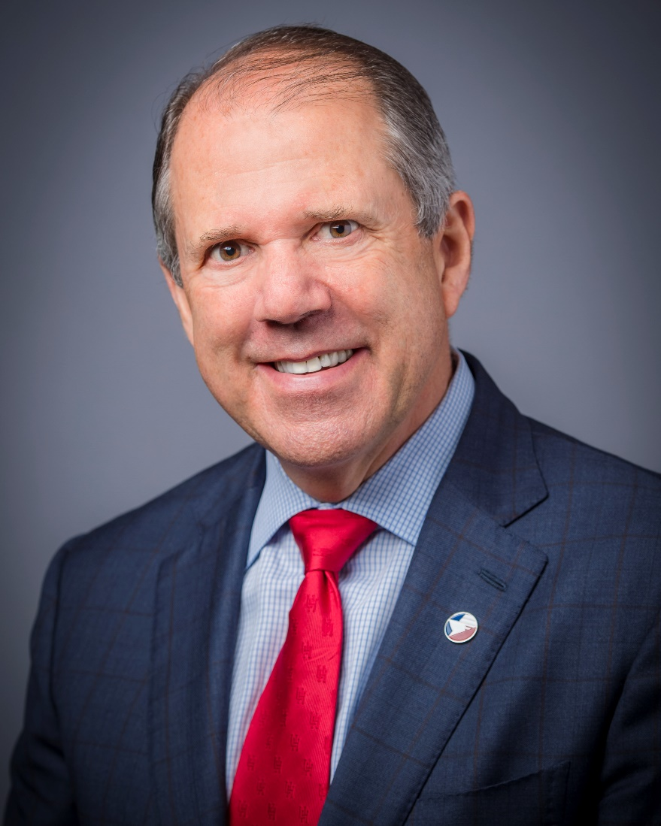
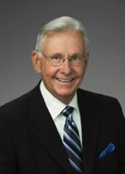
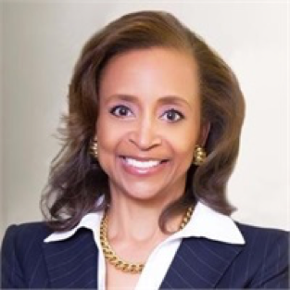
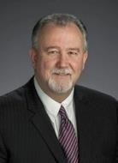
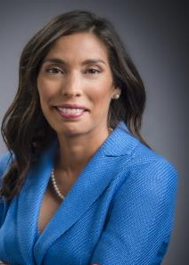
Port Commission
Dean E. Corgey
Clyde Fitzgerald
Cheryl D. Creuzot
Rick Campos
Chairman
Stephen H. DonCarlos
Roy D. Mease
Wendy Montoya
Cloonan
Notes:
This is the seven-member Port Commission that governs the Port. This procurement is considered a formal procurement, which has a dollar threshold of over $50k. Therefore, the Port Commission is responsible for formal procurement awards.

Slide 5
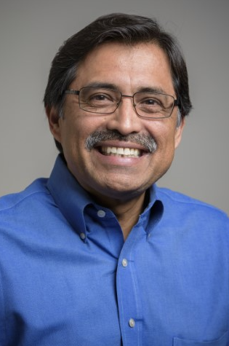
Business Equity
Port Houston:
Notes:
Welcome, thank you for being here today.
Introduce yourself

Slide 6
Small Business What Do We Do?
Small Business Development Program
Provide opportunities for local small businesses to participate in contracting and procurement at Port Houston with 35% overall SB goal.
Outreach Activities
Business-to-Business Connections
Industry Specific Forums
Training & Development Initiatives
Port University
Inter-Agency Mentor Protégé Program

Slide 7
Small Business Enrollment
Businesses must meet certain criteria and be certified with one of Port Houston’s partner agencies
Applies to all contracts over $50,000
Race-and gender-neutral program
Restricted to local small businesses within the 8 counties surrounding Houston (Harris, Montgomery, Waller, Brazoria, Ft. Bend, Galveston, Chambers, Liberty)
The size of the business must not exceed Code of Federal Regulations 49 CFR §26.67 or 13 CFR §124 for small business owners. Visit www.sba.gov/size for more information.
Net worth of the owner must be less than $1.32 million, excluding the owner’s primary homestead and assets of the business.

Slide 8
Small Business Criteria
Small Business Requirement:
Exempt

Slide 9
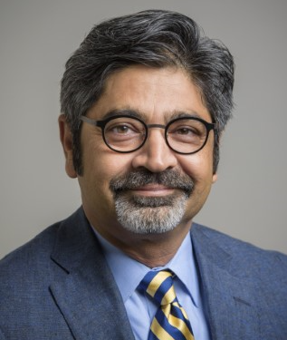
Procurement Services
Port Houston:
Dean Ainuddin, Manager Contract
Sommer Freeman, Contract Administrator
Notes:
Welcome, thank you for being here today.
Introduce yourself

Slide 10
Procurement Services
No Contact Period-No communication between interested vendors and PHA staff during the active period
Technical questions should be submitted via BuySpeed
Last day to submit questions-7 days before due date
Responses are due no later than 11 a.m. on 8/4/2021
Proposals must be submitted electronically via email to:
procurementproposals@porthouston.com
Use the forms in the package
Anticipated award date: 9/29/2021

Slide 11
Procurement Services (continued)
Evaluation Criteria
The Port Commission will award the contract to the Respondent whose Response provides the best value in consideration of the evaluation factors set forth below. Relative Importance of price and other evaluation factors: In accordance with Section 60.405 of the Texas Water Code, the Request for Proposals form lists the proposal evaluation criteria in the order of their relative importance, with the most important listed first.
Price
Benefit to PHA
Respondent
Overall Compliance with PHA Policies

Slide 12
Procurement Services (continued)
For ease of download, the solicitation is separated into 5 parts:
RFP Document
General Conditions
Special Conditions
Technical Specifications
Plans
Note: Pipeline Coordination Report (issued as an Adm. Addendum)

Slide 13
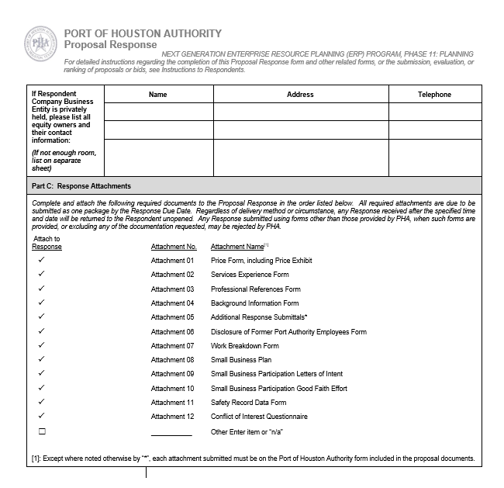
Procurement (continued)
Proposal Response form:
(Page 16 of RFP Document)
Page 2 of the Proposal Response
Form – Required Attachments
Checklist

Slide 14
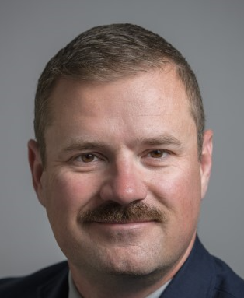
Scope
Port Houston:
David Casebeer
Project Manager, Channel Improvement
Notes:
Introduce yourself

Slide 15
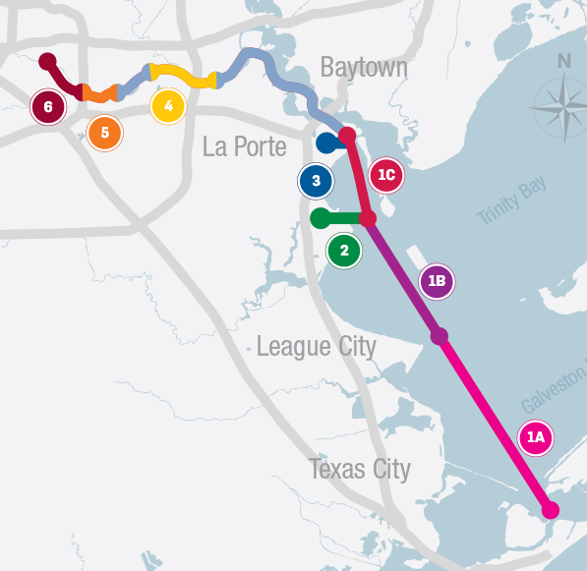
Greater Project Overview
Bolivar Roads to Redfish
1A
Bayport Ship Channel
2
Approximately 11.5 miles in length
Widen Channel to 700 feet
Bend easing
Construct New Bird Island
Mitigate for oyster habitat loss
Approximately 4 miles in length
Widen Channel to approximately 455 feet
Construct marshes and three bird islands in Galveston Bay
Mitigate for oyster habitat loss
Modify channel entrance to reduce shoaling
Redfish to Bayport Ship Channel
1B
Barbours Cut Ship Channel
3
Approximately 8.3 miles in length
Widen Channel to a minimum of 700 feet
Bend easing
Construct marshes and three bird islands in Galveston Bay
Mitigate for oyster habitat loss
Currently not in the proposed federal plan, so must be built by local interests
Widen Channel to approximately 455 feet
Construct additional marshes on Atkinson Island
Modify channel entrance
Boggy Bayou (BW 8) to Sims Bayou
4
Widen Channel to approximately 530 feet through Greens Bayou confluence
Deepen from existing 41 feet to 46.5 feet from Boggy Bayou to Hunting Bayou (last Turning Basin before reaching Washburn Tunnel)
Bayport Ship Channel to Barbours Cut
1C
Approximately 5 miles in length
Widen Channel to 700 feet
Construct additional marshes
Mitigate for oyster habitat loss
Currently not in the proposed federal plan, so must be built by local interests
Sims Bayou to IH 610
5
Deepen from existing 37 feet to 41.5 feet
IH 610 to Turning Basin
6
No improvement planned in these areas
Deepen from existing up to 41.5 feet
Increase Brady Island Turning Basin
Notes:
If you have not attended one of our virtual industry days, this is an overview map of all of the segments that will be constructed through several contracts over the next few years.
(very quick overview of the whole P11 project)

Slide 16
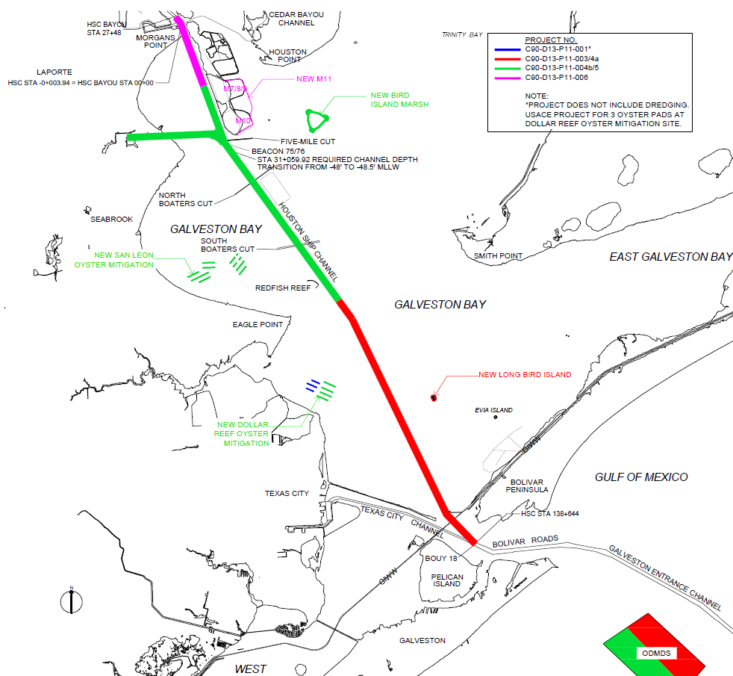
Design Package 3/4A: Bolivar Roads to Redfish
HSC Station 138+369 to 73+476
Activities:
Channel widening from 530 to 700 feet wide
Dredging
Excavation of 1.7 million CY of dredged material
Excavation of 1.9 million CY of dredged material for placement at ODMDS
Shoreline protection
30,000 tons of material for rip-rap
Bird island construction
New Long Bird Island
Maintenance via hopper dredge possible at beginning of contract
Notes:
Design Package 3 portion of contract
8 miles
HSC Widening from 530 to 700 feet
1.7 MCY
New Long Bird Island Construction

Slide 17
Design Package 3/4A: Bolivar Roads to Redfish
HSC Station 138+369 to 73+476
Activities:
HSC Station 138+369 to 98+000
Excavating 1.7 million CY of dredged material
Shoreline protection
31,000 tons of material for armor stone
5,000 tons of blanket stone
New Long Bird Island Construction
Oyster mitigation
18,500 tons of crushed limestone utilized

Slide 18
Design Package 3/4A: Bolivar Roads to Redfish
HSC Station 138+369 to 73+476
Activities:
HSC Station 98+000 to 73+476​
Excavating 1.9 million CY of dredged material​
Materials to be transported in scows to the ODMDS
Hopper dredging is not permitted for new work
Notes:
Design Package 4a portion of contract
4.6 miles
HSC Widening from 530 to 700 feet
1.9 MCY
Disposal in ODMDS

Slide 19
Houston Ship Channel, Typical Cross-Section
Notes:
To give you a general idea of the dredging to be done, here is a typical cross section of the channel where the new work dredging will be done. As you can see, all the work will be done on the slopes of the existing channel. There are some sections that have more material and some that may have little material dredging required. Notice that there is paid overdepth located within the toes of the future channel but none on the slopes.

Slide 20
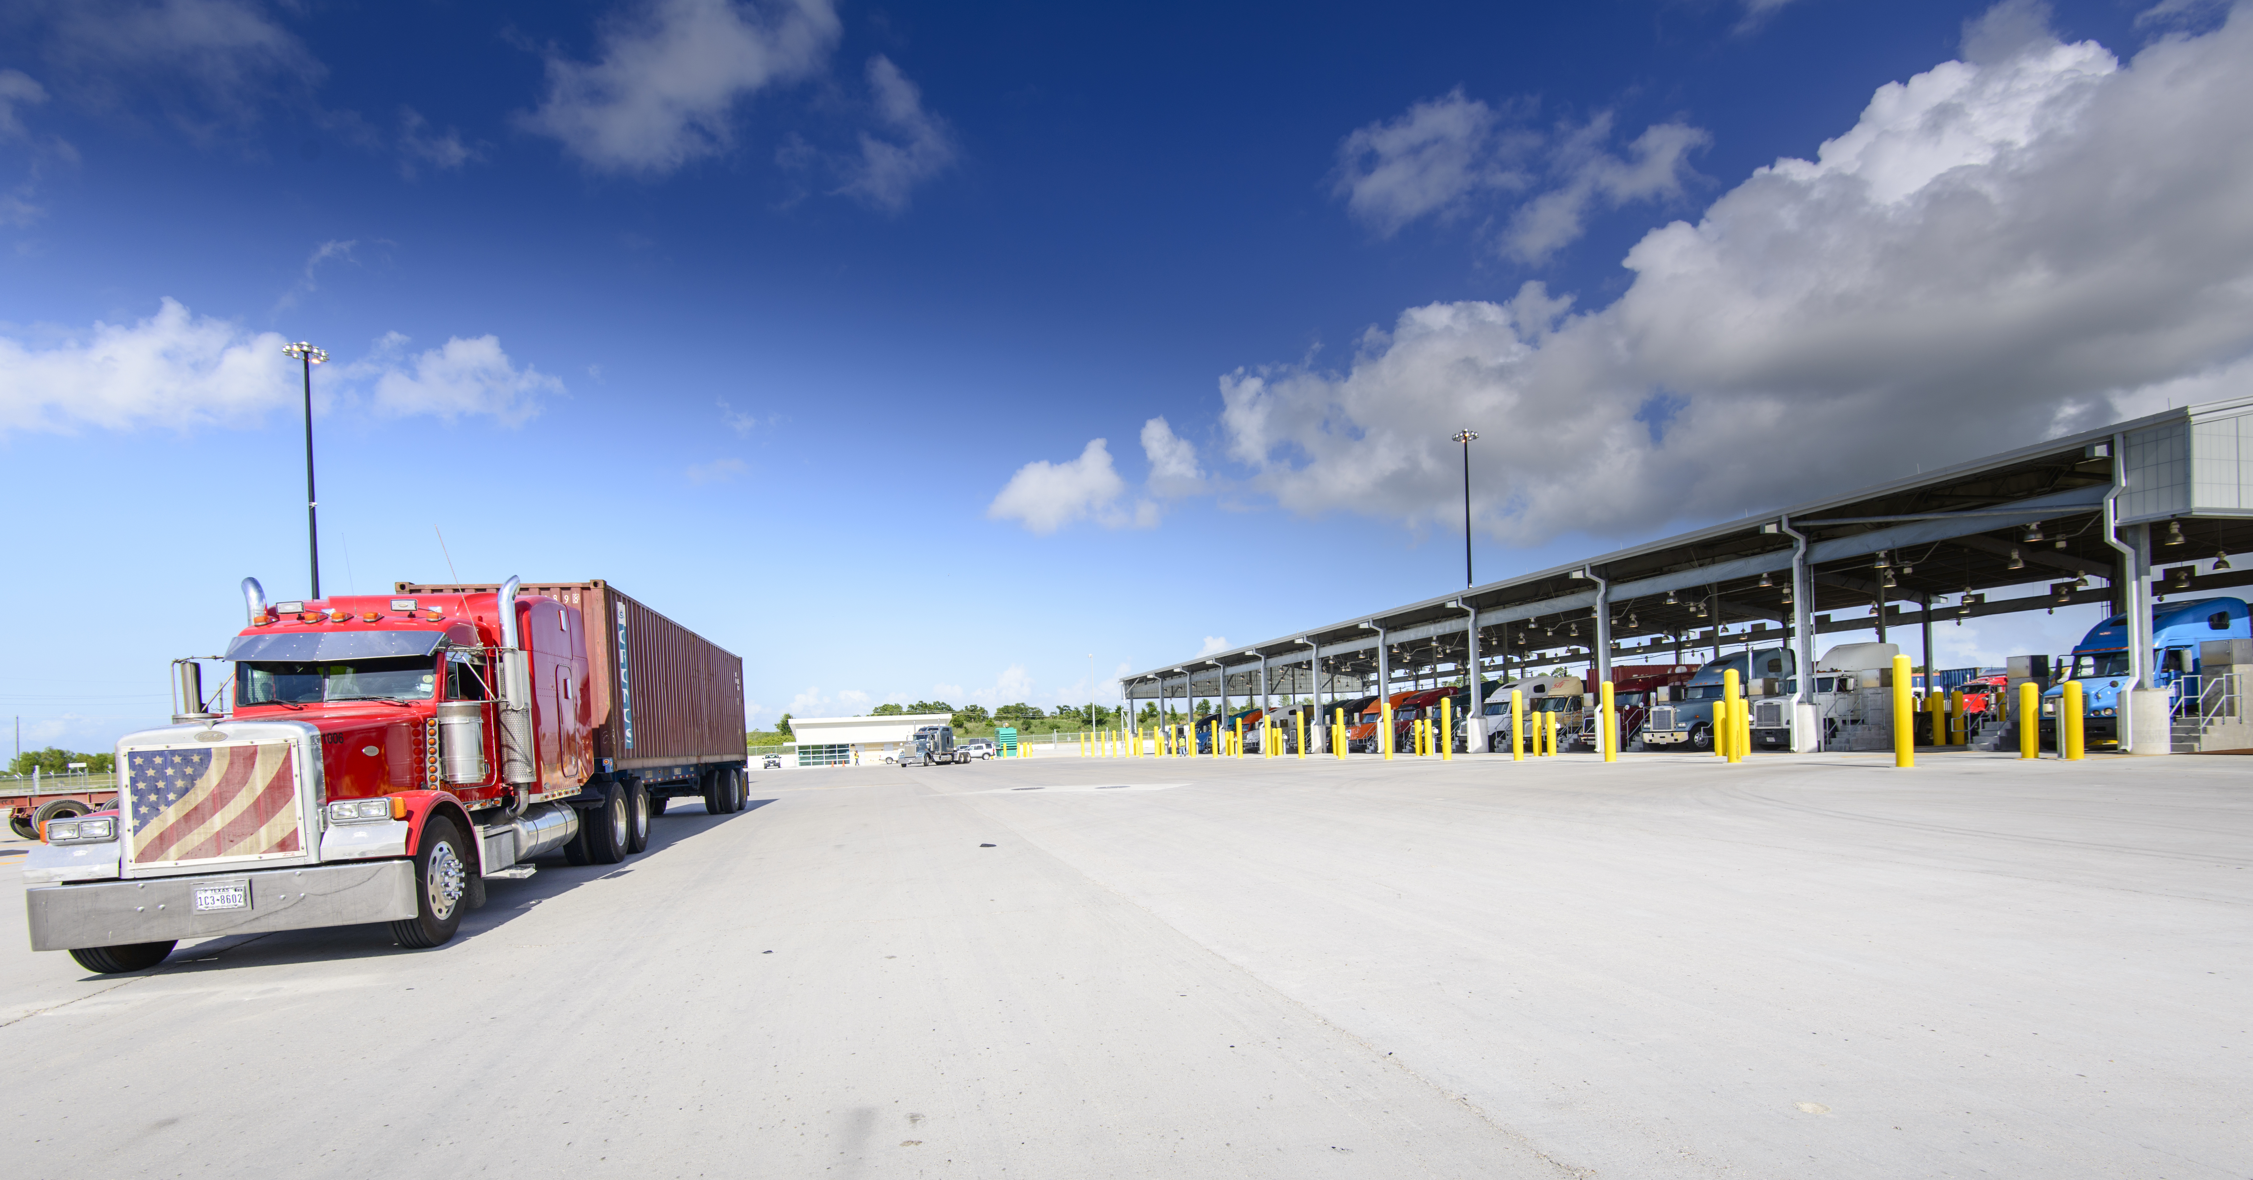
Port Houston
David Casebeer
Project Manager
www.porthouston.com
QUESTIONS?

