Slide 1
RFP-1722 Purchase of Three Dockside Electric Container Cranes for Wharf 6 at Bayport Container Terminal
PORT HOUSTON
Paulo Soares
Sr. Director, Maintenance January 6, 2021 @ 9 A.M.
Notes:
Welcome, thank you for being here today.
Introduce yourself

Slide 2
Agenda
Pre-Proposal Conference House Rules
Port Commission
Procurement Services
Scope
Q/A
Notes:
This is not a “Lift and Shift” but rather an effort to “lift and standardize our business processes and remove the “People Interrupt” (ie. The manual intervention in a standard workflow).

Slide 3
Pre-Proposal Conference House Rules
Attendees will begin the meeting in listen-only mode.
There will be a Q&A session at the end of today’s presentation.
If you have any questions during the presentation, you may submit your Questions through the WebEx chat feature and they will be addressed at the end of the presentation.
This session is being recorded and will be posted on the BuySpeed homepage under “Pre-Bid/Proposal Conference Information.”
Notes:
This is not a “Lift and Shift” but rather an effort to “lift and standardize our business processes and remove the “People Interrupt” (ie. The manual intervention in a standard workflow).

Slide 4
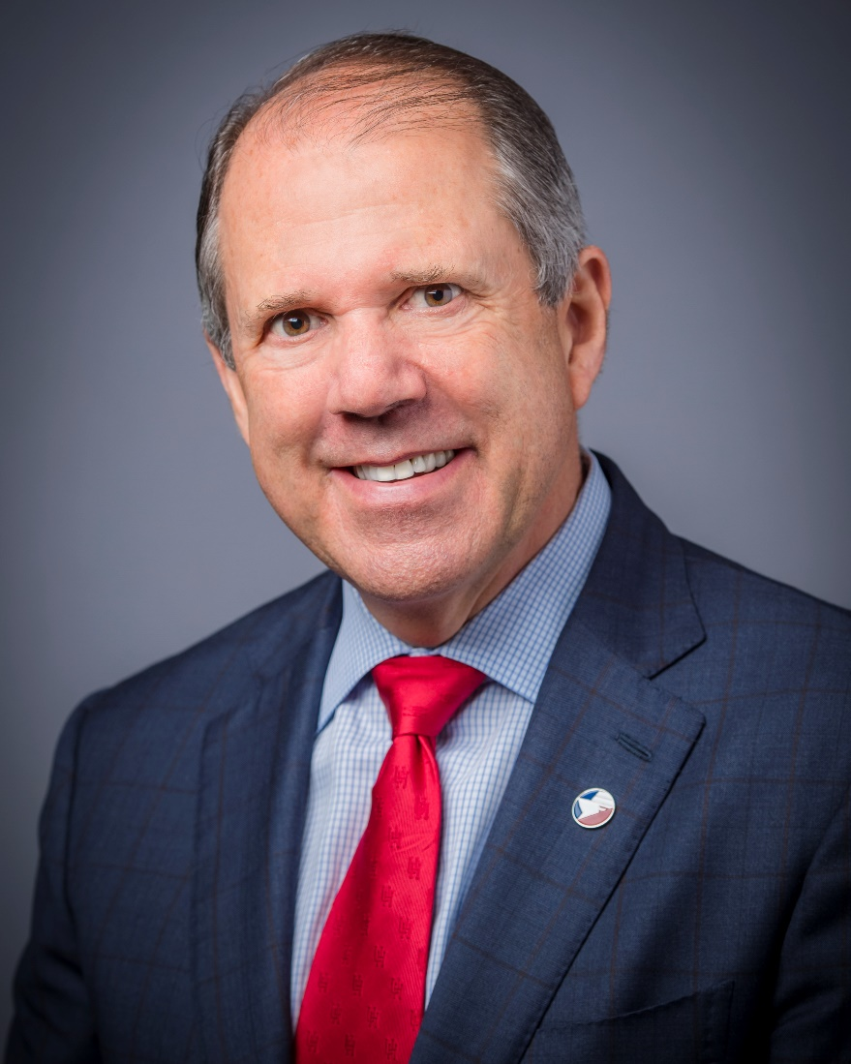
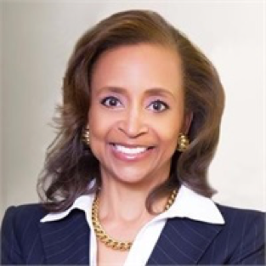
Port Commission
Dean E. Corgey
Clyde Fitzgerald
Cheryl D. Creuzot
Rick Campos
Chairman
Stephen H. DonCarlos
Roy D. Mease
Wendy Montoya
Cloonan
WELCOME MESSAGE | 2

Slide 5
Procurement Services
Port Houston:
Notes:
Welcome, thank you for being here today.
Introduce yourself

Slide 6
Procurement
No Contact Period-No communication between interested vendors and PHA staff during the active period
Technical questions should be submitted via BuySpeed
Proposal submittal questions should be submitted to: procurement@porthouston.com
Responses are due no later than 11 a.m. on 3/17/2021
Proposals must be submitted electronically via email to:
procurementproposals@porthouston.com
Anticipated award date: TBD

Slide 7
Procurement (Cont.d)
Evaluation Criteria
The Port Commission will award the contract to the Respondent whose Response provides the best value in consideration of the evaluation factors set forth below.

Slide 8
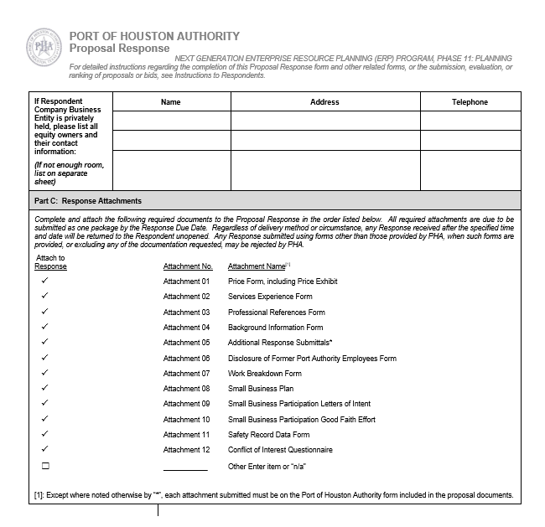
Procurement (Cont.d)
Proposal Response form:
(Page 17 of solicitation)
Page 2 of the Proposal Response
Form– Required Attachments

Slide 9
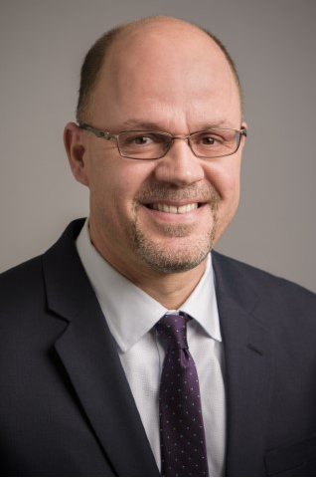
MAINTENANCE ADMINISTRATION
Port Houston:
Paulo Soares
Director, Maintenance
Notes:
Introduce yourself

Slide 10
Scope Details
The Port of Houston Authority is seeking proposals for design, fabrication, assembly and delivery of three dockside electric container cranes to PHA’s Bayport Container Terminal.
Installation, endurance testing, commissioning and training of PHA Maintenance personnel and ILA operators are also part of the scope for this turn-key project.
Wharf No. 6, where these cranes will be offloaded, hasn’t been constructed yet. Construction contract should be awarded by February 2021.

Slide 11
Scope Details (continued)

Slide 12
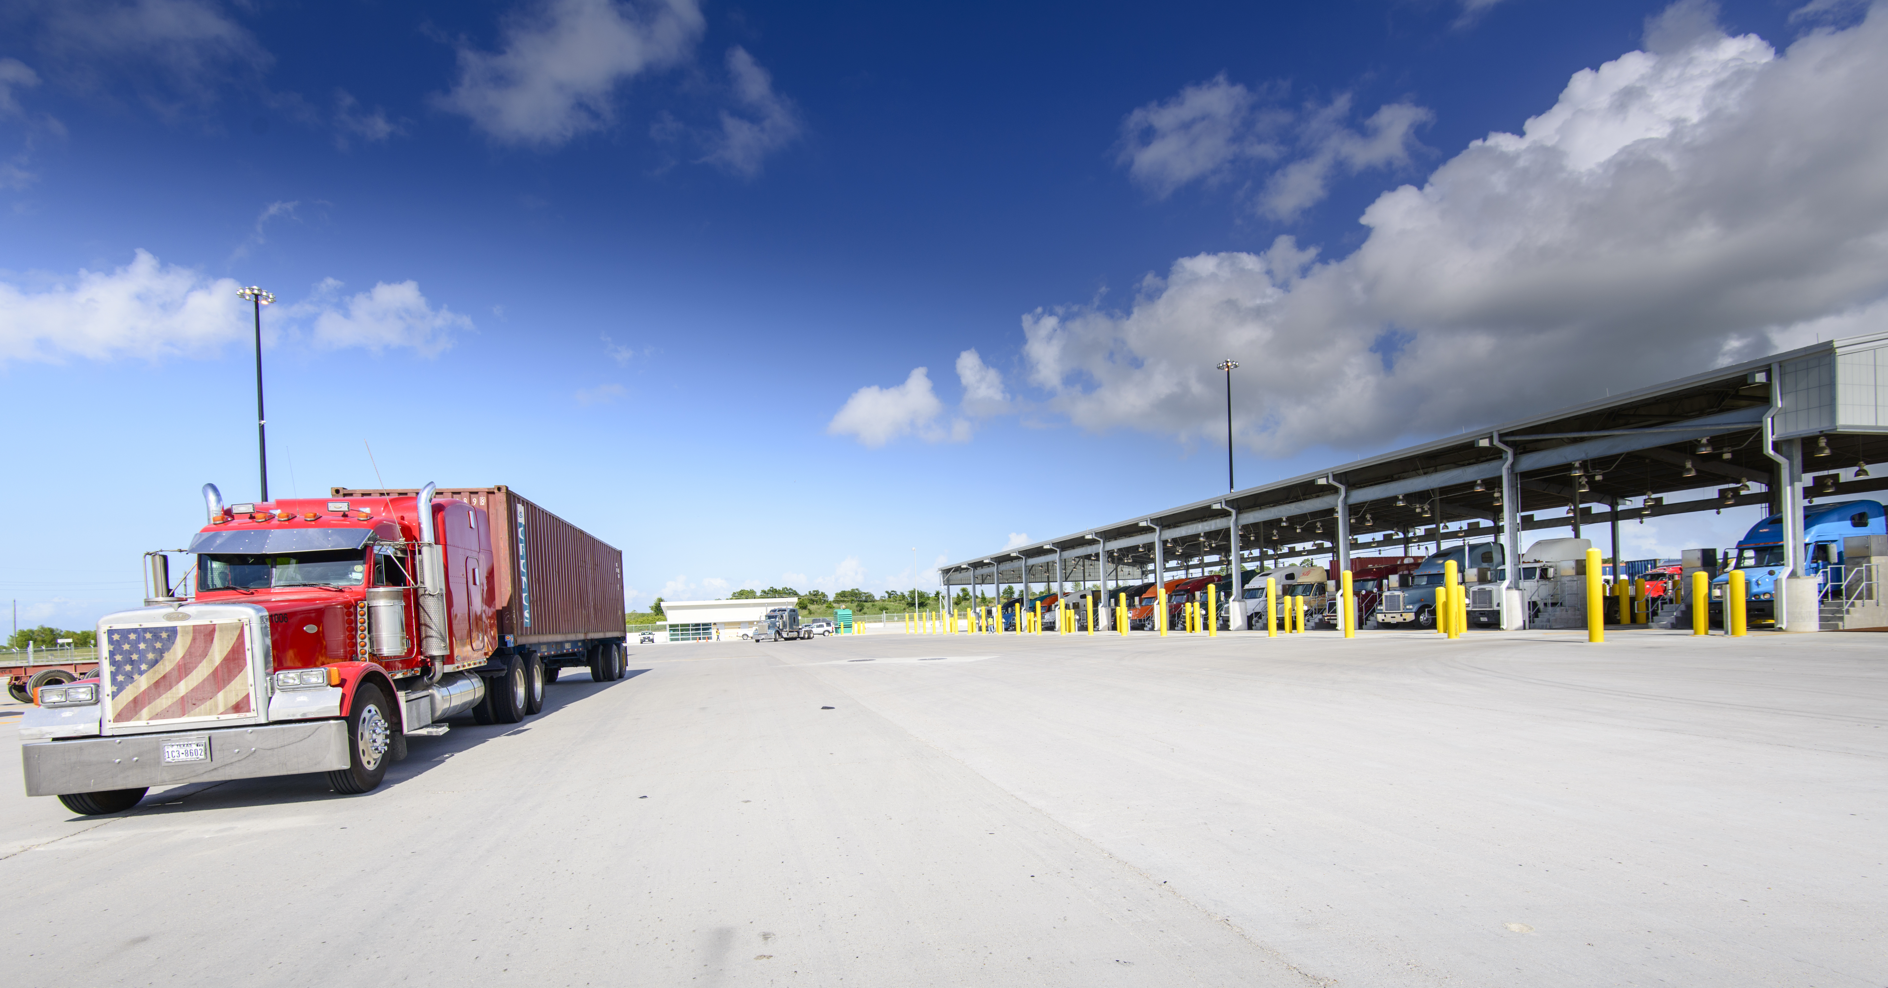
Port Houston
Paulo Soares
Sr. Director, Maintenance
www.porthouston.com

