Slide 1
Port Houston
RFP-1677 Relocation of Three Wharf Cranes from Bayport Container Terminal to Barbours Cut Terminal
Paulo Soares
Sr. Director, Maintenance November 19, 2020

Slide 2
Agenda
Pre-Proposal Conference House Rules
Port Commission
Procurement Services
Scope
Q/A
Notes:
This is not a “Lift and Shift” but rather an effort to “lift and standardize our business processes and remove the “People Interrupt” (ie. The manual intervention in a standard workflow).

Slide 3
Pre-Proposal Conference House Rules
Attendees will begin the meeting in listen-only mode.
There will be a Q&A session at the end of today’s presentation.
If you have any questions during the presentation, you may submit your Questions through the WebEx chat feature and they will be addressed at the end of the presentation.
This session is being recorded and will be sent out to all registered attendees.
Notes:
This is not a “Lift and Shift” but rather an effort to “lift and standardize our business processes and remove the “People Interrupt” (ie. The manual intervention in a standard workflow).

Slide 4
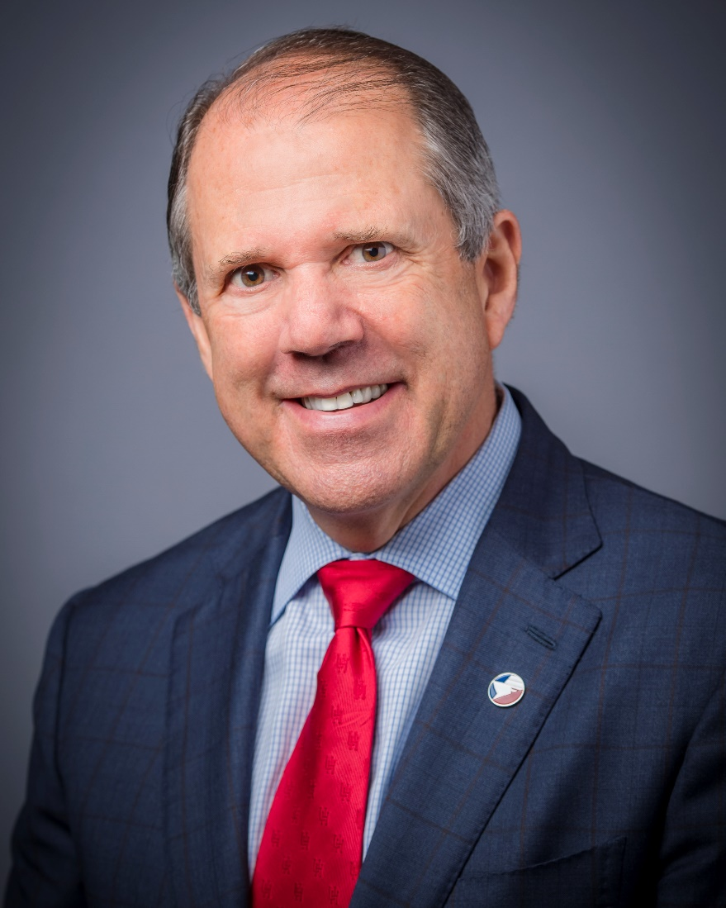
Port Commission
Dean E. Corgey
Clyde Fitzgerald
Cheryl D. Creuzot
Rick Campos
Chairman
Stephen H. DonCarlos
Roy D. Mease
Wendy Montoya
Cloonan
WELCOME MESSAGE | 2

Slide 5
Procurement
No Contact Period-No communication between interested vendors and PHA staff during the active period
Technical questions should be submitted via BuySpeed
Proposal submittal questions should be submitted to: procurement@porthouston.com
Responses are due no later than 11 a.m. on 12/16/2020
Proposals must be submitted electronically via email to:
procurementproposals@porthouston.com
Anticipated award date: 1/26/2021

Slide 6
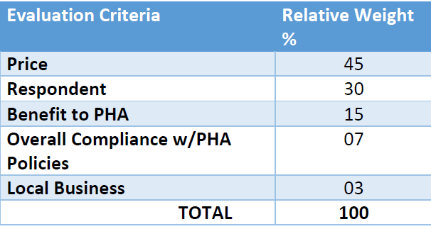
Procurement (Cont.d)
Evaluation Criteria
The Port Commission will award the contract to the Respondent whose Response provides the best value in consideration of the evaluation factors set forth below.

Slide 7
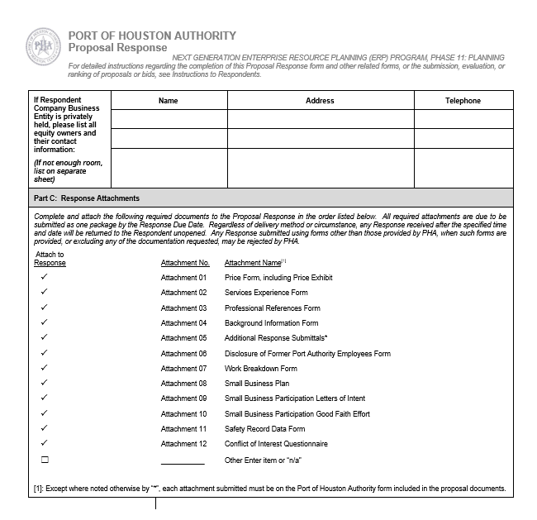
Procurement (Cont.d)
Proposal Response form:
(Page 15 of solicitation)
Page 2 of the Proposal Response
Form– Required Attachments

Slide 8
Scope Details
The Port Authority seeks a service provider that can provide preparation, bracing of cargo, loading, transportation, offloading, removal of bracing and recommissioning of three wharf cranes from wharf no. 5 at Bayport Container Terminal to wharf no. 3 at Barbours Cut Terminal for each of the following Port Authority facilities all located in Harris County:
Bayport Container Terminal 12621 Port Road, Seabrook, TX 77586
Barbours Cut Terminal 1819 E. Barbours Cut Blvd., La Porte, TX 77571
Given some differences between wharves at Bayport Container Terminal and Barbours Cut Terminal, the Contractor shall furnish and install the following:
Two (2) 300mm spacers to be installed between bottom of waterside sill beam and main yokes on each crane. A total of six (6) spacers.
Eight (8) modified tie-down screws and four (4) longer tie-down tension bars per crane. A total of twenty-four (24) modified tie-down screws and twelve (12) longer tie-down tension bars.
One (1) 300mm spacer to be installed between bottom of waterside sill beam and stowage pin bracket. A total of three (3) spacers.

Slide 9
Scope Details (continued)

Slide 10
Port Houston
Paulo Soares
Sr. Director, Maintenance
www.porthouston.com

