Slide 1
RFP – Benefits and Payroll Integration Technology and Services

Slide 2
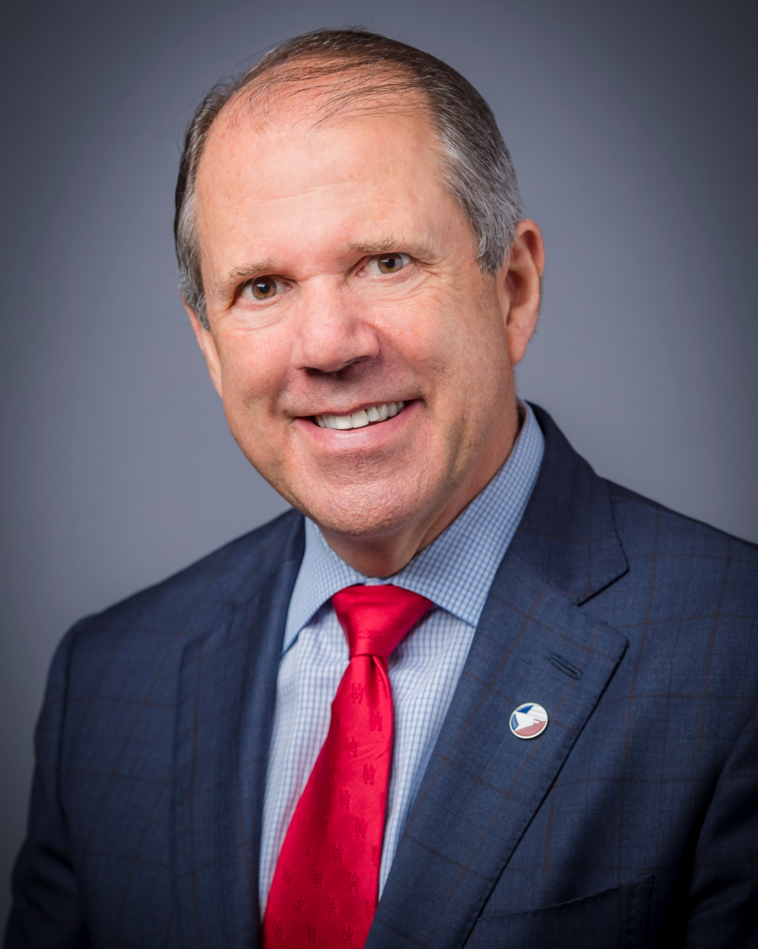
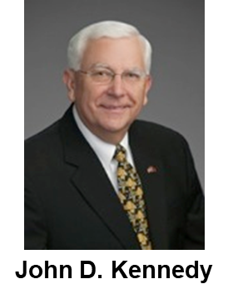
Port Commission
Theldon R. Branch, III
Dean E. Corgey
Stephen H. DonCarlos
Ric Campo
Chairman
Clyde Fitzgerald
Roy D. Mease
| 2

Slide 3
CSCSP – Vegetate Middle Berm at Bayport Container Vegetate Middle Berm at Bayport at Bayport Container Terminal e Middle Berm at Bayport Container Terminal
AGENDA
Introductions
Procurement Procedures
Selection Criteria
Scope of Services
Questions
All attendees must sign-in
| 3

Slide 4
RFP – Benefits and Payroll Integration Technology and Services
PHA Personnel:
Roger Walter – Director, Human Resources
Fonda Gignac – Manager, HRIS & Benefits
Azlina Kabani – HR Services Analyst
David McNamara – Assistant General Counsel & Interim Chief People Officer
Jessica Shaver – Chief People Officer
| 4

Slide 5
RFP – Benefits and Payroll Integration Technology and Services
Procurement Procedures:
Request for Proposals (RFP) are due on June 19, 2019 no later than 11:00 A.M.
One original and eight copies and electronic copy (on a thumb drive in .pdf format), packaged in one sealed envelope
Selected vendor will be recommended to Port Commission for approval on July 29, 2019
| 5

Slide 6
RFP – Benefits and Payroll Integration Technology and Services
Selection Criteria
The Port Commission will award the contract to the responsible proposer submitting the best proposal based on the following:
Criteria %
Price 30
Respondent 20
Benefit to Port Authority 40
Overall Compliance 10
100
| 6

Slide 7
RFP – Benefits and Payroll Integration Technology and Services
Request for Proposal Response:
Part C– Required Response Attachments
| 7

Slide 8
RFP – Benefits and Payroll Integration Technology and Services
General Scope of Services:
PHA intends to enter into an agreement with the selected provider for calendar year 2020, with the options to renew (at PHA’s discretion) for calendar years 2021 and 2022. The Benefits System must be ready for PHA use and participant enrollment by October 1, 2019.
| 8

Slide 9
RFP – Benefits and Payroll Integration Technology and Services
General Scope of Services continued:
The Benefit System shall include:
Online Benefits Enrollment and Administration
Vendor Management
Billing and Financial Reporting
Payroll Management
Affordable Care Act Management
Dependent Management
| 9

Slide 10
THANK YOU
Fonda Gignac
Port Houston
Questions?
www.PortHouston.com
111 East Loop North
Houston, TX 77029

