Slide 1
RFP – Hydrographic Survey Vessel
Craig J. Kasper, P.E.
May 2019

Slide 2
Port Commission
John D. Kennedy
Dean E. Corgey
Clyde Fitzgerald
Ric Campo
Chairman
Theldon R. Branch, III
Stephen H. DonCarlos
Roy D. Mease
WELCOME MESSAGE | 2

Slide 3
CSCSP – Vegetate Middle Berm at Bayport Container Vegetate Middle Berm at Bayport at Bayport Container Terminal e Middle Berm at Bayport Container Terminal
AGENDA
Introductions
Harris County
Small Business
Procurement Services
Selection Criteria
Project Parameters
Questions
All attendees must sign-in and indicate attendance

Slide 4
RFP – Hydrographic Survey Vessel
PHA Personnel:
Roger H. Hoh, P.E. – Director, PCM
Craig J. Kasper, P.E. – Construction Manager
Louis Bergman, RPLS – Survey Party Chief
Ross Talbot – Construction Delivery Mgr.
Pedro Gonzales – Small Business Development
Harris County:
Robert Rocha – Wage Rate Monitor

Slide 5
RFP – Hydrographic Survey Vessel
Harris County Wage Rate Compliance & Requirements:
Attendance at pre-bid/proposal meetings
Review and approve weekly certified payroll records
Monitor wage rate compliance
Review claims of non-compliance from the field and recommend appreciate responses as required or permitted under the Wage Scale Act

Slide 6
RFP – Hydrographic Survey Vessel
Small Business Requirement:
Overall PHA annual Goal for Small Business participation of 35%
No Small Business Participation
Local Business criterion shall not exceed the Relative Weight of 3%.

Slide 7
RFP – Hydrographic Survey Vessel
Procurement:
Request for Proposals (RFP) are due on June 19, 2019 no later than 11:00 A.M.
One original and five copies, packaged in one sealed envelope
All proposals will be opened and read publicly in the PHA first floor conference room by Procurement Services on Wednesday, June 19, 2019 at 11:30 A.M.

Slide 8
RFP – Hydrographic Survey Vessel
Selection Criteria
The Port Commission will award a contract to the top-rated proposer submitting the proposal that offers the best value to PHA.
Responsible:
Meet the applicable Small Business Participation requirements, if any;
Have the ability to comply with the required delivery or performance schedule, taking into consideration other business commitments;
Have a satisfactory record of performance and integrity;
Have satisfactory safety and environmental record;
Have satisfactory references; and
Have the necessary facilities, equipment, materials, personnel, organization, experience, authorizations, technical skills, and financial resources to fulfill the terms of the contract for the project

Slide 9
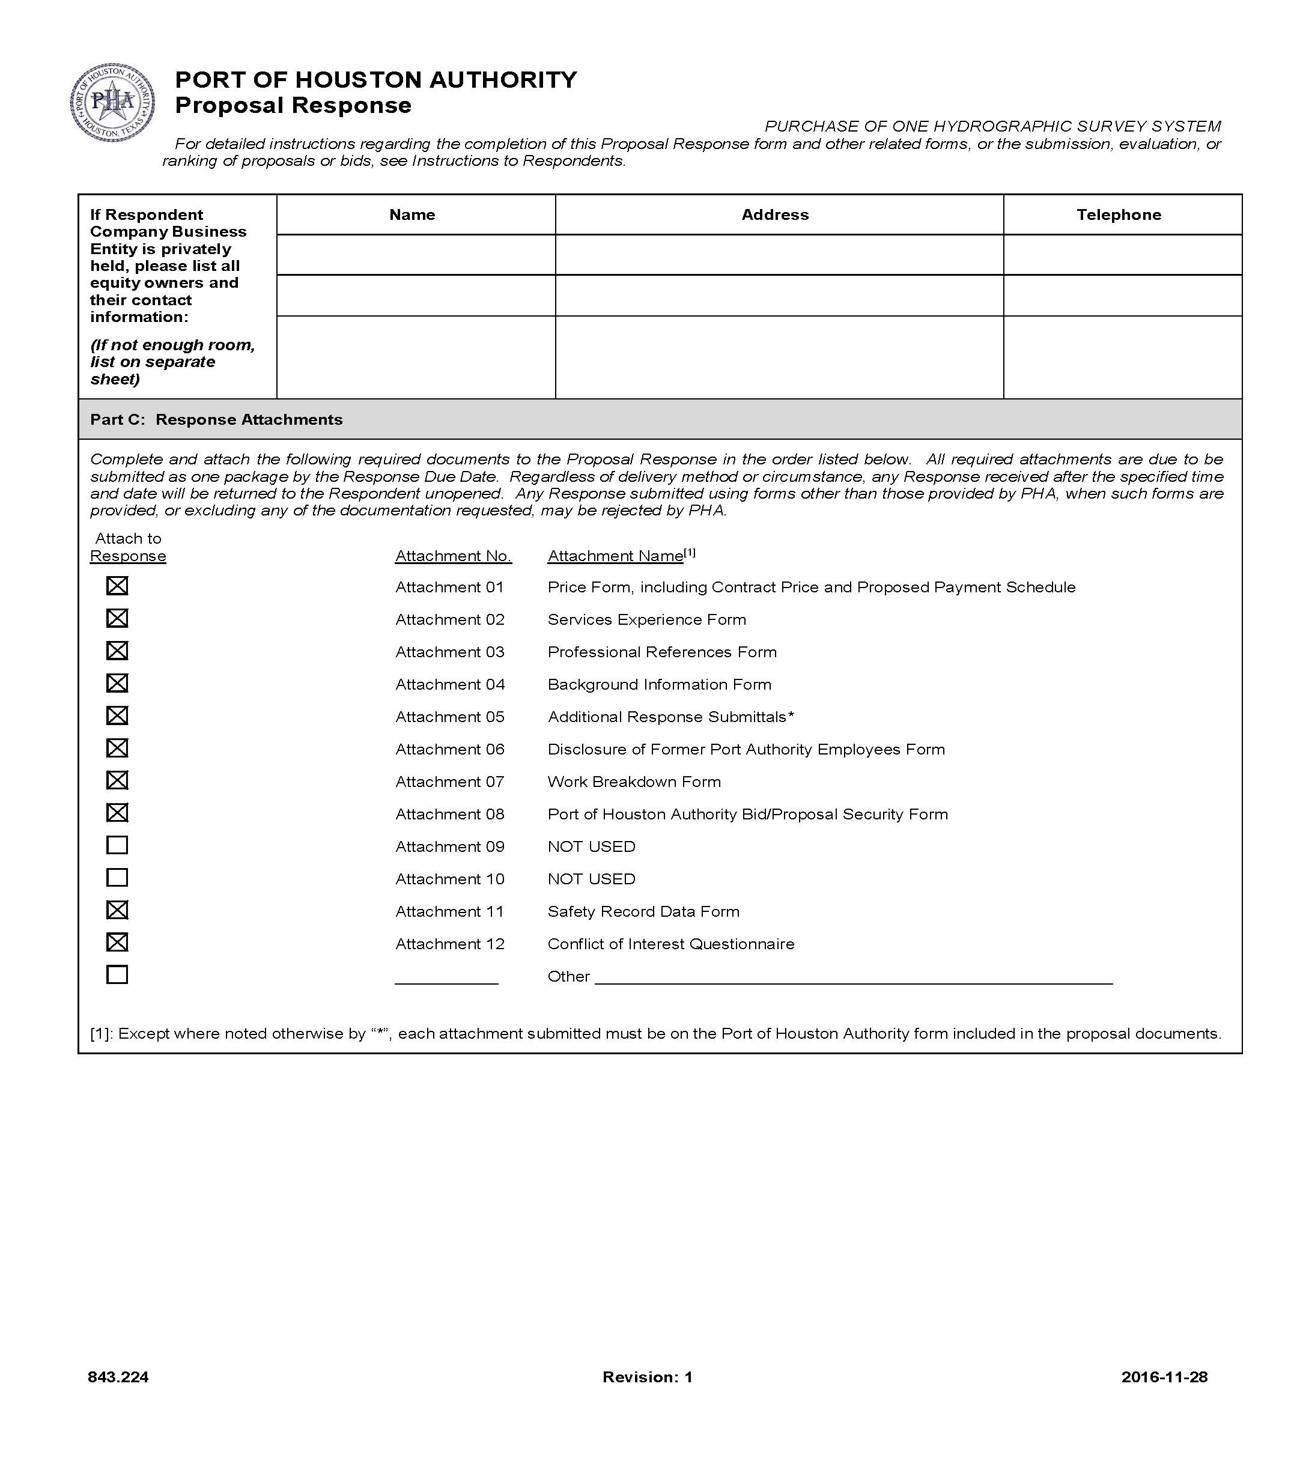
RFP – Hydrographic Survey Vessel
Request for Proposal Response:
Required Attachments

Slide 10
RFP – Hydrographic Survey Vessel
Price Exhibit – organized by major system components
Not a divisible proposal
ALL BLANKS MUST BE FILLED IN ON EVERY PAGE OF THE PRICE EXHIBIT
All references to price are on the pricing sheet
Partial payments approved for equipment and materials related to Price Exhibit Item Nos. 1, 2 & 5

Slide 11
Goods & Services Agreement Excerpts
Contract is for a maximum of 120 calendar days
Contract includes Milestone-based Payment Schedule
No Liquidated damages
A preliminary baseline schedule is required with the proposal

Slide 12
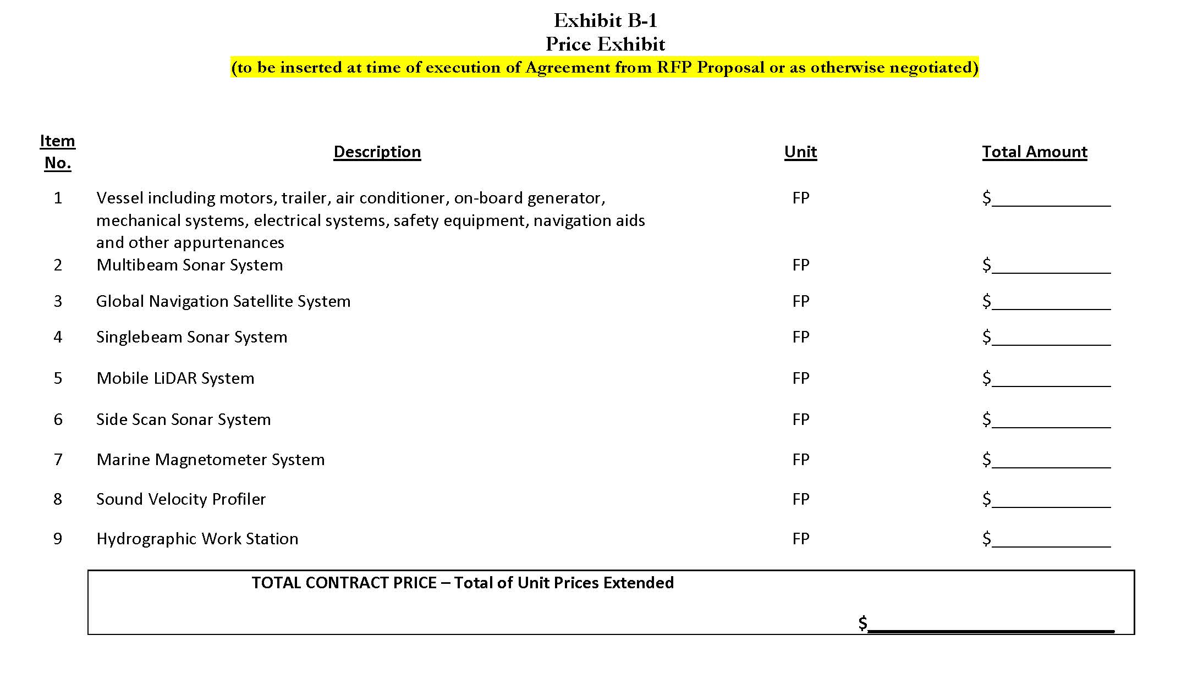
RFP – Hydrographic Survey Vessel

Slide 13
Components of the “System”
For use within PHA terminal berths and docks in nearshore waters, depths less than 100 feet
Survey and positioning equipment operate independently and collectively (Multibeam sonar and Mobile LiDAR)
Specification is the minimum standard
PHA will evaluate proposed elements
Fixed price includes cost for software, operational training, support services, and warranty
“Turn-key” system

Slide 14
Components of the “System”
Pre-shipment and on-site testing requirements
12-month technical support and warranty period
Provide on-site training for PHA personnel
Minimum of five (5) eight hour days for PHA training

Slide 15
THANK YOU
Craig J. Kasper, P.E.
Construction Manager
Port Houston
Questions?
www.PortHouston.com
111 East Loop North
Houston, TX 77029

