Slide 1
RFP – 1148 Disparity Study Services
Gilda Ramirez | Sr. Director of Small Business & Education Outreach |

Slide 2
Port Commission
John D. Kennedy
Dean E. Corgey
Clyde Fitzgerald
Ric Campo
Chairman
Theldon R. Branch, III
Stephen H. DonCarlos
Roy D. Mease
WELCOME MESSAGE | 2

Slide 3
CSCSP – Vegetate Middle Berm at Bayport Container Vegetate Middle Berm at Bayport at Bayport Container Terminal e Middle Berm at Bayport Container Terminal
AGENDA
Introductions
Project Purpose
Overview of Project
Small Business
Procurement Services
Selection Criteria
Questions
All attendees must sign-in

Slide 4
RFP– 1148 Disparity Study Services
PHA Personnel:
Gilda Ramirez – Sr. Director, Small Business & Education Outreach
Yvette Camel-Smith – Director, Procurement Services
Tanika Chukwumerije – Manager, Contracts
Akilah Hicks – Small Business Coordinator
Krystle Brown – Contract Compliance Analyst

Slide 5
RFP– 1148 Disparity Study Services
Purpose of Study:
To determine the Availability of qualified SMWDBEs in the Port of Houston Authority’s (PHA’s) Regional Geographic Market Area
To analyze the extent to which disparities, if any, exist in PHA’s Utilization of such businesses in its contract awards
To examine the extent to which the disparities might have been impacted by past or present discrimination
To serve as the foundation for enhancements to PHA’s existing Small Business Development Program and for future policies and programs

Slide 6
RFP– 1148 Disparity Study Services
Overview of Project:
To analyze PHA’s utilization of SBEs, MBEs, WBEs, and DBEs on procured contracts more than $50,000 (approx. 850 contracts; $800m)
To identify and evaluate a random sample of contracts $50,000 or less from each of the relevant PHA departments (approx. 5,500 contracts; $53m)
Based on four (4) years of historical data- January 1, 2015 to December 31, 2018 (Study Period)
Contract Term-16 months, with one option to extend for 8 months

Slide 7
RFP– 1148 Disparity Study Services
Small Business
35% SB Target
To receive points for small business participation, small business companies (prime and
subcontractors) must be enrolled in the Port Authority Small Business Development Program at the time of submission of the Response. In order for a joint venture to receive credit as a small business, the joint venture itself must be enrolled in the Port Authority Small Business Development Program at the time of submission of the Response.
• To receive points for small business participation, the Respondent’s proposed price must be within three percent (3%) of the Lowest Eligible Price.

Slide 8
RFP– 1148 Disparity Study Services
Small Business
Responses submitted by Port Authority-Enrolled Small Businesses will receive a minimum of 2/3 of the points available for small business participation.
If that Port Authority-Enrolled Small Business subcontracts to a Port Authority-Enrolled subcontractor, the Respondent will receive the remaining points available for small business participation.
Responses submitted by a company that is not a Port Authority-Enrolled Small Business will receive the percentage of the points available for Small Business Participation corresponding directly to the ratio of the percentage of work to be performed by the Port Authority-Enrolled Small Business subcontractors according to the formula:

Slide 9
RFP– 1148 Disparity Study Services
Procurement:
Request for Proposals (RFP) are due on June 19, 2019 no later than 11:00 A.M.
One original and five copies, packaged in one sealed envelope
No Contact Period
Use forms in solicitation package

Slide 10
RFP– 1148 Disparity Study Services
Selection Criteria:
The Port Commission will award the contract to the Respondent whose Response provides the best value in consideration of the evaluation factors set forth below.
Evaluation Criteria | Relative Weight %
Price | 20
Respondent Firm Qualifications and Experience | 25
Qualifications and Experience of Respondent’s Personnel and Subcontractors | 25
Project Management/Structure and Methodology | 25
Small Business Participation | 5

Slide 11
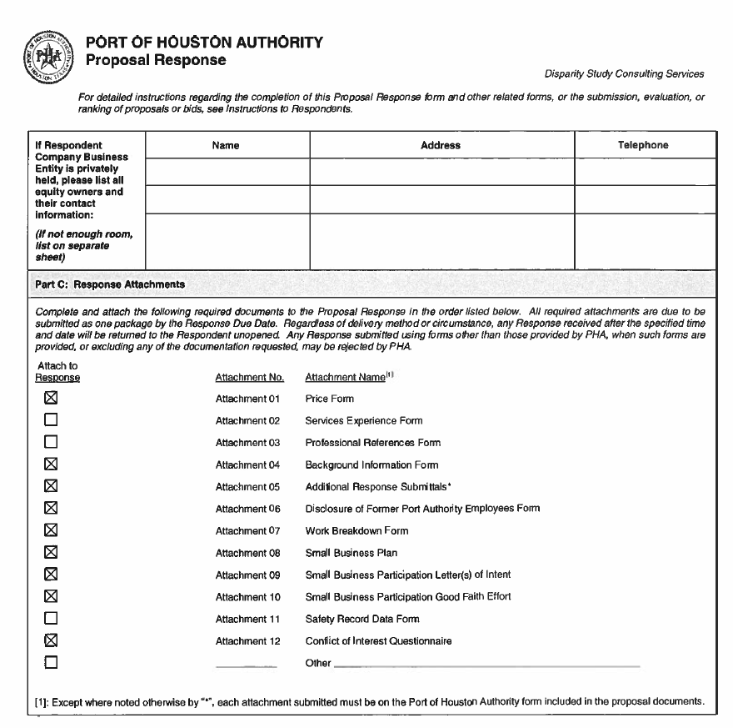
RFP– 1148 Disparity Study Services
Proposal Response:
Page 2 – Required Attachments

Slide 12
THANK YOU
Questions?
procurement@poha.com

