Slide 1



RFP-311 JDE Managed CNC Services
Chris Brown| Director IT - Applications| Information Technology

Slide 2
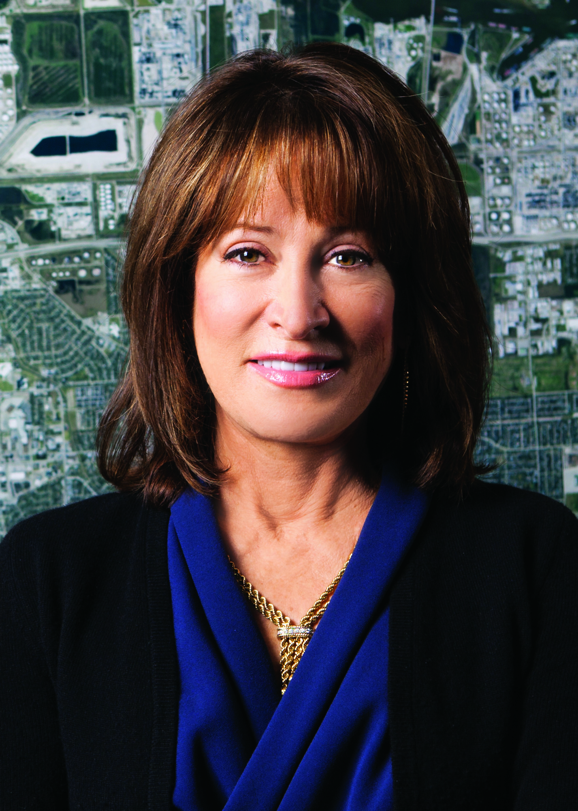
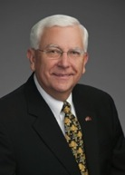
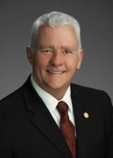

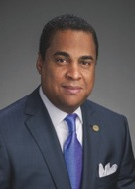

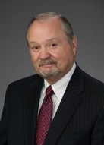
Port Commission
John D. Kennedy
Dean E. Corgey
Clyde Fitzgerald
Janiece M. Longoria
Chairman
Theldon R. Branch, III
Stephen H. DonCarlos
Roy D. Mease
WELCOME MESSAGE | 2

Slide 3
JDE Managed CNC Services
AGENDA
Introductions
Small Business
Procurement Services
Selection Criteria
Parameters
Questions
All attendees must sign-in and indicate attendance

Slide 4
JDE Managed CNC Services
PHA Personnel:
Charles Thompson – CIO
Chris Brown – Director
Pepe Cavazos – Systems Administrator
David Lopez – ERP Analyst (Finance/Procurement)
Phil Howell – ERP Analyst (HCM/Real Estate)
Pedro Gonzales – Small Business Development
Yvette Camel-Smith – Director of Procurement

Slide 5
JDE Managed CNC Services
Small Business Requirement:
This project has been deemed “Exempt” from the Small Business Development Program since this is a proprietary software program.

Slide 6
JDE Managed CNC Services
Procurement:
Request of Competitive Sealed Proposals (RFP) are due on March 22, 2017, no later than 11:00 A.M.
One original and five copies, packaged in one sealed envelope

Slide 7
JDE Managed CNC Services
Selection Criteria
The Port Commission will award the contract to the responsible proposer that offers the best value to the Port Authority.
Purchase Price- 25%
Vendor’s Reputation, Quality of Services and/or Product, Safety Record- 40%
Benefit to Port Authority- 22%
Small Business Participation and Local Business Participation- 10%
Overall Compliance with Port Authority Policies- 3%

Slide 8
JDE Managed CNC Services
General Scope of Services:
Managed JDE CNC Services;
Monthly JDE Developer Hours;
Annual Coverage for Three Years;
Additional CNC Hourly Rate;
Additional Developer Hourly Rate;

Slide 9

THANK YOU
Chris Brown
Director IT - Applications
Port Houston
Questions?
713.670.2400
procurement@poha.com
www.PortHouston.com
111 East Loop North
Houston, TX 77029
WELCOME MESSAGE | 4

