Slide 1
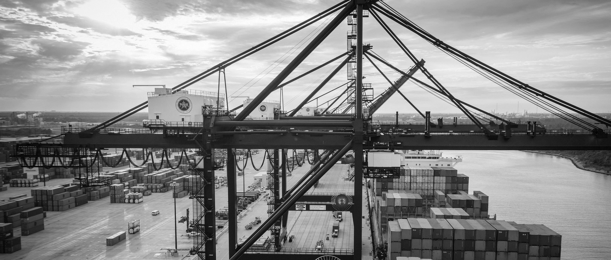
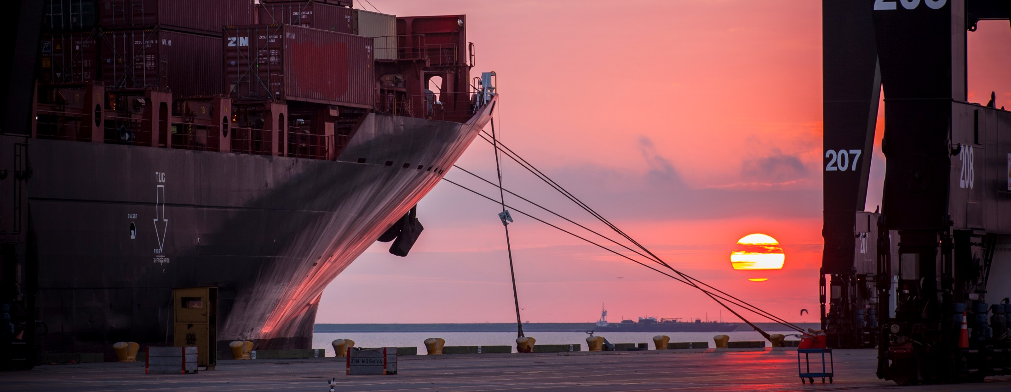
CSP # 963- REHABILITATION OF WHARF 3, CONSTRUCTION OF ELECTRICAL INFRASTRUCTURE AND LASH DOCK DEMOLITION AT BARBOURS CUT TERMINAL
Bill Aguirre, P.E. | Project Manager | Project & Construction Management (PCM)

Slide 2
REHABILITATION OF WHARF 3, CONSTRUCTION OF ELECTRICAL INFRASTRUCTURE AND LASH DOCK DEMOLITION AT BCT
AGENDA
Introductions
Harris County
Small Business
Procurement Services
Proposal Evaluation Criteria and Weight
Scope of Work
Questions
All attendees must sign-in and indicate attendance for site visit and TWIC cardholders

Slide 3
REHABILITATION OF WHARF 3, CONSTRUCTION OF ELECTRICAL INFRASTRUCTURE AND LASH DOCK DEMOLITION AT BCT
PHA Personnel:
Roger H. Hoh, P.E. – Director, PCM
Ross Talbot – Projects Delivery Manager
Bill Aguirre, P.E. – Project Manager
Harvey Ross – Construction Manager
Pedro Gonzales – Small Business Development
Tanika Chukwumerije – Contract Manager- Procurement
Engineering Consultants:
Suzanne Crawford, P.E.- Brown and Gay Engineers
Harris County:
Robert Rocha – Wage Rate Monitor

Slide 4
REHABILITATION OF WHARF 3, CONSTRUCTION OF ELECTRICAL INFRASTRUCTURE AND LASH DOCK DEMOLITION AT BCT
Harris County Wage Rate Compliance & Requirements:
Attendance at pre-bid/proposal meetings and pre-construction meetings
Review and approve weekly certified payroll records
Monitor wage rate compliance
Review claims of non-compliance from the field and recommend appropriate responses as required or permitted under the Wage Scale Act

Slide 5
REHABILITATION OF WHARF 3, CONSTRUCTION OF ELECTRICAL INFRASTRUCTURE AND LASH DOCK DEMOLITION AT BCT
Small Business Requirement:
Small Business Required Level (Minimum) for this Project = 16% of the Proposed Amount

Slide 6
REHABILITATION OF WHARF 3, CONSTRUCTION OF ELECTRICAL INFRASTRUCTURE AND LASH DOCK DEMOLITION AT BCT

Slide 7
REHABILITATION OF WHARF 3, CONSTRUCTION OF ELECTRICAL INFRASTRUCTURE AND LASH DOCK DEMOLITION AT BCT

Slide 8
REHABILITATION OF WHARF 3, CONSTRUCTION OF ELECTRICAL INFRASTRUCTURE AND LASH DOCK DEMOLITION AT BCT

Slide 9
REHABILITATION OF WHARF 3, CONSTRUCTION OF ELECTRICAL INFRASTRUCTURE AND LASH DOCK DEMOLITION AT BCT
Procurement:
Competitive Sealed Proposals (CSP) are due on March 13th, 2019 no later than 11:00 A.M.
One original and five copies, packaged in one sealed envelope
All proposals will be opened and read publicly in the PHA first floor conference room by Procurement Services on Wednesday, March 13th, 2019 at 11:30 A.M.

Slide 10
REHABILITATION OF WHARF 3, CONSTRUCTION OF ELECTRICAL INFRASTRUCTURE AND LASH DOCK DEMOLITION AT BCT
Selection Criteria
I. Small Business Participation-Minimum Required Level
Small Business Participation: Required Level (Minimum) 16%
II. Responses that satisfy the minimum small business participation requirement will be evaluated based on the below criteria:
Purchase price 50%
Vendor’s reputation, quality of services and/or product, safety record 35%
Benefit to Port Authority 7%
Overall Compliance with Port Authority Policies and Instructions 5%
Local Business 3%

Slide 11
REHABILITATION OF WHARF 3, CONSTRUCTION OF ELECTRICAL INFRASTRUCTURE AND LASH DOCK DEMOLITION AT BCT
Transportation Worker Identification Credential (TWIC) Requirement
Applies to unescorted access inside terminal
The escorting approval process includes:
Paperwork submission for approval
Face- to- face escort training (45min-1hour)
Escort badge issuance

Slide 12
REHABILITATION OF WHARF 3, CONSTRUCTION OF ELECTRICAL INFRASTRUCTURE AND LASH DOCK DEMOLITION AT BCT
TWIC Requirement (Cont.d)
The escort badge holder shall ensure that the escorted individual (non-TWIC holder) is continuously accompanied in a manner sufficient to observe whether the escorted individual is engaged in activities other than those for which escorted access was granted.
Escort Ratio’s (Secure/Restricted Areas):
On foot – 1 to 5, 1 TWIC escort may escort up to 5 non-TWIC holders
In vehicle (bus, van, etc.) – 1 TWIC escort may escort all non-TWIC holders in the vehicle.
Vehicle Escorts – 1 to 1 TWIC escort in lead vehicle can only escort 1 vehicle at a time.

Slide 13
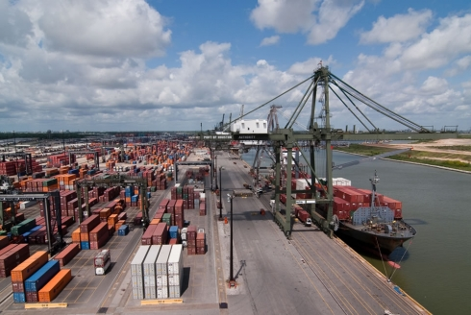
REHABILITATION OF WHARF 3, CONSTRUCTION OF ELECTRICAL INFRASTRUCTURE AND LASH DOCK DEMOLITION AT BCT
Typical Existing Wharf Prior to Rehabilitation

Slide 14
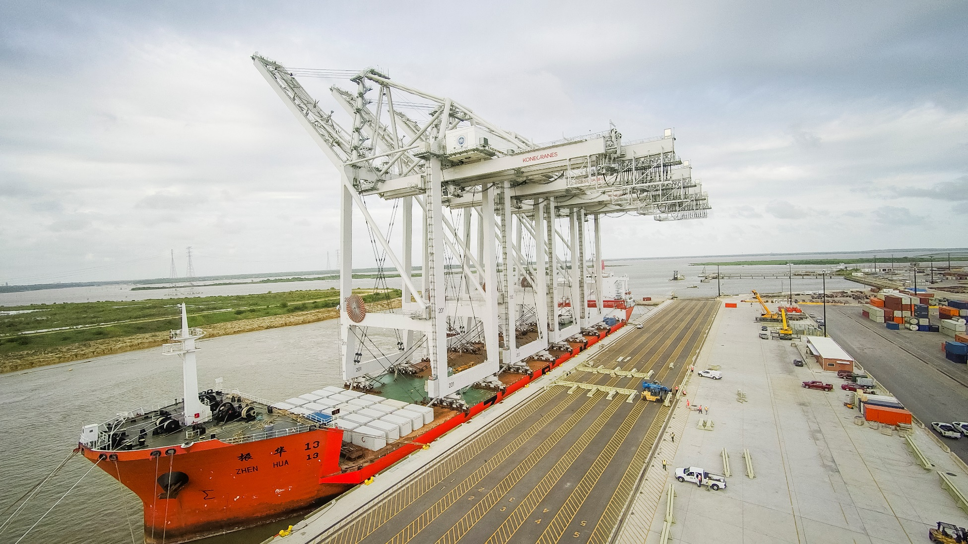
REHABILITATION OF WHARF 3, CONSTRUCTION OF ELECTRICAL INFRASTRUCTURE AND LASH DOCK DEMOLITION AT BCT
Typical Existing Wharf After Rehabilitation

Slide 15
PROJECT COMPONENTS
DEMOLITION OF LASH DOCK
REHABILITATION OF WHARF 3
ELECTRICAL INFRASTRUCTURE

Slide 16
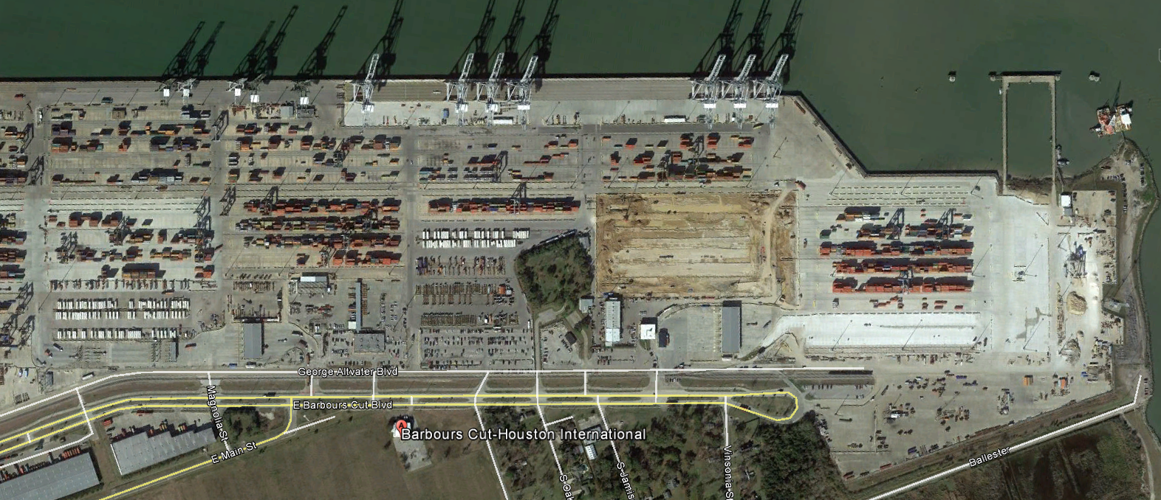
ACCESS TO W3 – REHABILIATION OF WHARF 3
REHABILITATION OF WHARF 3
CONTRACTOR’S LAYDOWN
ACCESS
WORK LIMITS

Slide 17
CRANE RAILS
PHASE 2
PHASE 1
NEW
PAVING
UTILITIES
258’
NEW
PAVING
UTILITIES
ELECTRICAL SUBSTATION
HIGH MAST LIGHT POLES, FIRE HYDRANTS
SSLS
STEVEDORE SUPPORT BLDG
PHASE 2: Commences after 75% of
Primary Duct bank is complete

Slide 18
REHABILITATION OF WHARF 3, CONSTRUCTION OF ELECTRICAL INFRASTRUCTURE AND LASH DOCK DEMOLITION AT BCT
General Scope of Services – Major Elements
Demolition
Demolition of the forward 25’ of wharf structure
Removal of the wharf deck pavement
Removal of the 50’ gage crane rail system
Demolition of Amenities Building and Electrical Shop
Yard pavement of approx. 150’ behind the bulkhead
Dredging
Removal of a 10’ wide swath at the face of the wharf to -50.5 MLLW
Disposal of spoils to Spillman Island
Waterside & Landside - Demolition/Dredge

Slide 19
REHABILITATION OF WHARF 3, CONSTRUCTION OF ELECTRICAL INFRASTRUCTURE AND LASH DOCK DEMOLITION AT BCT
REMOVE BASE & PAVEMENT
REMOVE FORWARD PORTION OF WHARF
107’
REMOVE FENDER SYSTEM
EXIST
BULKHEAD
S407.08
10’ DREDGE
DREDGE
TO -50.5 MLLW
Waterside - Demolition/Dredge

Slide 20
DEMO FORWARD
PORTION OF WHARF
DEMO WHARF
PAVEMENT
DREDGE
DEMO
LIGHT POLES, FIRE HYDRANTS
EXISTING
BULKHEAD LINE
258’
151’
DEMO
FIRE PUMP
DEMO
SSLS
DEMO
MAINTENANCE SHED
AND YARD
DEMO
AMENITIES BLDG
DEMO
PAVING
UNDERGROUND UTILITIES

Slide 21
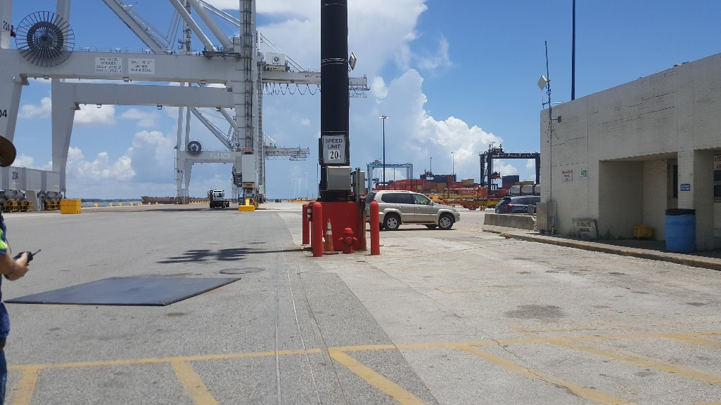
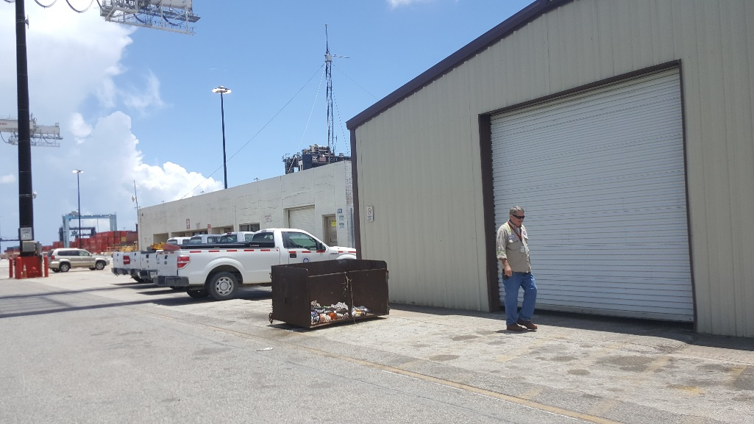
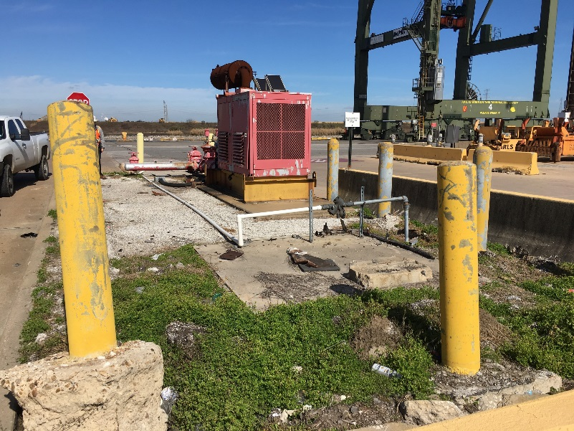
REHABILITATION OF WHARF 3, CONSTRUCTION OF ELECTRICAL INFRASTRUCTURE AND LASH DOCK DEMOLITION AT BCT
Demo – Pavement, Utilities, Amenities Building
Demo – Maintenance Shed
Demo – Fire Pump Station
(Sequencing Requirements Apply)
Demo – Sanitary Sewer Lift Station
Land side - Demolition

Slide 22
REHABILITATION OF WHARF 3, CONSTRUCTION OF ELECTRICAL INFRASTRUCTURE AND LASH DOCK DEMOLITION AT BCT
General Scope of Services (continued):
Wharf Rehabilitation
New wharf structure forward of Column Line B
New fender system
New 48” dia. drilled shafts and waterside crane beam
New crane rail system
New wharf deck base and asphalt pavement
Wharf appurtenances and utilities
Repairs to existing shafts and structural deck, which remain.
Waterside - Construction

Slide 23
REHABILITATION OF WHARF 3, CONSTRUCTION OF ELECTRICAL INFRASTRUCTURE AND LASH DOCK DEMOLITION AT BCT
NEW
CRANE RAIL
NEW
PAVEMENT
AND BASE
NEW
CRANE RAIL
NEW
CONC. DECK
NEW
TIE-BEAM
NEW
WATER SIDE
SHAFT
Repairs to
Existing Shafts
NEW LANDSIDE
SHAFT
Waterside - Construction

Slide 24
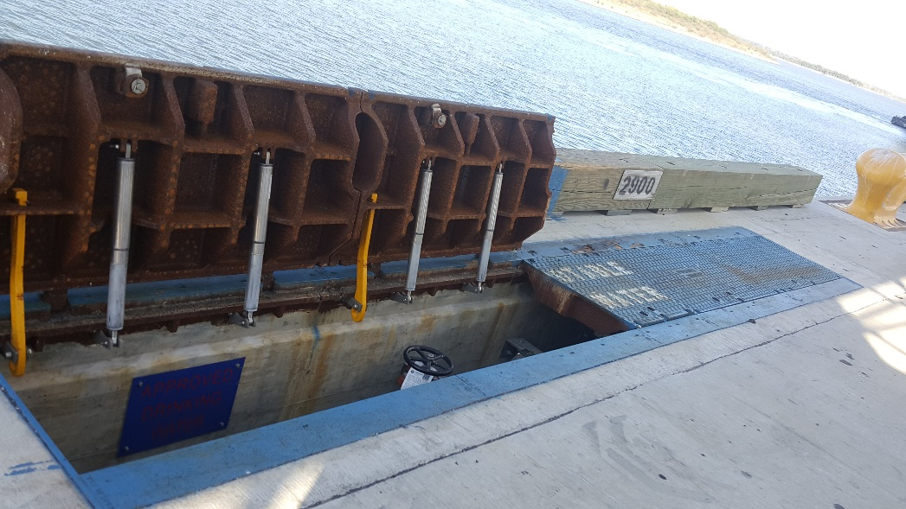
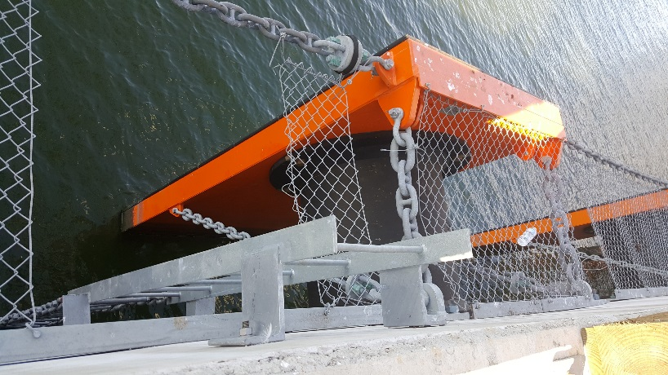
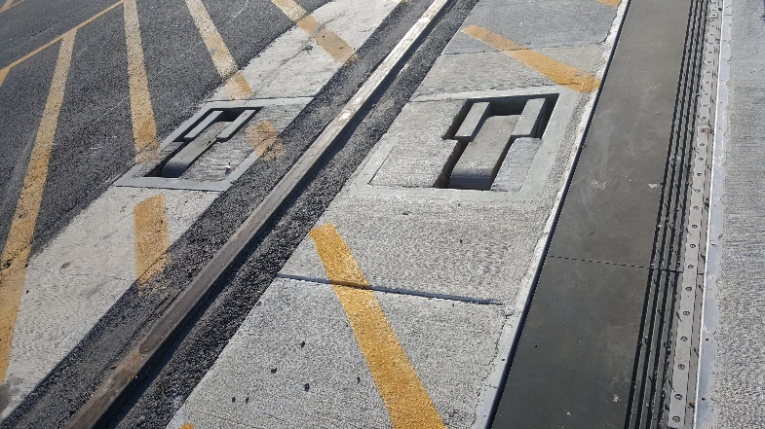
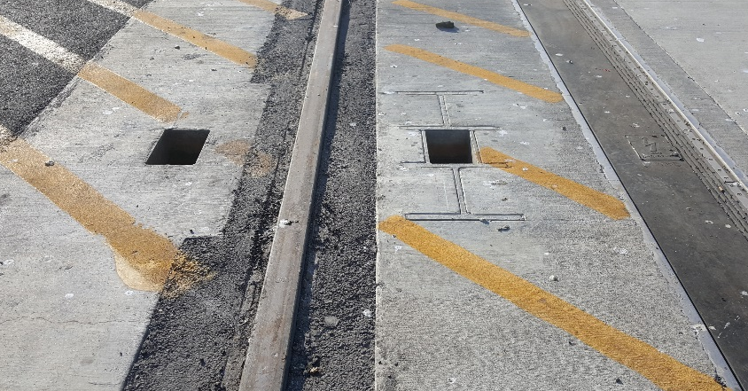
REHABILITATION OF WHARF 3, CONSTRUCTION OF ELECTRICAL INFRASTRUCTURE AND LASH DOCK DEMOLITION AT BCT
Fenders
Fall Arrest System
Ladders
Vaults, Timbers and Bollard
Crane Rail, Panzerbelt, Tie-Downs, and Stowage Pins
Waterside – Wharf Appurtenances

Slide 25
REHABILITATION OF WHARF 3, CONSTRUCTION OF ELECTRICAL INFRASTRUCTURE AND LASH DOCK DEMOLITION AT BCT
General Scope of Services (continued):
Landside Improvements
New Crane Rail
New 36” and 48” dia. drilled shafts - landside crane beam
New Stevedore Support Building
New 18” concrete pavement and base
Primary electrical power ductbank and conductors
Terminal Switchyard, High Mast Lighting
Utilities
Land side - Construction

Slide 26
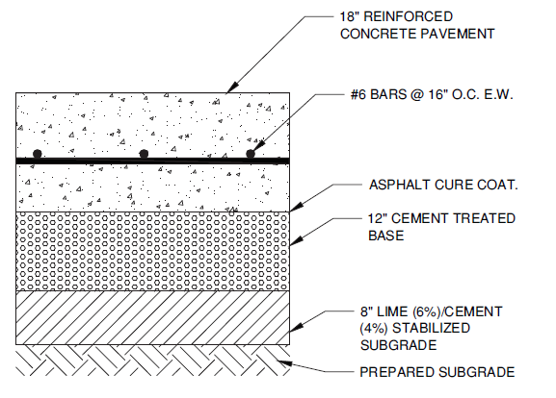
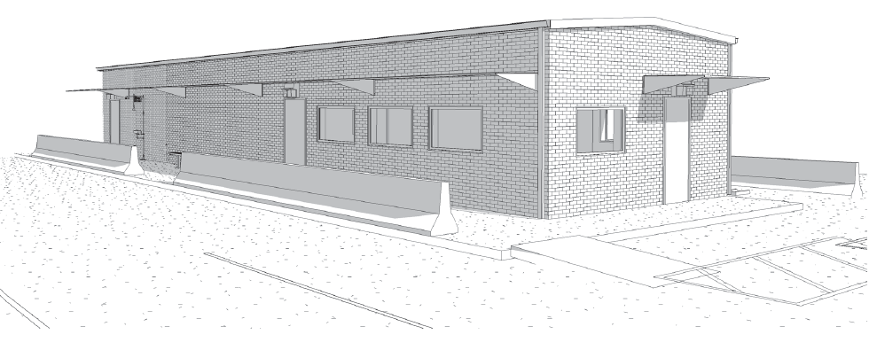
REHABILITATION OF WHARF 3, CONSTRUCTION OF ELECTRICAL INFRASTRUCTURE AND LASH DOCK DEMOLITION AT BCT
Stevedore Support Building
18” Concrete Paving
Utilities
Lighting
Electrical
Telecommunications
Water
Sanitary Sewer
Land side - Construction

Slide 27
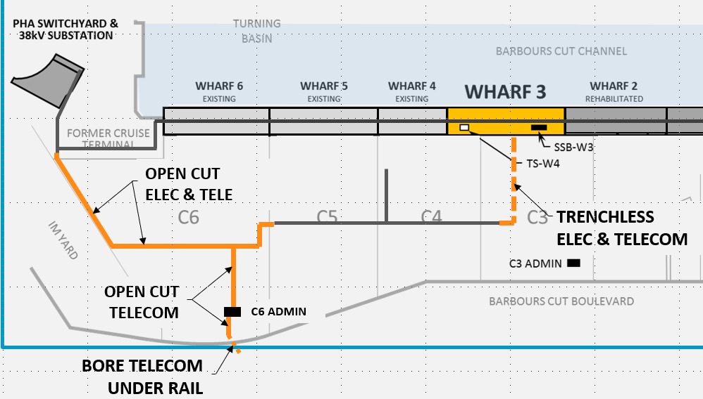
Project Components – Electrical Infrastructure
2,870 FT
810 FT
955 FT
100 FT
PROJECT:
3,680 FT ELECTRICAL + TELECOM
1,055 FT TELECOM

Slide 28
Contractor Access & Laydown – Electrical Infrastructure
REHAB WHARF 3
ELECTRICAL INFRASTRUCTURE
Laydown

Slide 29
Contractor Access
REHABILITATION OF WHARF 3, CONSTRUCTION OF ELECTRICAL INFRASTRUCTURE AND LASH DOCK DEMOLITION AT BCT
ELECTRICAL INFRASTRUCTURE
REHABILITATION OF WHARF 3
CONTRACTOR’S LAYDOWN
CONTRACTOR’S LAYDOWN
ACCESS
ACCESS
WORK LIMITS
WORK LIMITS

Slide 30
PHASING – Wharf & Elec Infrastructure
Wharf Phase 1
Concurrent Phase 1
Wharf Phase 2
Electrical Infrastructure
Phase 1
C7
C6
C5
C3
C4
Electrical Infrastructure - Phase 2
Commence After Backlands Phase 1
Infrastructure is Complete
C6 Admin

Slide 31
ENLARGED VIEW:
PHASE 1 WHAFT 3 AND PHASE 2 Electrical Infrastructure
CRANE RAILS
PHASE 1 - WHARF
258’
HIGH MAST LIGHT POLES, FIRE HYDRANTS
ELECTRICAL SUBSTATION
SSLS
STEVEDORE SUPPORT BLDG
NEW
PAVING
UTILITIES
Electrical Infrastructure
Phase 1 - TRENCHLESS

Slide 32
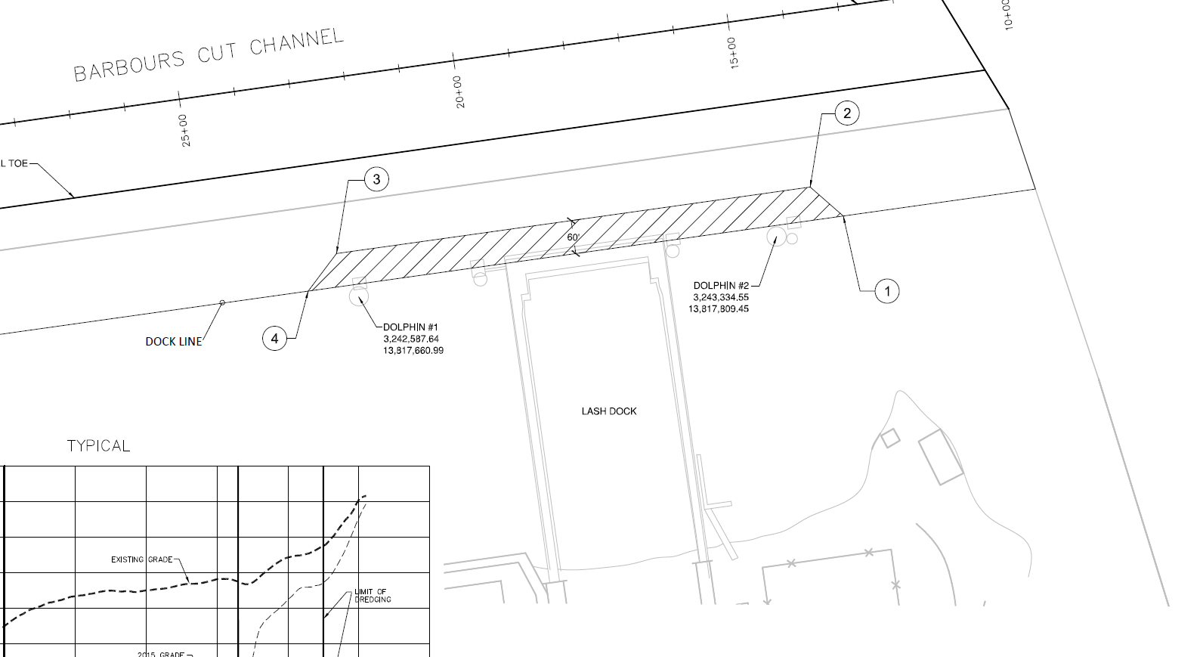
Project Components – DEMOLITION AT LASH DOCK
DREDGE
DOLPHIN REMOVAL
DEMO FORWARD PORTION

Slide 33
Contractor Access
REHABILITATION OF WHARF 3, CONSTRUCTION OF ELECTRICAL INFRASTRUCTURE AND LASH DOCK DEMOLITION AT BCT
DEMO LASH DOCK
ELECTRICAL INFRASTRUCTURE
REHABILITATION OF WHARF 3
DEMO LASH DOCK
CONTRACTOR’S LAYDOWN
CONTRACTOR’S LAYDOWN
CONTRACTOR’S LAYDOWN
ACCESS
ACCESS
ACCESS
WORK LIMITS
WORK LIMITS
WORK LIMITS

Slide 34
REHABILITATION OF WHARF 3, CONSTRUCTION OF ELECTRICAL INFRASTRUCTURE AND LASH DOCK DEMOLITION AT BCT
SITE VISIT RULES
No photographs – leave cell phones in your pockets or purses
Stay with group
PHA certified TWIC escorts must accompany individuals without a TWIC card
Safety vests, hard hat, safety glasses
No open-toed shoes
Personal flotation devices if within 20’ of face of wharf
Comply with your company’s safety policy

Slide 35
THANK YOU
Bill Aguirre, P.E.
Project Manager
Port Houston
Questions?
713.670.2400
email@poha.com
www.PortHouston.com
111 East Loop North
Houston, TX 77029
WELCOME MESSAGE | 4

