Slide 1
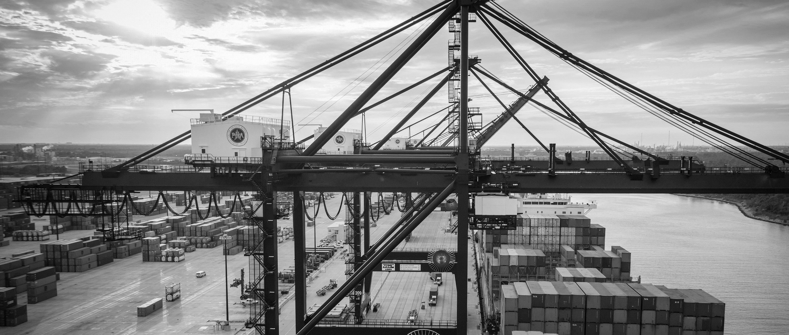
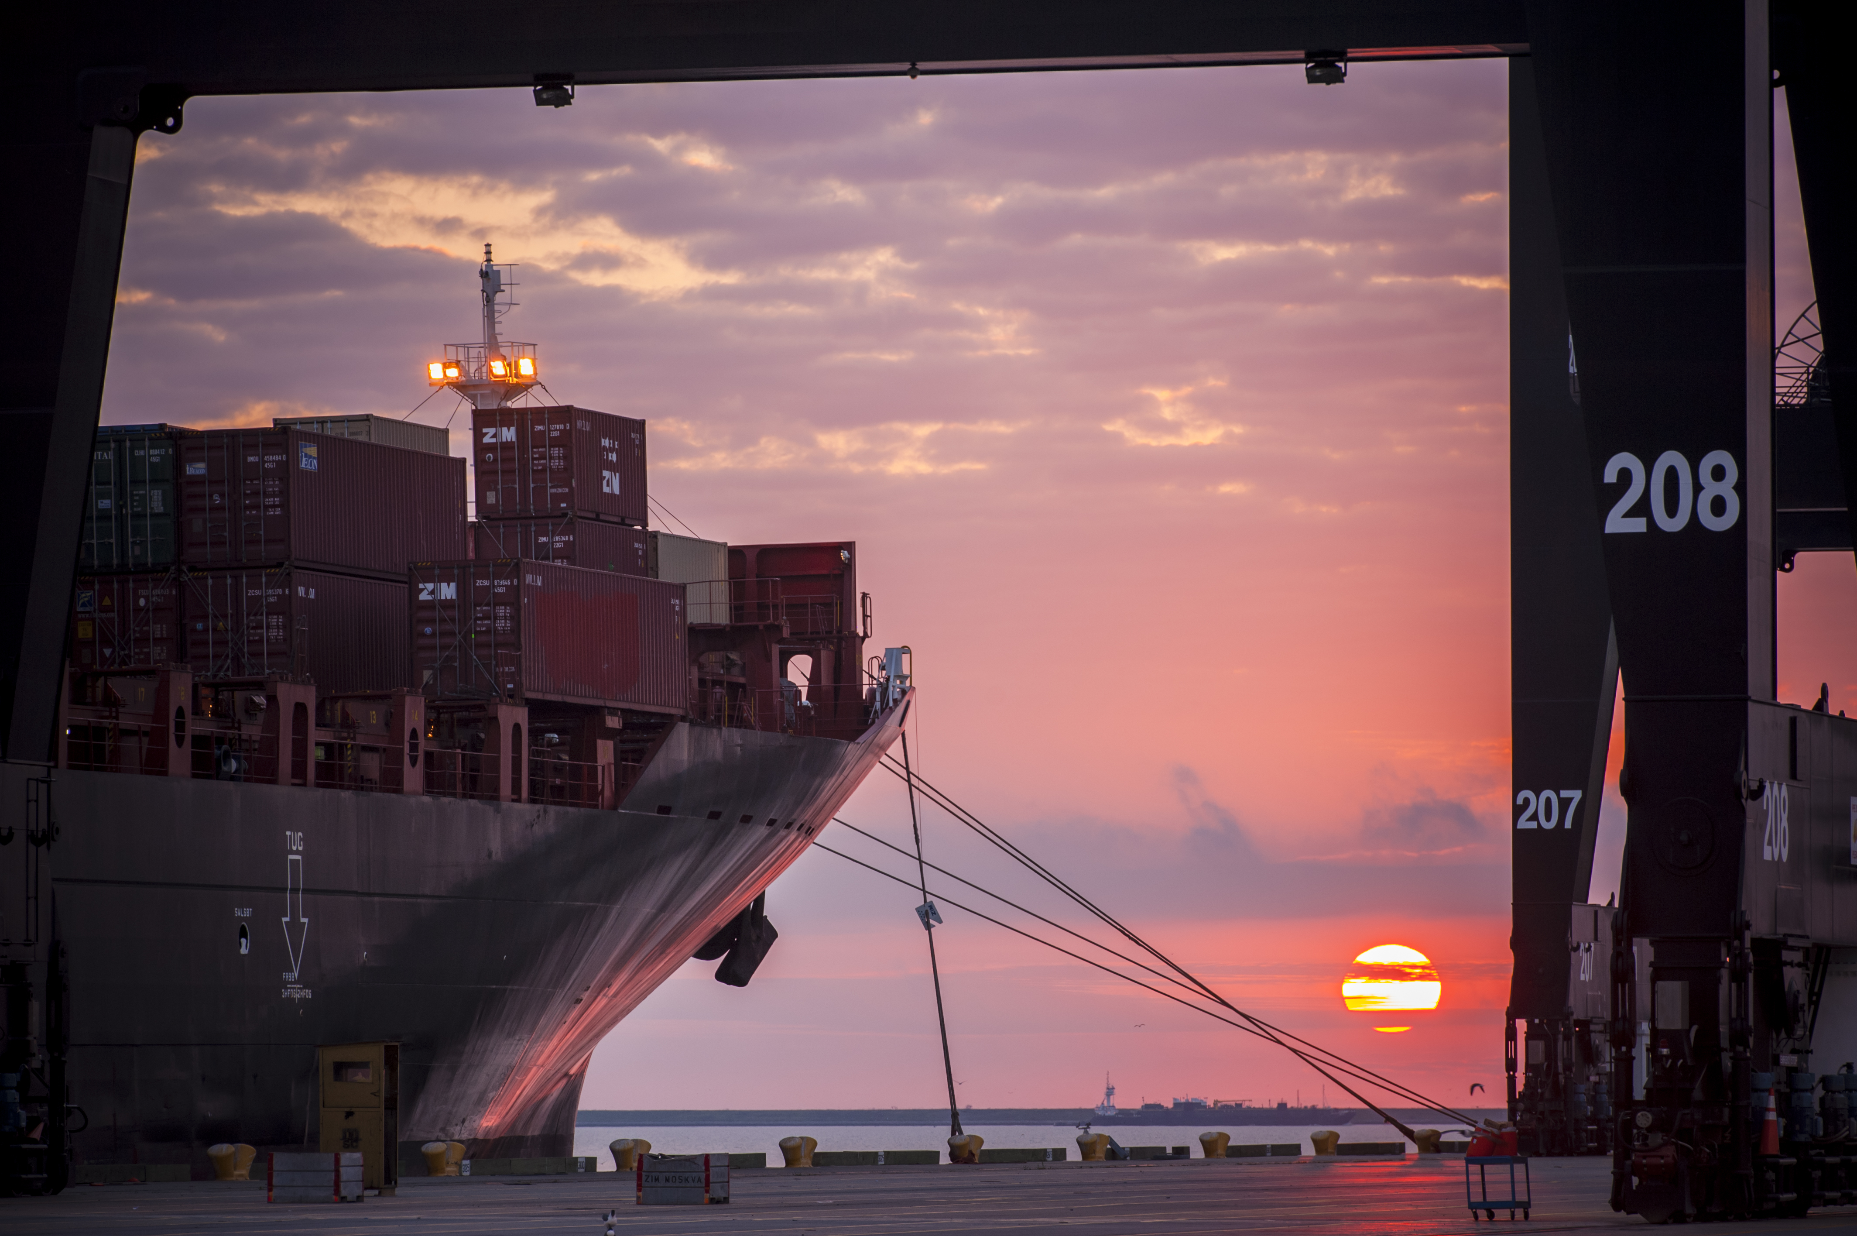
CSP # 938 REHABILITATION OF CONTAINER YARD 1 NORTH AND CONTAINER YARD 2 NORTH AT BARBOURS CUT TERMINAL
Bill Aguirre, P.E. | Project Manager | Project & Construction Management (PCM)

Slide 2
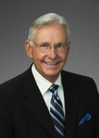
Port Commission
John D. Kennedy
Dean E. Corgey
Clyde Fitzgerald
Janiece M. Longoria
Chairman
Theldon R. Branch, III
Stephen H. DonCarlos
Roy D. Mease
WELCOME MESSAGE | 2

Slide 3
REHABILITATION OF CONTAINER YARD 1 NORTH AND CONTAINER YARD 2 NORTH AT BARBOURS CUT TERMINAL
AGENDA
Introductions
Harris County
Small Business
Procurement Services
Selection Criteria
Scope of Work
Questions
All attendees must sign-in and indicate if attending the site visit.

Slide 4
REHABILITATION OF CONTAINER YARD 1 NORTH AND CONTAINER YARD 2 NORTH AT BARBOURS CUT TERMINAL
PHA Personnel:
Roger H. Hoh, P.E. – Director, PCM
Don Smith. – Design and Planning Manager
Bill Aguirre, P.E. – Project Manager
Harvey Ross – Construction Manager
Pedro Gonzales – Small Business Development
Tanika Chukwumerije- Contracts Manager
Yvette Camel-Smith – Director of Procurement
Harris County:
Robert Rocha – Wage Rate Monitor

Slide 5
REHABILITATION OF CONTAINER YARD 1 NORTH AND CONTAINER YARD 2 NORTH AT BARBOURS CUT TERMINAL
Harris County Wage Rate Compliance & Requirements:
Attendance at pre-bid/proposal meetings and pre-construction meetings
Review and approve weekly certified payroll records
Monitor wage rate compliance
Review claims of non-compliance from the field and recommend appreciate responses as required or permitted under the Wage Scale Act

Slide 6
REHABILITATION OF CONTAINER YARD 1 NORTH AND CONTAINER YARD 2 NORTH AT BARBOURS CUT TERMINAL
Small Business Requirement:
Small Business Participation required level for this Project is 20% of the Purchase Price.

Slide 7
REHABILITATION OF CONTAINER YARD 1 NORTH AND CONTAINER YARD 2 NORTH AT BARBOURS CUT TERMINAL
Procurement:
Competitive Sealed Proposals (CSP) are due on January 16, 2019, no later than 11:00 A.M.
One original and six copies, packaged in one sealed envelope
All proposals will be opened and read publicly in the PHA first floor conference room by Procurement Services on Wednesday, January 16, 2019 at 11:30 A.M.

Slide 8
REHABILITATION OF CONTAINER YARD 1 NORTH AND CONTAINER YARD 2 NORTH AT BARBOURS CUT TERMINAL
Selection Criteria
I. Small Business Participation-Minimum Required Level
Small Business Participation: Required Level (Minimum) 20%
II. Responses that satisfy the minimum small business participation requirement will be evaluated based on the below criteria:
Purchase price 50%
Vendor’s reputation, quality of services and/or product, safety record 35%
Benefit to Port Authority 7%
Overall Compliance with Port Authority Policies and Instructions 5%
Local Business 3%

Slide 9
REHABILITATION OF CONTAINER YARD 1 NORTH AND CONTAINER YARD 2 NORTH AT BARBOURS CUT TERMINAL
Rehabilitation of Approx. 20 acres
Respondents are to rely on their own estimates and material take-off for project bidding/proposing.

Slide 10
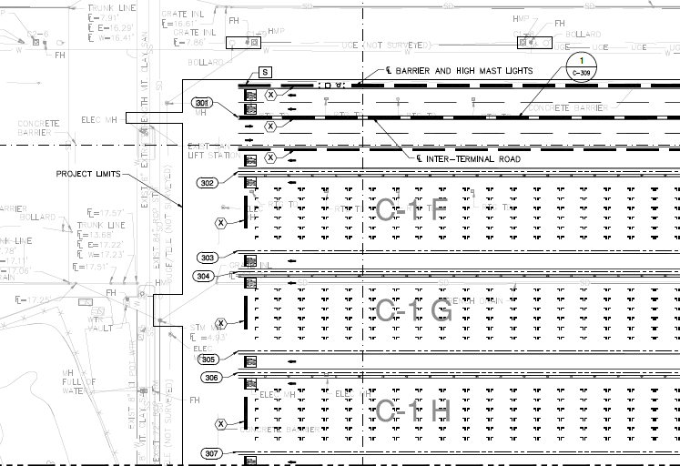
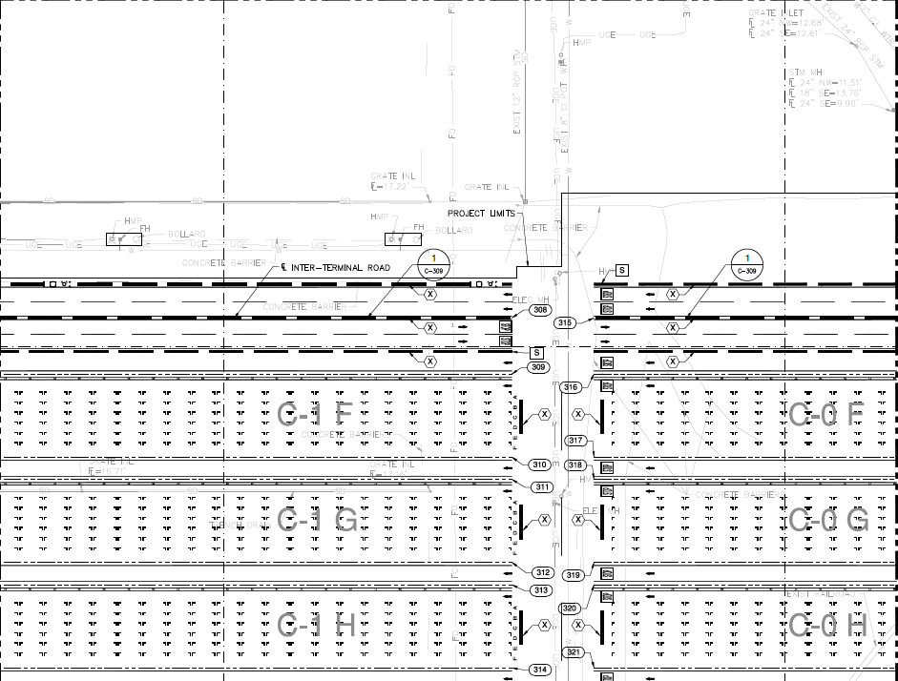
Access
CONCRETE
BATCH
C1 N
C2 N
C1 - MID
CONTRACTOR
PARKING
CONTRACTOR
ACCESS
GATE 4
Barbours Cut Blvd
CONTRACTOR
LAYDOWN
Security: TWIC Requirements apply
✓

Slide 11
REHABILITATION OF CY1N and CY2N
AT BARBOURS CUT TERMINAL
General Scope of Services – Major Elements
DEMOLITION
2,000’ x 435’ = 20 acres
18” PAVING SECTION
12” Cement Treated Base (CTB)
4” Drainage Layer (#57 Stone)
Woven Geotechnical Fabric
8” Lime Cement Stabilize Subgrade (LCSS)
Respondents are to rely on their own estimates and material take-off for project bidding/proposing.

Slide 12
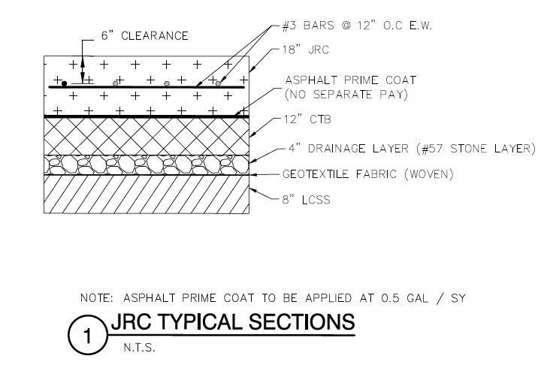
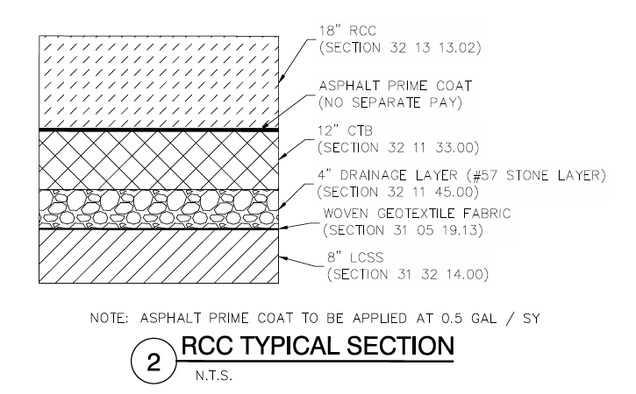
REHABILITATION OF CY1N and CY2N
AT BARBOURS CUT TERMINAL
PAVEMENT SECTIONS
7.5 Acres
12.5 Acres
Respondents are to rely on their own estimates and material take-off for project bidding/proposing.

Slide 13
REHABILITATION OF CY1N and CY2N
AT BARBOURS CUT TERMINAL
General Scope of Services – Major Elements
UTILITIES
Water:
1,500 LF ~ 12” Dia.
Storm Sewer:
3,500 LF ~ 18” Pre-Cast Trench Drain,
Airport Rated Frames
Sewer:
650 LF ~ 8” gravity sewer,
Lift Station
100 LF ~3” FM
Elec/Tele Ductbank
2300 LF Primary
200 LF service to LS
Respondents are to rely on their own estimates and material take-off for project bidding/proposing.

Slide 14
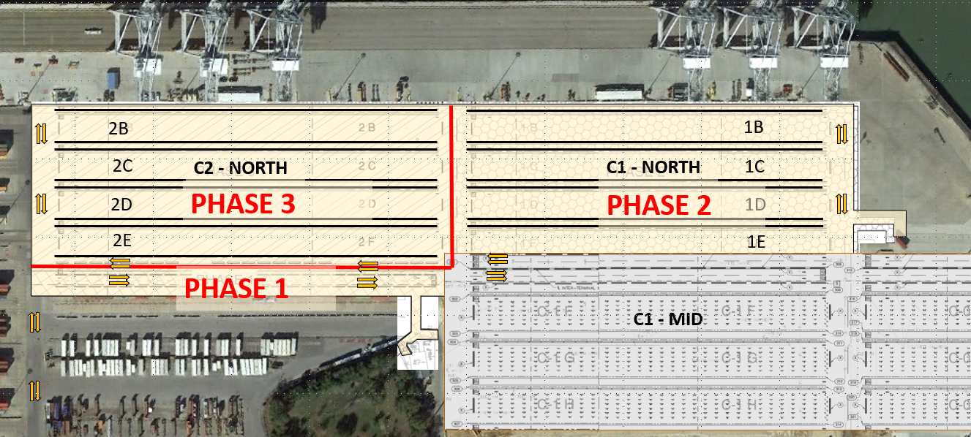
Phasing
EXISTING SANITARY LIFT STATION
NEW SANITARY LIFT STATION
PHASE 1 – 1.5 Acres

Slide 15
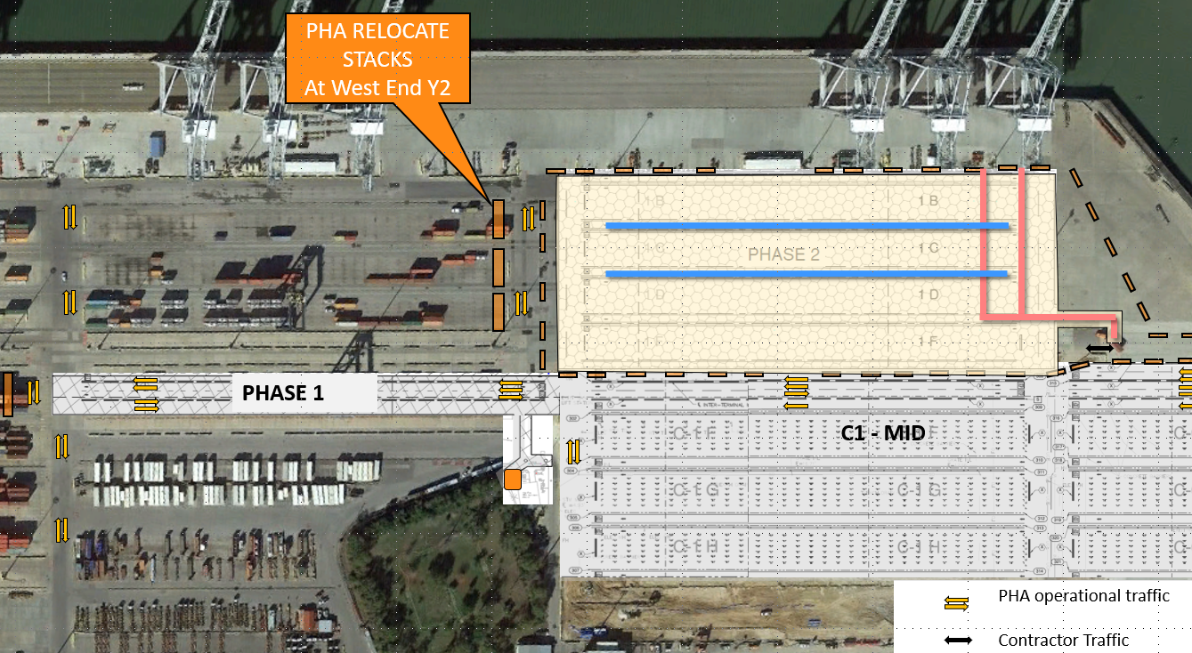
Phasing
TRENCH DRAINS
ELEC/TELE
Phase 2 – C1N ( 8.7 Acres)

Slide 16
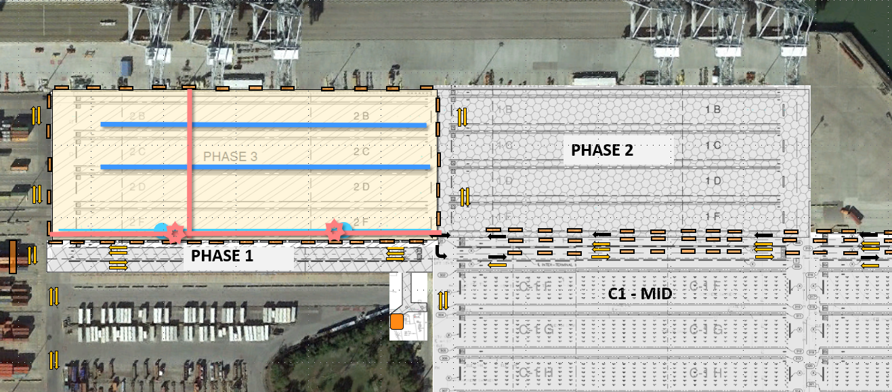
Phasing
CAUTION
TRENCH DRAINS
SEWER
WATER/
HYD
ELEC/TELE
HMPs
PHASE 3 – C2N (9.8 Acres)

Slide 17
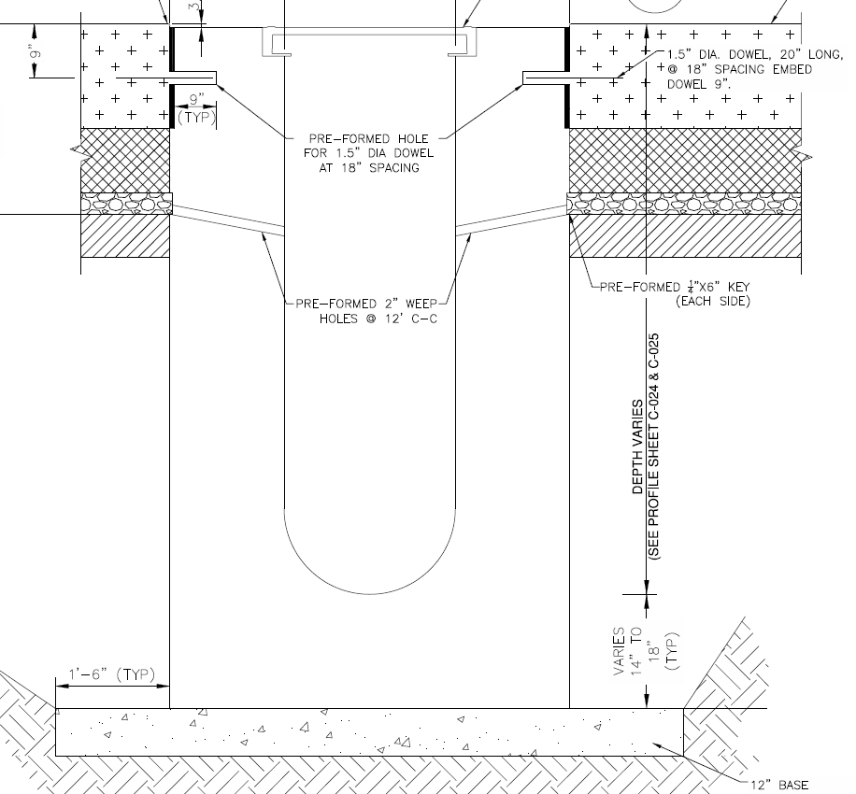
Schedule
Pre-Cast Trench Drains – Long Lead Item
18”
Project: 3,500 LF Trench Drains
(Not an Issue – Due to Phasing)
VARIES 4FT – 12 FT
roughly ½ in Phase 2
Remainder in Phase 3

Slide 18
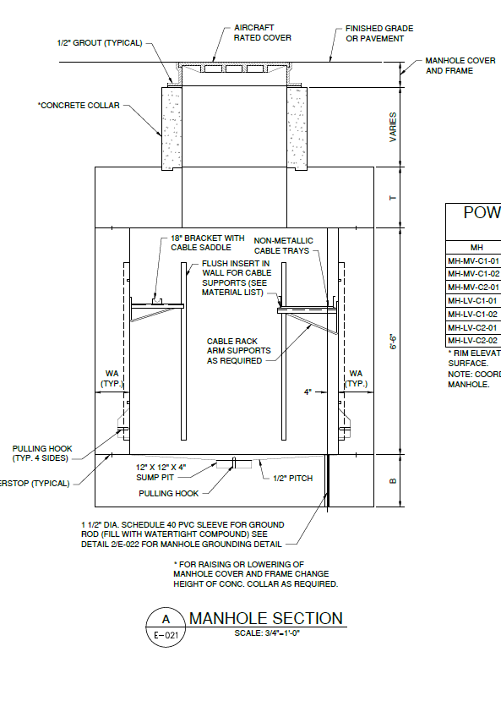
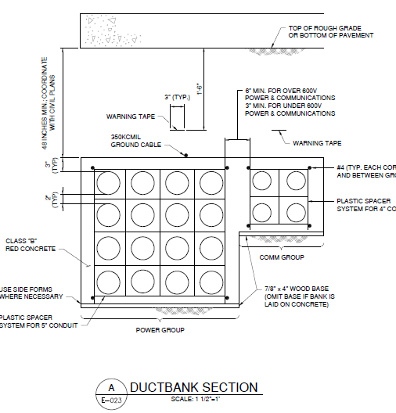
Electrical/ telecom manholes & ductbank
APPROX. 7 FT

Slide 19
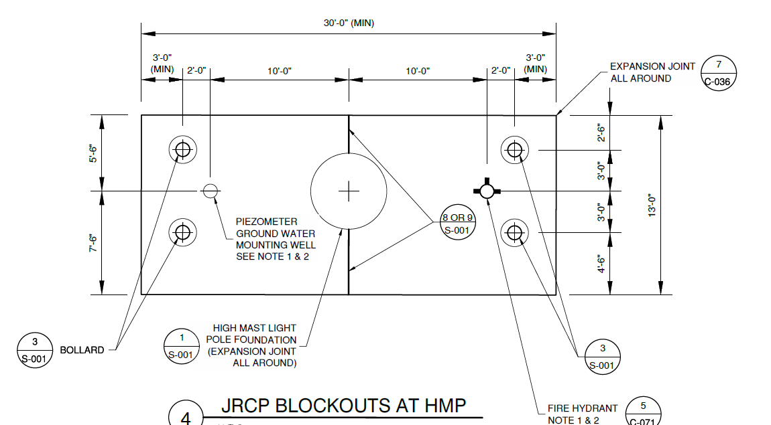
REHABILITATION OF CONTAINER YARD 1 NORTH AND CONTAINER YARD 2 NORTH AT BARBOURS CUT TERMINAL
PIEZOMETERS
GROUNDWATER CONTROL
For Utilities
For Pavement

Slide 20
REHABILITATION OF CONTAINER YARD 1 NORTH AND CONTAINER YARD 2 NORTH AT BARBOURS CUT TERMINAL
QUESTIONS ?

Slide 21
REHABILITATION OF CONTAINER YARD 1 NORTH AND CONTAINER YARD 2 NORTH AT BARBOURS CUT TERMINAL
SITE VISIT RULES
No photographs – leave cell phones in your pockets or purses
Stay with group
PHA certified TWIC escorts must accompany individuals without a TWIC card
Safety vests, hard hat, safety glasses
No open-toed shoes
Personal flotation devices if within 20’ of face of wharf
Comply with your company’s safety policy

Slide 22
THANK YOU
Bill Aguirre, P.E.
Project Manager
Port Houston
Questions?
713.670.2400
email@poha.com
www.PortHouston.com
111 East Loop North
Houston, TX 77029
WELCOME MESSAGE | 4

