Slide 1
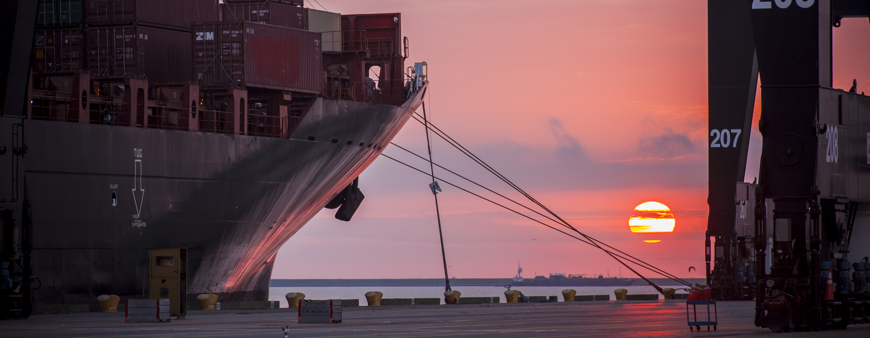
CSP – Renovation of Executive Office Building at Turning Basin Terminal-Revised
Brenda C Trevino, P.E. PMP | Director, Technical & Business Analytics
October 2018

Slide 2
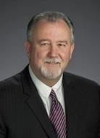
Port Commission
John D. Kennedy
Dean E. Corgey
Clyde Fitzgerald
Janiece M. Longoria
Chairman
Theldon R. Branch, III
Stephen H. DonCarlos
Roy D. Mease
WELCOME MESSAGE | 2

Slide 3
CSCSP – Vegetate Middle Berm at Bayport Container Vegetate Middle Berm at Bayport at Bayport Container Terminal e Middle Berm at Bayport Container Terminal
AGENDA
Introductions
Harris County
Small Business
Procurement Services
Selection Criteria
[Site] Parameters
Questions
All attendees must sign-in and indicate attendance for site visit

Slide 4
CSP – Renovation of Executive Office Building at Turning Basin Terminal -Revised
PHA Personnel:
Roger H. Hoh, P.E. – Director, PCM
Harvey Ross–Construction Manager
Brenda C. Trevino, P.E. – Project Manager
Ross Talbot – Construction Delivery Mgr.
Pedro Gonzales – Small Business Development
Robert D Tanner – Director. Real Estate
Harris County:
Robert Rocha – Wage Rate Monitor

Slide 5
CSP – Renovation of Executive Office Building at Turning Basin Terminal -Revised
Harris County Wage Rate Compliance & Requirements:
Attendance at pre-bid/proposal meetings and pre-construction meetings
Review and approve weekly certified payroll records
Monitor wage rate compliance
Review claims of non-compliance from the field and recommend appreciate responses as required or permitted under the Wage Scale Act

Slide 6
CSP- Renovation of Executive Office Building at Turning Basin Terminal - Revised
Small Business Requirement:
Participation Goal Small Business is 35% of the Purchase Price
Small Business Participation and the Local Business criterion shall not exceed the Relative Weight of 15%.

Slide 7
CSP – Renovation of Executive Office Building at Turning Basin Terminal -Revised
Procurement:
Competitive Sealed Proposals(CSP) are due on December 5, 2018 no later than 11:00 A.M.
One original and eight copies, packaged in one sealed envelope
All proposals will be opened and read publicly in the PHA first floor conference room by Procurement Services on Wednesday, December 5, 2018 at 11:30 A.M.

Slide 8
CSP – Renovation of Executive Office Building at Turning Basin Terminal -Revised
Selection Criteria
The Port Commission will award the contract to the responsible proposer submitting the lowest and best proposal.
Responsible:
Meet the applicable Small Business Participation requirements, if any;
Have the ability to comply with the required delivery or performance schedule, taking into consideration other business commitments;
Have a satisfactory record of performance and integrity;
Have satisfactory safety and environmental record;
Have satisfactory references; and
Have the necessary facilities, equipment, materials, personnel, organization, experience, authorizations, technical skills, and financial resources to fulfill the terms of the contract for the project

Slide 9
CSP – Renovation of Executive Office Building at Turning Basin Terminal -Revised
Competitive Sealed Proposal Response:
Page 2 – Required Attachments

Slide 10
CSP – Renovation of Executive Office Building at Turning Basin Terminal -Revised
Price Exhibit – organized by floor
Allowance 1 & 2 are defined
Not a divisible proposal
Items identified for add and deduct must be justified prior to use and are not in contract cost
ALL BLANKS MUST BE FILLED IN ON EVERY PAGE OF THE PRICE EXHIBIT

Slide 11
CSP – Renovation of Executive Office Building at Turning Basin Terminal -Revised
All references to price are on the pricing sheet
Specifications govern over drawings
Each floor is subtotaled on the pricing exhibit
Fixed Price items will be billed on a Schedule of Values

Slide 12
Special Conditions Excerpts
A site walk is mandatory for every respondent
Contract is for a maximum of 670 calendar days
No incentive paid for early completion
Contract includes 5 interim milestones
Work by Own Forces is a minimum of 10%
Liquidated damages for each Milestone is $800/day
Each floor/milestone shall be completed prior to moving to another floor/milestone, and the floor shall be fully functional and ready for staff to begin work
A preliminary baseline schedule is required with the proposal
Allow for time identified in solicitation for furniture and IT cabling contractors
A presentation of the reasoning for elements in the schedule may be requested by PHA

Slide 13
Access to Work
Noise and access to work on the 1st and 4th floors shall consider operating areas of the floor to remain open to staff and public
Workers are to enter and leave a work floor from stairwells.
Deliveries of equipment and materials will be after hours by elevator or through the stairwells
No work permitted on Commission Days
A boardroom schedule will be provided to manage visits from dignitaries

Slide 14
Work by Others
IT cabling (demo and install)
Furniture purchase and installs
Disposal of existing furniture after Operations has moved specific pieces to other terminals
Removal by Operations to take no longer than 48 hours on each floor, prior to Contractor taking possession of that floor
Time for these pieces to be moved prior to Contractor possession will not count as Contract Time

Slide 15
CSP – Renovation of Executive Office Building at Turning Basin Terminal -Revised Site Visit on Nov 2, 2018 noon 1st floor training room
Safety vests, hard hat, safety glasses, where required
No open-toed shoes
Personal flotation devices if within 20’ of face of wharf
Comply with your company’s safety policy
Alternate site visits will be held on 11-6-18 at 10am and 11-8-18 at 10am
Photographs – may be taken except toward dock, personnel or of Security features
Stay with group
No TWIC is required on this project
A valid government issued Photo ID is required to go on the walk

Slide 16
THANK YOU
Brenda C. Trevino, P.E.
Director Tech & Bus Analytics
Port Houston
Questions?
www.PortHouston.com
111 East Loop North
Houston, TX 77029

