Slide 1
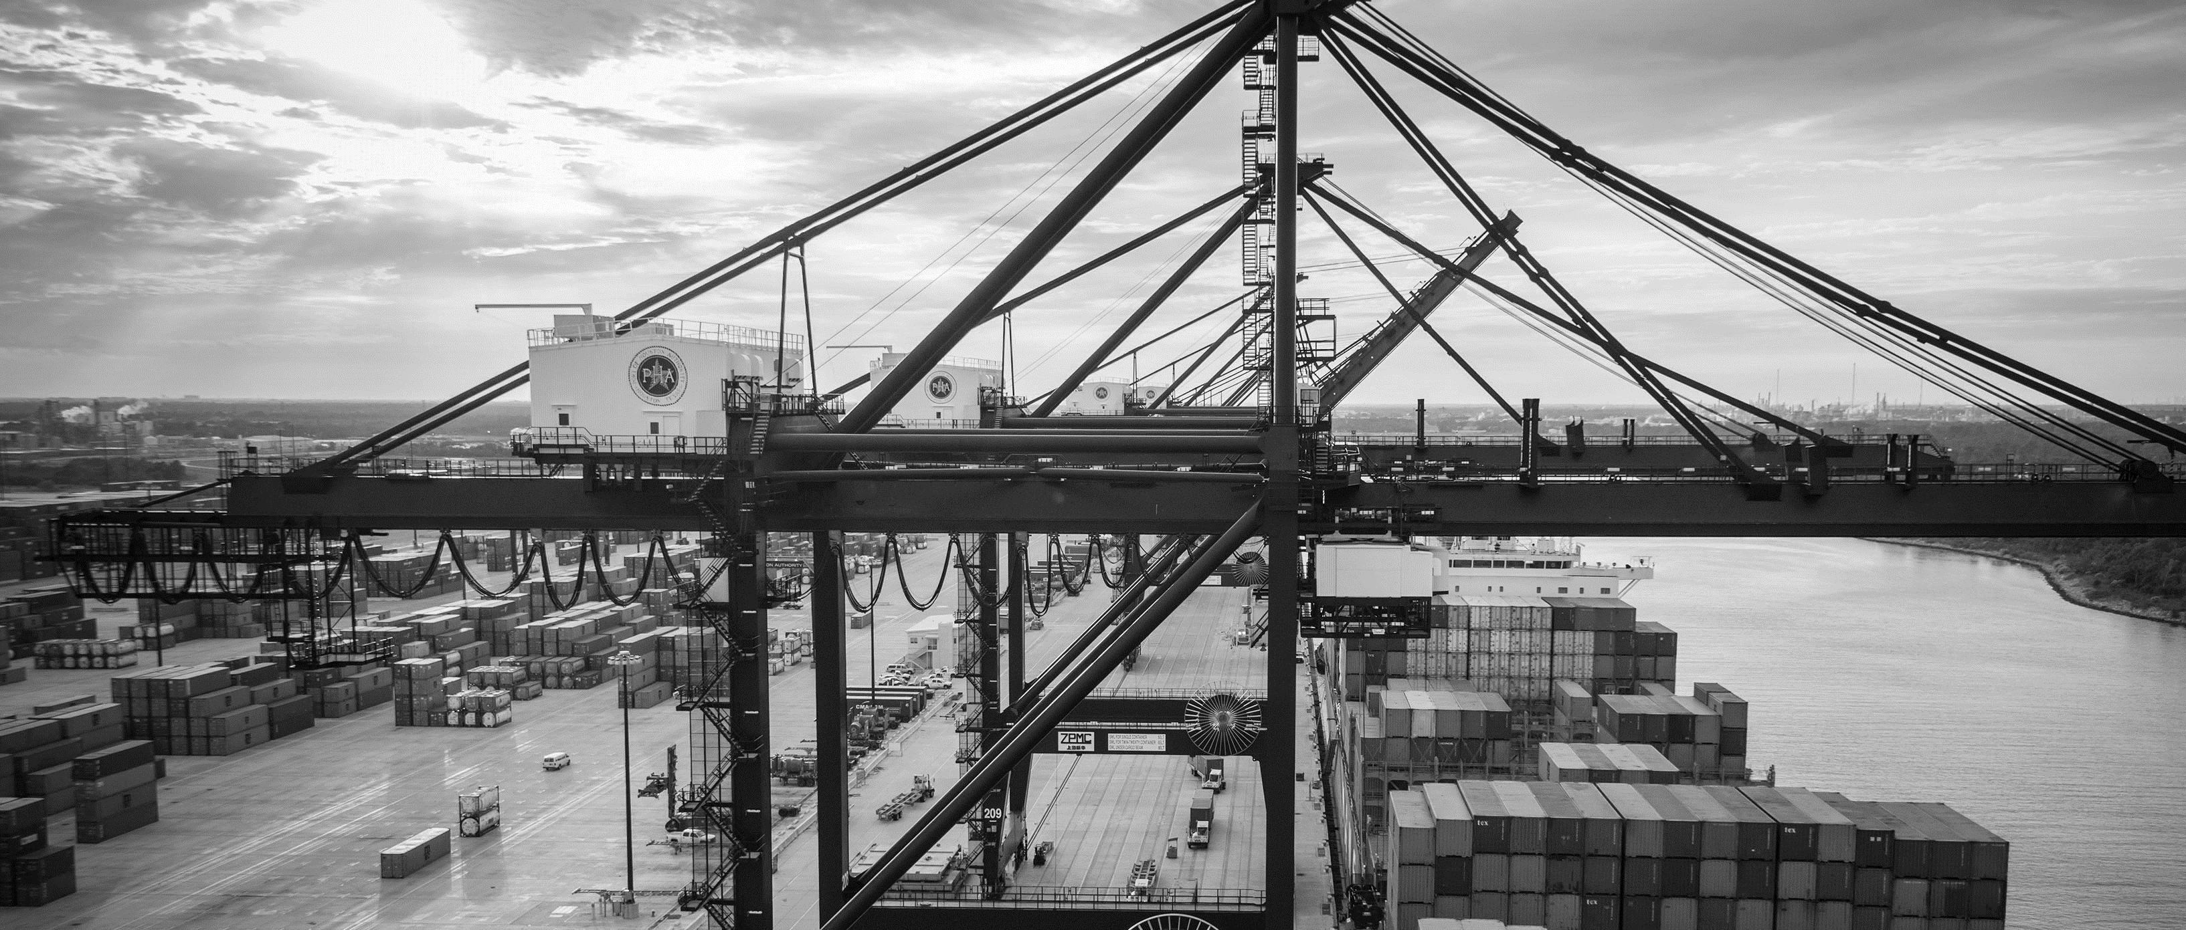
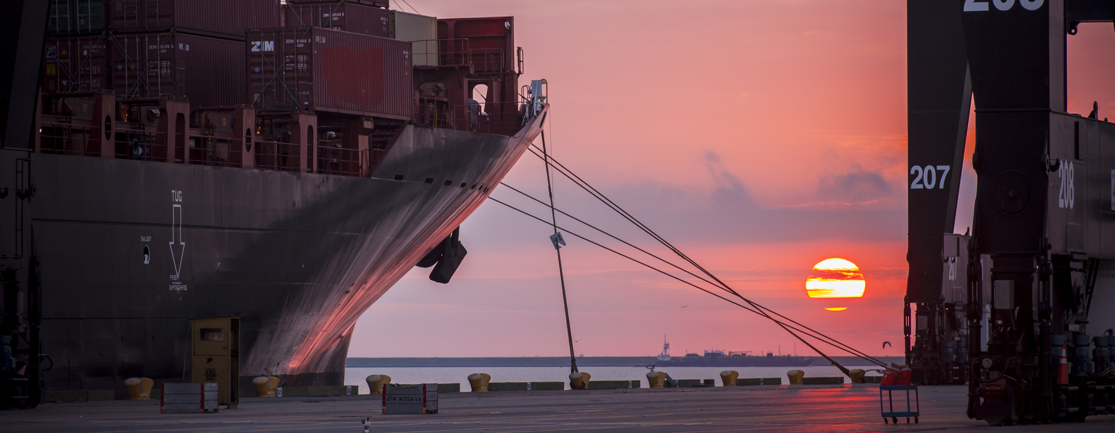
CSP – Remodel Gate Services Building for USDA at Bayport Terminal
Brenda C Trevino, P.E. PMP | Director, Technical & Business Analytics

Slide 2
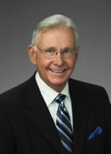
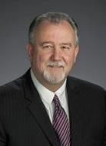
Port Commission
John D. Kennedy
Dean E. Corgey
Clyde Fitzgerald
Janiece M. Longoria
Chairman
Theldon R. Branch, III
Stephen H. DonCarlos
Roy D. Mease
WELCOME MESSAGE | 2

Slide 3
CSCSP – Vegetate Middle Berm at Bayport Container Vegetate Middle Berm at Bayport at Bayport Container Terminal e Middle Berm at Bayport Container Terminal
AGENDA
Introductions
Harris County
Small Business
Procurement Services
Selection Criteria
[Site] Parameters
Questions
All attendees must sign-in and indicate attendance for site visit

Slide 4
CSP – Remodel Gate Services Building for USDA at Bayport Terminal
PHA Personnel:
Roger H. Hoh, P.E. – Director, PCM
Nick Kotsatos–Construction Manager
Bill Aguirre, P.E. – Project Manager
Ross Talbot – Construction Delivery Mgr.
Pedro Gonzales – Small Business Development
Ryan Mariacher– Sr. Dir. Container Terminals
Harris County:
Robert Rocha – Wage Rate Monitor

Slide 5
CSP – Remodel Gate Services Building for USDA at Bayport Terminal
Harris County Wage Rate Compliance & Requirements:
Attendance at pre-bid/proposal meetings and pre-construction meetings
Review and approve weekly certified payroll records
Monitor wage rate compliance
Review claims of non-compliance from the field and recommend appreciate responses as required or permitted under the Wage Scale Act

Slide 6
CSP – Remodel Gate Services Building for USDA at Bayport Terminal
Small Business Requirement:
Participation Goal Small Business is 0% of the Purchase Price
Small Business Participation and the Local Business criterion shall not exceed the Relative Weight of 3%.

Slide 7
CSP – Remodel Gate Services Building for USDA at Bayport Terminal
Procurement:
Competitive Sealed Proposals(CSP) are due on November 14th, 2018 no later than 11:00 A.M.
One original and five copies, packaged in one sealed envelope
All proposals will be opened and read publicly in the PHA first floor conference room by Procurement Services on Wednesday, November 14th, 2018 at 11:30 A.M.

Slide 8
CSP – Remodel Gate Services Building for USDA at Bayport Terminal
Selection Criteria
The Port Commission will award the contract to the responsible proposer submitting the lowest and best proposal.
Responsible:
Meet the applicable Small Business Participation requirements, if any;
Have the ability to comply with the required delivery or performance schedule, taking into consideration other business commitments;
Have a satisfactory record of performance and integrity;
Have satisfactory safety and environmental record;
Have satisfactory references; and
Have the necessary facilities, equipment, materials, personnel, organization, experience, authorizations, technical skills, and financial resources to fulfill the terms of the contract for the project

Slide 9
CSP – Remodel Gate Services Building for USDA at Bayport Terminal
Competitive Sealed Proposal Response:
Page 2 – Required Attachments

Slide 10
CSP – Remodel Gate Services Building for USDA at Bayport Terminal
Price Exhibit – organized by specification division
Not a divisible proposal
Items identified for add and deduct must be justified prior to use and are not in contract cost
ALL BLANKS MUST BE FILLED IN ON EVERY PAGE OF THE PRICE EXHIBIT

Slide 11
CSP – Remodel Gate Services Building for USDA at Bayport Terminal
All references to price are on the pricing sheet
Specifications govern over drawings
Fixed Price items will be billed on a Schedule of Values

Slide 12
Special Conditions Excerpts
A site walk is not mandatory for every respondent
Contract is for a maximum of 140 calendar days
No incentive paid for early completion
Work by Own Forces is a minimum of 10%
Liquidated damages is $2802/day
North end of the building must remain operational during the construction period.
Coordination with Operations and Maintenance Personnel will be coordinated in advance
This is a TWIC secure project
Escort services are required

Slide 13
CSP – Remodel Gate Services Building for USDA at Bayport Terminal Site Visit on October 18, 2018 10pm
Safety vests, hard hat, safety glasses, where required
No open-toed shoes
Personal flotation devices if within 20’ of face of wharf
Comply with your company’s safety policy
photographs – only in specified areas of the building
Stay with group
A valid government issued Photo ID is required to go on the walk

Slide 14
THANK YOU
Brenda C. Trevino, P.E.
Project Manager
Port Houston
Questions?
www.PortHouston.com
111 East Loop North
Houston, TX 77029

