Slide 1

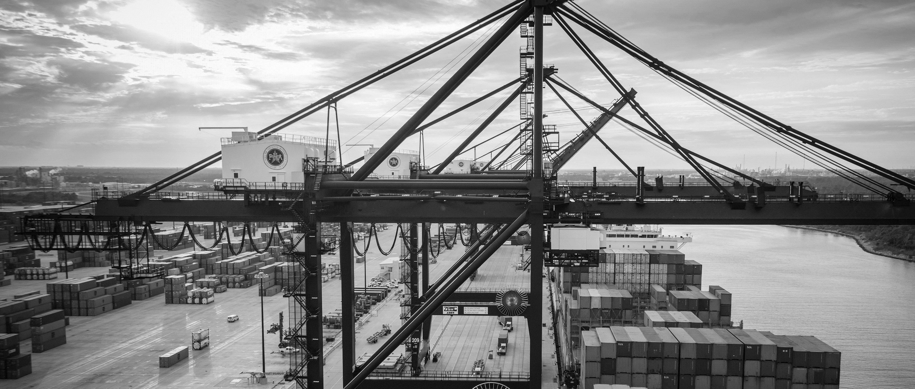
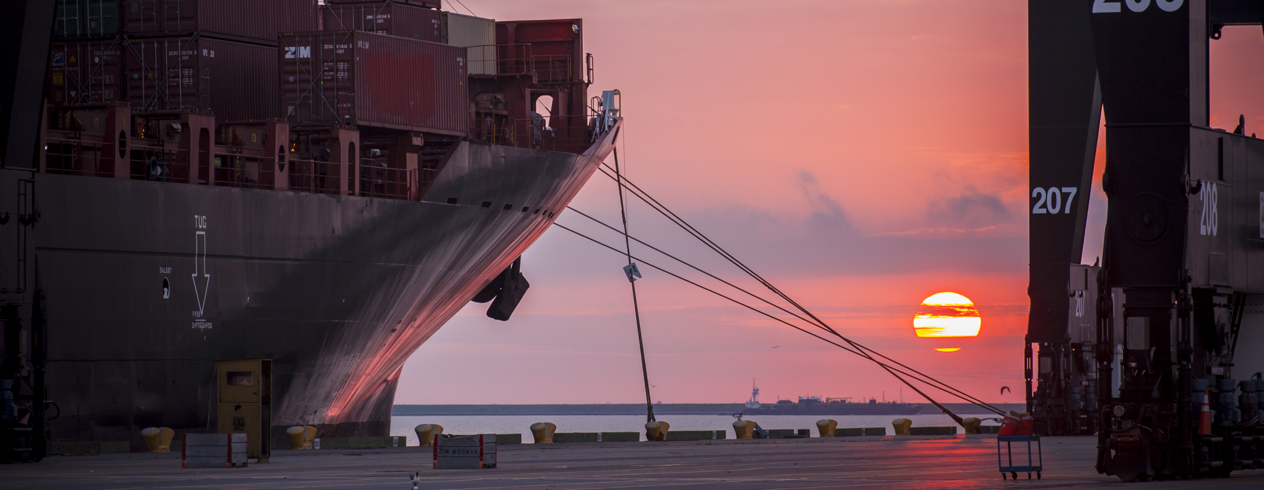
CSP – Construct Rail Spur at Bayport Terminal
Brenda C Trevino, P.E. PMP | Director, Technical & Business Analytics

Slide 2
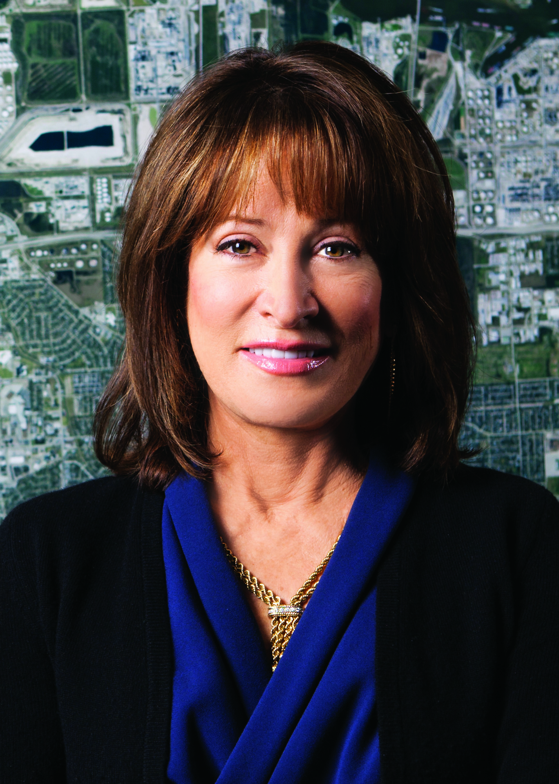
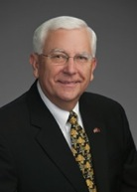
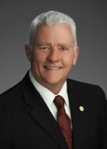

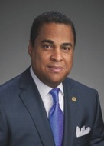

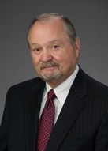
Port Commission
John D. Kennedy
Dean E. Corgey
Clyde Fitzgerald
Janiece M. Longoria
Chairman
Theldon R. Branch, III
Stephen H. DonCarlos
Roy D. Mease
WELCOME MESSAGE | 2

Slide 3
CSCSP – Vegetate Middle Berm at Bayport Container Vegetate Middle Berm at Bayport at Bayport Container Terminal e Middle Berm at Bayport Container Terminal
AGENDA
Introductions
Harris County
Small Business
Procurement Services
Selection Criteria
[Site] Parameters
Questions
All attendees must sign-in and indicate attendance for site visit

Slide 4
CSP – Construct Rail Spur at Bayport Terminal
PHA Personnel:
Roger H. Hoh, P.E. – Director, PCM
Nick Kotsatos, P.E.–Construction Manager
Brenda C. Trevino, P.E. – Project Manager
Ross Talbot – Construction Delivery Mgr.
Pedro Gonzales – Small Business Development
Ryan Mariacher– Director, Container Operations
Harris County:
Robert Rocha – Wage Rate Monitor

Slide 5
CSP – Construct Rail Spur at Bayport Terminal
Harris County Wage Rate Compliance & Requirements:
Attendance at pre-bid/proposal meetings and pre-construction meetings
Review and approve weekly certified payroll records
Monitor wage rate compliance
Review claims of non-compliance from the field and recommend appreciate responses as required or permitted under the Wage Scale Act

Slide 6
CSP- Construct Rail Spur at Bayport Terminal
Small Business Requirement:
Participation Goal Small Business is 35% of the Purchase Price
Small Business Participation and the Local Business criterion shall not exceed the Relative Weight of 15%.

Slide 7
CSP – Construct Rail Spur at Bayport Terminal
Procurement:
Competitive Sealed Proposals(CSP) are due on August 29th, 2018 no later than 11:00 A.M.
One original and eight copies, packaged in one sealed envelope
All proposals will be opened and read publicly in the PHA first floor conference room by Procurement Services on Wednesday, August 29th, 2018 at 11:30 A.M.

Slide 8
CSP – Construct Rail Spur at Bayport Terminal
Selection Criteria
The Port Commission will award the contract to the responsible proposer submitting the lowest and best proposal.
Responsible:
Meet the applicable Small Business Participation requirements, if any;
Have the ability to comply with the required delivery or performance schedule, taking into consideration other business commitments;
Have a satisfactory record of performance and integrity;
Have satisfactory safety and environmental record;
Have satisfactory references; and
Have the necessary facilities, equipment, materials, personnel, organization, experience, authorizations, technical skills, and financial resources to fulfill the terms of the contract for the project

Slide 9
CSP – Construct Rail Spur at Bayport Terminal
Competitive Sealed Proposal Response:
Page 2 – Required Attachments

Slide 11
CSP – Construct Rail Spur at Bayport Terminal
General Solicitation Information
Price Exhibit – organized by specification grouping
  UPRR
  TxDOT
  PHA
Not a divisible proposal
  Pricing is required for the base project and for the optional fill package
    These 2 drawing sets are included in the overall solicitation
25% Own Forces work is required. Identify which portion is Own Forces work on the appropriate attachment
Site visit is not mandatory
ALL BLANKS MUST BE FILLED IN ON EVERY PAGE OF THE PRICE EXHIBIT

Slide 12
CSP – Construct Rail Spur at Bayport Terminal
General Solicitation Information-cont’d.
All references to price are on the pricing sheet
Specifications govern over drawings
Fixed Price items will be billed on a Schedule of Values

Slide 13
Special Conditions Excerpts
  Liquidated damages $500/day for every day over 10 months from Notice to Proceed
  Coordination is required with TxDOT, UPRR, the City of Seabrook, American Acryl, PolyOne and permitting authorities
    This coordination must be evident on the approved baseline schedule of the successful contractor
  Note the inclusion of the following in the package:
    Appendices A-F. Including Rail Crossing Specifications, UPRR General Conditions, Geotechnical Report, SWPPP Sample Plan, Reference Drawings and Department of the Army Permit

Slide 14
Access to Work
Access to the work is via ROW owned by PHA, TxDOT or UPRR
A staging area for the contractor will be identified on PHA property
Known utilities have been adjusted
Work in TxDOT ROW must be coordinated with local TxDOT projects

Slide 15
Work by Others
UPRR work force will install connectivity to existing rail and industrial track where required
TxDOT plans to follow this project with work in the SH146 corridor at Red Bluff

Slide 16
CSP – Construct Rail Spur at Bayport Terminal
Site Visit on August 7, 2018 10:30am SH146 & Red Bluff Rd
Safety vests, hard hat, safety glasses, where required
No open-toed shoes
Comply with your company’s safety policy
Site Visit is not mandatory
No photographs – outside of PHA ROW
Stay with group
No TWIC is required on this project
A valid government issued Photo ID is required to go on the walk

Slide 17
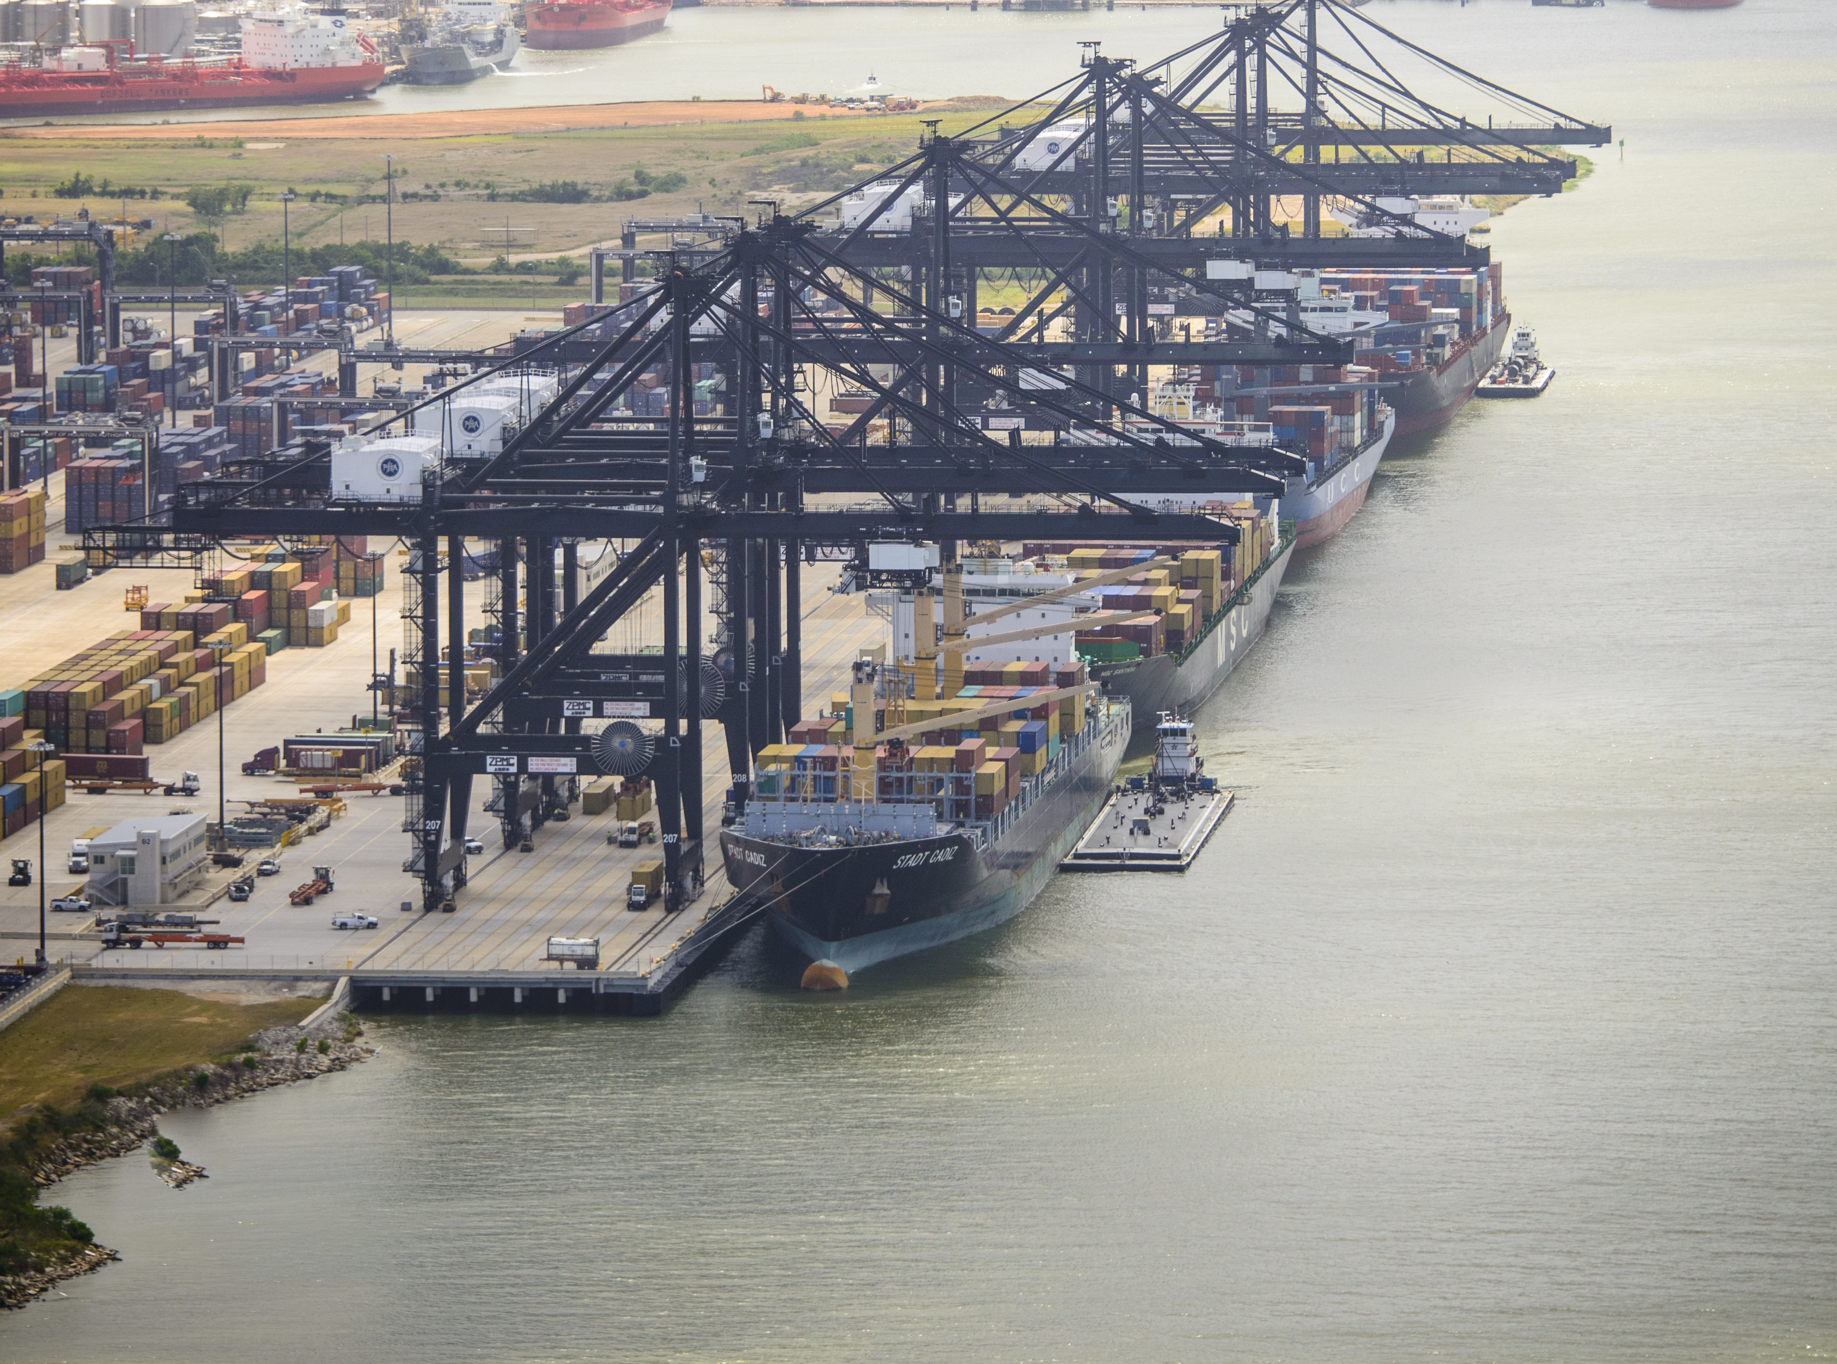
THANK YOU
Brenda C. Trevino, P.E.
Project Manager
Port Houston
Questions?
www.PortHouston.com
111 East Loop North
Houston, TX 77029

Slide 18
Additional Slides of PolyOne Area Tracks

Slide 19
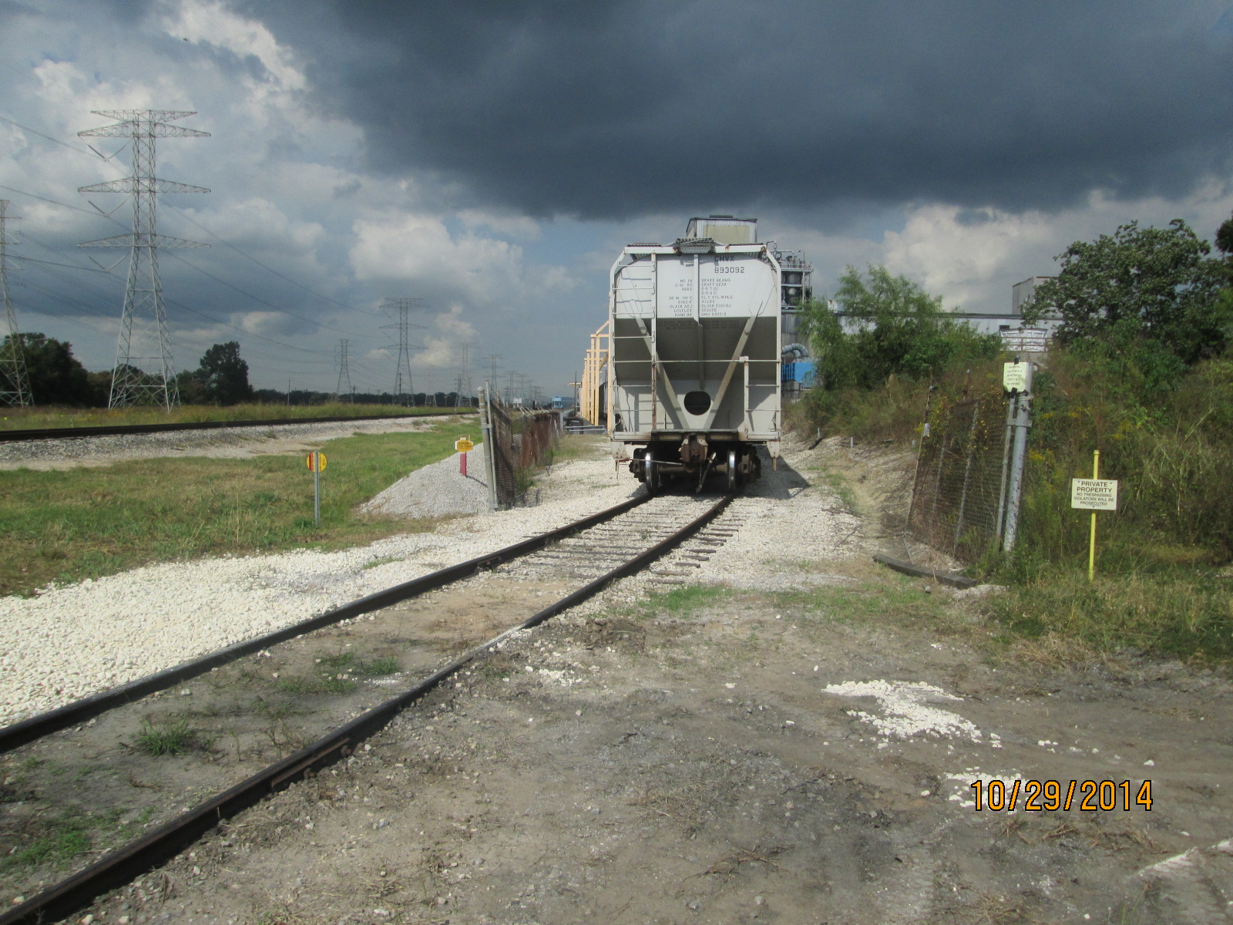
S. End PolyOne Looking North

Slide 20
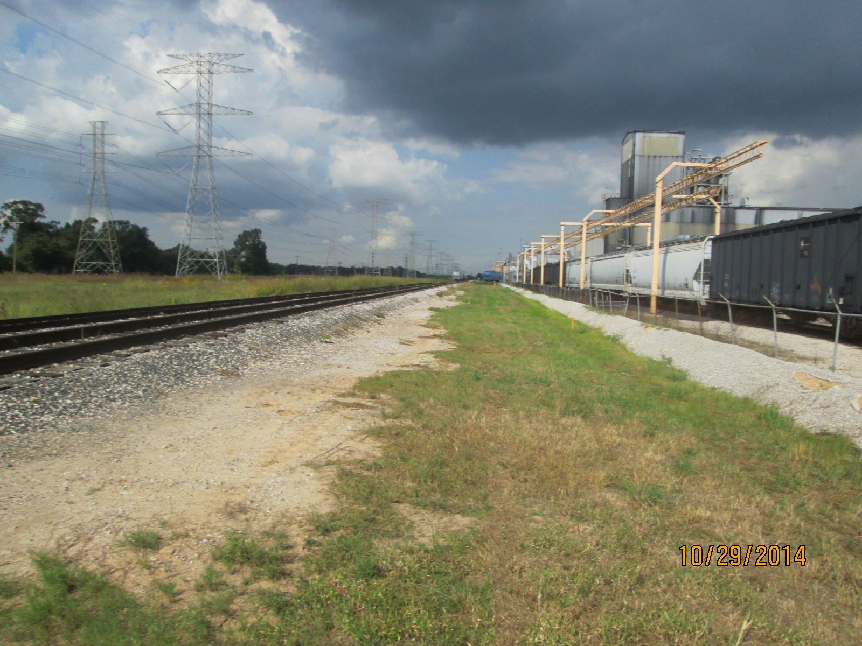
S. End PolyOne Looking North

Slide 21
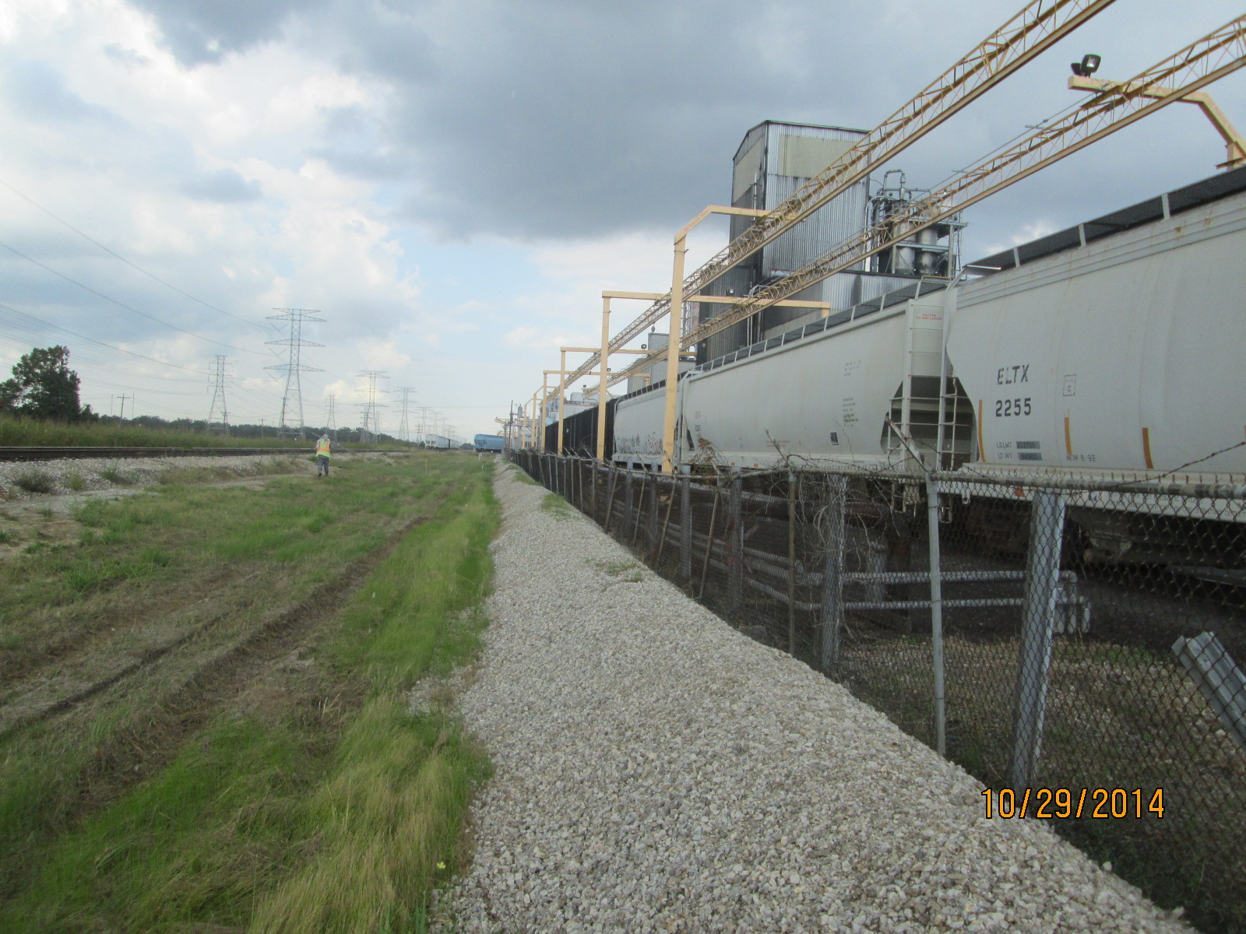
PolyOne Track 925 Looking North

Slide 22
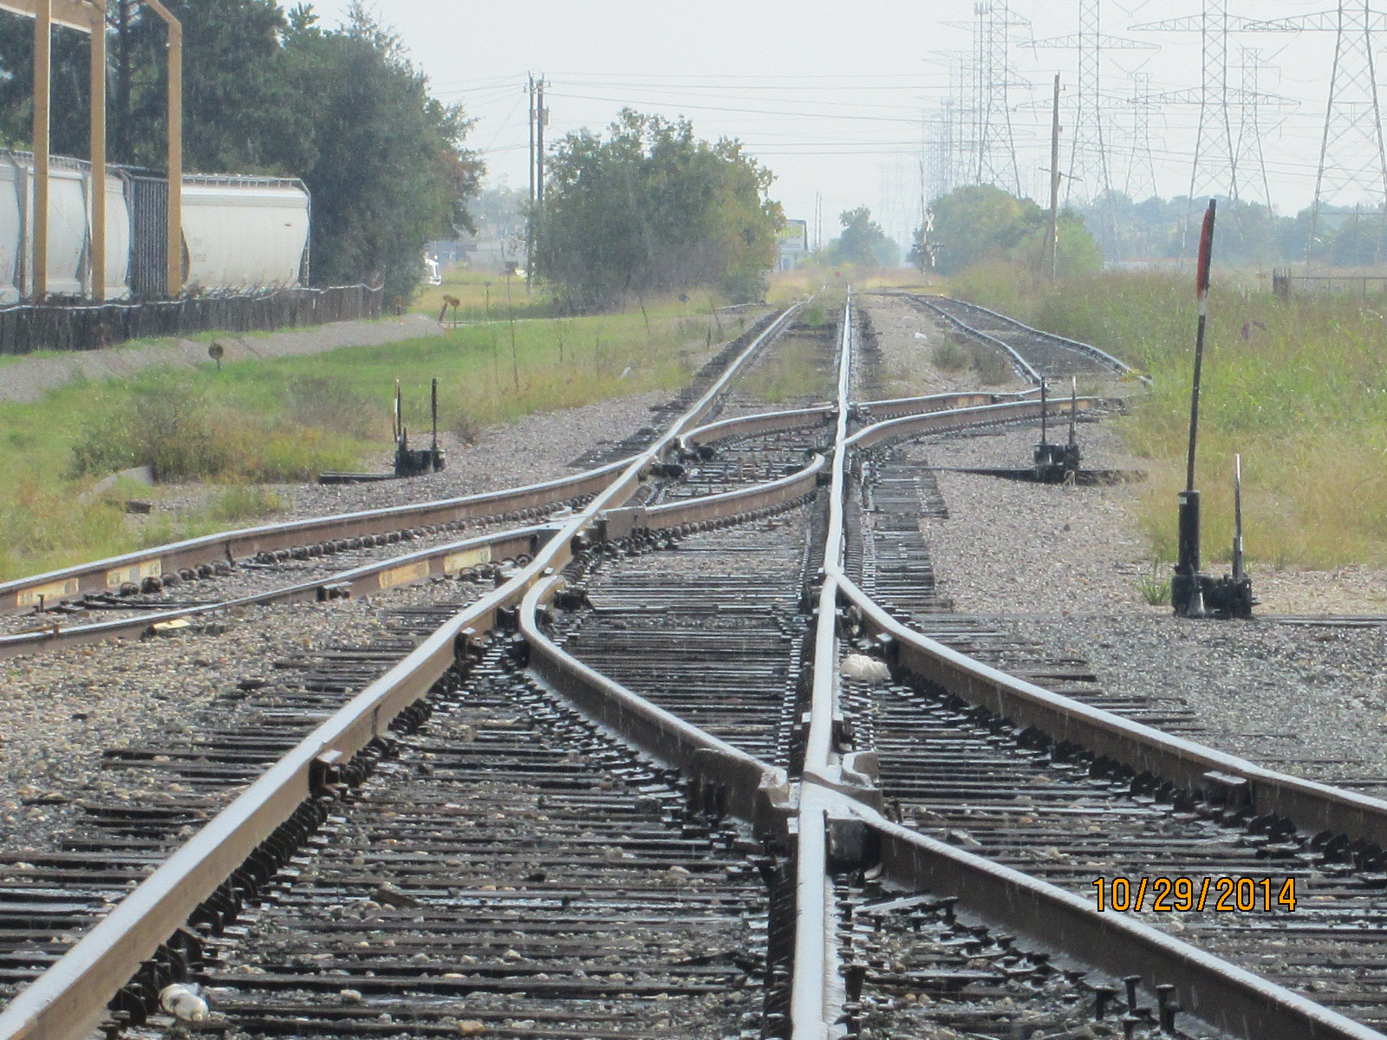
S. End Track 145 Looking South

Slide 23
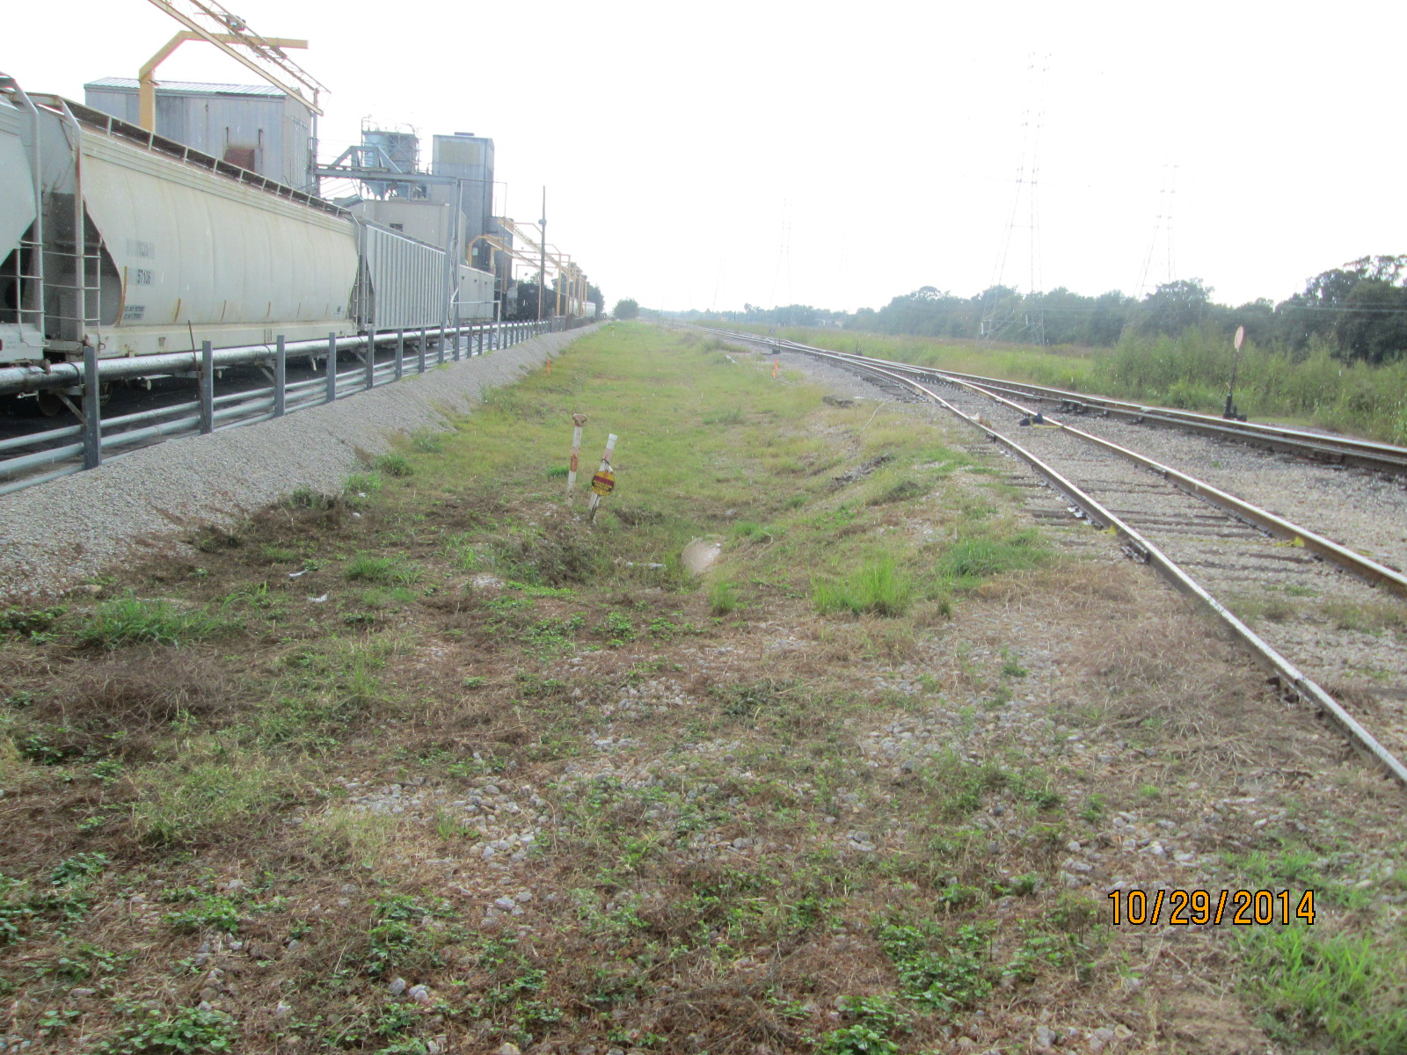
Looking South at S. End Track 145

Slide 24
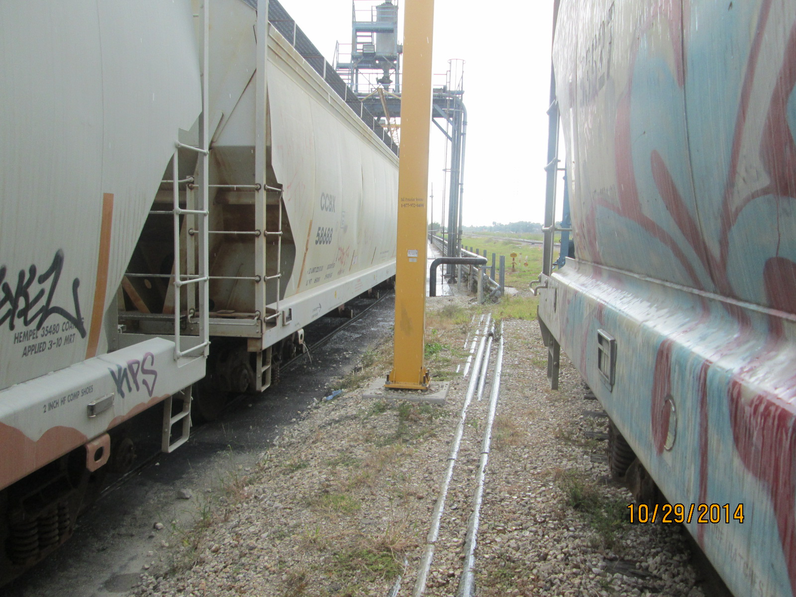
Fall Protection Support Tracks 925-921

Slide 25
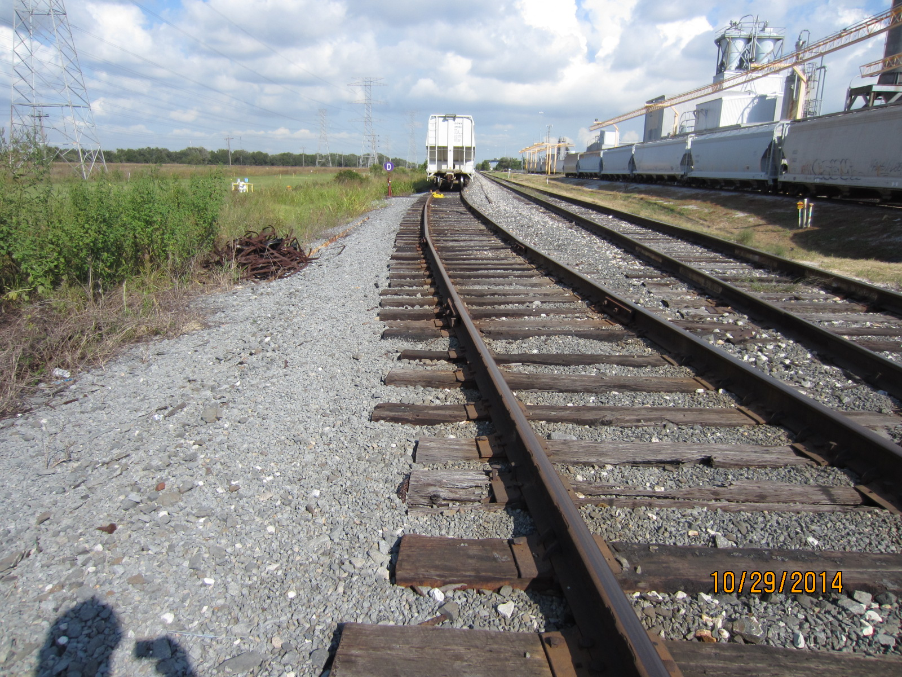
Looking North at S. End Track 145

Slide 26
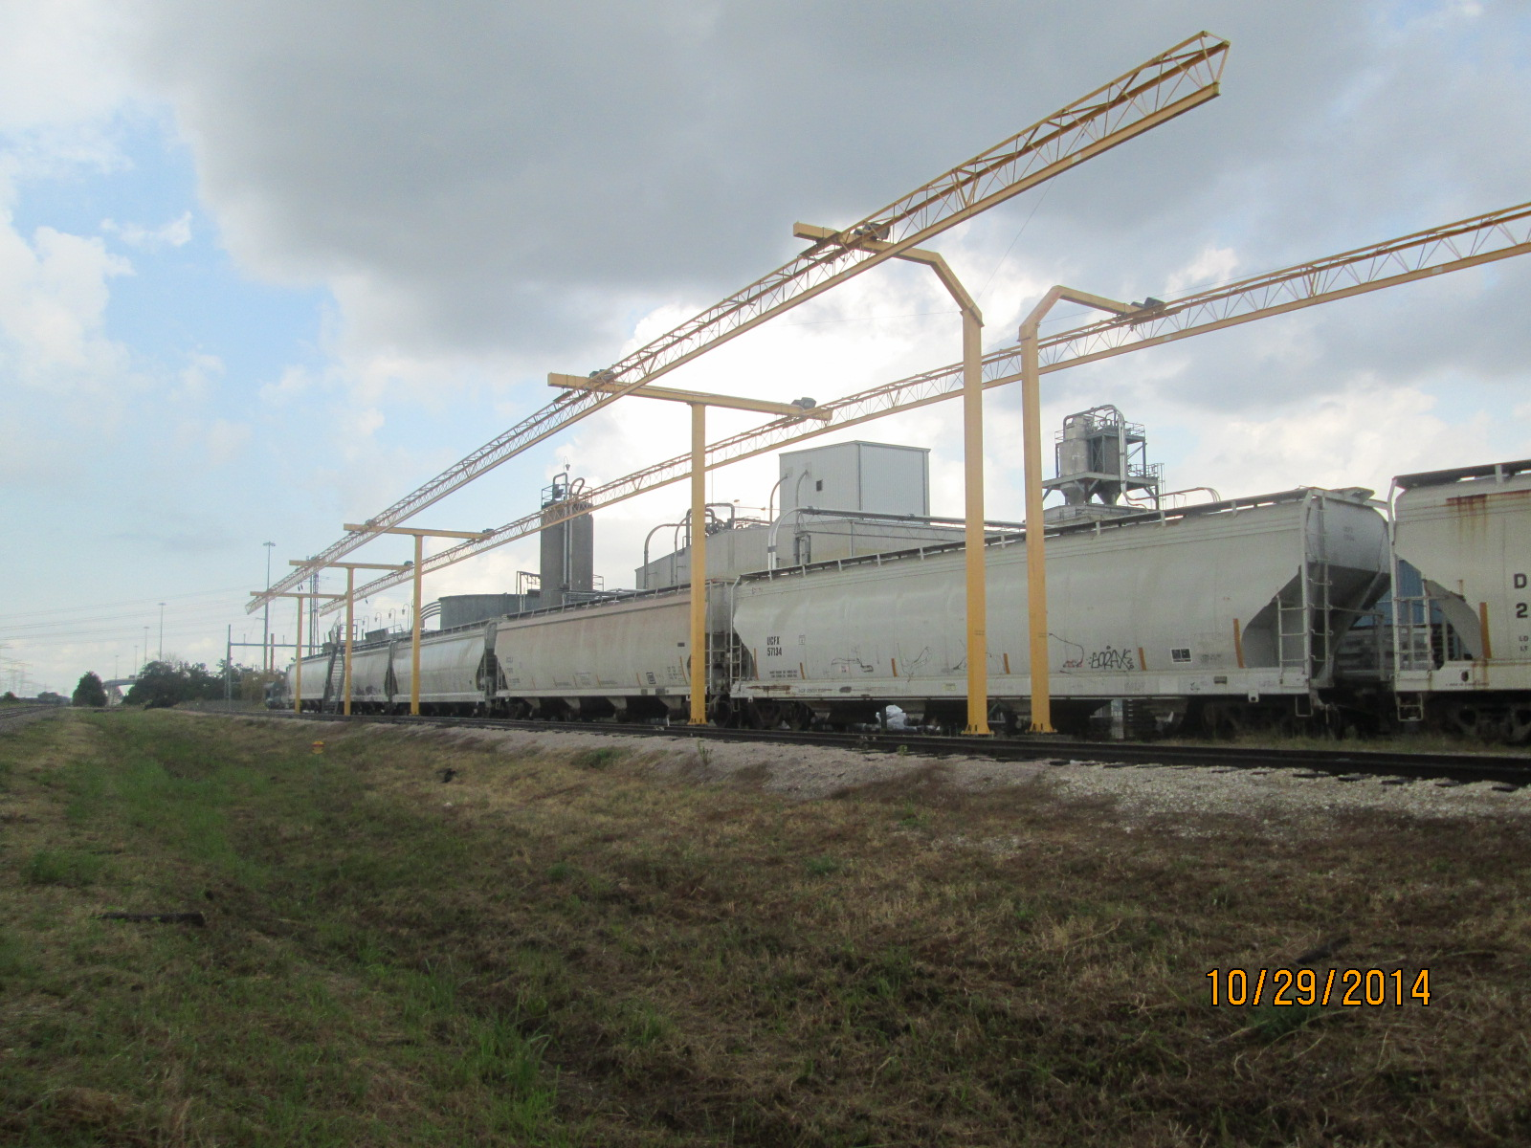
PolyOne Tracks 920 – 921 Looking North

Slide 27
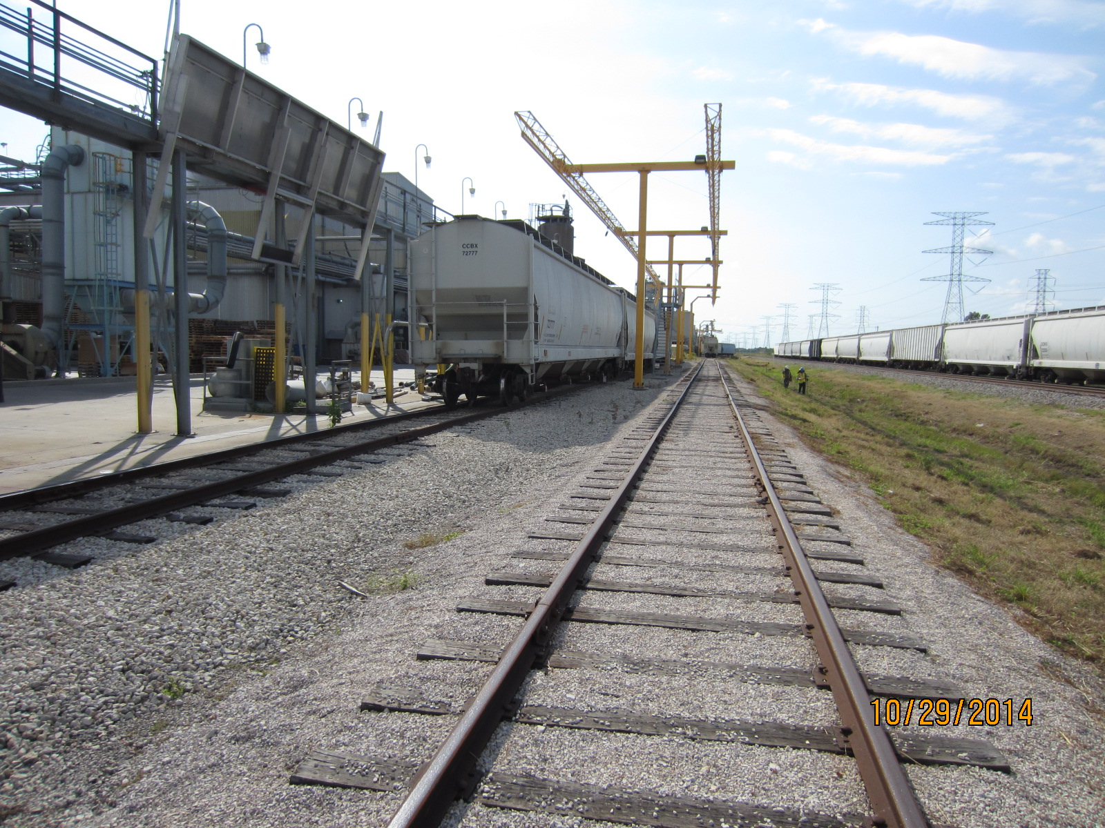
PolyOne Tracks 920 - 921 Looking South

Slide 28
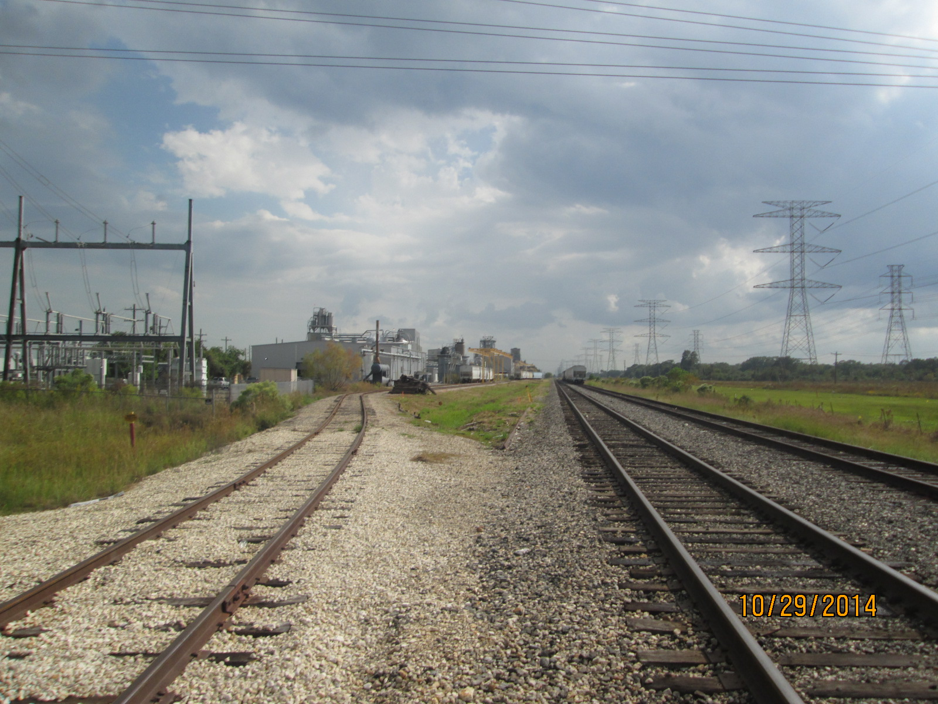
North End PolyOne Looking South

Slide 29
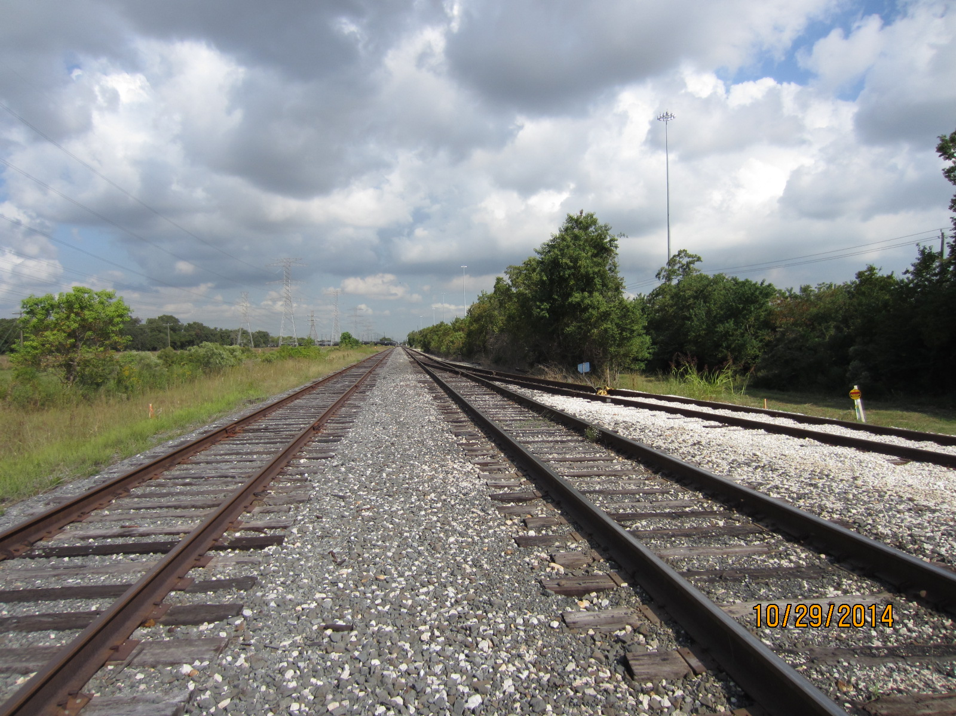
Looking North – Track 145 & Lead Track

