Slide 1
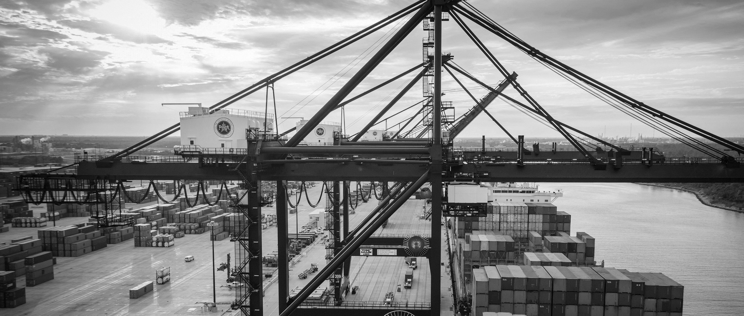
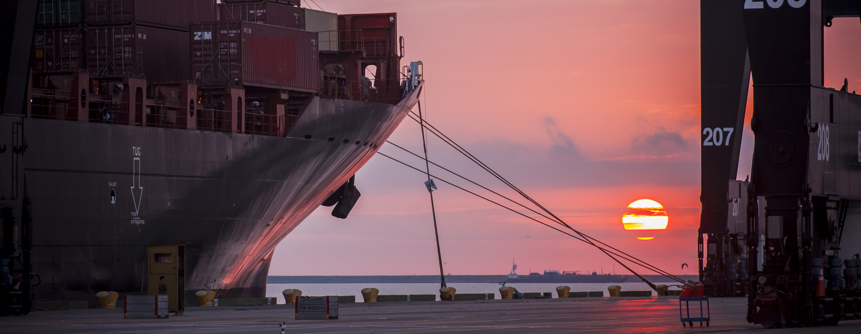
CSP – Vegetate Middle Berm at Bayport Container Terminal-Revised
Brenda C Trevino, P.E. | Project Manager | Project & Construction Management (PCM)

Slide 2
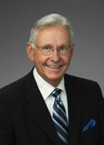
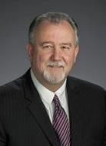
Port Commission
John D. Kennedy
Dean E. Corgey
Clyde Fitzgerald
Janiece M. Longoria
Chairman
Theldon R. Branch, III
Stephen H. DonCarlos
Roy D. Mease
WELCOME MESSAGE | 2

Slide 3
CSCSP – Vegetate Middle Berm at Bayport Container Vegetate Middle Berm at Bayport at Bayport Container Terminal e Middle Berm at Bayport Container Terminal
AGENDA
Introductions
Harris County
Small Business
Procurement Services
Selection Criteria
[Site] Parameters
Questions
All attendees must sign-in and indicate attendance for site visit and if TWIC cardholders

Slide 4
CSP – Vegetate Middle Berm at Bayport Container Terminal-Revised
PHA Personnel:
Roger H. Hoh, P.E. – Director, PCM
Nick Kotsatos–Construction Manager
Brenda C. Trevino, P.E. – Project Manager
Pedro Gonzales – Small Business Development
Ryan Mariacher– Director of Container Terminals
Harris County:
Robert Rocha – Wage Rate Monitor

Slide 5
CSP – Vegetate Middle Berm at Bayport Container Terminal-Revised
Harris County Wage Rate Compliance & Requirements:
Attendance at pre-bid/proposal meetings and pre-construction meetings
Review and approve weekly certified payroll records
Monitor wage rate compliance
Review claims of non-compliance from the field and recommend appreciate responses as required or permitted under the Wage Scale Act

Slide 6
CSP – Vegetate Middle Berm at Bayport Container Terminal-Revised
Small Business Requirement:
Participation Goal Small Business is 35% of the Purchase Price
Small Business Participation and the Local Business criterion shall not exceed the Relative Weight of 15%.

Slide 7
CSP – Vegetate Middle Berm at Bayport Container Terminal-Revised
Procurement:
Competitive Sealed Proposals(CSP) are due on January 3, 2018 no later than 11:00 A.M.
One original and five copies, packaged in one sealed envelope
All proposals will be opened and read publicly in the PHA first floor conference room by Procurement Services on Wednesday, January 3, 2018 at 11:30 A.M.

Slide 8
CSP – Vegetate Middle Berm at Bayport Container Terminal-Revised
Selection Criteria
The Port Commission will award the contract to the responsible bidder/proposer submitting the lowest and best proposal.
Responsible:
Meet the applicable Small Business Participation requirements, if any;
Have the ability to comply with the required delivery or performance schedule, taking into consideration other business commitments;
Have a satisfactory record of performance and integrity;
Have satisfactory safety and environmental record;
Have satisfactory references; and
Have the necessary facilities, equipment, materials, personnel, organization, experience, authorizations, technical skills, and financial resources to fulfill the terms of the contract for the project

Slide 9
CSP – Vegetate Middle Berm at Bayport Container Terminal-Revised
Competitive Sealed Bid/ Proposal Response:
Page 2 – Required Attachments

Slide 10
CSP – Vegetate Middle Berm at Bayport Container Terminal-Revised

Slide 11
Berm Cross Section

Slide 12
Vegetate Berm At Bayport Container Terminal-Revised

Slide 13
CSP – Vegetate Middle Berm at Bayport Container Terminal-Revised Site Visit on December 13, 2017 2-4PM West Entry Gate/Old SH146
No photographs – leave cell phones in your pockets or purses
Stay with group
PHA certified TWIC escorts must accompany individuals without a TWIC card
Safety vests, hard hat, safety glasses
No open-toed shoes
Personal flotation devices if within 20’ of face of wharf
Comply with your company’s safety policy

Slide 14
THANK YOU
Brenda C. Trevino, P.E.
Project Manager
Port Houston
Questions?
www.PortHouston.com
111 East Loop North
Houston, TX 77029

