Slide 1
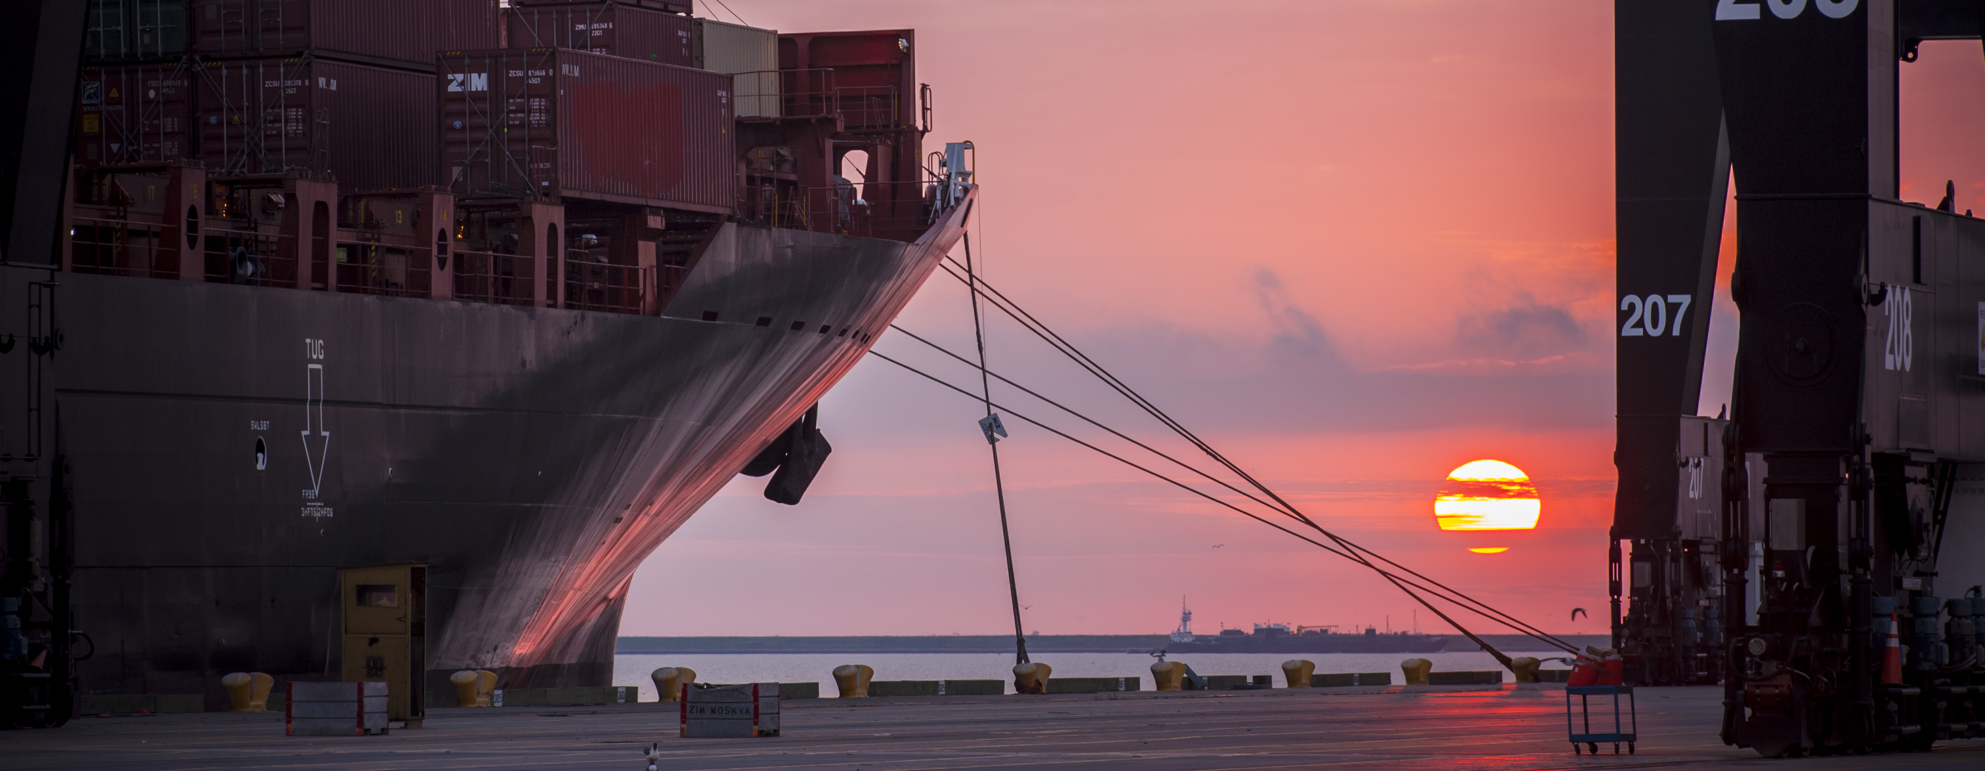
CSP-533 ANNUAL WHARF CRANE & RTG CRANE PAINTING AT BAYPORT & BARBOURS CUT TERMINAL
Alvin Jackson, P.E. | Project Manager | Project & Construction Management (PCM)

Slide 2
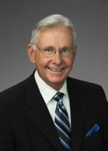
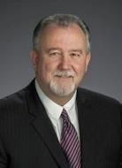
Port Commission
John D. Kennedy
Dean E. Corgey
Clyde Fitzgerald
Janiece M. Longoria
Chairman
Theldon R. Branch, III
Stephen H. DonCarlos
Roy D. Mease
WELCOME MESSAGE | 2

Slide 3
Annual Wharf Crane & RTG Crane Painting at Bayport & Barbours Cut Container Terminals - 2018
AGENDA
Introductions
Harris County
Small Business
Procurement Services
Selection Criteria
[Site] Parameters
Questions
All attendees must sign-in and indicate attendance for site visit and TWIC cardholders

Slide 4
Annual Wharf Crane & RTG Crane Painting at Bayport & Barbours Cut Container Terminals - 2018
PHA Personnel:
Roger H. Hoh, P.E. – Director, PCM
Alvin Jackson, P.E. – Project Manager
Don Smith – Construction Manager
Pedro Gonzales – Small Business Development
Yvette Camel-Smith – Director of Procurement
Harris County:
Robert Rocha – Wage Rate Monitor

Slide 5
Annual Wharf Crane & RTG Crane Painting at Bayport & Barbours Cut Container Terminals - 2018
Harris County Wage Rate Compliance & Requirements:
Attendance at pre-bid/proposal meetings and pre-construction meetings
Review and approve weekly certified payroll records
Monitor wage rate compliance
Review claims of non-compliance from the field and recommend appreciate responses as required or permitted under the Wage Scale Act

Slide 6
Annual Wharf Crane & RTG Crane Painting at Bayport & Barbours Cut Container Terminals - 2018
Small Business Requirement:
This project is exempt from the PHA Small Business
Participation Goal Small Business Participation Goal for this Project = 35% of the Purchase Price

Slide 7
Annual Wharf Crane & RTG Crane Painting at Bayport & Barbours Cut Container Terminals - 2018
Procurement:
Competitive Sealed Bids/Proposals (CSB/CSP) are due on October 25, 2017, no later than 11:00 A.M.
One original and six copies, packaged in one sealed envelope
All bids/proposals will be opened and read publicly in the PHA first floor conference room by Procurement Services on Wednesday, October 25, 2017 at 11:30 A.M.

Slide 8
Annual Wharf Crane & RTG Crane Painting at Bayport & Barbours Cut Container Terminals - 2018
Selection Criteria
The Port Commission will award the contract to the responsible bidder/proposer submitting the lowest and best bid/proposal.
Responsible:
Meet the applicable Small Business Participation requirements, if any;
Have the ability to comply with the required delivery or performance schedule, taking into consideration other business commitments;
Have a satisfactory record of performance and integrity;
Have satisfactory safety and environmental record;
Have satisfactory references; and
Have the necessary facilities, equipment, materials, personnel, organization, experience, authorizations, technical skills, and financial resources to fulfill the terms of the contract for the project

Slide 9
Annual Wharf Crane & RTG Crane Painting at Bayport & Barbours Cut Container Terminals - 2018

Slide 10
Annual Wharf Crane & RTG Crane Painting at Bayport & Barbours Cut Container Terminals - 2018

Slide 11
Annual Wharf Crane & RTG Crane Painting at Bayport & Barbours Cut Container Terminals - 2018

Slide 12
Annual Wharf Crane & RTG Crane Painting at Bayport & Barbours Cut Container Terminals - 2018

Slide 13
Annual Wharf Crane & RTG Crane Painting at Bayport & Barbours Cut Container Terminals - 2018

Slide 14
Annual Wharf Crane & RTG Crane Painting at Bayport & Barbours Cut Container Terminals - 2018

Slide 15
Annual Wharf Crane & RTG Crane Painting at Bayport & Barbours Cut Container Terminals - 2018
General Scope of Services: This Project will consist of blasting, priming, and painting the Wharf Cranes and RTG Cranes on an “as-needed” basis at Bayport and Barbours Cut Container Terminals. Work will begin in the 1st quarter of 2018.
Respondents are to rely on their own estimates and material take-off for project bidding/proposing.

Slide 16
Annual Wharf Crane & RTG Crane Painting at Bayport & Barbours Cut Container Terminals - 2018
No photographs – leave cell phones in your pockets or purses
Stay with group
PHA certified TWIC escorts must accompany individuals without a TWIC card
Safety vests, hard hat, safety glasses
No open-toed shoes
Personal flotation devices if within 20’ of face of wharf
Comply with your company’s safety policy

Slide 17
THANK YOU
Name
Alvin Jackson, P.E.
Port Houston
Questions?
713.670.2400
ajackson@poha.com
www.PortHouston.com
111 East Loop North
Houston, TX 77029
WELCOME MESSAGE | 4

