Slide 1
Pre-Proposal Conference:
CSP-2305 REPAIR OF WHARVES 24, 25 AND 26 AT TURNING BASIN TERMINAL REVISED.
July 26, 2022
3:00 p.m.
PORT HOUSTON

Slide 2
AGENDA
Pre-Proposal Conference House Rules
Introductions
Business Equity
Procurement Services
Selection Criteria
Project Scope
Questions

Slide 3
PRE-PROPOSAL CONFERENCE HOUSE RULES
Attendees will begin the meeting in listen-only mode.
There will be a Q&A session at the end of today’s presentation.
If you have any questions during the presentation, you may submit your Questions through the WebEx Q&A feature and they will be addressed at the end of the presentation.
This presentation recording will be posted on the BuySpeed homepage under “Pre-Bid/Proposal Conference Information.”

Slide 4
PHA Personnel:
Roger H. Hoh, P.E. – Director, PCM
Corrie Yaw – Project Manager
Ruth Flores – Construction Manager
Yvette Camel-Smith – Director, Procurement
Dean Ainuddin – Procurement Contract Manager
Gilda Ramirez – Director, Business Equity
Brenda Ruiz – Business Equity
Non-PHA Personnel:
Robert Rocha – Harris County Wage Rate Monitor

Slide 5
PORT COMMISSION
Dean E. Corgey
Commissioner
Clyde Fitzgerald
Commissioner
Stephen H. DonCarlos
Commissioner
Ric Campo
Chairman of the Port Commission
Roy D. Mease
Commissioner
Wendy Montoya Cloonan
Commissioner
Cheryl D. Creuzot
Commissioner
Notes:
So let’s talk about Port Houston. First, we are governed by a seven-member Commission, led by Chairman Ric Campo.

Slide 6
Harris County Wage Rate Compliance & Requirements:
Attendance at pre-bid/proposal meetings and preliminary meetings
Review and approve weekly certified payroll records
Monitor wage rate compliance
Review claims of non-compliance from the field and recommend appropriate responses as required or permitted under the Wage Scale Act

Slide 7
BUSINESS EQUITY

Slide 8
BUSINESS EQUITY
S/MWBE INITIATIVE
Business Equity Division provides resources to small, minority- and woman-owned businesses (S/MWBE) seeking to participate in Port Houston procurements and contracts.
Port Houston promotes business opportunities for all sectors of the community and recognizes the importance of vendor and suppler diversity in its contracts.
Port Houston has established an organizational ​35% Small Business participation goal and a​ 30% Minority-and Woman Business Enterprise (MWBE) aspirational goal.
35%
SBE participation goal
30%
MWBE aspirational goal

Slide 9
BUSINESS ENTERPRISE DEFINITIONS
Small Business Enterprise (SBE)
Gross revenues or number of employees, averaged over the past three years does not exceed the size standards defined by SBA.
The net worth of the owner must be less than $1.32 million, excluding the owner’s primary residence and assets of the business.
Minority Business Enterprise (MBE)
At least 51% Owned by one or more Minority Individuals, or at least 51% of the equity is Owned by one or more Minority Individuals.
Both the management and daily business operations are carried out and controlled by one or more of the Minority Individuals who own it.
Woman-Owned Business Enterprise (WBE)-
At least 51% Owned by one or more Women, or at least 51% of the equity is Owned by one or more Women
Both the management and daily business operations are carried out and controlled by one or more of the Women who own it.
Notes:
As a contractor Contractor you are agrees to:
• Placing qualified S/MWBEs on solicitation lists; S/MWBEs must perform a Commercially Useful Function (CFU) to be counted towards goals. CANNOT BE A PASS THROUGH

Slide 10
CERTIFYING PARTNERS
Small and M/WBEs must meet certain criteria and be certified with one of the following partner agencies:
Local Presence
Harris
Montgomery
Waller
Ft. Bend
Brazoria
Galveston
Chambers
Liberty
City of Houston *
Houston Minority Supplier Development Council
METRO *
National Minority Supplier Development Council & Affiliates
Small Business Administration 8(a) *
South Central Texas Regional Certification Agency – SCTRCA *
Texas Comptroller of Public Accounts – HUB Certification
Texas Department of Transportation – TxDOT *
Women’s Business Enterprise Alliance
Women’s Business Enterprise National Council & Affiliates – WBENC
* No fee to apply
Notes:
Port Houston is not a certifying entity but we accept the certifications from our certifying partners . Meeting the certification requirements for any of the listed partners is a requirement to be part of the Port of Houston S/MWBE Program. After certification has been verified, interested business must complete an enrollment process to be inducted into the S/MWBE Program.

Slide 11
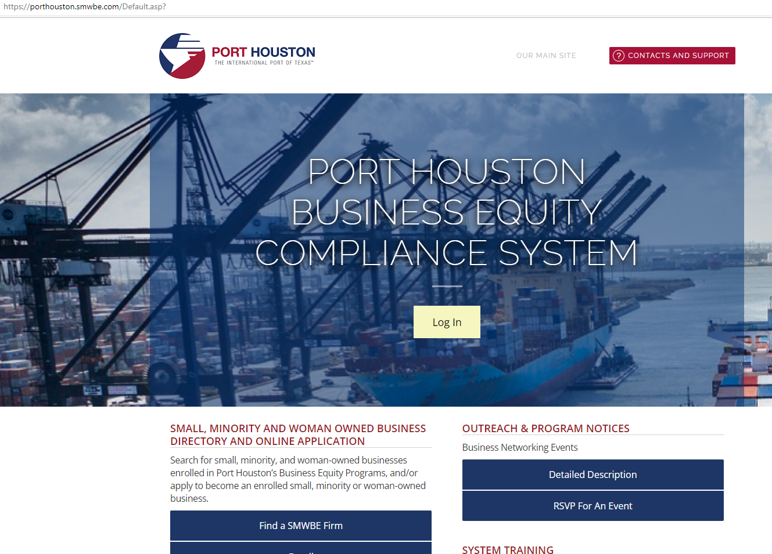
PORT HOUSTON S/MWBE ENROLLMENT DIRECTORY
How do I identify Port Houston enrolled small,
minority- and woman-owned businesses
(S/MWBE)?
Search for businesses in 2 easy steps:
1. Visit https://porthouston.smwbe.com Under the section on the
left labeled Small, Minority and Woman Owned Business
Directory and Online Application select the blue button labeled,
"Find a S/MWBE Firm".
2. You will need to complete at least one of the fields in the popup
window titled, Port Houston S/MWBE Enrollment Directory
and Search.
www.porthouston.smwbe.com
Notes:
Search for small, minority, and woman-owned businesses enrolled in Port Houston’s Business Equity Programs
NAIC Codes
Download our directory.

Slide 12
BUSINESS EQUITY CONTRACT REQUIREMENTS
30% Small Business Enterprise (SBE) participation, 5 points relative weight

Slide 13
TIPS TO INCREASE PARTICIPATION
Establish relationships with S/MWBE’s in advance ​
Assuring that S/MWBEs are solicited whenever they are potential sources; ​
Subdivide the work, when economically feasible, into smaller tasks or quantities to permit maximum participation by S/MWBE’s;​
Use the Port of Houston Directory.
Advertise opportunities
What subcontractors have you done business in the past and do they qualify?
Notes:
As a contractor Contractor you are agrees to:
• Placing qualified S/MWBEs on solicitation lists; S/MWBEs must perform a Commercially Useful Function (CFU) to be counted towards goals. CANNOT BE A PASS THROUGH

Slide 14
Contractors
Placing qualified S/MWBEs on solicitation lists; S/MWBEs must perform a Commercially Useful Function (CFU) to be counted towards goals; ​
S/MWBEs are solicited whenever they are potential sources; ​
Establishing delivery schedules, where the requirement permits, which encourage participation by S/MWBE’s;
Using the services and assistance, as appropriate, of such organizations as the Small Business Administration and the Minority Business Development Agency of the Department of Commerce.​
Notes:
As a contractor Contractor you are agrees to:
• Placing qualified S/MWBEs on solicitation lists; S/MWBEs must perform a Commercially Useful Function (CFU) to be counted towards goals. CANNOT BE A PASS THROUGH

Slide 15
PROCUREMENT

Slide 16
PROCUREMENT
No Contact Period – No communication between interested vendors and Port Houston staff during the active period.
Technical questions should be submitted via BuySpeed
Last day to submit questions: 7 days before due date (8/10/2022)
Responses are due no later than 11 a.m. on 8/17/2022
Proposals must be submitted electronically via email to: procurementproposals@porthouston.com
Use forms in the package
Anticipated award date: 9/27/2022

Slide 17
EVALUATION CRITERIA
Port Houston will select the provider of the services offering the best value to Port Houston. If the Respondent meets the 30% SB target/goal (or provides adequate documentation of Good Faith Efforts), then the response package will be evaluated based on the following criteria and relative weights.
Evaluation Criteria | Relative Weight (%)
Price | 40
Respondent | 25
Benefit to Port Authority | 25
Overall Compliance with Port Houston Policies Small Business Participation | 5 5

Slide 18
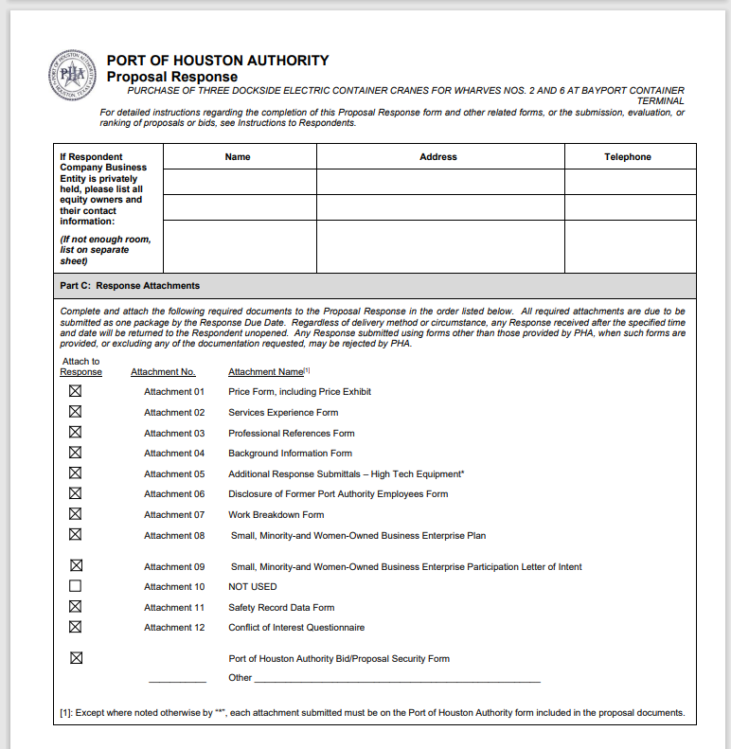
DOCUMENT CHECKLIST
Proposal Response form:
(Page 31 of Solicitation Package)
Page 2 of the Proposal Response Form – Required Attachments

Slide 19
SCOPE OF WORK OVERVIEW

Slide 20
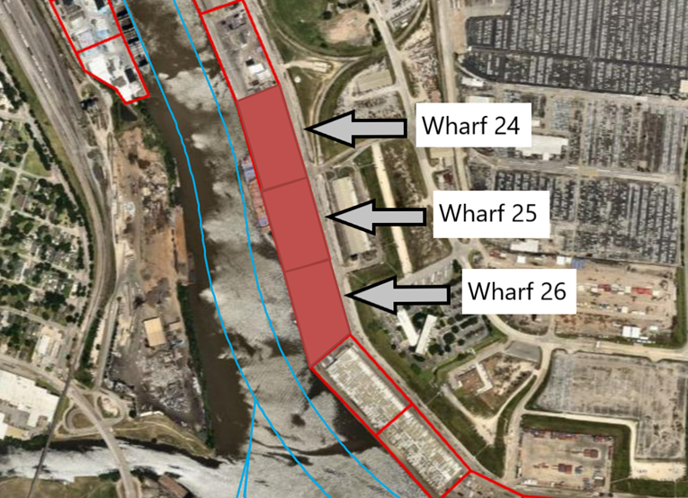
Overall Scope of Project
Repair to 3 wharves within the Turning Basin Terminal
Project Duration: 300 calendar days
Scope
Topside/Underside Repair to Reinforced Concrete
Mooring Cleat Replacement/Repair
Expansion Joint Repair/Replacement
Crack Repair

Slide 21
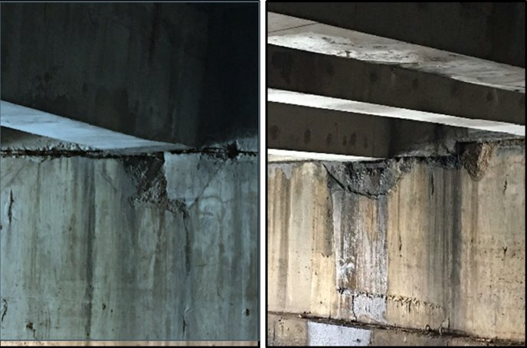
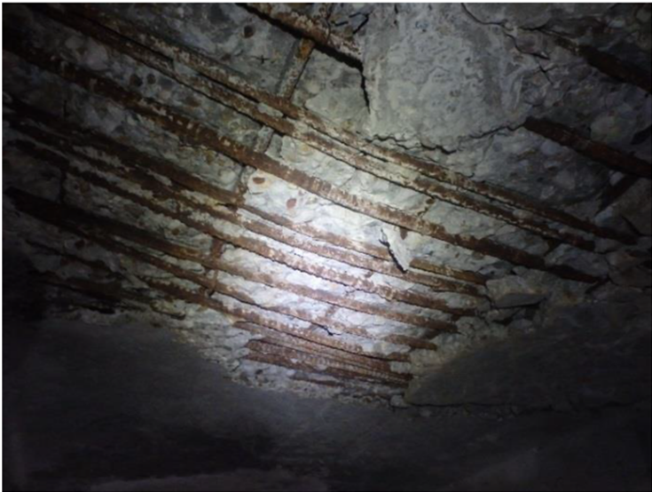
Current Conditions/Repairs Needed

Slide 22
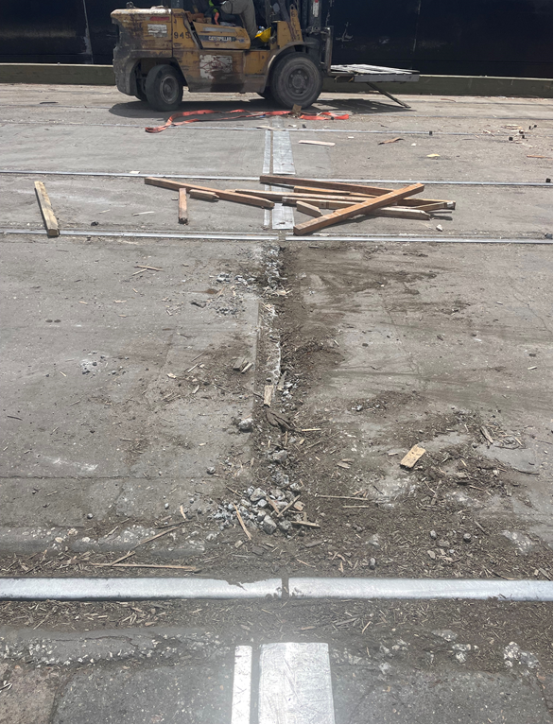
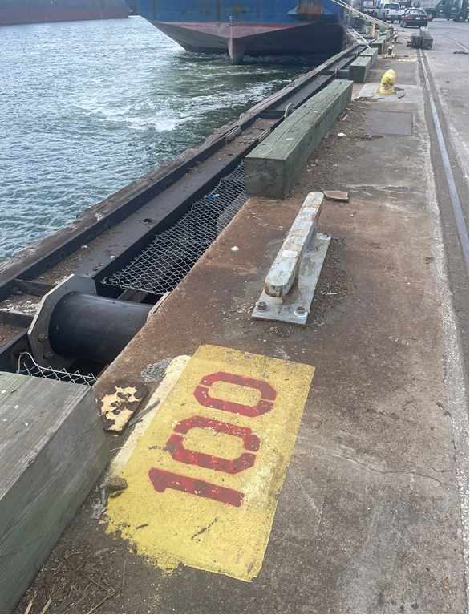
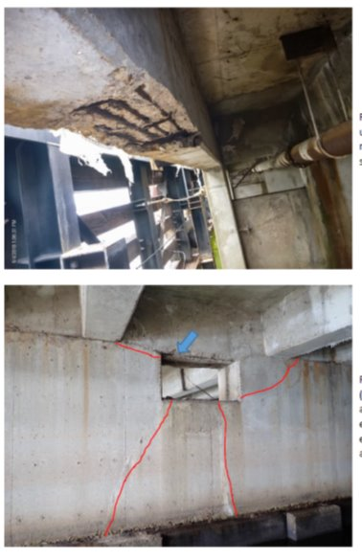
Current Conditions/Repairs Needed (Cont'd)

Slide 23
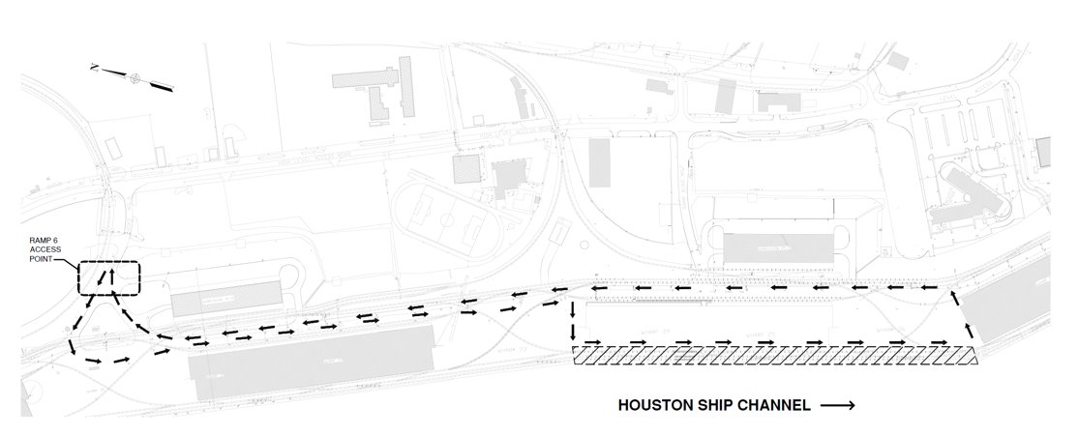
Access
*TWIC Required

Slide 24
Phasing
Each phase much be substantially completed before proceeding to the next
Wharf under construction at the time will be discontinued from public use; however, the other two wharves will remain active.
Coordinate with construction manager on wharf availability prior to construction
Shipping activities take priority over construction
Do not interfere with terminal operations without coordinating with the construction manager
Phase 1
Phase 2
Phase 3

Slide 25
Project Specific Requirements
30% SBE goal
By submitting proposal
Agree to 30-day NTP and mobilization from award date
Submitted within 30 days of award date
Dust Control Plan
Health and Safety Plan
Site Specific Spill Prevention Plan

Slide 26
Procurement Services
Email: procurement@porthouston.com
Phone: (713) 670- 2464
QUESTIONS?
PORT HOUSTON

