Slide 1

Pre-Proposal Conference:
CSP-2207 Repair of Wharves 24, 25, and 26 at Turning Basin Terminal
April 21, 2022
2 p.m.
PORT HOUSTON

Slide 2

AGENDA
Pre-Proposal Conference House Rules
Introductions
Harris County
Business Equity
Procurement Services
Selection Criteria
Questions

Slide 3
PRE-PROPOSAL CONFERENCE HOUSE RULES
Attendees will begin the meeting in listen-only mode.
There will be a Q&A session at the end of today’s presentation.
If you have any questions during the presentation, you may submit your Questions through the WebEx Q&A feature and they will be addressed at the end of the presentation.
This presentation recording will be posted on the BuySpeed homepage under “Pre-Bid/Proposal Conference Information.”

Slide 4
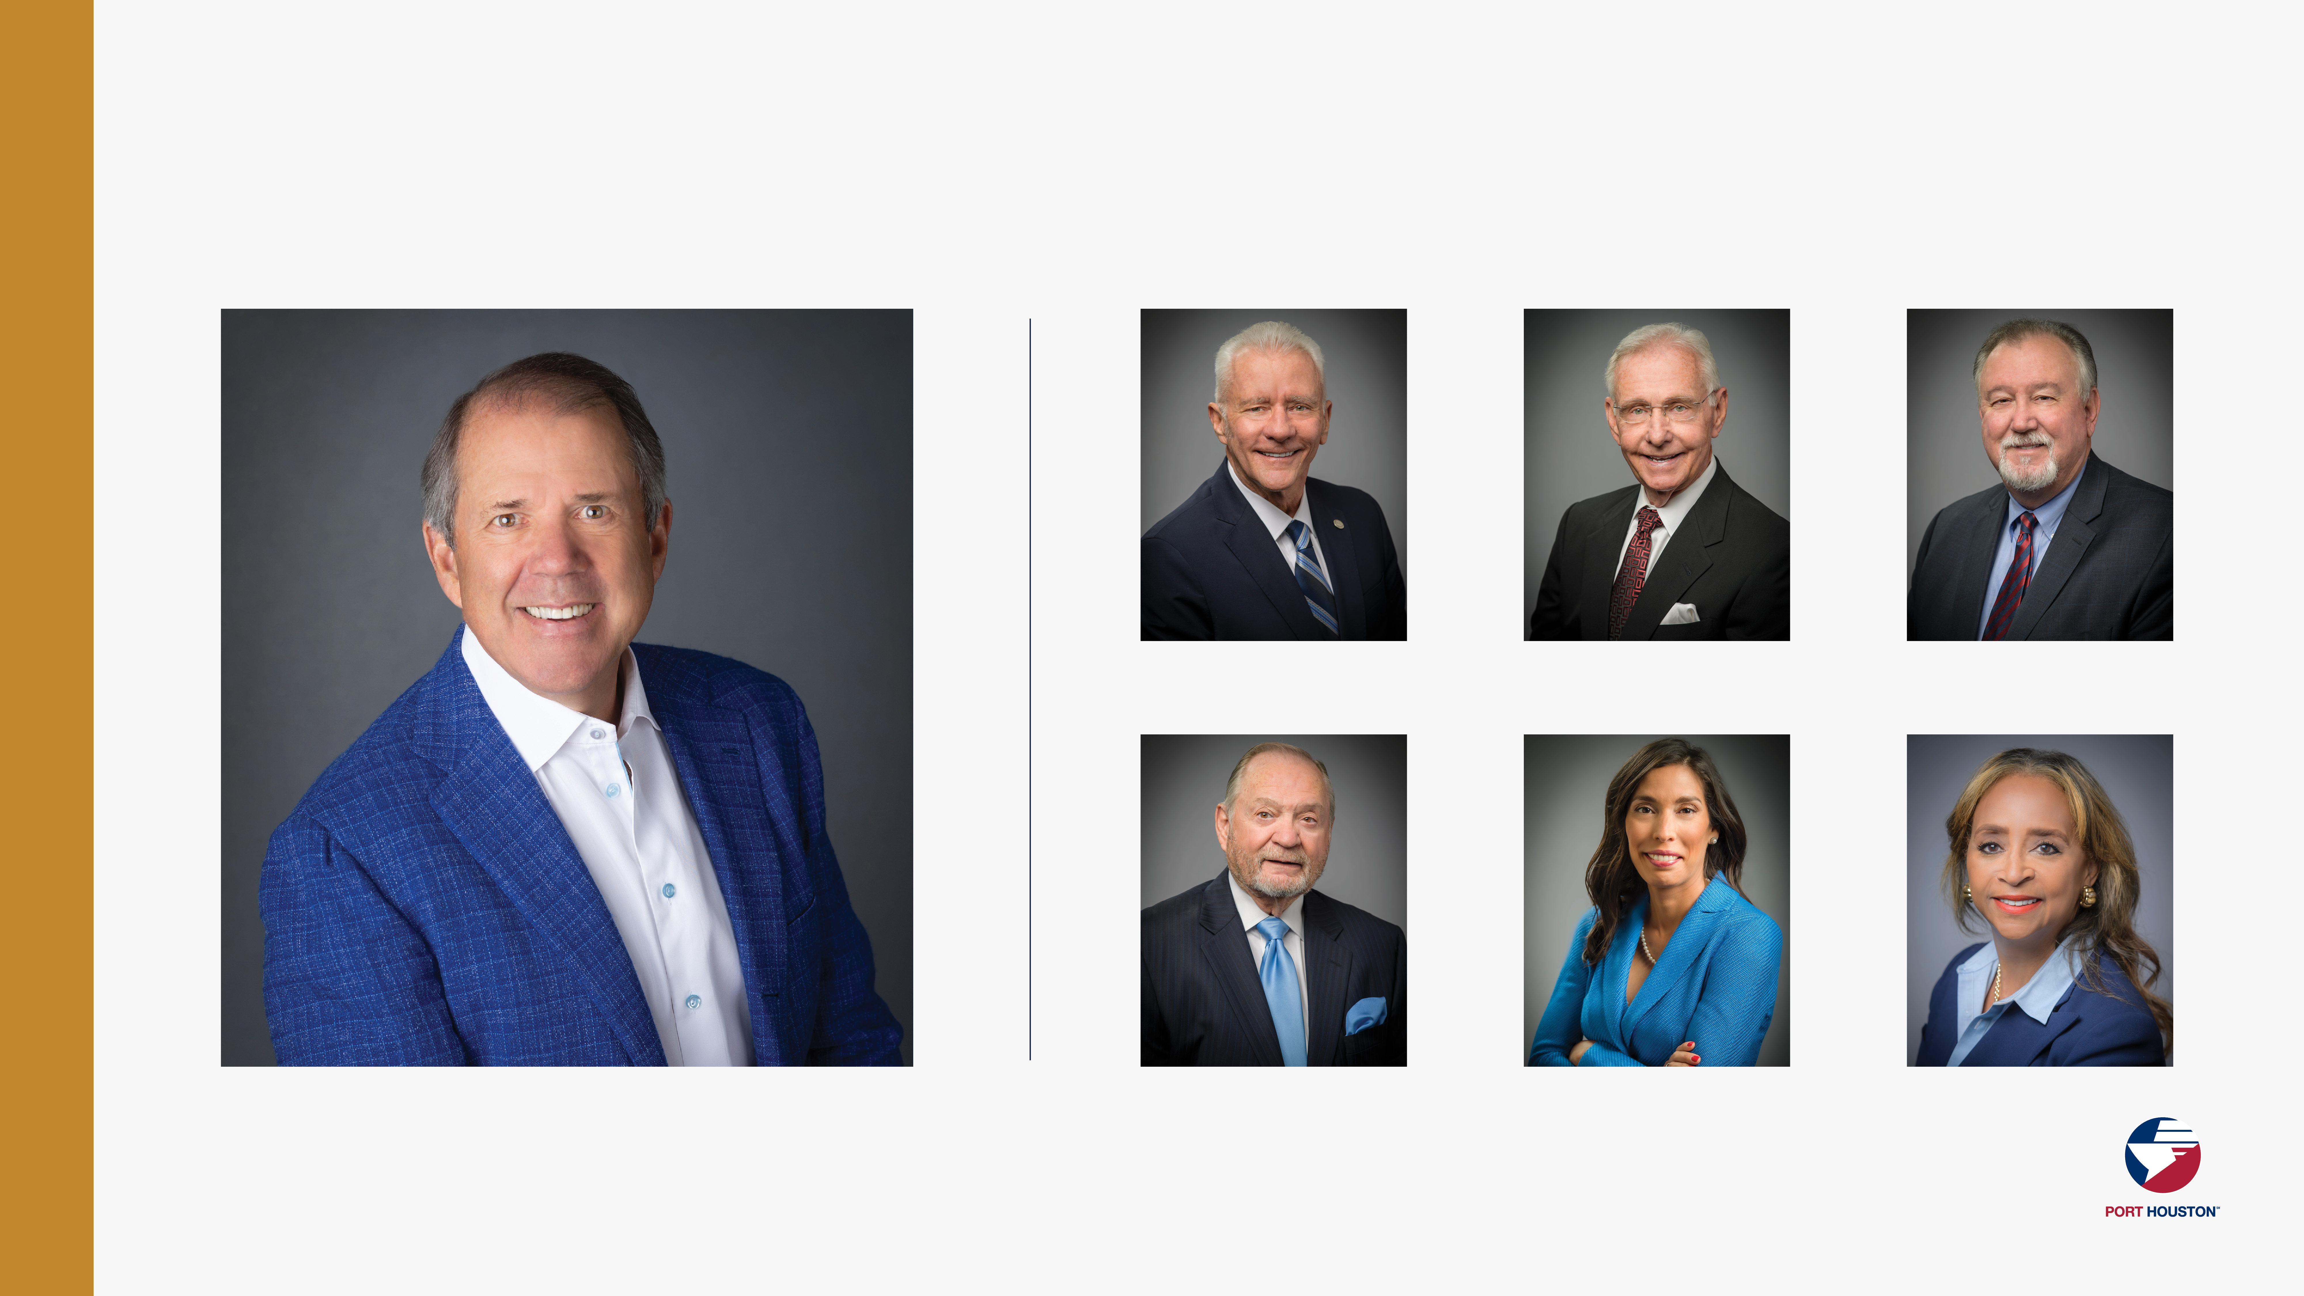
PORT COMMISSION
Dean E. Corgey
Commissioner
Clyde Fitzgerald
Commissioner
Stephen H. DonCarlos
Commissioner
Ric Campo
Chairman of the Port Commission
Roy D. Mease
Commissioner
Wendy Montoya Cloonan
Commissioner
Cheryl D. Creuzot
Commissioner
Notes:
So let’s talk about Port Houston. First, we are governed by a seven-member Commission, led by Chairman Ric Campo.

Slide 5
PHA Personnel:
Roger H. Hoh, P.E. – Director, PCM
Eddy Kharrazi, P.E. – Project Manager
Oscar Zavala CM – Construction Manager
Brenda Ruiz – Business Equity
Yvette Camel-Smith – Director, Procurement
Tanika Chukwumerije – Manager, Contracts, Procurement
PHA Personnel:
Robert Rocha - Wage Rate Monitor

Slide 6
Harris County Wage Rate Compliance & Requirements:
Attendance at pre-bid/proposal meetings and preliminary meetings
Review and approve weekly certified payroll records
Monitor wage rate compliance
Review claims of non-compliance from the field and recommend appreciate responses as required or permitted under the Wage Scale Act

Slide 7

BUSINESS EQUITY

Slide 8

BUSINESS EQUITY
S/MWBE INITIATIVE
Business Equity Division provides
resources to small, minority- and woman-owned businesses (S/MWBE) seeking to participate in Port Houston procurements and contracts.
Port Houston promotes business opportunities for all sectors of the community and recognizes the importance of vendor and suppler diversity in its contracts.
Port Houston has established an organizational ​35% Small Business participation goal and a​ 30% Minority-and Woman Business Enterprise (MWBE) aspirational goal.
35%
SBE participation goal
30%
MWBE aspirational goal

Slide 9
BUSINESS EQUITY
All dollars awarded and committed to enrolled S/MWBEs count towards Port Houston's S/MWBE goals regardless of whether the individual solicitation includes criteria for small, minority, woman-owned business participation.
Notes:
Initiative will reduce barriers to MBEs and WBEs who want to engage in business with Port Houston
Port Houston is working to identify and contact qualified S/MWBEs to meet our participation goals
Implemented race- and gender-neutral measures to ensure equal opportunities for all contractors and subcontractors
Port Houston is continuing to provide training, mentorship, networking and development assistance to all S/MWBEs

Slide 10


BUSINESS EQUITY DEFINITIONS
Small Business Enterprise (SBE)
Gross revenues or number of employees, averaged over the past three years does not exceed the size standards defined by SBA.
The net worth of the owner must be less than $1.32 million, excluding the owner’s primary residence and assets of the business.
Minority Business Enterprise (MBE)
At least 51% Owned by one or more Minority Individuals, or
At least 51% of the equity is Owned by one or more Minority Individuals.
Both the management and daily business operations are carried out and controlled by one or more of the Minority Individuals who own it.
Woman-Owned Business Enterprise (WBE)-
At least 51% Owned by one or more Women, or
At least 51% of the equity is Owned by one or more Women
Both the management and daily business operations are carried out and controlled by one or more of the Women who own it.

Slide 11










CERTIFYING PARTNERS
Small and M/WBEs must meet certain criteria and be certified with one of the following partner agencies:
Local Presence
Harris
Montgomery
Waller
Ft. Bend
Brazoria
Galveston
Chambers
Liberty
City of Houston *
Houston Minority Supplier Development Council
METRO *
National Minority Supplier Development Council & Affiliates
Small Business Administration 8(a) *
South Central Texas Regional Certification Agency – SCTRCA *
Texas Comptroller of Public Accounts – HUB Certification
Texas Department of Transportation – TxDOT *
Women’s Business Enterprise Alliance
Women’s Business Enterprise National Council & Affiliates – WBENC
* No fee to apply
Notes:
Port Houston is not a certifying entity but we accept the certifications from our certifying partners . Meeting the certification requirements for any of the listed partners is a requirement to be part of the Port of Houston S/MWBE Program. After certification has been verified, interested business must complete an enrollment process to be inducted into the S/MWBE Program.

Slide 12
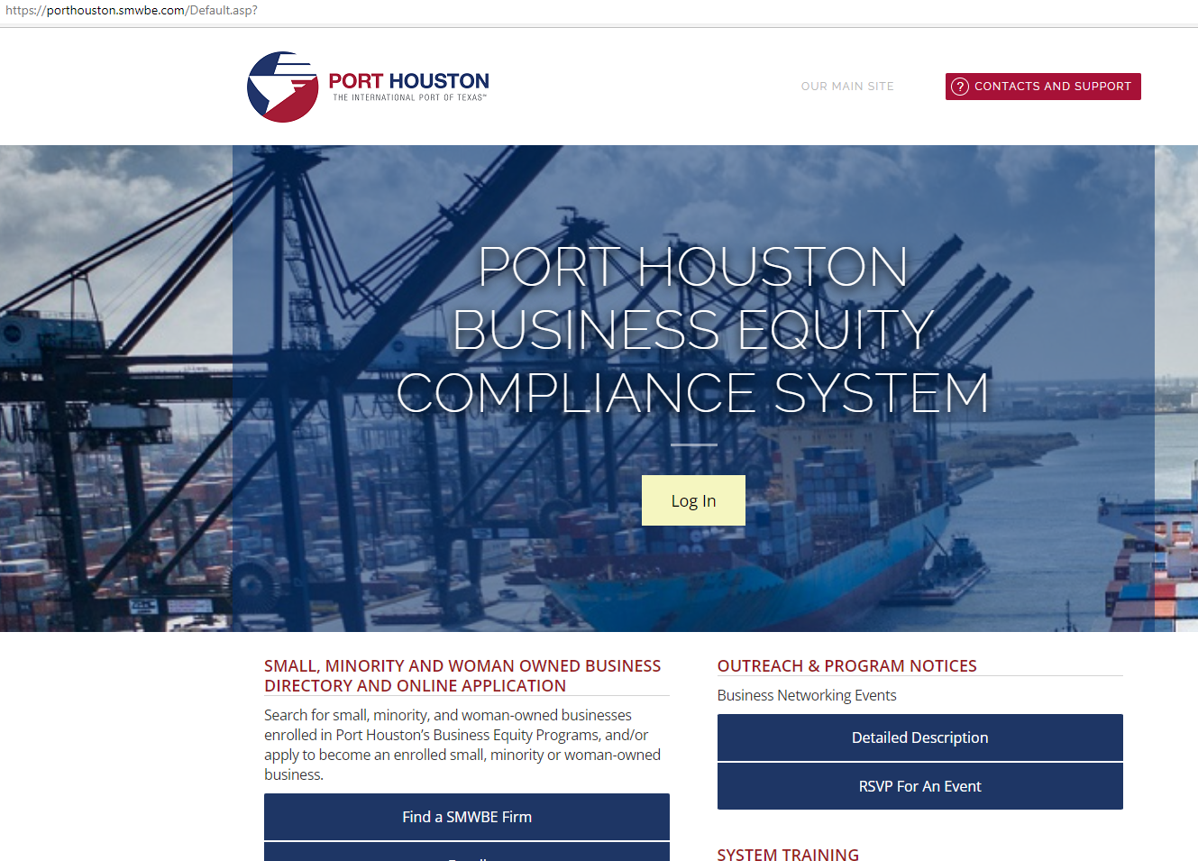
PORT HOUSTON S/MWBE ENROLLMENT DIRECTORY
How do I identify Port Houston enrolled small,
minority- and woman-owned businesses
(S/MWBE)?
Search for businesses in 2 easy steps:
1. Visit https://porthouston.smwbe.com Under the section on the
left labeled Small, Minority and Woman Owned Business
Directory and Online Application select the blue button labeled,
"Find a S/MWBE Firm".
2. You will need to complete at least one of the fields in the popup
window titled, Port Houston S/MWBE Enrollment Directory
and Search.
www.porthouston.smwbe.com
Notes:
Search for small, minority, and woman-owned businesses enrolled in Port Houston’s Business Equity Programs
NAIC Codes
Download our directory.

Slide 13
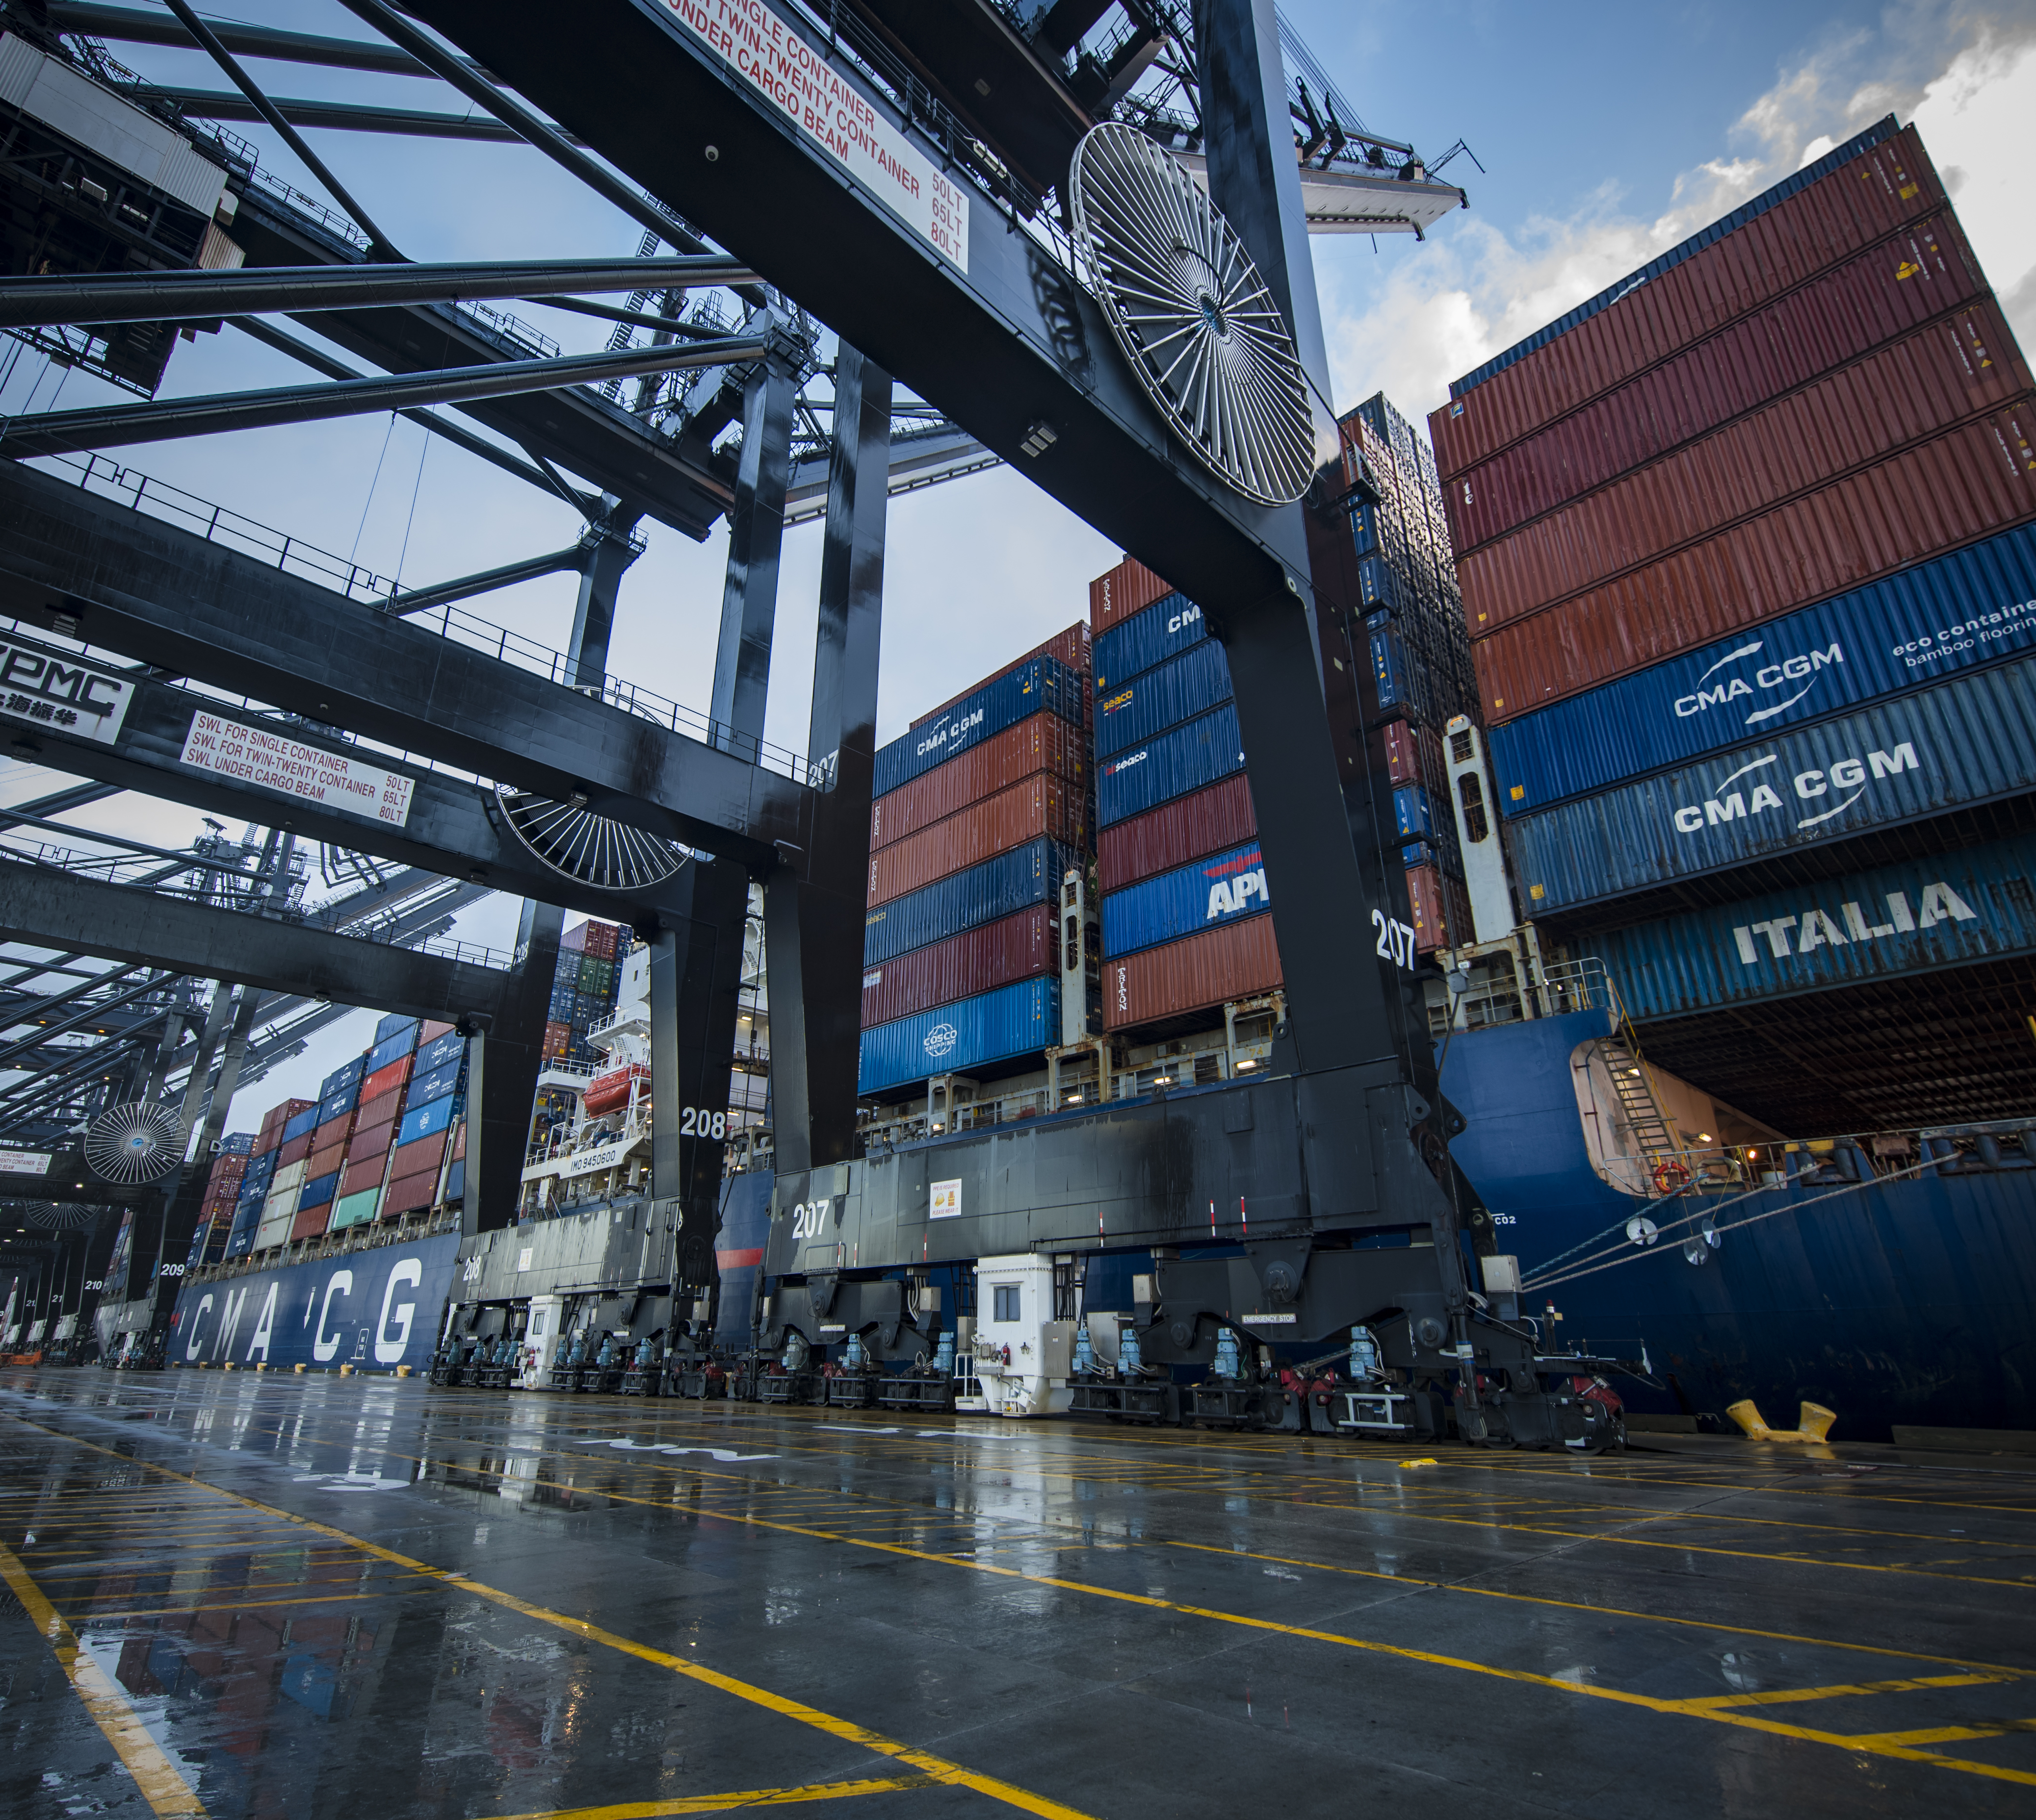
CONTRACTOR RESPONSIBILITES
Contractor is encouraged to and agrees it will endeavor to:
• Placing qualified S/MWBE’s on solicitation lists; ​
Assuring that S/MWBE’s are solicited whenever they are potential sources; ​
Dividing total requirements, when economically feasible, into smaller tasks or quantities to permit maximum participation by S/MWBE’s;​
Establishing delivery schedules, where the requirement permits, which encourage participation by S/MWBE’s;
Using the services and assistance, as appropriate, of such organizations as the Small Business Administration and the Minority Business Development Agency of the Department of Commerce.​

Slide 14
BUSINESS EQUITY CONTRACT REQUIREMENTS
Minority Business Enterprise (MBE) required minimum participation 15% Pass/Fail

Slide 15
PROCUREMENT

Slide 16
PROCUREMENT
No Contact Period – No communication between interested vendors and Port Houston staff during the active period.
  Technical questions should be submitted via BuySpeed
  Last day to submit questions: 7 days before due date (5/4/2022)
Responses are due no later than 11 a.m. on 5/11/2022
Proposals must be submitted electronically via email to: procurementproposals@porthouston.com
Use forms in the package
Anticipated award date: 6/28/2022

Slide 17
EVALUATION CRITERIA
Port Houston will select the provider of the services offering the best value to Port Houston. The criteria and relative weights that will be considered by Port Houston in evaluating each Response are as follows:
CRITERIA | RELATIVE WEIGHT (%)
Price | 45
Vendor's Reputation, Quality of Services, Safety Record | 25
Benefit to Port Authority | 25
Overall Compliance with Port Authority Policies | 5

Slide 18
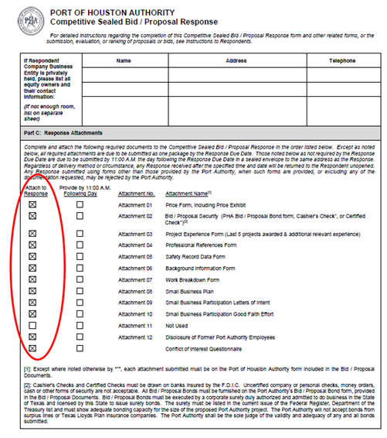
DOCUMENT CHECKLIST
Proposal Response form:
(Page 31 of CSP Document)
Page 2 of the Proposal Response Form – Required Attachments

Slide 19
SCOPE OF WORK OVERVIEW

Slide 20
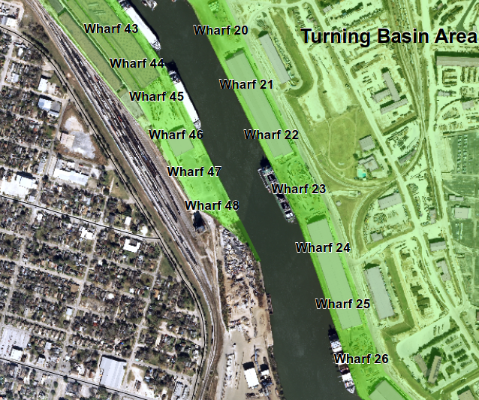

Wharves 24, 25 & 26
EOB
EOB

Slide 21
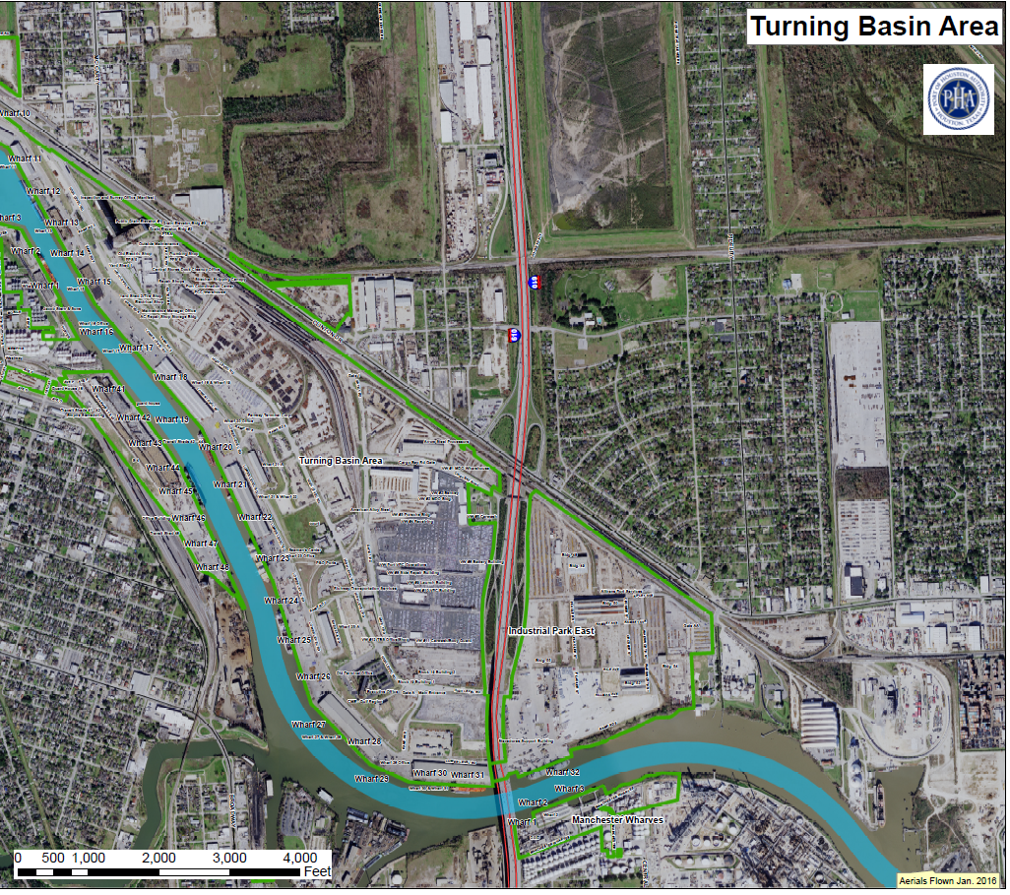
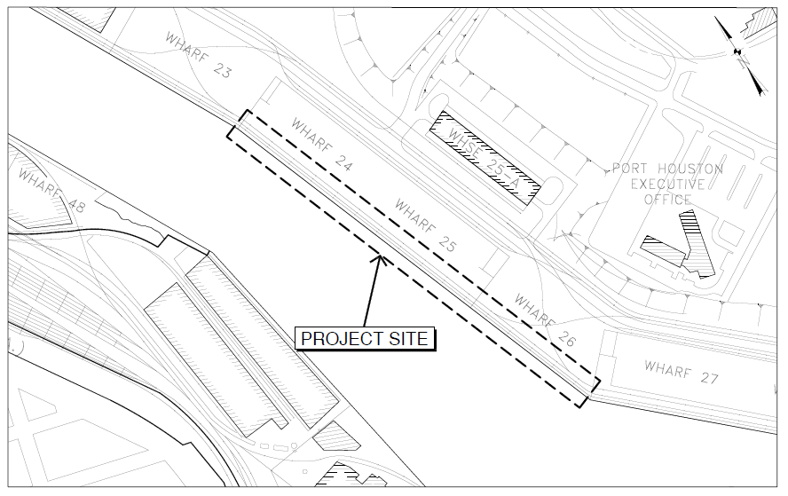
Wharves 24, 25 & 26
EOB

Slide 22
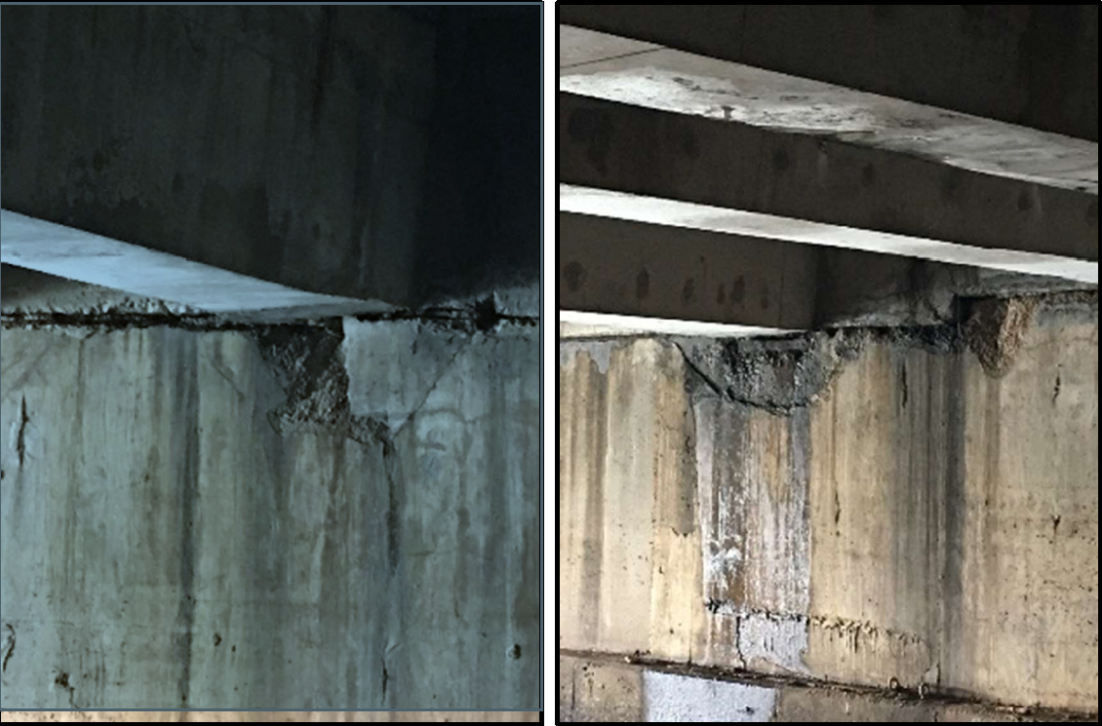
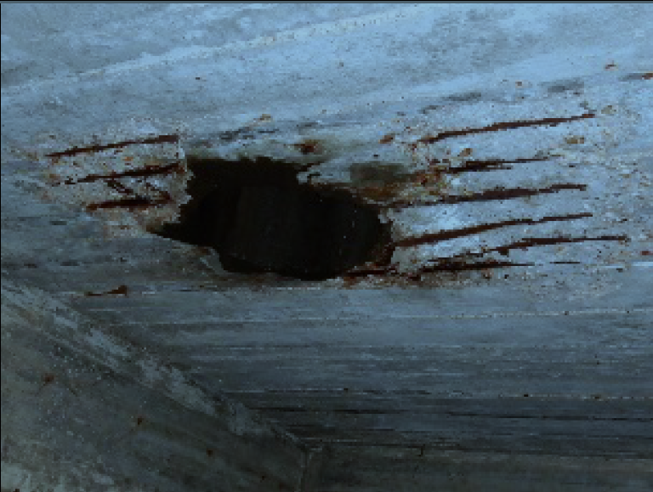
Condition of Wharves 24, 25 & 26
5

Slide 23
Condition of Wharves 24, 25 & 26
5

Slide 24
Condition of Wharves 24, 25 & 26

Slide 25
Condition of Wharves 24, 25 & 26
5

Slide 26
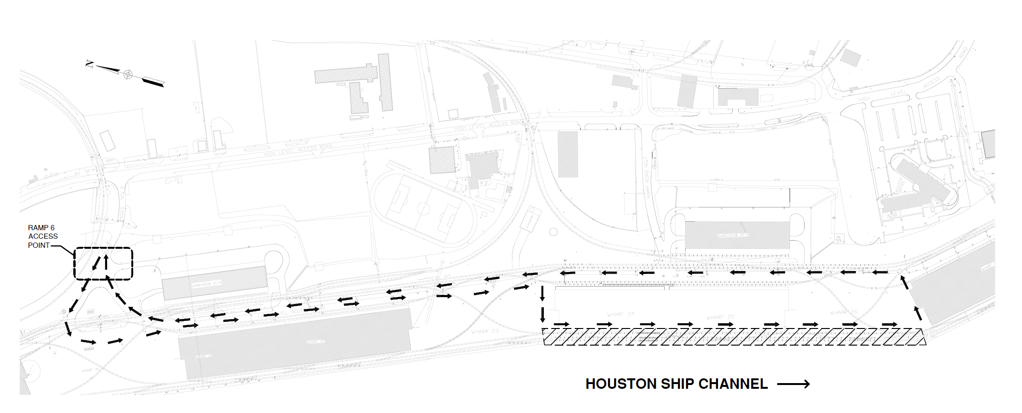
Access

Slide 27
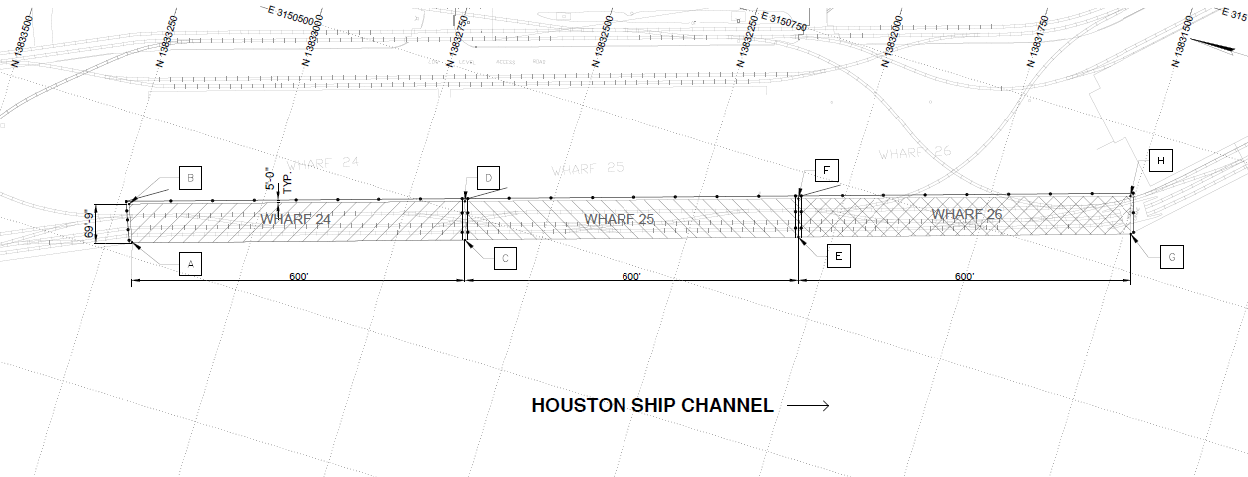
Wharves 24, 25 & 26

Slide 28
Thank you

Slide 29
Procurement Services
Email: procurement@porthouston.com
Phone: (713) 670- 2464
QUESTIONS?
PORT HOUSTON

