Slide 1
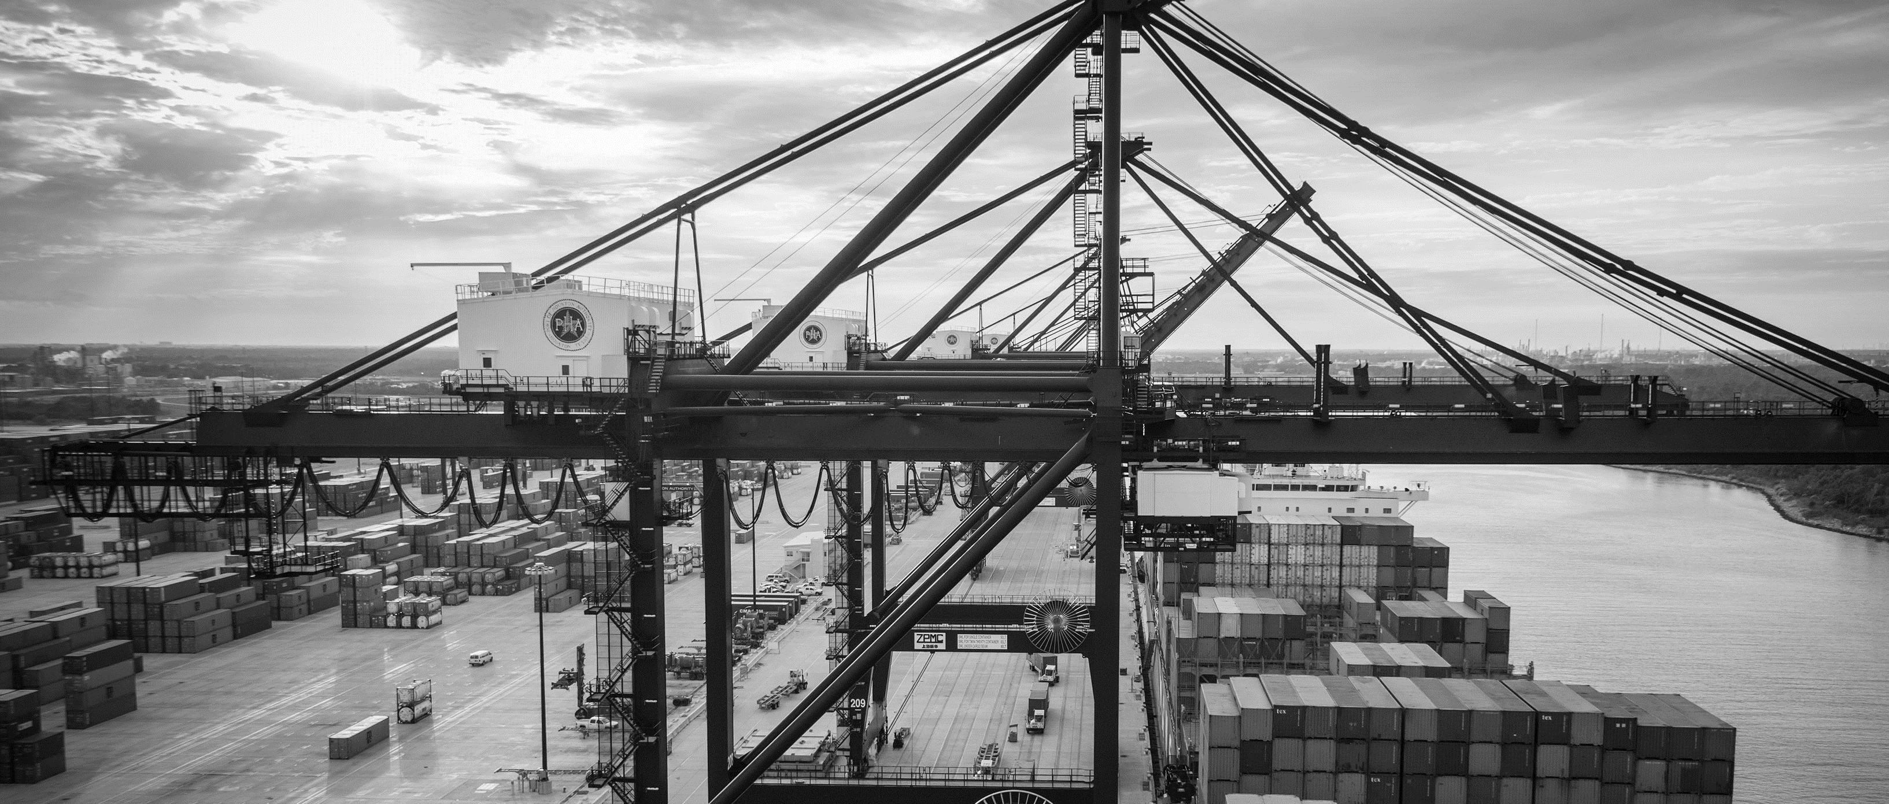
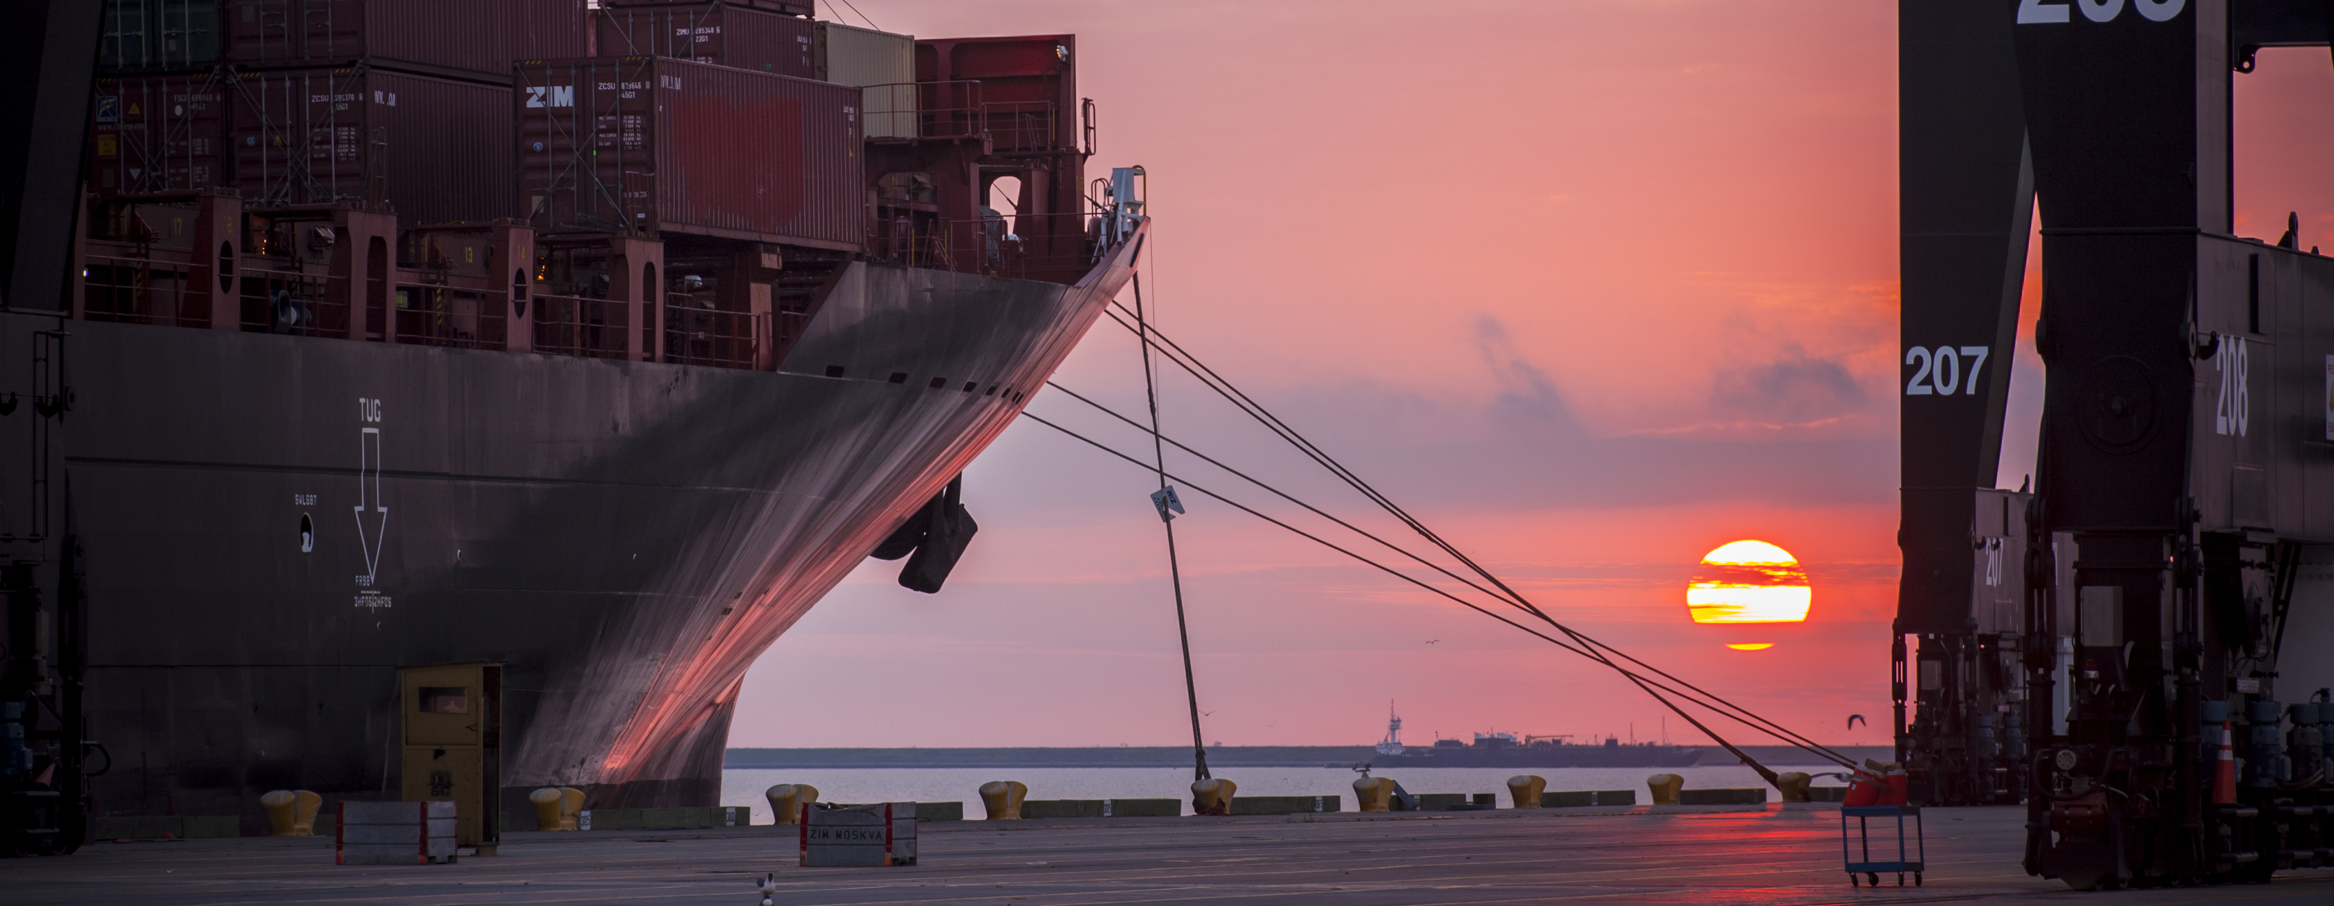
CSP-214 Revised Woodhouse Terminal Water and Sewer Line Replacement
Barbara Harris Smith, P.E. | Project Manager | Project & Construction Management (PCM)

Slide 2
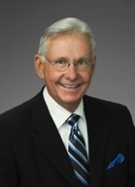
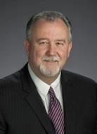
Port Commission
John D. Kennedy
Dean E. Corgey
Clyde Fitzgerald
Janiece M. Longoria
Chairman
Theldon R. Branch, III
Stephen H. DonCarlos
Roy D. Mease
WELCOME MESSAGE | 2

Slide 3
CSP-214
AGENDA
Introductions
Harris County
Small Business
Procurement Services
Selection Criteria
[Site] Parameters
Questions
All attendees must sign-in and indicate attendance for site visit and TWIC cardholders

Slide 4
CSP-214
PHA Personnel:
Roger H. Hoh, P.E. – Director, PCM
Brock Lewis, P.E. – Chief Construction Manager
Barbara Harris Smith, P.E. – Project Manager
Alex Lion, E.I.T. – Construction Manager
Pedro Gonzales – Small Business Development
Yvette Camel-Smith – Director of Procurement
Mike Ellis – IT Department
Harris County:
Robert Rocha – Wage Rate Monitor

Slide 5
CSP-214
Harris County Wage Rate Compliance & Requirements:
Attendance at pre-bid/proposal meetings and pre-construction meetings
Review and approve weekly certified payroll records
Monitor wage rate compliance
Review claims of non-compliance from the field and recommend appreciate responses as required or permitted under the Wage Scale Act

Slide 6
CSP-214
Small Business Requirement:
Participation Goal Small Business is 35% of the Purchase Price
Small Business Participation and the Local Business criterion shall not exceed the Relative Weight of 15%.

Slide 7
CSP-214
Procurement:
Competitive Sealed Proposals (CSP) are due on January 11, 2017, no later than 11:00 A.M.
One original and five copies, packaged in one sealed envelope
All bids/proposals will be opened and read publicly in the PHA first floor conference room by Procurement Services on Wednesday, January 11, 2017 at 11:30 A.M.

Slide 8
CSP-214
Selection Criteria
The Port Commission will award the contract to the responsible bidder/proposer submitting the lowest and best proposal.
Responsible:
Meet the applicable Small Business Participation requirements, if any;
Have the ability to comply with the required delivery or performance schedule, taking into consideration other business commitments;
Have a satisfactory record of performance and integrity;
Have satisfactory safety and environmental record;
Have satisfactory references; and
Have the necessary facilities, equipment, materials, personnel, organization, experience, authorizations, technical skills, and financial resources to fulfill the terms of the contract for the project

Slide 9
CSP-214
Competitive Sealed Bid/ Proposal Response:
Page 2 – Required Attachments

Slide 10
CSP-214
General Scope of Services:
This project consists of construction of approximately 5,200 linear feet of replacement water and sewer mains consisting of:
Approximately 4,100 LF of 6 and 8-inch diameter iron water main.
Approximately 300 LF of 6 and 8-inch diameter fusible PVC water main
Approximately 850 LF of 3-inch diameter ductile iron sewage force main
Water main appurtenances, fire hydrants, water valves, and six potable water boat fill stations
Duplex sewage pump station and valve vault

Slide 11
CSP-214
General Scope of Services (continued):
Water Main Work Highlights
Temporary water main bypass system to be installed parallel to Alignment E to facilitate replacement water main work
Refer to Sheets D-007 and D-008 for removal of existing piping from beneath Wharves 1, 2 and 3 to allow for replacement water and sewer mains
Replacement water main to be grooved joint ductile iron pipe with bracing and bracketing per Sheet D-003. Painted per Port Houston specifications
Refer to schedule of appurtenances on Sheet C-001 for water and (sewage force main) work below Wharves 1, 2 and 3
Boat fill station details on Sheet D-002 and D-004.

Slide 12
CSP-214
General Scope of Services (continued):
Sewage Pump Station and Force Main Work Highlights
Sewage pump station to be consistent with that recently installed by Port Houston at the Turning Basin project
Coordinate on electrical service with Clerk’s Office project
Sewage force main in common trench with encased water main for first 150 LF from valve vault – controlled density fill backfill
Proposed sewage force main reconnects to existing force main in utility trench at approximately Station 20+90 on Alignment C on Sheet C-004

Slide 13
CSP-214
General Scope of Services (continued):
Refer to Sequence of Construction on Sheet G-002
Preconstruction potholing to precede all work
Schedule coordination of all work the PHA dock operations essential
Coordinate work with Port Terminal Railroad Association
Excavation spoils to be disposed of off-site – PHA approval
Coordination for sewage pump station construction with Contract for Clerk’s Office
Respondents are to rely on their own estimates and material take-off for project bidding/proposing.

Slide 14
CSP-214
No photographs – leave cell phones in your pockets or purses
Stay with group
PHA certified TWIC escorts must accompany individuals without a TWIC card
Safety vests, hard hat, safety glasses
No open-toed shoes
Personal flotation devices if within 20’ of face of wharf
Comply with your company’s safety policy

Slide 15
THANK YOU
Barbara Harris Smith, P.E.
Project Manager
Port Houston
Questions?
www.PortHouston.com
111 East Loop North
Houston, TX 77029
WELCOME MESSAGE | 4

