Slide 1
NEW FENDER SYSTEM AT WHARF 1 AT TURNING BASIN TERMINAL
PRE-PROPOSAL CONFERENCE:
October 21, 2021
2:00 p.m. (CST)

Slide 2
AGENDA
Pre-Proposal Conference House Rules
Port Commission
Business Equity
Procurement Services
Scope of Services
Q & A

Slide 3
PRE-PROPOSAL HOUSE RULES
Attendees will begin the meeting in listen-only mode.
There will be a Q&A session at the end of today’s presentation.
If you have any questions during the presentation, you may submit your Questions through the WebEx chat feature and they will be addressed at the end of the presentation.
This presentation will be recorded and posted on the BuySpeed homepage under “Pre-Bid/Proposal Conference Information.”

Slide 4
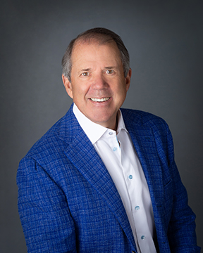
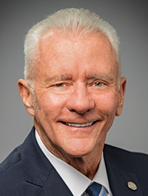
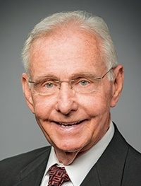
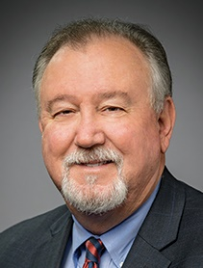
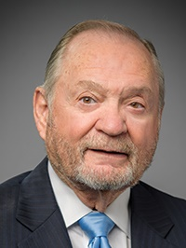
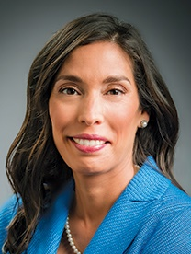
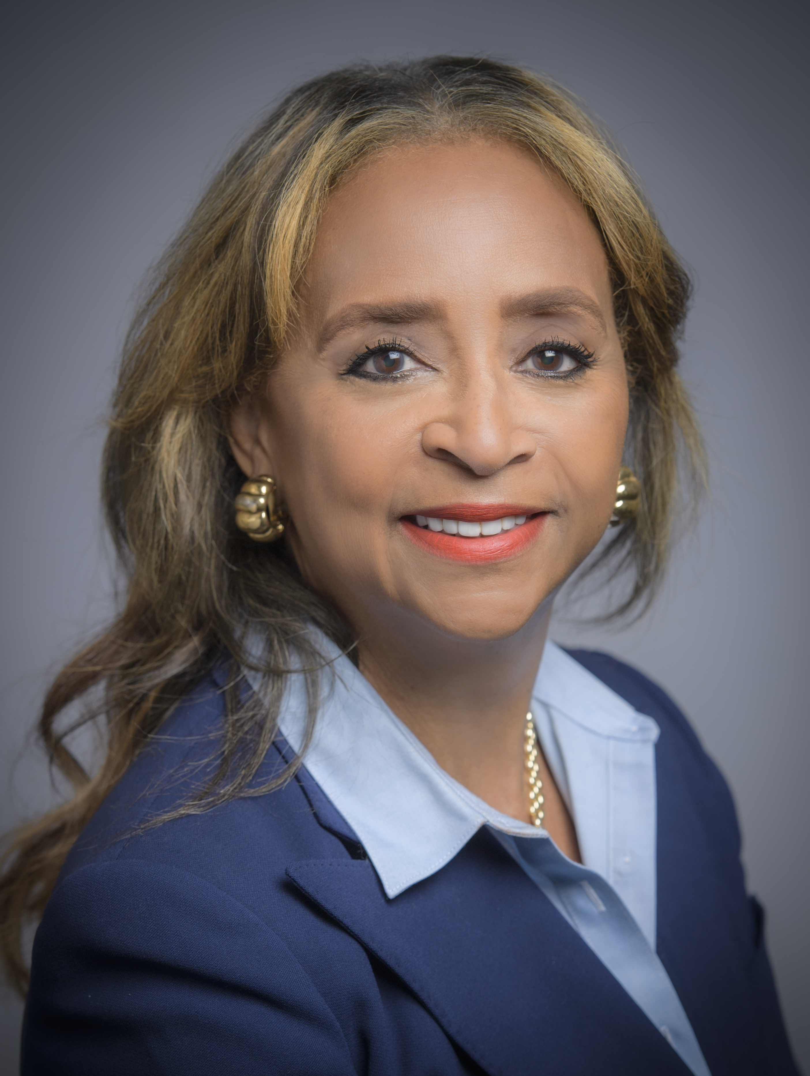
PORT COMMISSION
Dean E. Corgey
Commissioner
Clyde Fitzgerald
Commissioner
Stephen H. DonCarlos
Commissioner
Ric Campo
Chairman
Roy D. Mease
Commissioner
Wendy Montoya Cloonan
Commissioner
Cheryl D. Creuzot
Commissioner
Notes:
So let’s talk about Port Houston. First, we are governed by a seven-member Commission, led by Chairman Ric Campo.

Slide 5
Business Equity
New Fender System at Wharf 1 at TBT
Pedro Gonzalez, P.E.,
Manager, Mentoring Program

Slide 6
BUSINESS EQUITY, S/MWBE INITIATIVE
The New Business Equity Division provides resources to small, minority- and woman-owned businesses (S/MWBE) seeking to participate in Port Houston procurements and contracts
Our goal is to maintain a 35% overall Small Business (SBE) participation and aspire to reach a 30% Minority- and Woman-Owned Business (MWBE) participation
Notes:
The Port Commission, at its April 27, 2021 meeting, approved the NEW Minority- and Woman-Owned Business Enterprise Development Policy and the Amended and Restated Small Business Development Policy.
Initiative will reduce barriers to MBEs and WBEs who want to engage in business with Port Houston
Port Houston is working to identify and contact qualified S/MWBEs to meet our participation goals
Implemented race- and gender-neutral measures to ensure equal opportunities for all contractors and subcontractors
Port Houston is continuing to provide training, mentorship, networking and development assistance to all S/MWBEs

Slide 7
BUSINESS EQUITY
Small Business Enterprise (SBE)
Small Business Enterprise “SBE” means a firm whose gross revenues or number of employees, averaged over the past three years, inclusive of any affiliates as defined by 13 CFR § 121.103, does not exceed the size standards defined in Section 3 of the Federal Small Business Act and applicable Small Business Administration regulations related to the size standards found in 12 CFR §121. The net worth of the owner must be less than $1.32 million, excluding the owner’s primary residence and assets of the business.
Minority Business Enterprise (MBE)
Minority-Owned Business Enterprise “MBE” means a Business that is at least 51% Owned by one or more Minority Persons, or for which at least 51% of the equity is Owned by one or more Minority Persons, and both the management and daily business operations are carried out and controlled by one or more of the Minority Persons who own it.

Slide 8
BUSINESS EQUITY
Woman Business Enterprise (WBE)
Woman-Owned Business Enterprise “WBE” means a Business that is at least 51% Owned by one or more female American citizens, or for which at least 51% of the equity is Owned by one or more female American citizens, and both the management and daily business operations are carried out and controlled by one or more of the female American citizens who own it.
MWBE and SBE Policies
The Port Commission, at its April 27, 2021 meeting, approved the NEW Minority- and Woman-Owned Business Enterprise Development Policy and the Amended and Restated Small Business Development Policy.

Slide 9
PARTNER AGENCIES
Small and MWBEs must meet certain criteria and be certified with one of the following partner agencies:
*City of Houston (SBE, MBE, WBE)
Houston Minority Supplier Development Council (MBE)
*METRO (SBE)
*SBA 8(a) (SDB)
*State of Texas HUB Certification (HUB)
South Texas Central Regional Certification Agency (SBE, MBE, WBE)
*Texas Department of Transportation (SBE)
Women’s Business Enterprise Alliance (WBE)
*No fee to apply

Slide 10
S/MWBE REQUIREMENTS
Contractor is encouraged to and agrees it will endeavor to:
Placing qualified small and minority businesses and women’s business enterprises on solicitation lists;
Assuring that small and minority businesses, and women’s business enterprises are solicited whenever they are potential sources;
Dividing total requirements, when economically feasible, into smaller tasks or quantities to permit maximum participation by small and minority businesses, and women’s business enterprises;
Establishing delivery schedules, where the requirement permits, which encourage participation by small and minority businesses, and women’s business enterprises;
Using the services and assistance, as appropriate, of such organizations as the Small Business Administration and the Minority Business Development Agency of the Department of Commerce; and
Requiring the prime contractor, if subcontracts are to be let, to take the affirmative steps listed in paragraphs (b)(1) through (5) of this section.

Slide 11
S/MWBE REQUIREMENTS
This project has a 20% minimum pass/fail small business participation requirement.

Slide 12
Procurement Services
New Fender System at Wharf 1 at TBT
Dean Ainuddin,
Manager, Contracts

Slide 13
PROCUREMENT
No Contact Period – No communication between interested vendors and Port Houston staff during the active period.
Technical questions should be submitted via BuySpeed
Last day to submit questions: 7 days before due date (11/3/2021)
Responses are due no later than 11 a.m. on 11/3/2021
Proposals must be submitted electronically via email to: procurementproposals@porthouston.com
Use forms in the package
Anticipated award date: 12/7/2021

Slide 14
PROCUREMENT
Evaluation Criteria
The Port Commission will award the contract to the Respondent whose Response provides the best value in consideration of the evaluation factors set forth below.
Evaluation Criteria | Relative Weight %
Price | 45
Vendor’s Reputation, Quality of Services and Safety Record | 25
Benefit to the Port Authority | 25
Overall Compliance with Port Authority Policies and Instructions | 5
TOTAL | 100

Slide 15
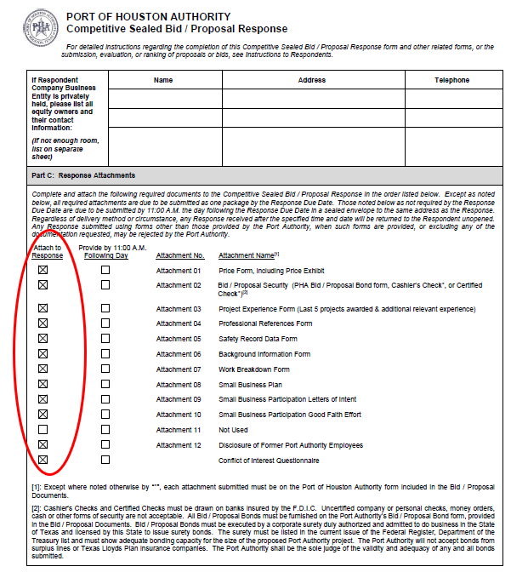
PROCUREMENT
Proposal Response form:
(Page 32 of CSP Document)
Page 2 of the Proposal Response Form – Required Attachments

Slide 16
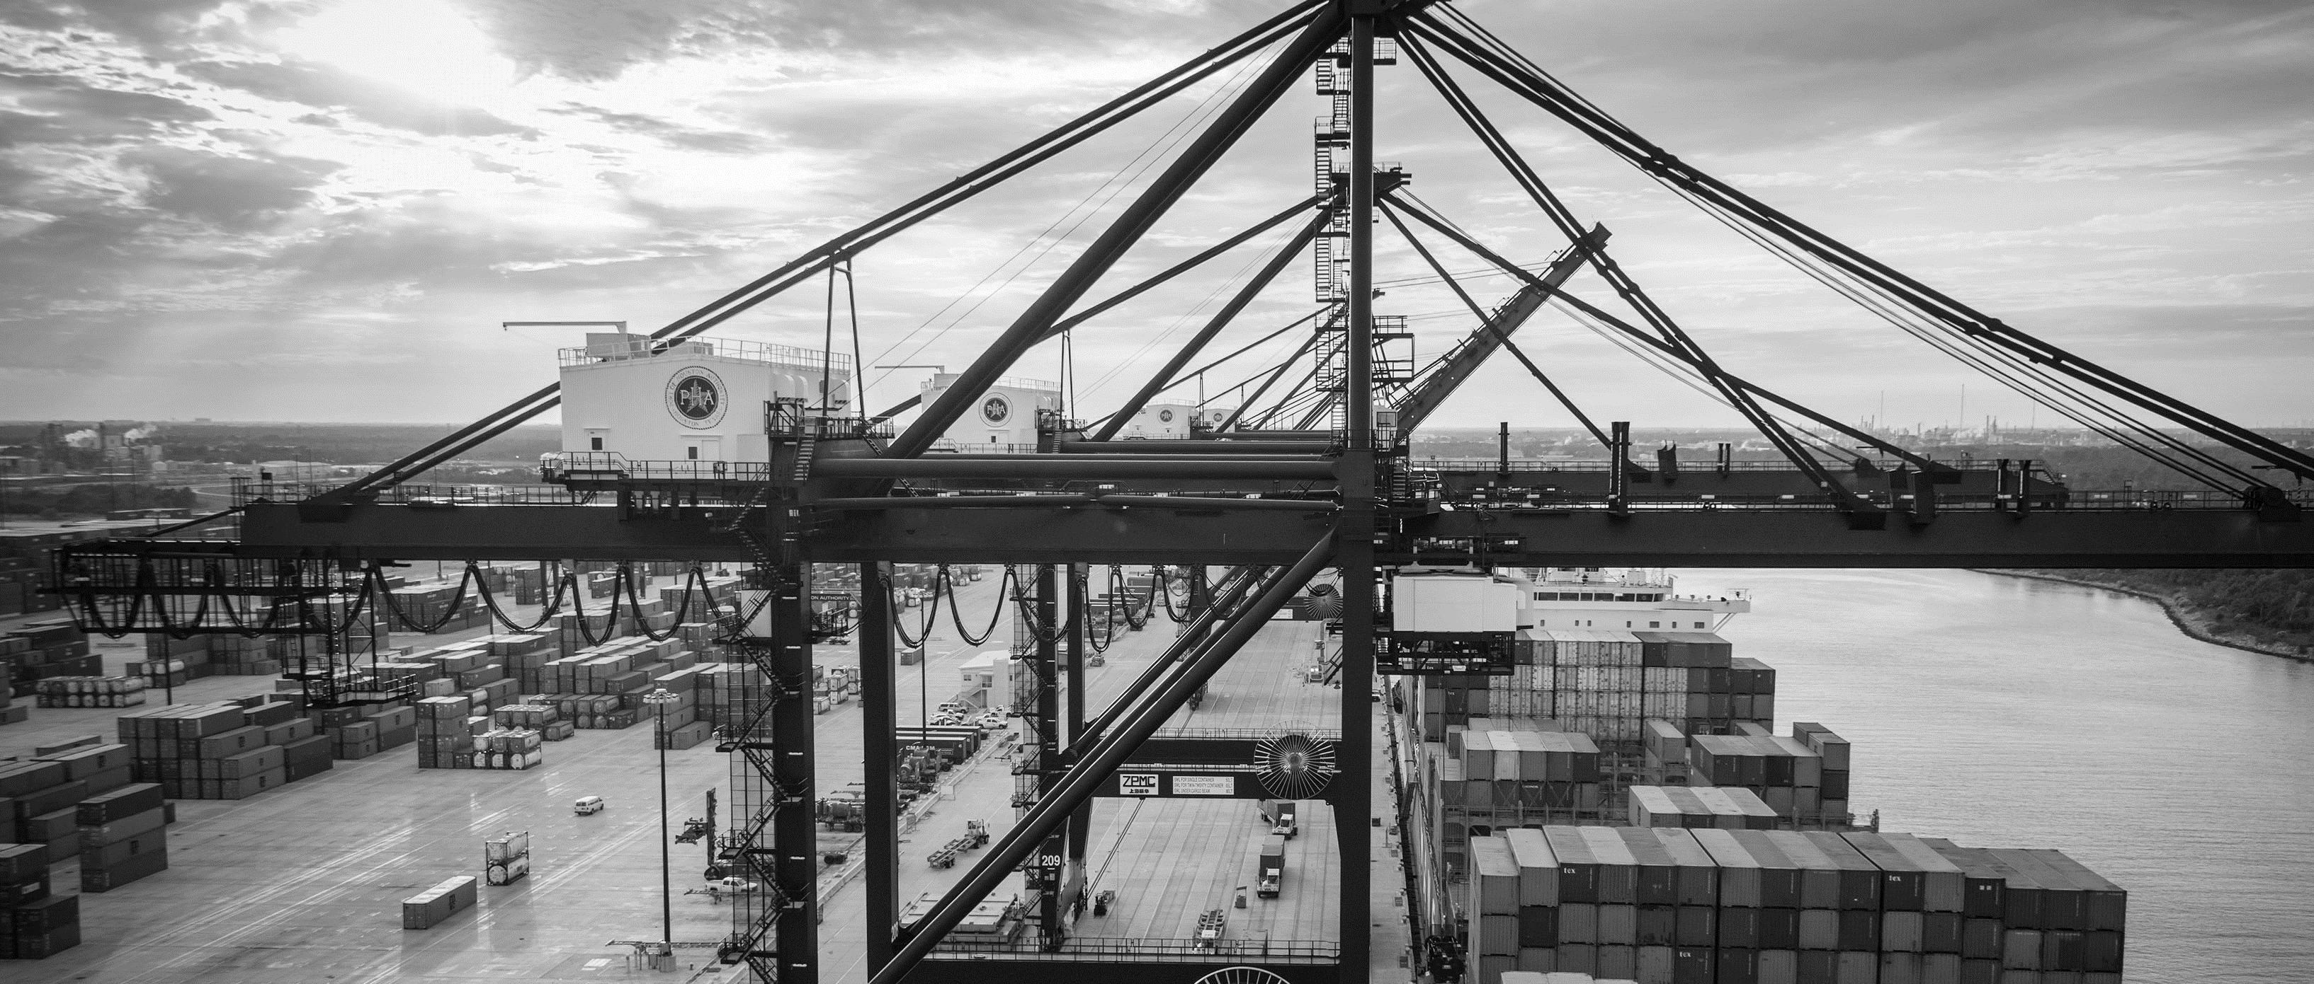
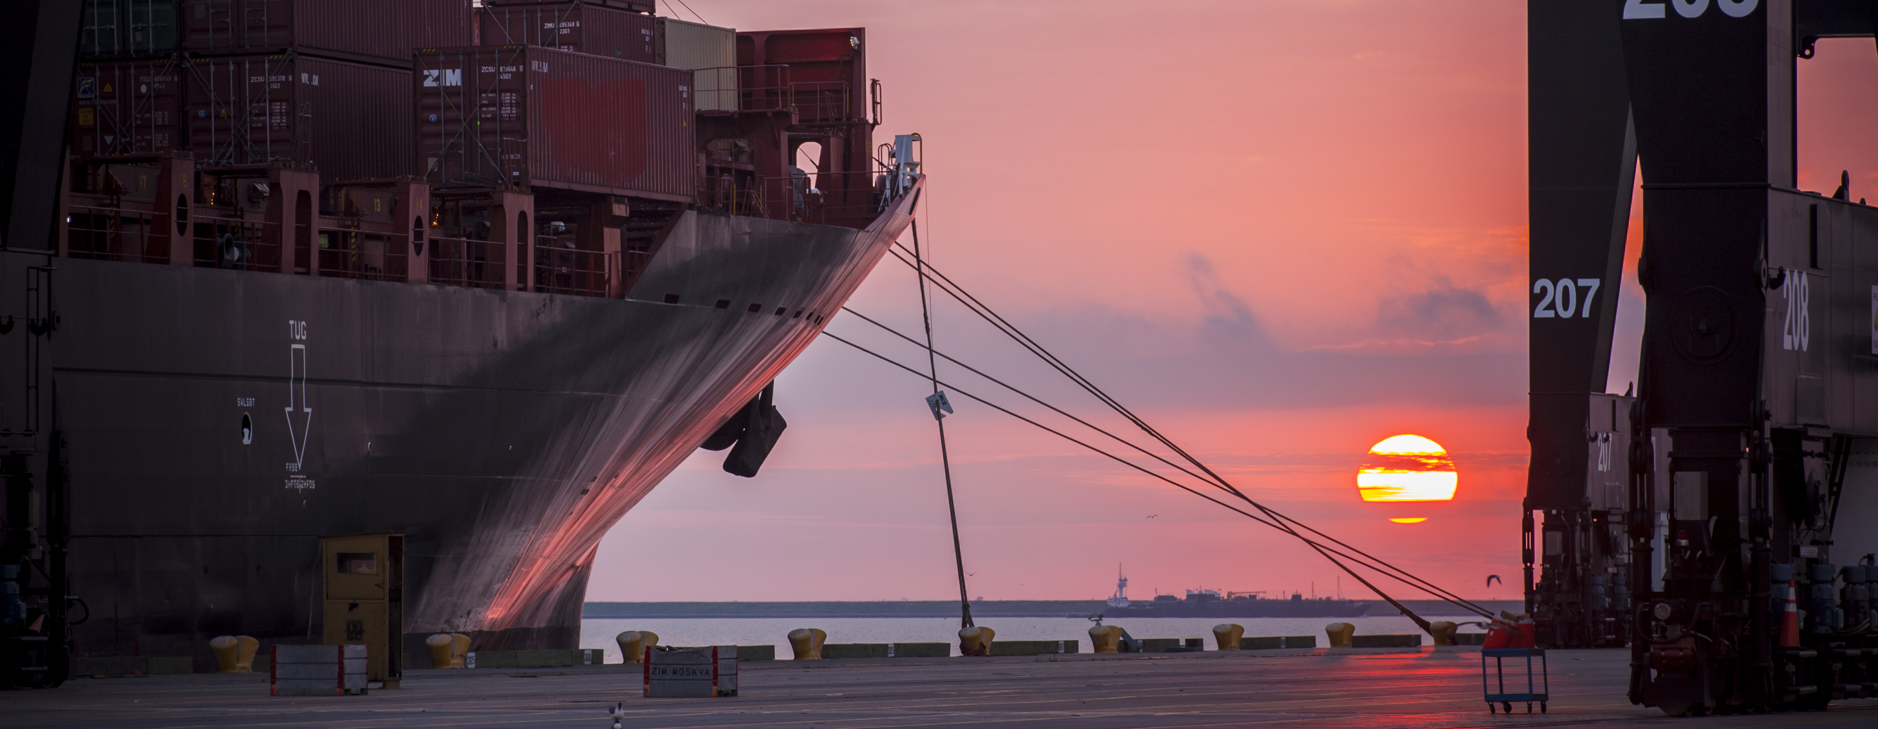
CSP 2026 - New Fender System at Wharf 1 –Turning Basin Terminal
Eddy Kharrazi, P.E. | Project Manager | Project & Construction Management (PCM)

Slide 17
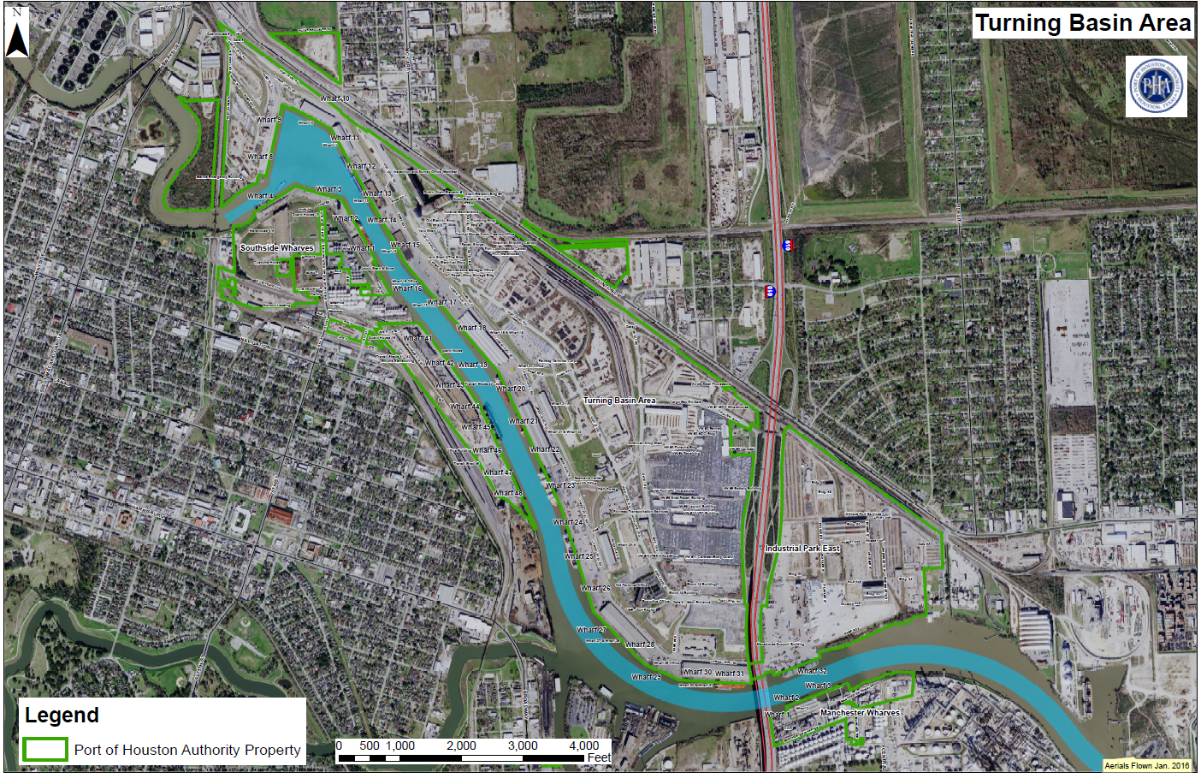
CSP 2026 – New Fender System at Wharf 1 - TURNING BASIN TERMINAL
EOB

Slide 18
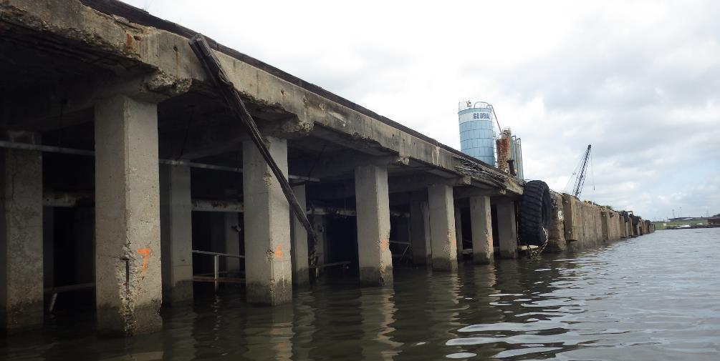
CSP 2026 New Fender System at Wharf 1
TURNING BASIN TERMINAL

Slide 19
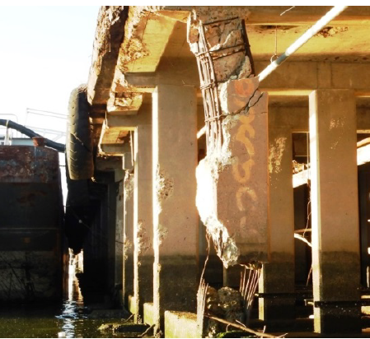
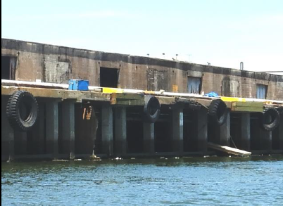
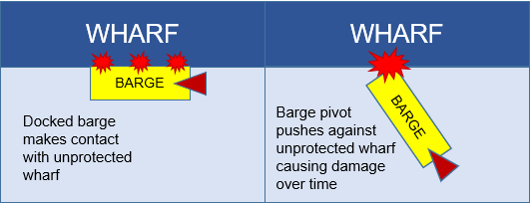
CSP 2026 New Fender System at Wharf 1
TURNING BASIN TERMINAL
Wharf 1 is part of the southside wharves at the Turning Basin
Tenants using the wharf include Jacob Stern and BWC (Contanda)
Current wharf fender system is composed of rubber tires hanging off of the dock face with timber fascia sitting behind the tire.
This system is not adequate to protect the underside of the wharf from damage resulting from tugboats pivoting barges against the structure
A proper fender is necessary to protect the wharf from oceangoing vessels and barges

Slide 20
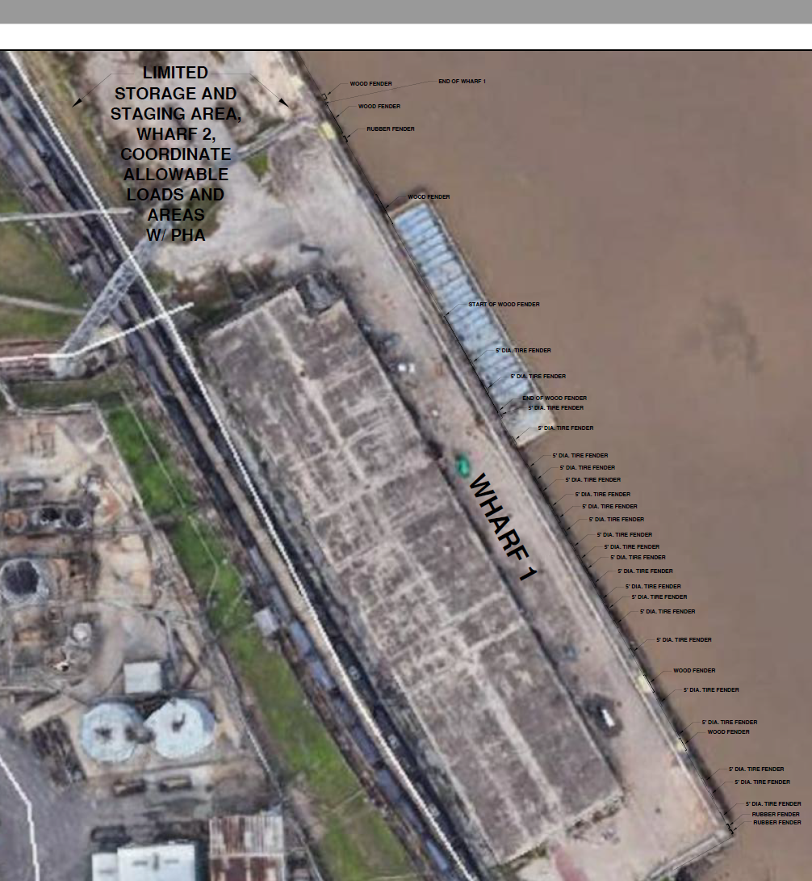
CSP 2026
New Fender System at Wharf 1
TURNING BASIN TERMINAL

Slide 21
CSP 2026 New Fender System at Wharf 1 TURNING BASIN TERMINAL
10” Flat Slab Concrete Deck - Alt “B”
Concrete Columns – Plan 2
Channel side
Concrete Pile Cap – Plan 2
38’
Timber Piles (ca 1959)
43’
52’
47’
1959 Construction used Plan 2 (concrete) columns with Alt “B” (Flat slab)

Slide 22
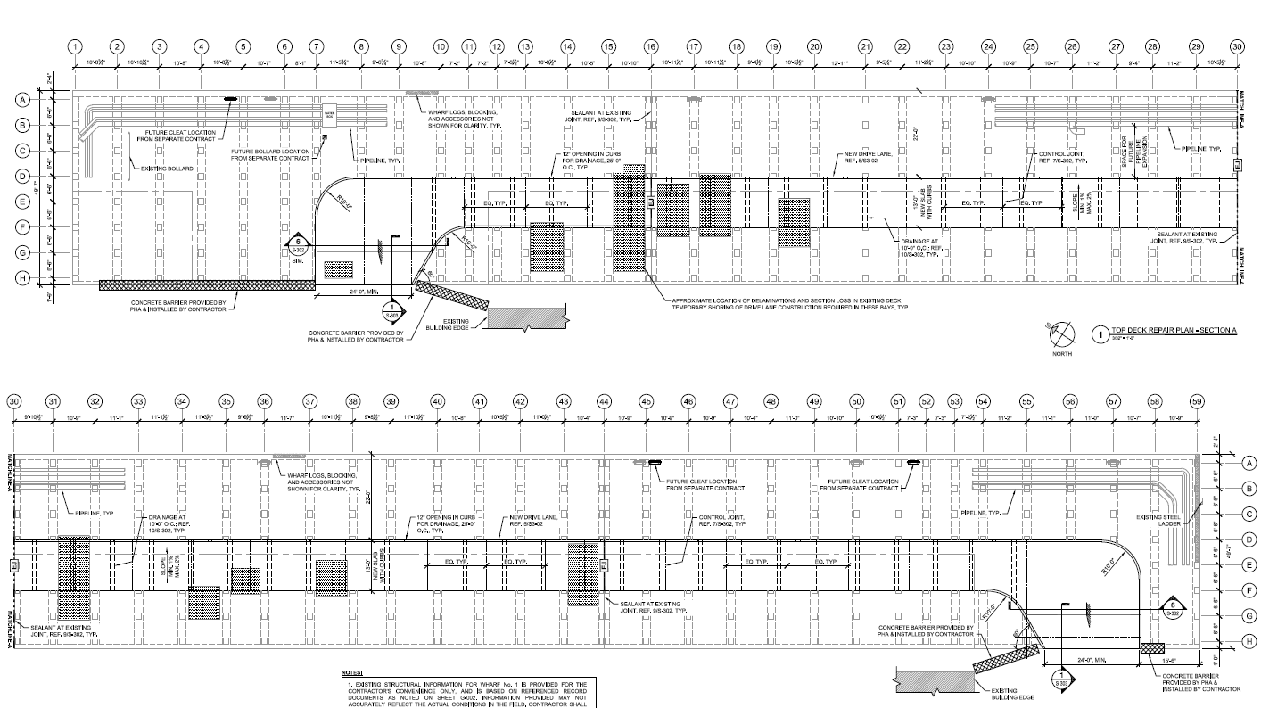
CSP 2026 New Fender System at Wharf 1
TURNING BASIN TERMINAL

Slide 23
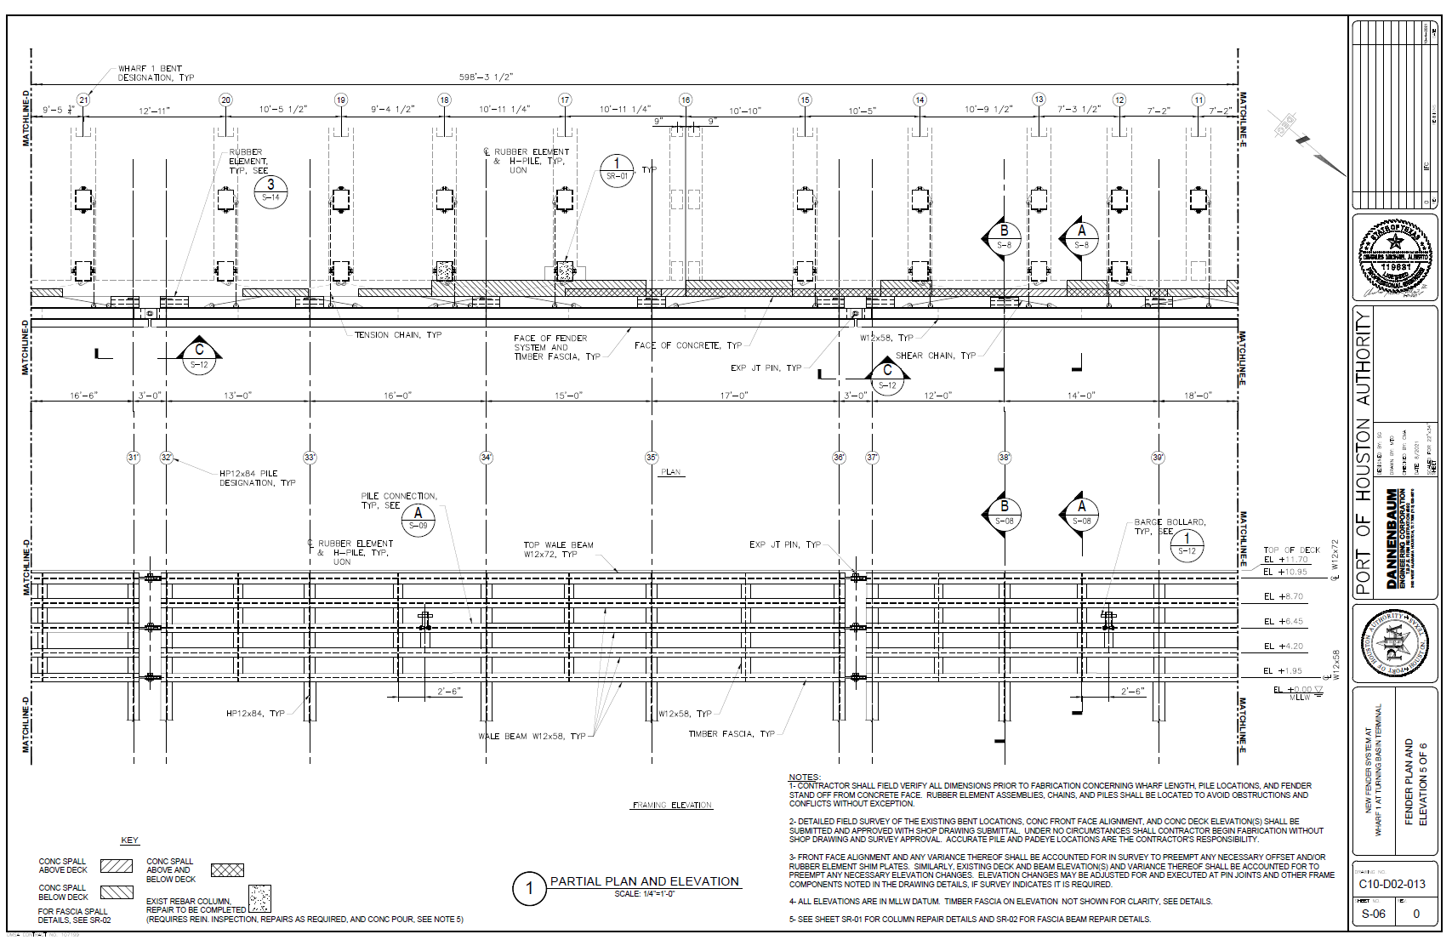
CSP 2026 New Fender System at Wharf 1
TURNING BASIN TERMINAL

Slide 24
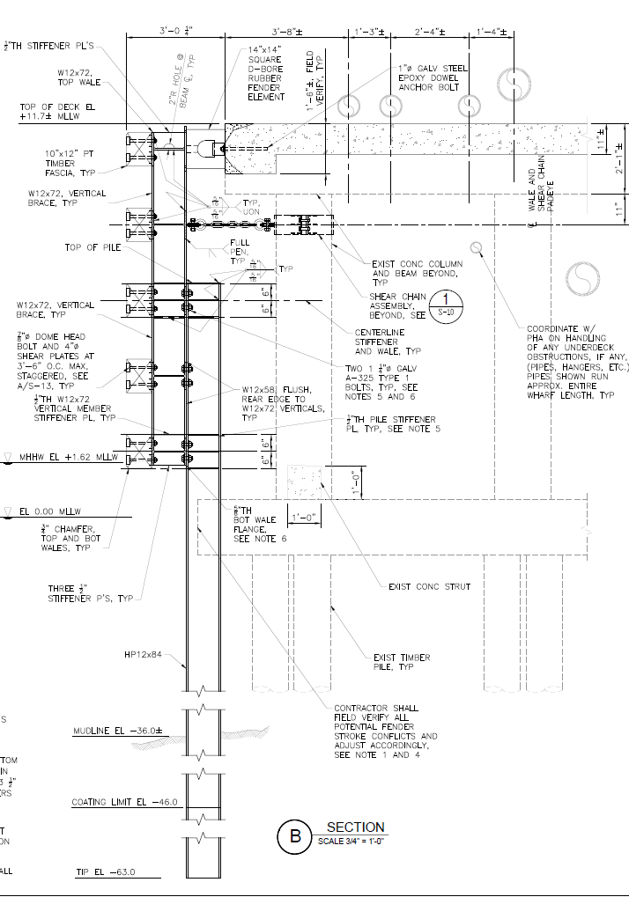
CSP 2026 New Fender System at Wharf 1
TURNING BASIN TERMINAL

Slide 25
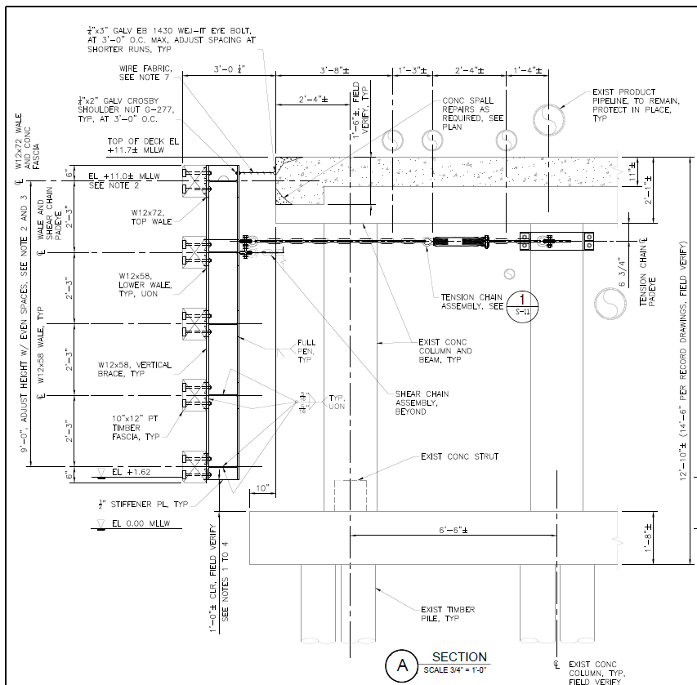
CSP 2026 New Fender System at Wharf 1
TURNING BASIN TERMINAL

Slide 26
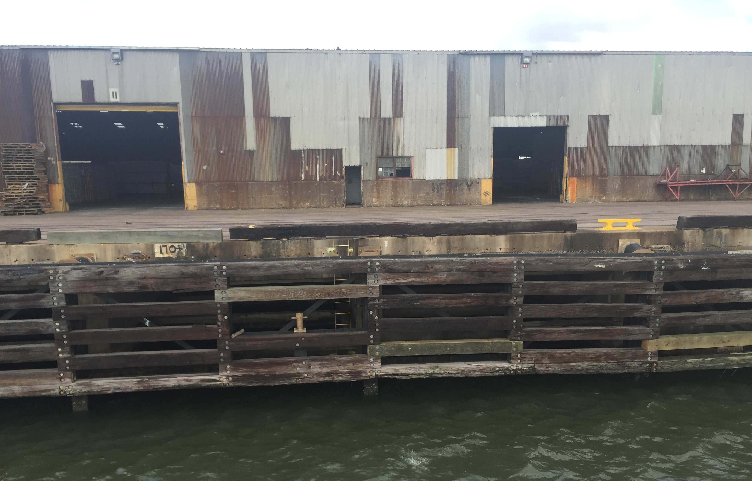
CSP 2026 New Fender System at Wharf 1
TURNING BASIN TERMINAL

Slide 27
CSP 2026 New Fender System at Wharf 1
TURNING BASIN TERMINAL
MINIMUM INSURANCE REQUIREMENTS
Kind of Insurance | Limits of Liability
Workers’ Compensation Insurance Employers Liability Coverage Coverage shall be endorsed as follows: Longshore and Harbor Workers’ Compensation Act (If exposure exists) Jones Act (If exposure exists) | Statutory $1,000,000 Per Accident $1,000,000 Per Accident for Disease
B. Commercial General Liability Coverage including but not limited to: Premises and operations Products and completed operations. Personal and Bodily injury liability Contractual Liability Independent Contractors Explosion, collapse and underground Sudden and Accidental Pollution Liability Coverage. | $2,000,000 General Aggregate $1,000,000 Per Occurrence
Business Automobile Liability including all owned, non-owned and hired automobiles. | $1,000,000 Per Occurrence
Protection and Indemnity Insurance, including collision liability coverage, on all vessels utilized on the project. | $1,000,000 Per Occurrence
Environmental Impairment Liability (If exposure exists) | $5,000,000 Per Occurrence
Umbrella Liability Coverage | $5,000,000 Per Occurrence in excess of limits of coverages in (B), (C) and (E) above.

Slide 28
THANK YOU
Eddy Kharrazi, P.E.
Project Manager
Port Houston
Questions?
www.PortHouston.com
111 East Loop North
Houston, TX 77029

