Slide 1
Pre-Proposal Conference Meeting Replacement of Electrical Infrastructure from Transformer B to Administration Building Switchboard at Bayport Terminal December 14, 2020
Port Houston:
Notes:
Welcome, thank you for being here today.
Introduce yourself

Slide 2
PORT OF HOUSTON
Pre-Proposal Conference Meeting
for Replacement of Electrical Infrastructure from Transformer B to Administration Building Switchboard at Bayport Terminal
December 17, 2020
AGENDA
Introduction Hugh Moore
Procurement Tanika Chukwumerije
Scope Overview Hugh Moore
Questions Panelist

Slide 3
Pre-Proposal Conference Meeting House Rules
Attendees will begin the meeting in listen-only mode.
There will be a Q&A session at the end of today’s presentation.
If you have any questions during the presentation, you may submit your questions through the WebEx chat addressed to all participants and they will be answered at the end of the presentation.
This presentation will be uploaded to the BuySpeed homepage under the “Pre-Bid/Pre-Proposal Conference Information” link.

Slide 4
Procurement Services
Port Houston:
Notes:
Welcome, thank you for being here today.
Introduce yourself

Slide 5
PROCUREMENT
No Contact Period-No communication between interested vendors and PHA staff upon solicitation release until award
Technical questions should be submitted via BuySpeed
Last day to submit questions- 7 days before due date
Responses are due no later than 11 a.m. on 1/20/2021
Proposals must be submitted electronically via email to: procurementproposals@porthouston.com
Anticipated award date: 2/23/2021
Addenda will be posted via BuySpeed
Use the forms in the solicitation package

Slide 6
PROCUREMENT (continued)
Evaluation Criteria
The Port Commission will award the contract to the Respondent whose Response provides the best value in consideration of the evaluation factors set forth below.
Price
Vendor Reputation, Quality of Services, Safety/Env. Record
Benefit to PHA
Overall Compliance w/PHA Policies
Local Business Participation
Notes:
Vendor reputation-Resumes of key personnel must be submitted w/response

Slide 7
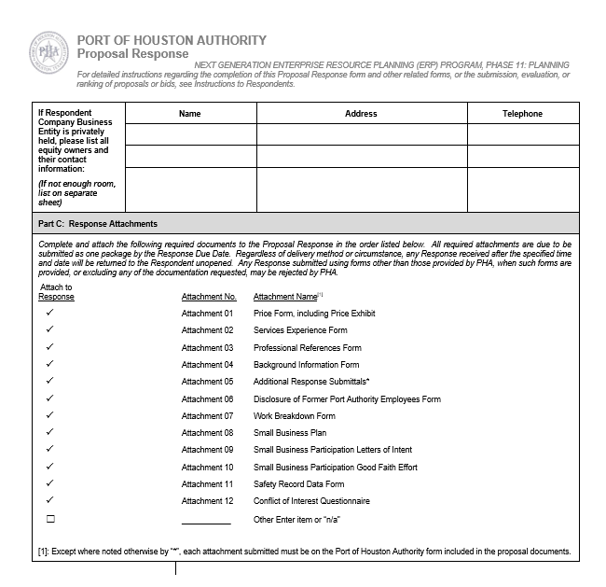
PROCUREMENT (continued)
Proposal Response form
(Page 30 of 315)
Page 2 – Required Attachments

Slide 8
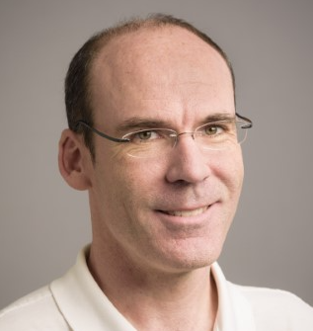
BAYPORT MAINTENANCE
Port Houston:
Hugh Moore
Manager, Bayport Maintenance
Notes:
Welcome, thank you for being here today.
Introduce yourself

Slide 9
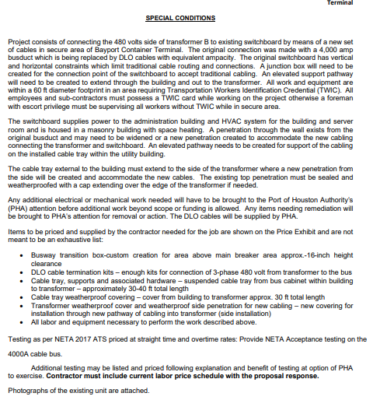
SCOPE OVERVIEW

Slide 10
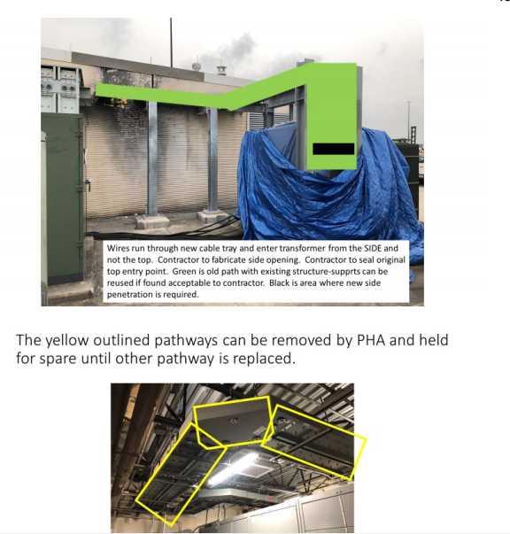
SCOPE OVERVIEW

Slide 11
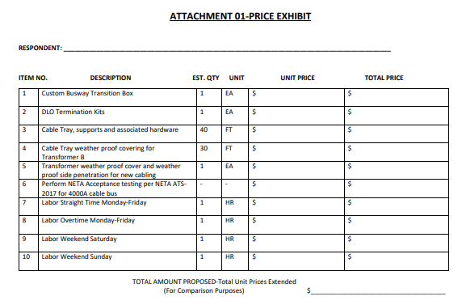
SCOPE OVERVIEW

Slide 12
Replacement of Electrical Infrastructure from Transformer B to Administration Building Switchboard at Bayport Terminal
Questions & Answers
POST QUESTIONS IN THE CHAT

Slide 13
Thank You
Port Houston:

