Slide 1
Repair and Rehabilitation of Wharf No. 9 at Turning Basin
Derek L. Garrett | Project Manager | Project & Construction Management (PCM)

Slide 2
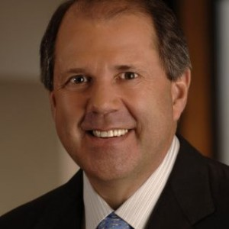
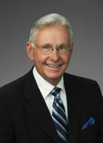
Port Commission
Dean E. Corgey
Clyde Fitzgerald
Theldon R. Branch, III
Rick Campos
Chairman
Stephen H. DonCarlos
Roy D. Mease
Wendy Montoya
Cloonan
WELCOME MESSAGE | 2

Slide 3
CSP – Repair and Rehabilitation of Wharf No. 9
AGENDA
Introductions
Harris County
Small Business
Procurement Services
Selection Criteria
Scope of Work
Questions
Site Visit

Slide 4
CSP – Repair and Rehabilitation of Wharf No. 9
PHA Personnel:
Roger H. Hoh, P.E. – Director, PCM
Oscar Zavala P.E. – Construction Manager
Derek L. Garrett – Project Manager
Randy Stiefel – Director, General Cargo Facilities
Yvette Camel-Smith – Director, Procurement Services
Pedro Gonzalez, P.E. – Small Business Manager
Harris County:
Robert Rocha – Wage Rate Monitor

Slide 5
CSP – Repair and Rehabilitation of Wharf No. 9
Harris County Wage Rate Compliance & Requirements:
Attendance at pre-bid/proposal meetings and pre-construction meetings
Review and approve weekly certified payroll records
Monitor wage rate compliance
Review claims of non-compliance from the field and recommend appreciate responses as required or permitted under the Wage Scale Act

Slide 6
Rehabilitation and Repair of Wharf No. 9 at Turning Basin Terminal
Small Business Requirement:
Participation Requirement: Small Business Requirement for this Project = 15% of the Purchase Price.
Bidder who fail to meet the minimum 15% requirement will be considered non-responsive and will not be evaluated

Slide 7
CSP – Repair and Rehabilitation of Wharf No. 9
Procurement:
Competitive Sealed Proposals (CSP) are due on January 22, 2020, no later than 11:00 A.M.
One original and five copies, packaged in one sealed envelope
All proposals will be opened and read publicly in the PHA first floor conference room by Procurement Services on Wednesday, January 22, 2020 at 11:30 A.M.

Slide 8
Rehabilitation and Repair of Wharf No. 9 at Turning Basin Terminal
Selection Criteria
The Port Commission will award the contract after a thorough analysis of proposals submitted based on the published selection criteria.
Small Business Participation: Required Level (Minimum) 15
Vendors who meet the above minimum threshold will be evaluated accordingly:
Purchase Price: 45
Vendor’s Reputation, Quality of Services and/or Product, Safety Record: 40
Overall Compliance w/PHA Policies and Instructions: 12
Local Certified Business: 3
TOTAL 100

Slide 9
CSP – Repair and Rehabilitation of Wharf No. 9
Competitive Sealed Proposal Response:
Page 2 – Required Attachments

Slide 10
CSP – Repair and Rehabilitation of Wharf No. 9
General Scope of Services:
Patch and repair of paving
Replace failed backland paving
Replace fender system
Backland steel pile driving
Soil nail retrofit
Contract Time = 240 Days

Slide 11
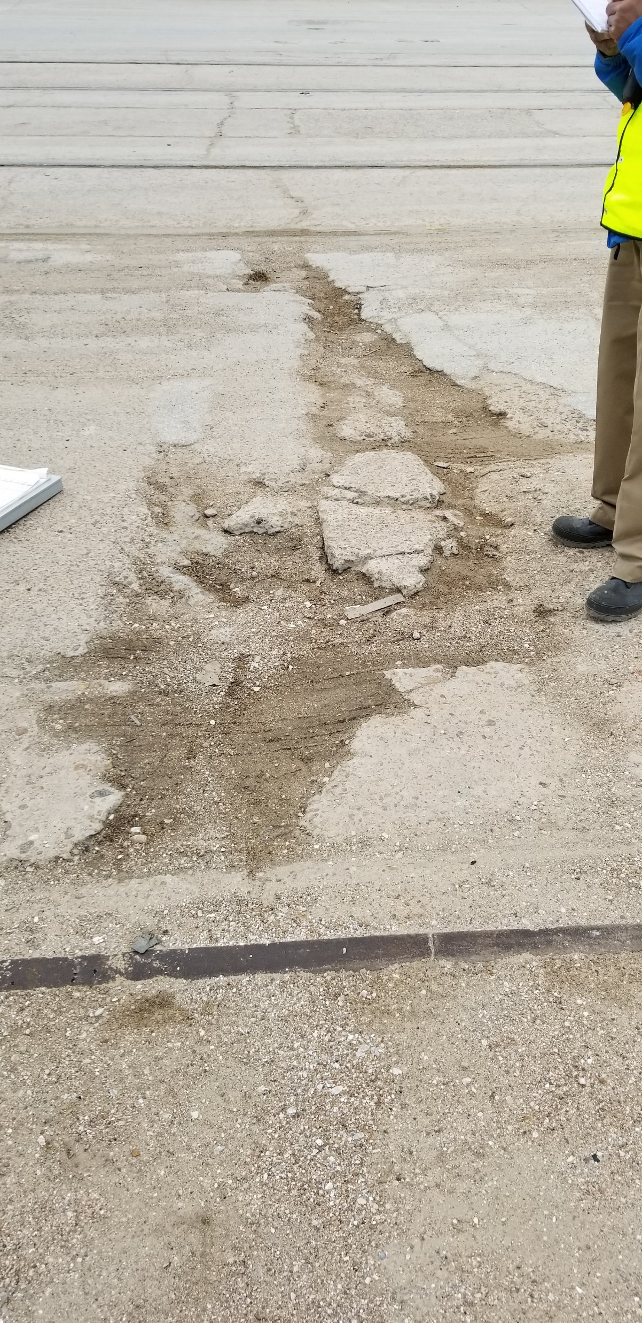
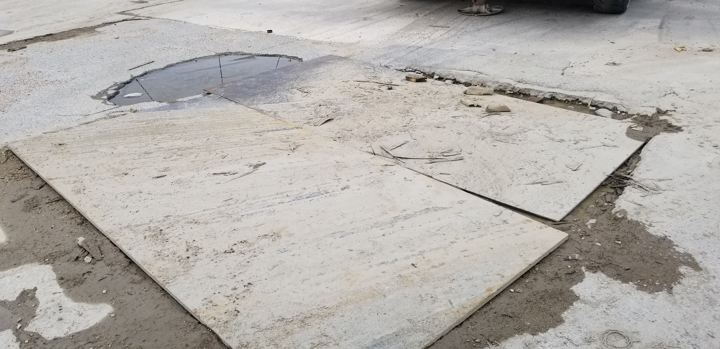
CSP – Repair and Rehabilitation of Wharf No. 9

Slide 12
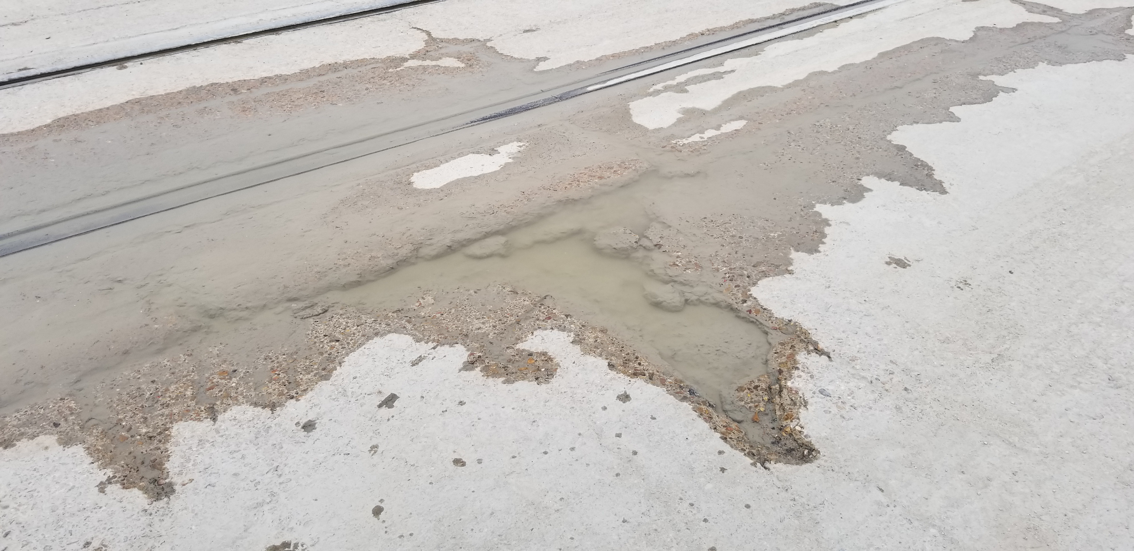
CSP – Repair and Rehabilitation of Wharf No. 9

Slide 13
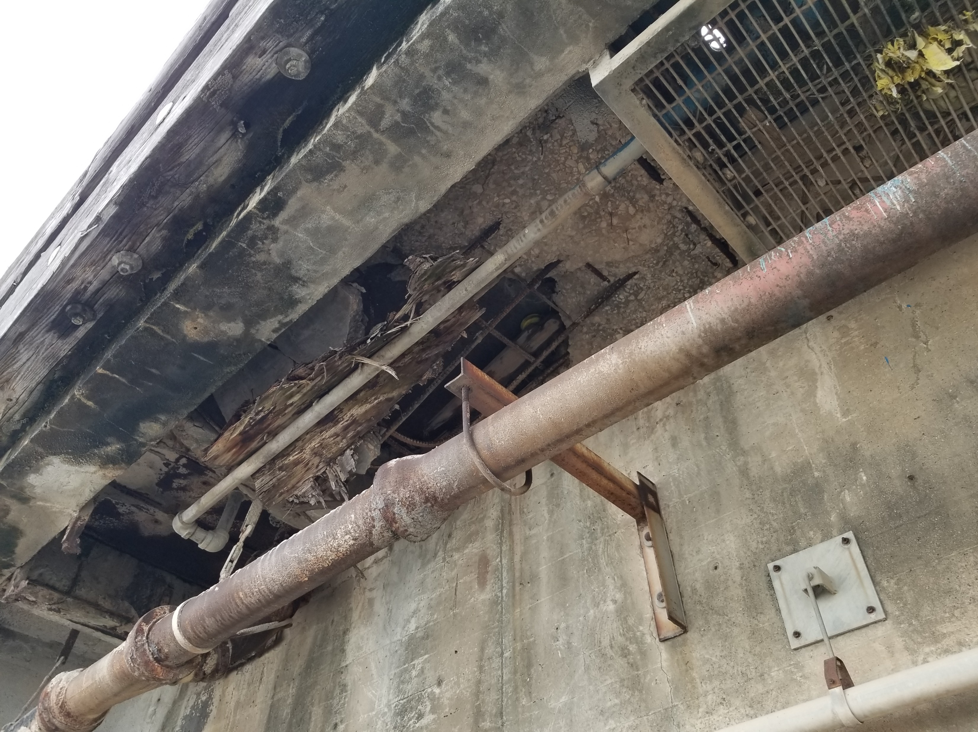
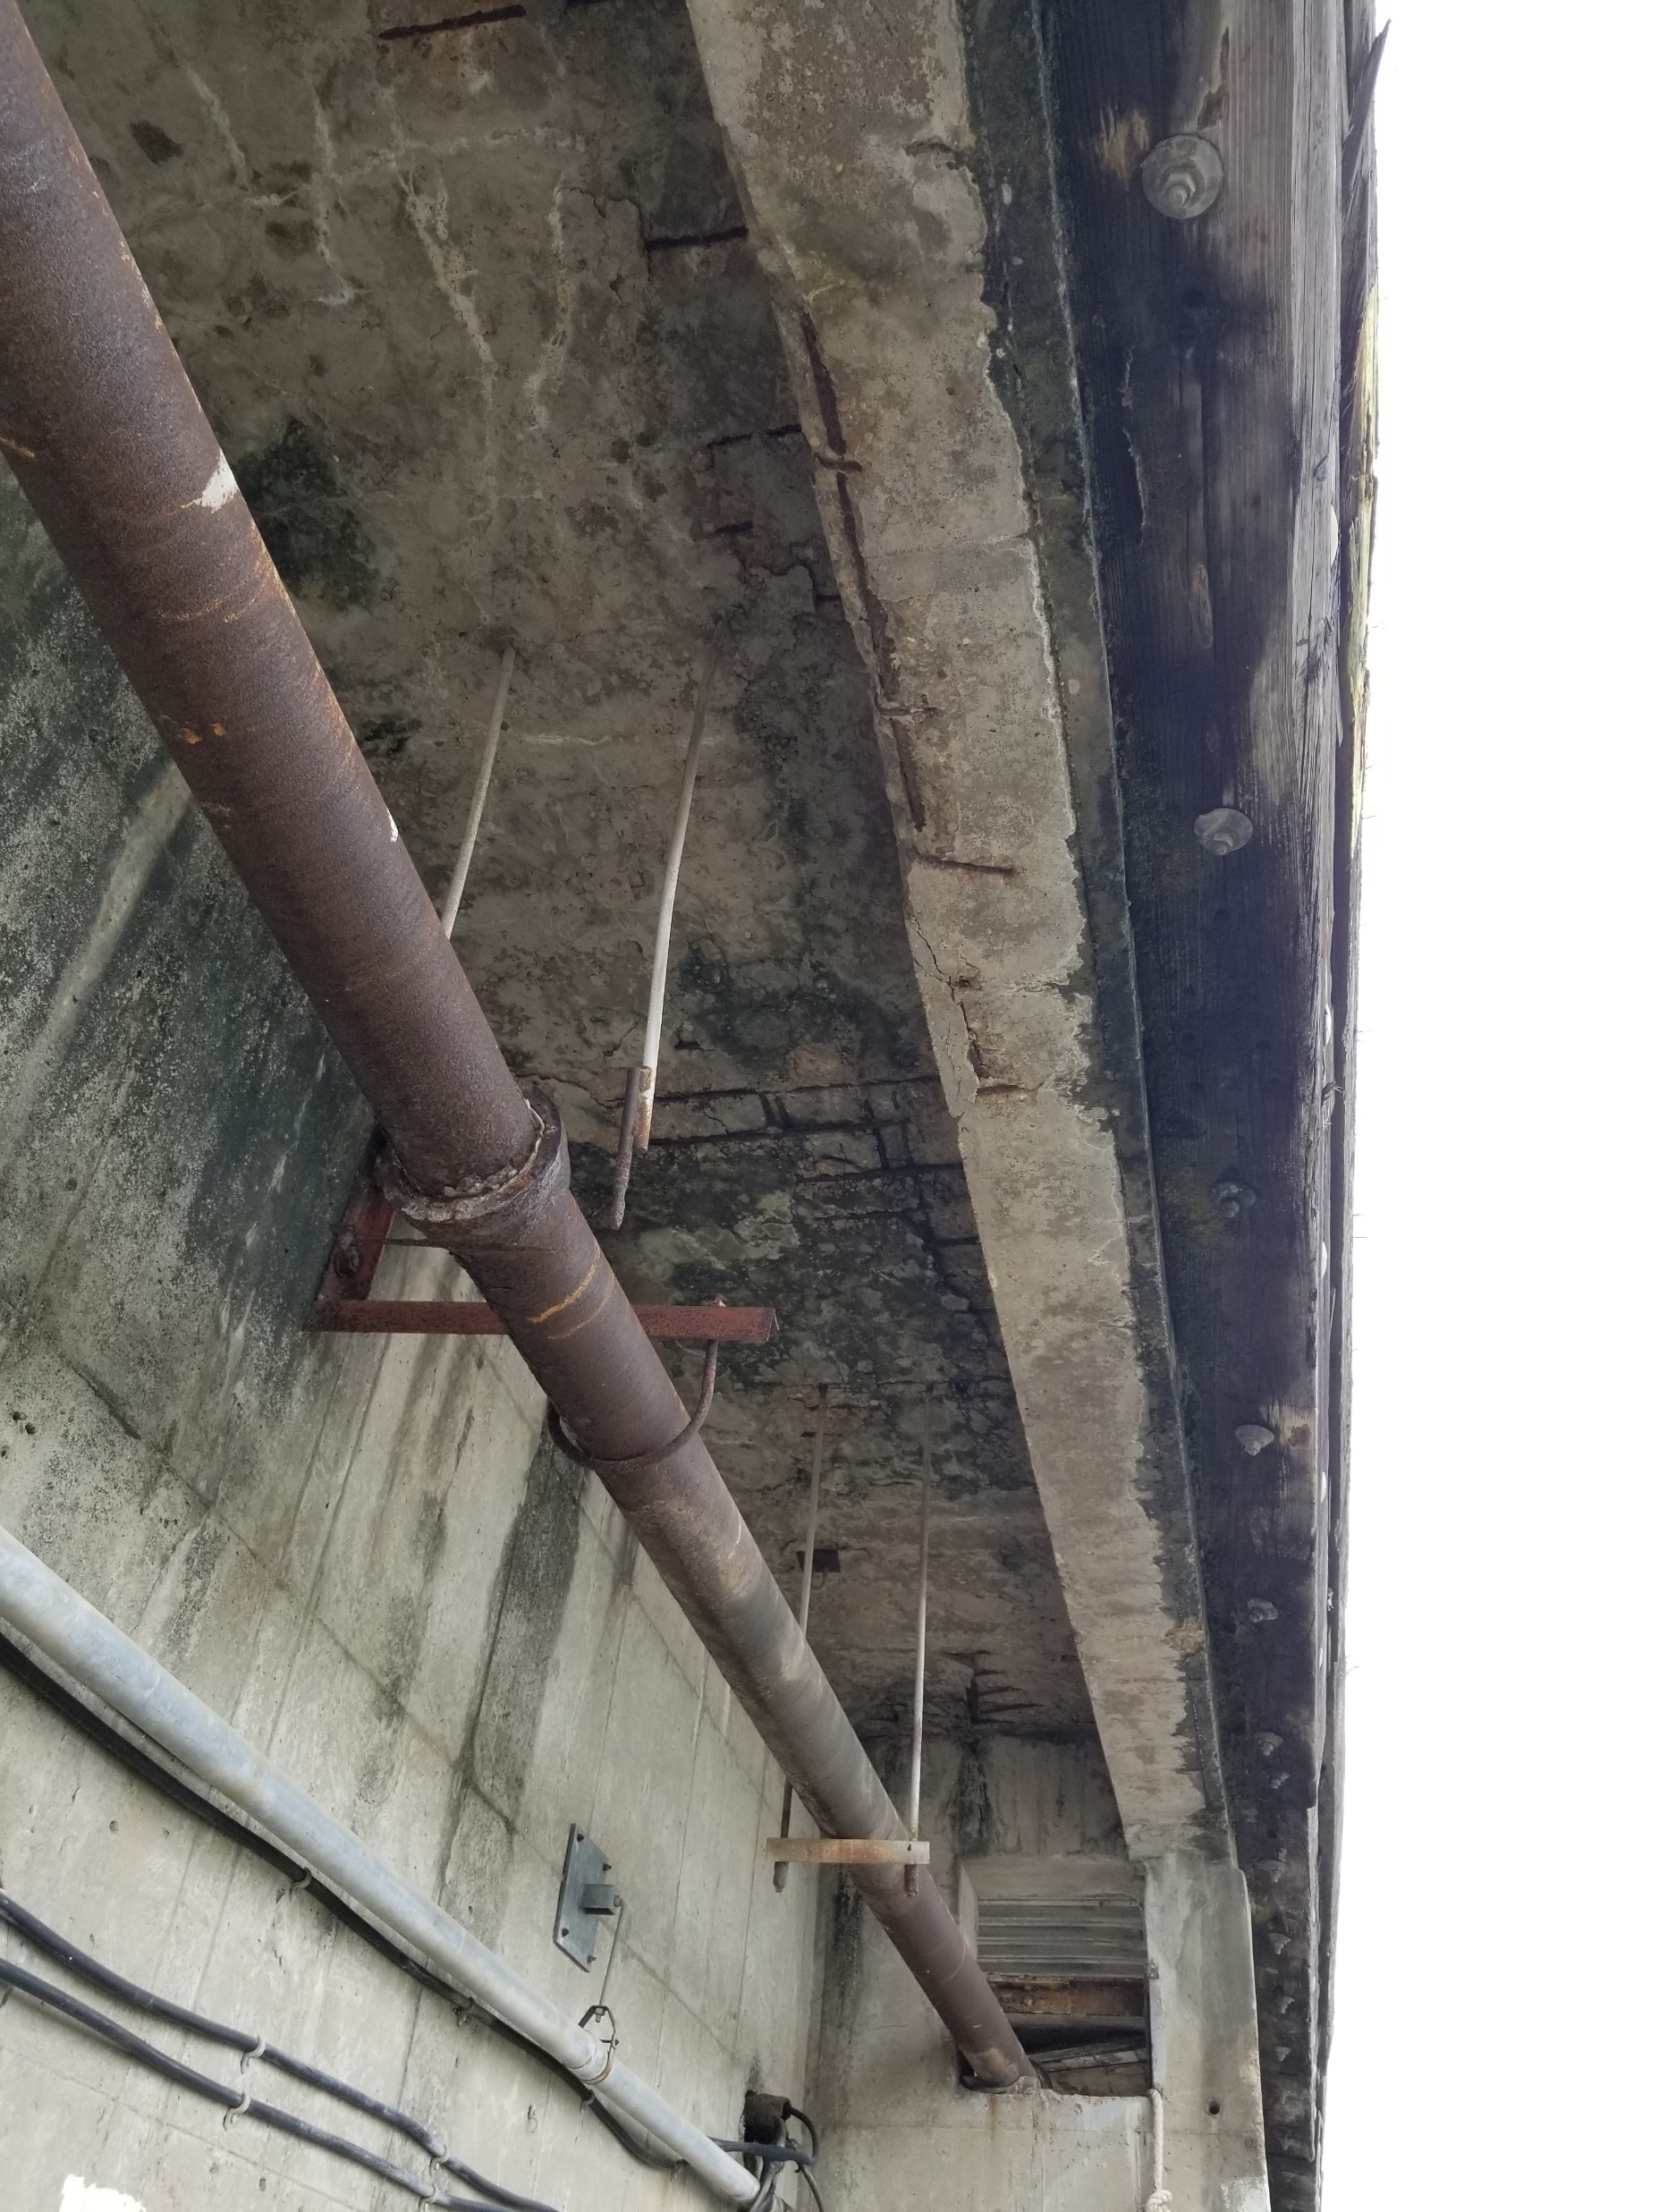
CSP – Repair and Rehabilitation of Wharf No. 9

Slide 14
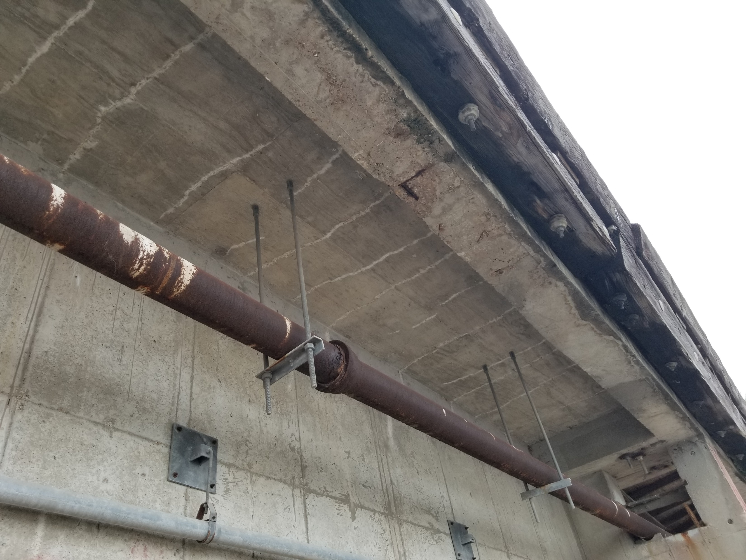
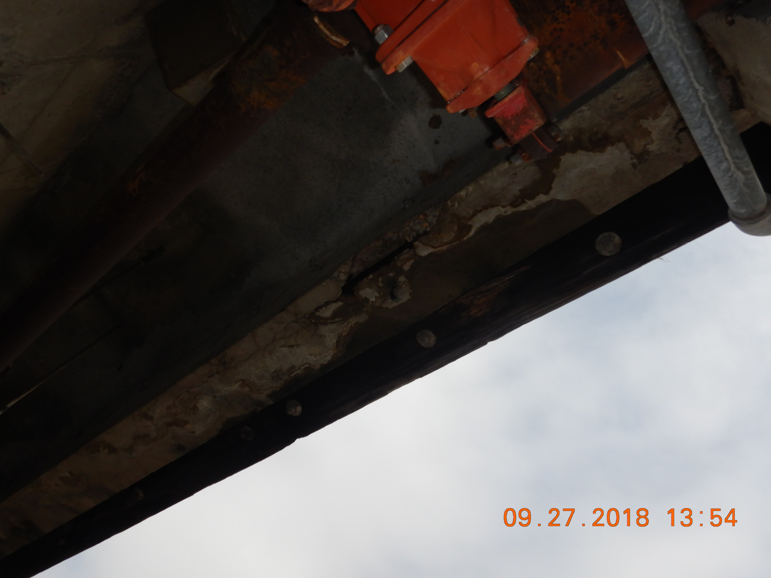
CSP – Repair and Rehabilitation of Wharf No. 9

Slide 15
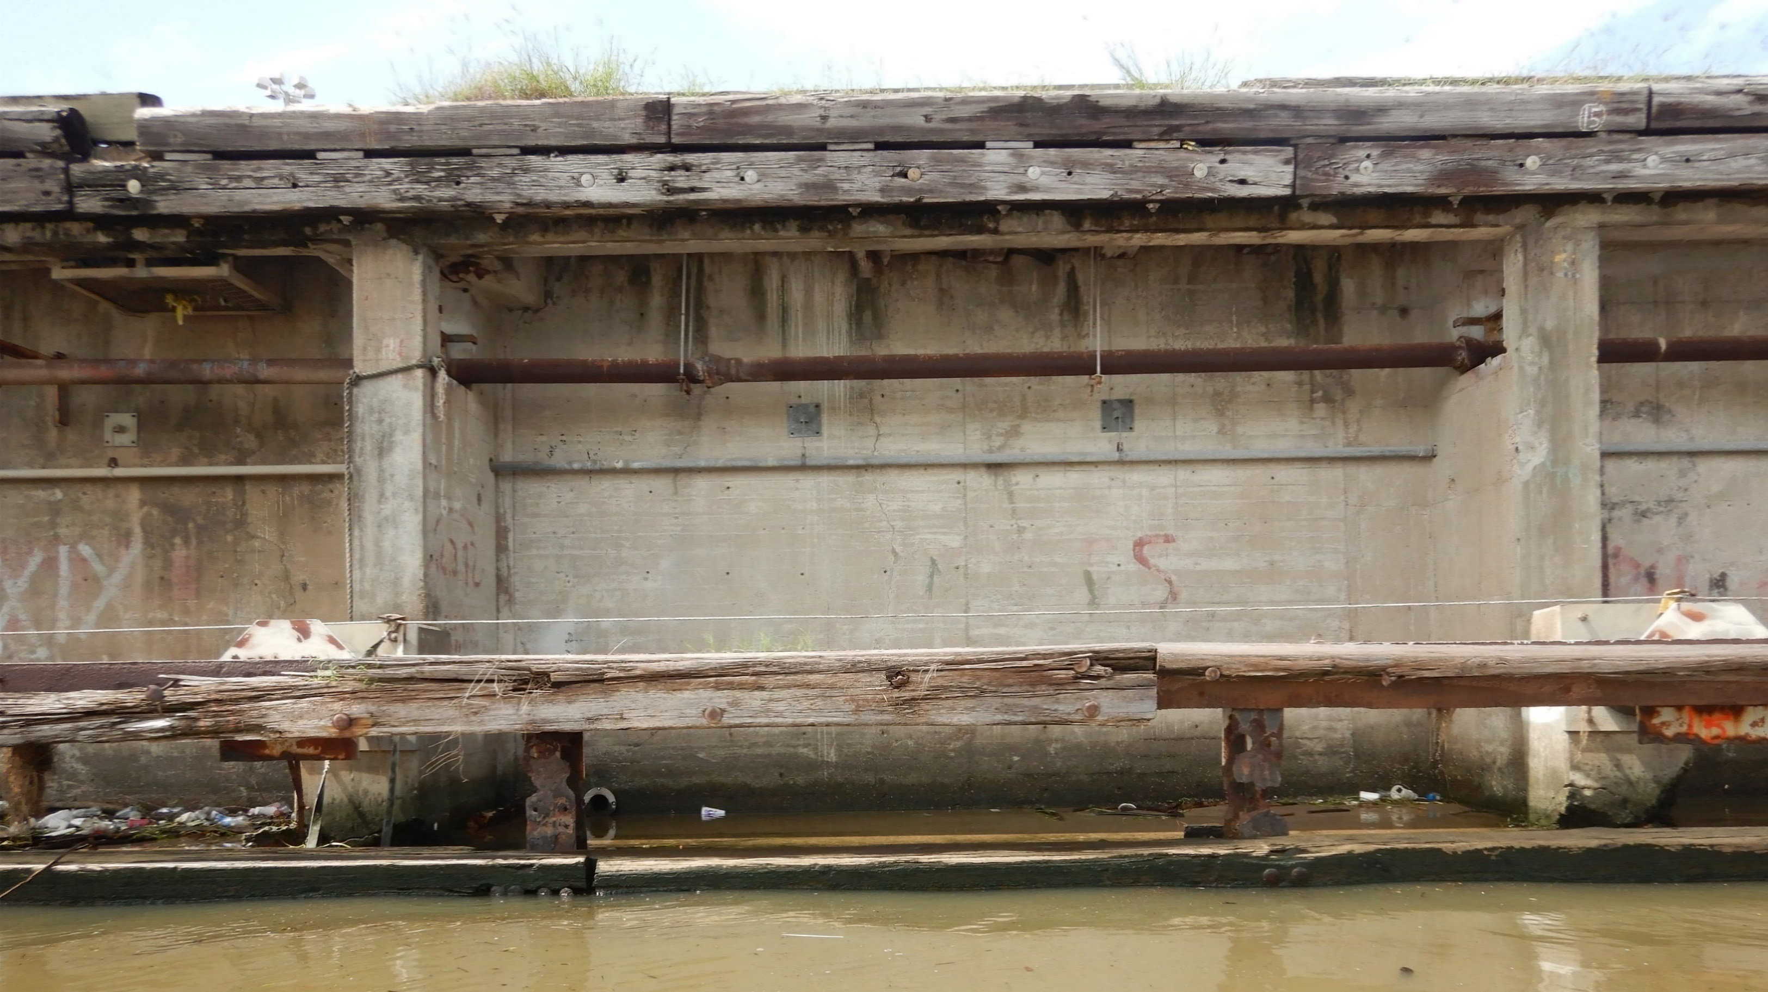
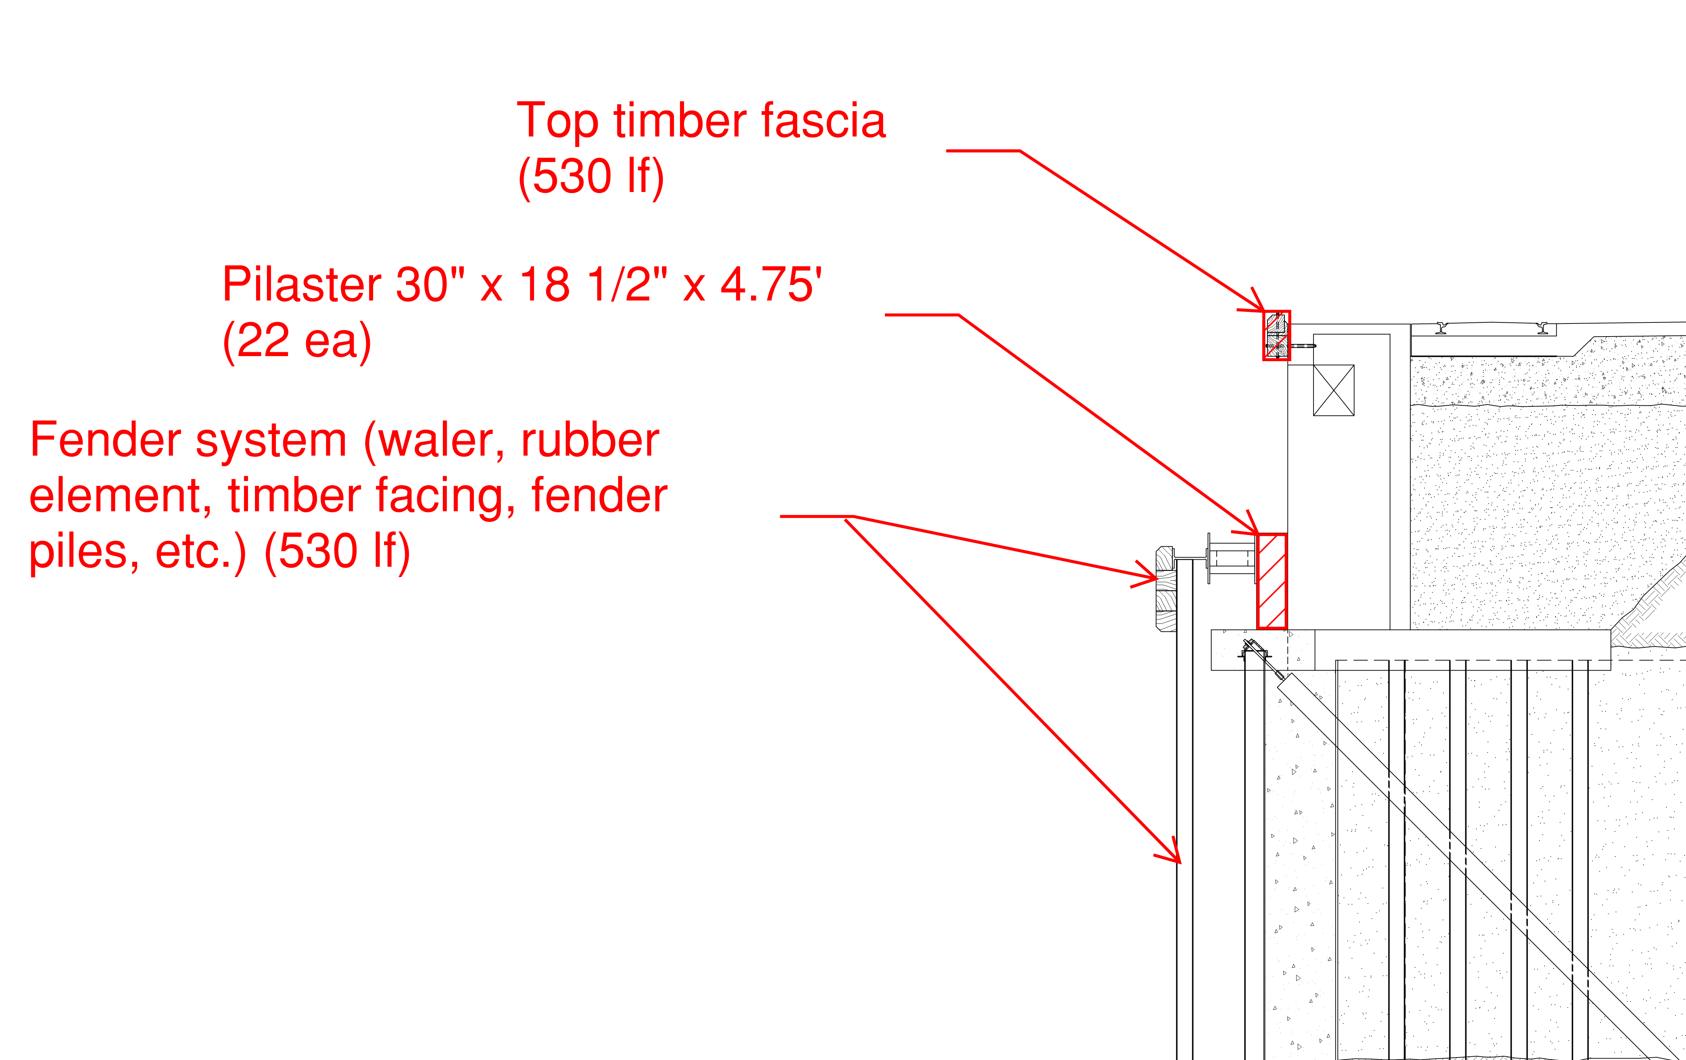
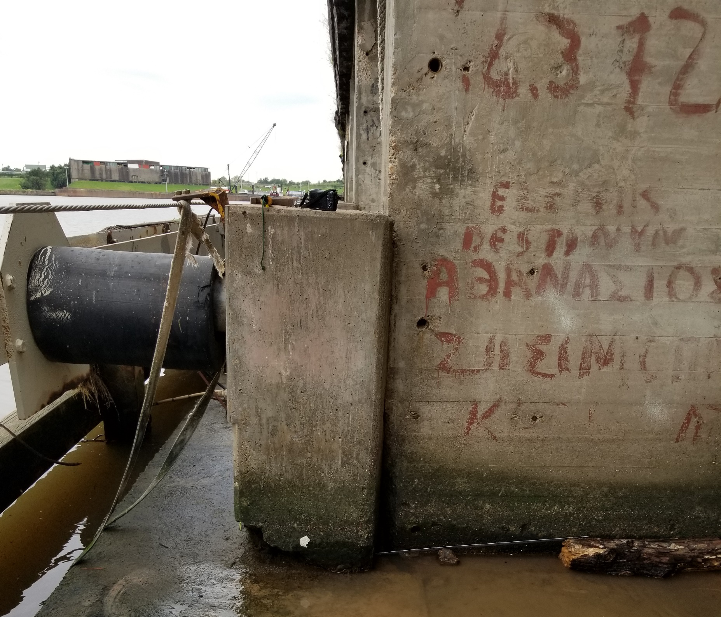
CSP – Repair and Rehabilitation of Wharf No. 9
Demolition

Slide 16
THANK YOU
Derek Garrett
Project Manager
Port Houston
Questions?
www.PortHouston.com
111 East Loop North
Houston, TX 77029

