Slide 1

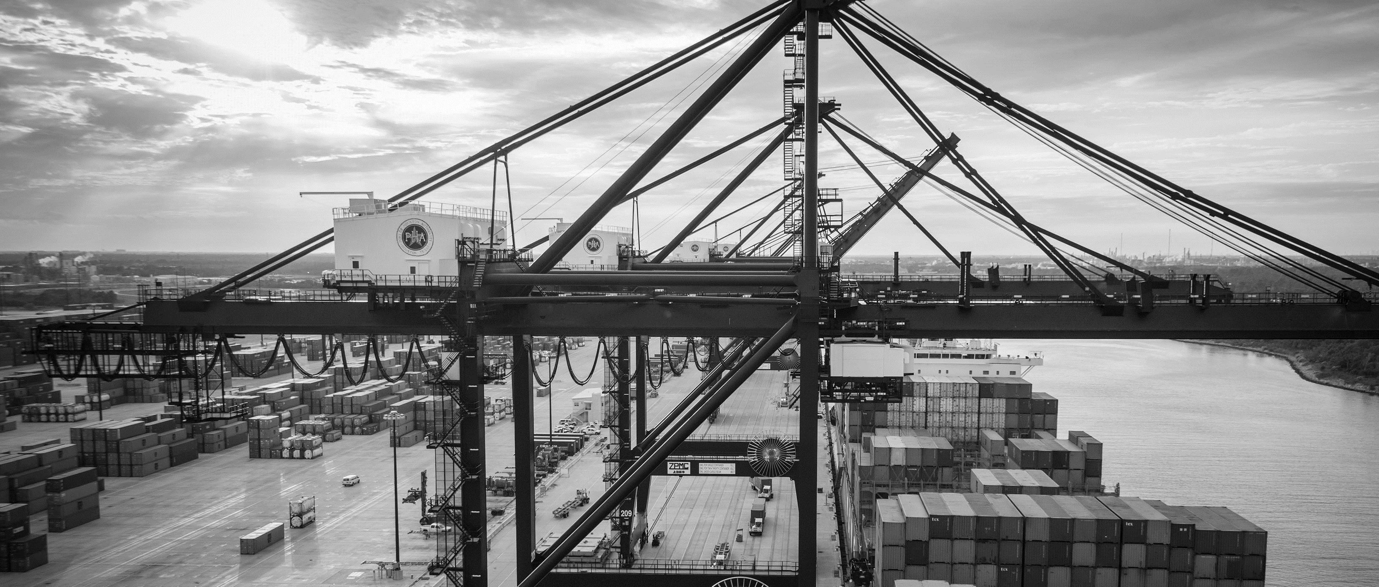
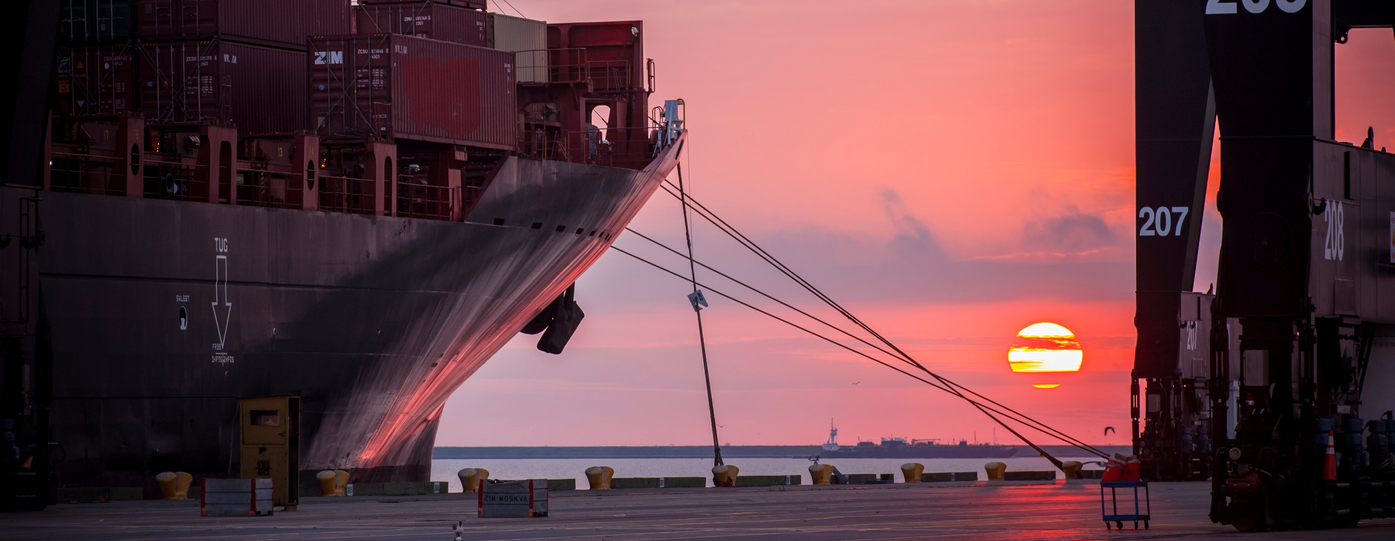
CSB 808 - Wharf 11/12 Collision Repair at Turning Basin Terminal – DC 1170
Eddy Kharrazi, P.E. | Project Manager | Project & Construction Management (PCM)

Slide 2
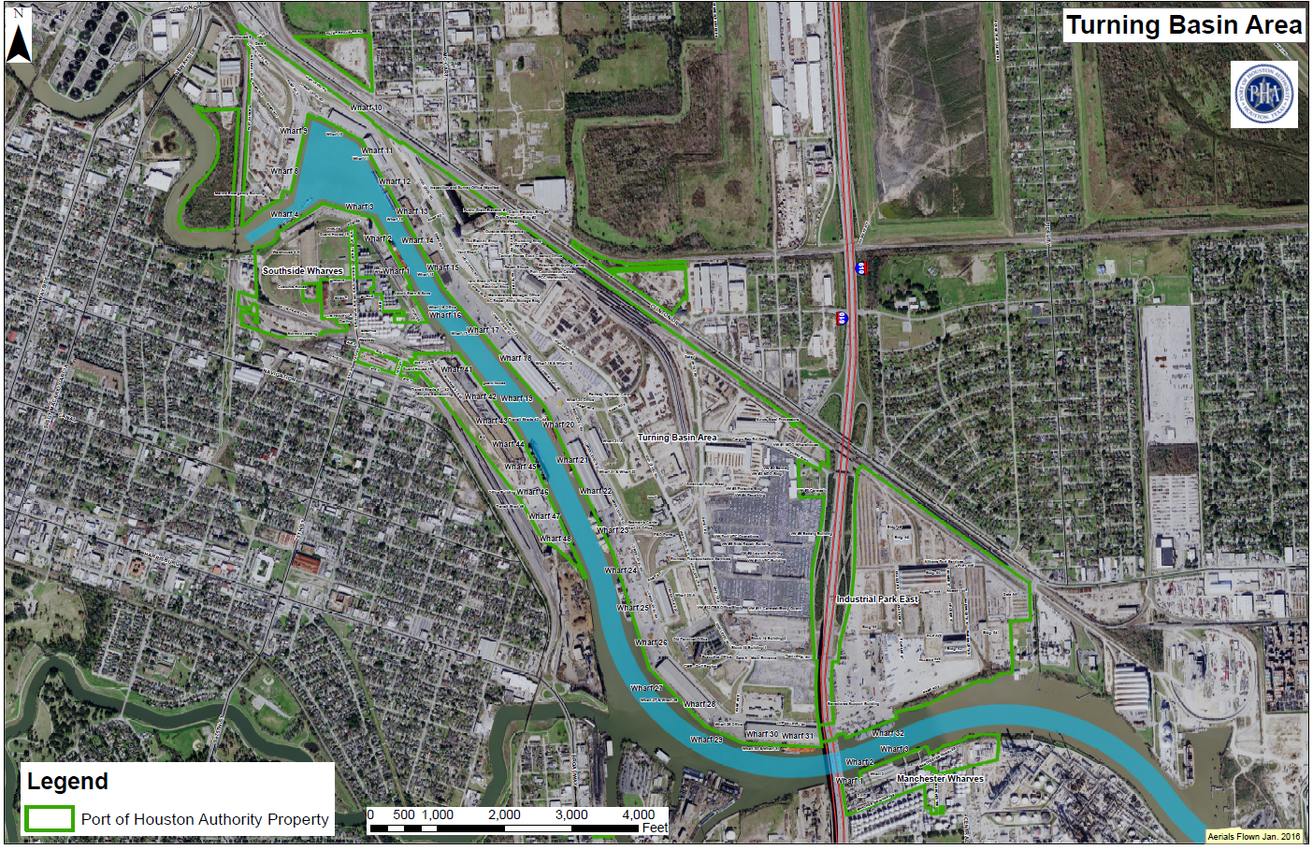
CSB 808 – Wharf 11/12 Collision Repair
You Are Here

Slide 3
CSB 808 – Wharf 11 / 12
WHARF 12, BENT 10
Damage to shearwall column

Slide 4
CSB 808 – Wharf 11 / 12
WHARF 11, BENT 23
Damage to front column

Slide 5
CSB 808 – Wharf 11 / 12
WHARF 12, BENT 21
Damage to shearwall column
Damage to shearwall column

Slide 6
CSB 808 – Wharf 11 / 12
WHARF 11, BENT 23
Damage to front column

Slide 7
CSB 808 – Wharf 11 / 12
WHARF 11, BENT 25
Damage to shearwall column

Slide 8
CSB 808 – Wharf 11 / 12
WHARF 12, BENT 29
Damage to shearwall column

Slide 9
CSB 808 – Wharf 11 / 12
WHARF 12, BENT 10
Damage to shearwall column

Slide 10
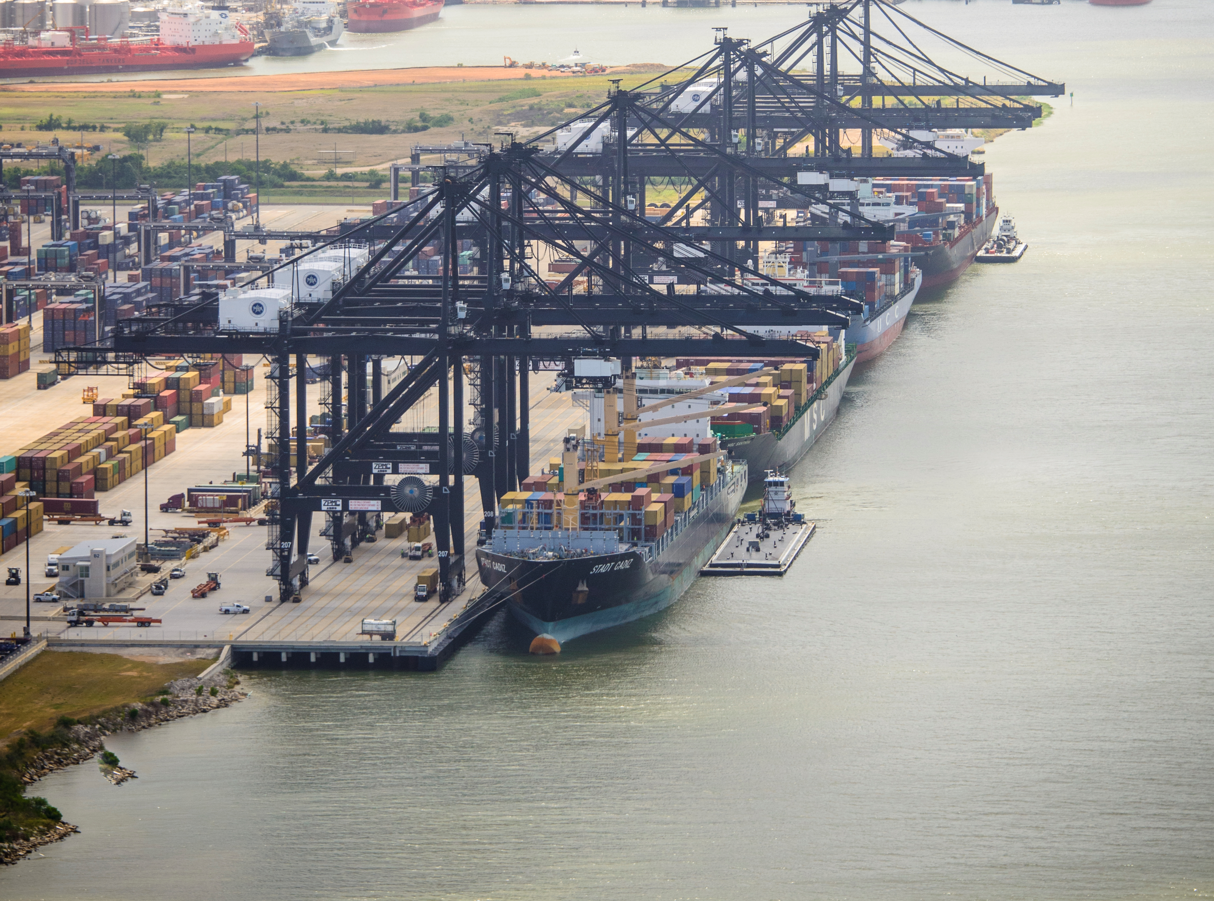
THANK YOU
Eddy Kharrazi, P.E.
Project Manager
Port Houston
Questions?
www.PortHouston.com
111 East Loop North
Houston, TX 77029

Slide 11
CSB – Wharf 11/12 Collision Repair
No photographs – leave cell phones in your pockets or purses
Stay with group
PHA certified TWIC escorts must accompany individuals without a TWIC card
Safety vests, hard hat, safety glasses
No open-toed shoes
Personal flotation devices if within 20’ of face of wharf
Comply with your company’s safety policy

