Slide 1
DEMOLITION OF THE FORMER SEAFARERS CENTER BUILDING AT TURNING BASIN TERMINAL
Presented by: Project and Construction Management - Alvin Jackson, P.E.

Slide 2
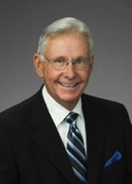
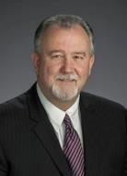
Port Commission
John D. Kennedy
Dean E. Corgey
Clyde Fitzgerald
Janiece M. Longoria
Chairman
Theldon R. Branch, III
Stephen H. DonCarlos
Roy D. Mease
WELCOME MESSAGE | 2

Slide 3
Demolition for the Former Seafarers Center Building at TBT
AGENDA
Introductions
Harris County
Small Business
Procurement Services
Selection Criteria
Project Scope of Work
Questions
All attendees must sign-in and indicate attendance for site visit and TWIC cardholders

Slide 4
Demolition for the Former Seafarers Center Building at TBT
Personnel:
Roger H. Hoh, P.E. – Director, PCM
Alvin Jackson, P.E. – Project Manager
Ross Talbot – Construction Manager
Pedro Gonzales – Small Business Development
Yvette Camel-Smith – Director of Procurement
Harris County:
Robert Rocha – Wage Rate Monitor

Slide 5
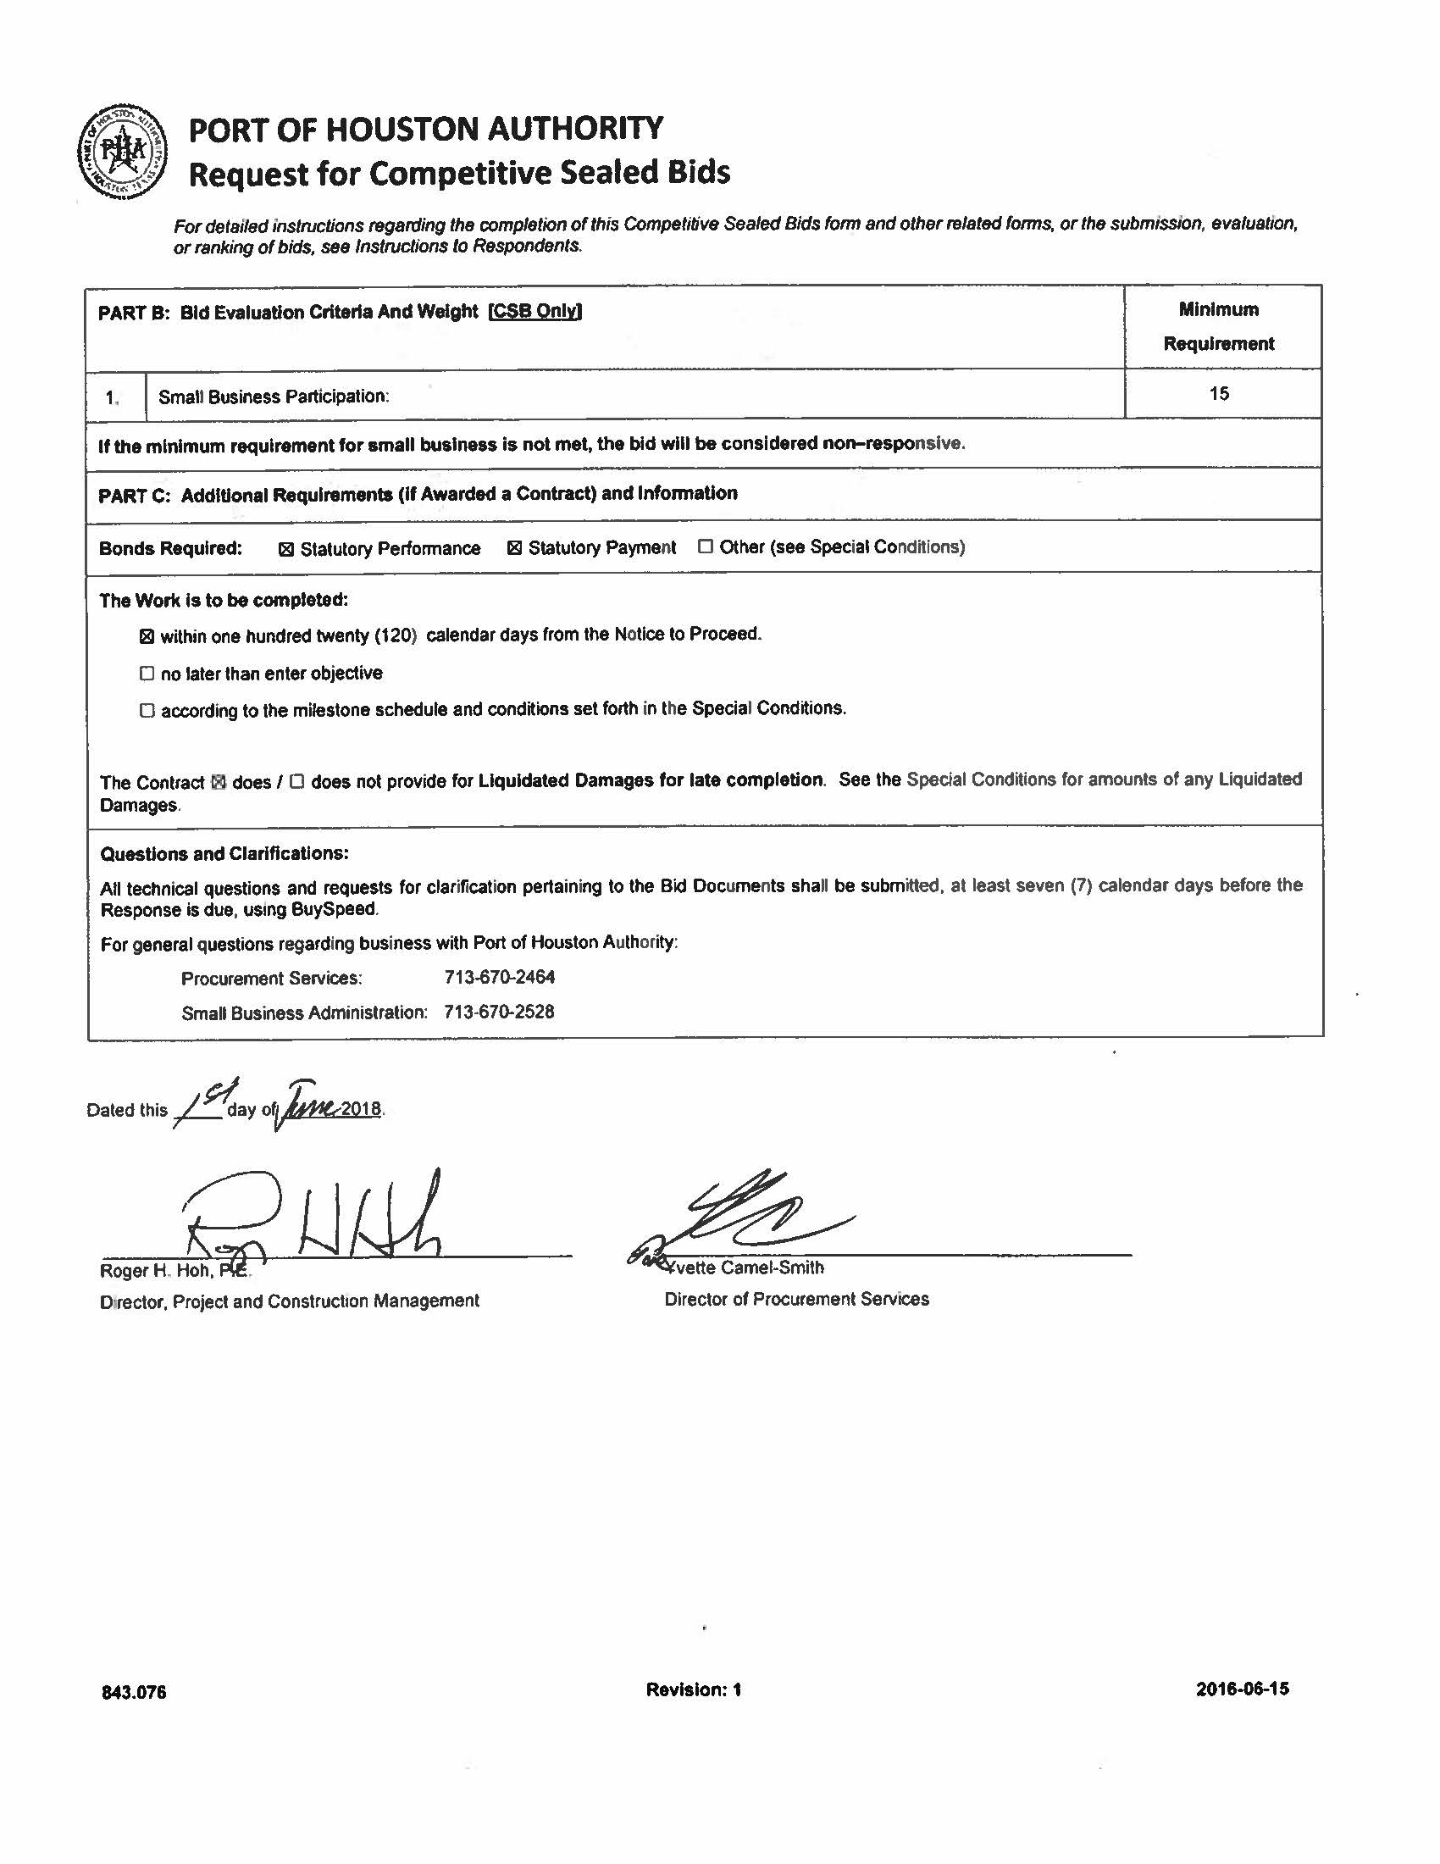

Slide 6
Project Description
This project is to demolish the entire building structure, slab, pool, pool deck, pool equipment and backfill to grade on the existing site.

Slide 7
Follow
Up
Pictures

Slide 8
.I

Slide 12
;'
,,.
.� '·j :; ·:..
. '
"I
•
., ..
. ''
,. �
•
l
�
f
'.r •••.:·· ...,.
·.,. _{f ·:;}
,.
, ..., .
�
_{ei}1-::·
. '
,,,
..
..
,, •
'
� .
• \
..,,.
<. •
�.
,,,,.,
•I
..... ·�,. ⁽.
...
·, � · ., .·;
-r
. .^{t'}..,.•.
,I
I _{fi}
·,
• .i,,·. • t^{·J,.},r
_{y}f•l.l�
"\.' .....
.,
• , r'
·
:
�
..
i
\.
�
,/
r., ·�
.^{,I}',·�
'\ _a"\' � O 0

Slide 13
Location

Slide 15
Scope
Of
Job

Slide 16
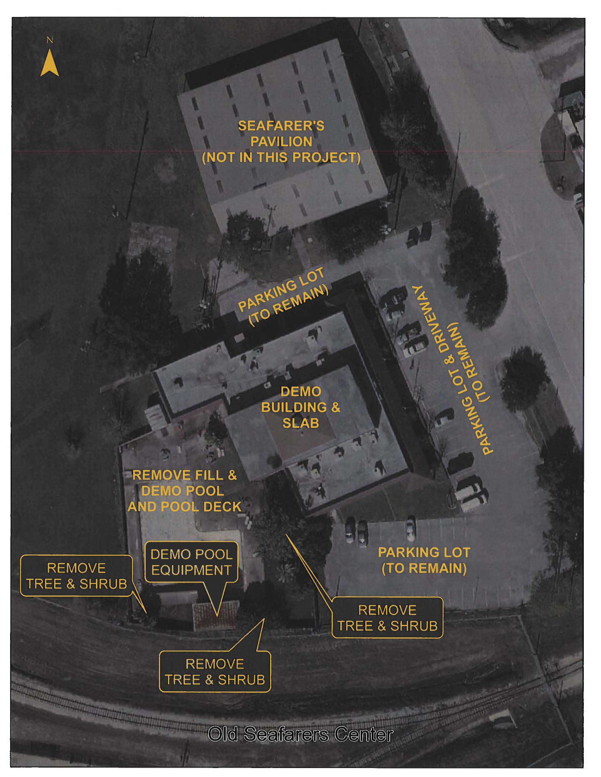

Slide 17
Drawings

Slide 24
THANK YOU
Alvin Jackson, P.E.
Project Manager
Questions?
www.PortHouston.com
111 East Loop North
Houston, TX 77029
WELCOME MESSAGE | 4

